Slide 1
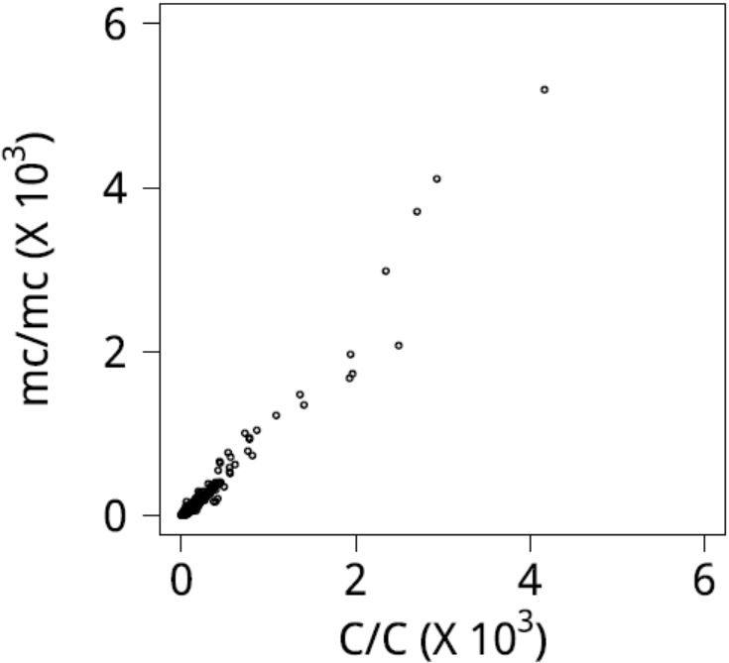
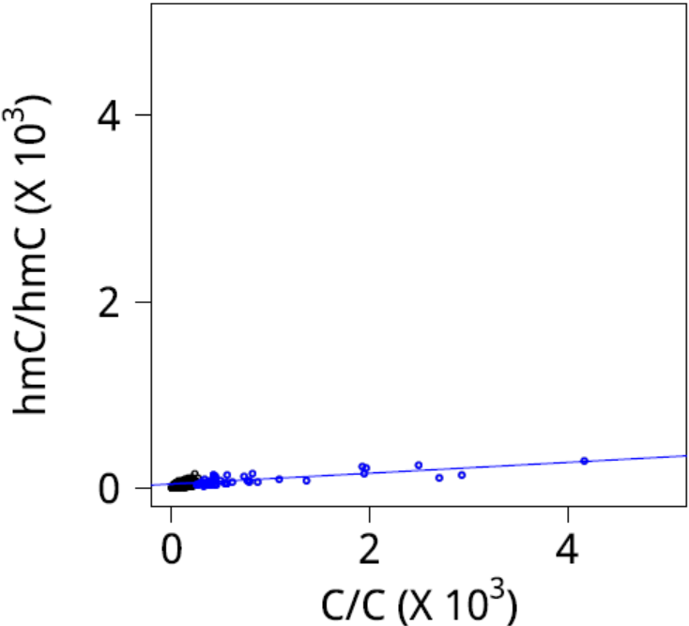
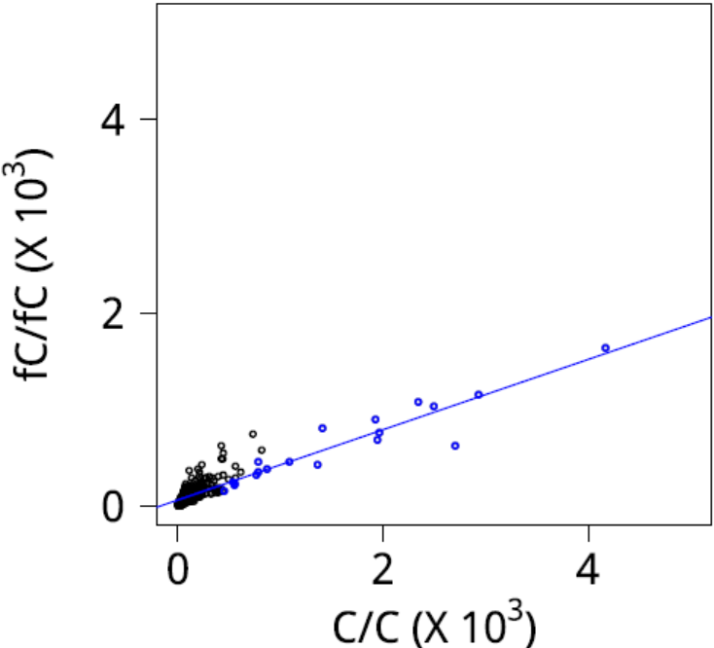
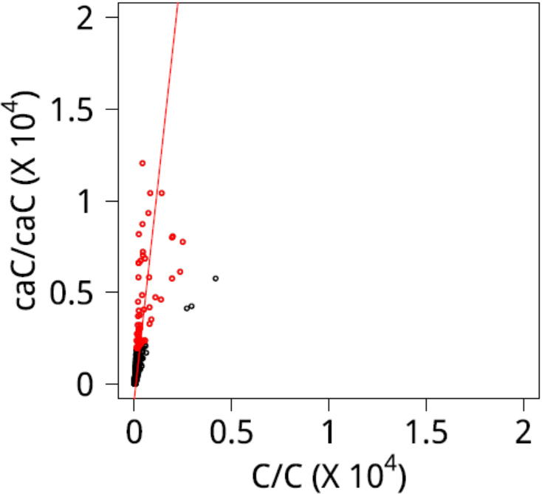



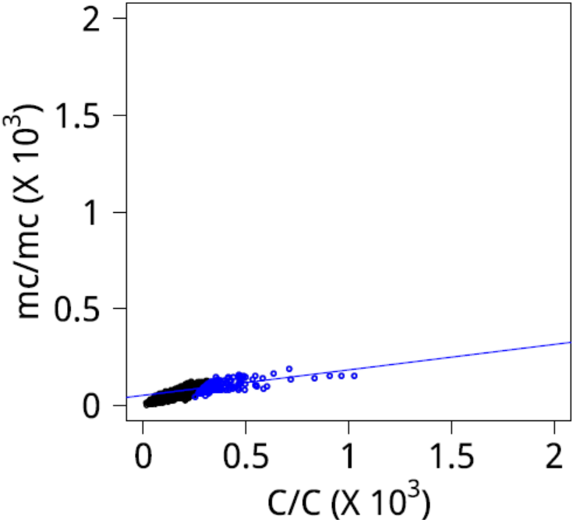
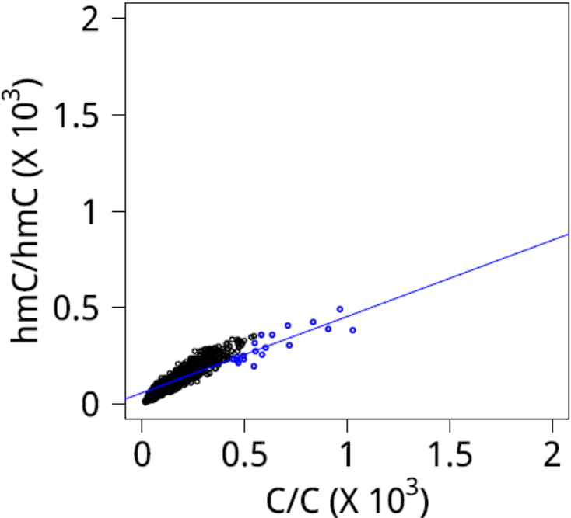
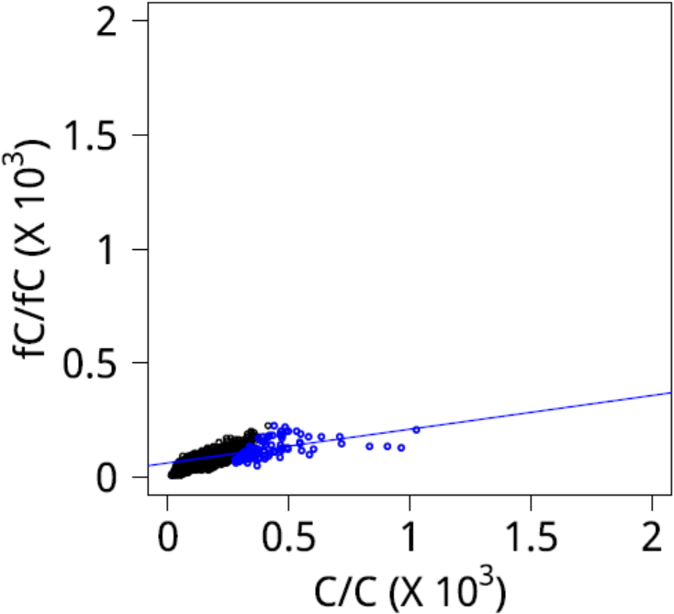
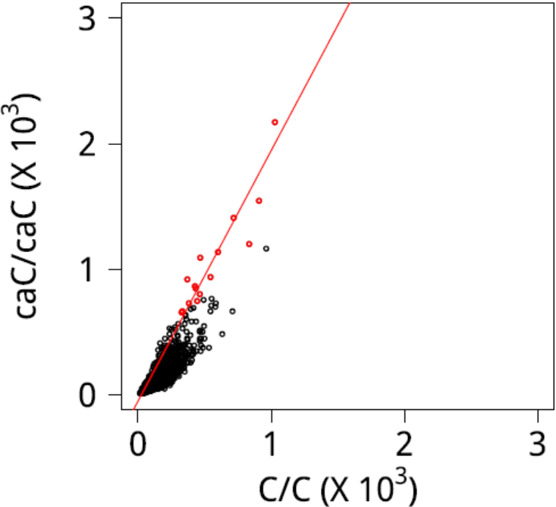




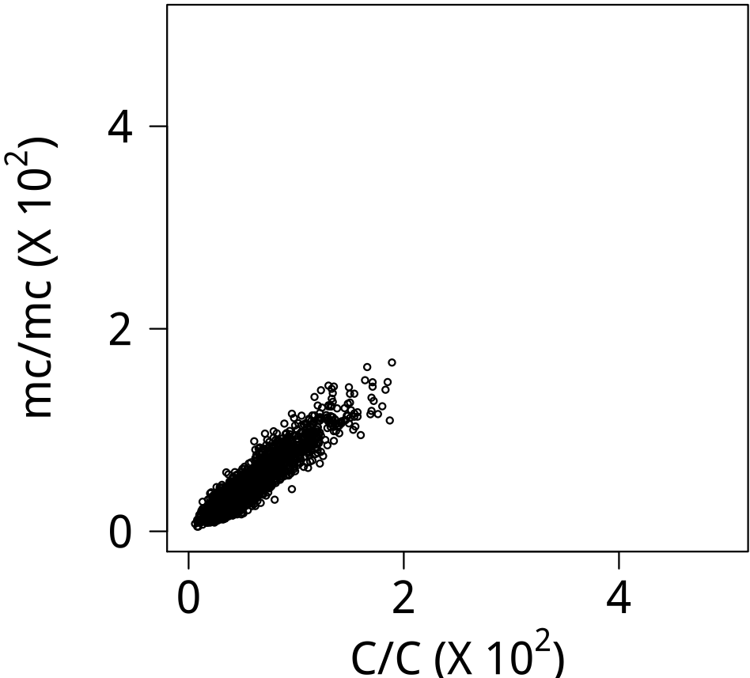
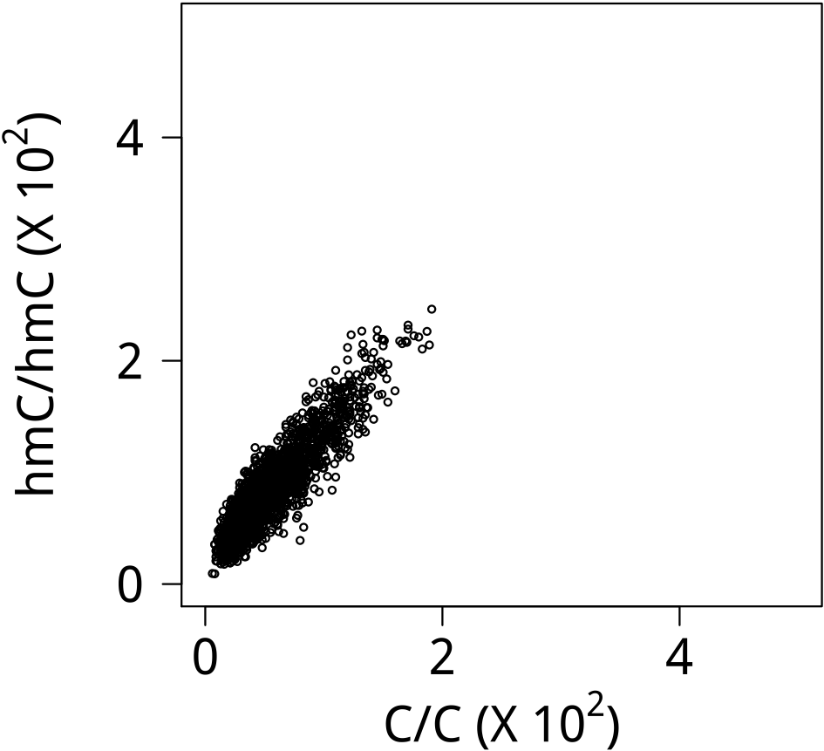
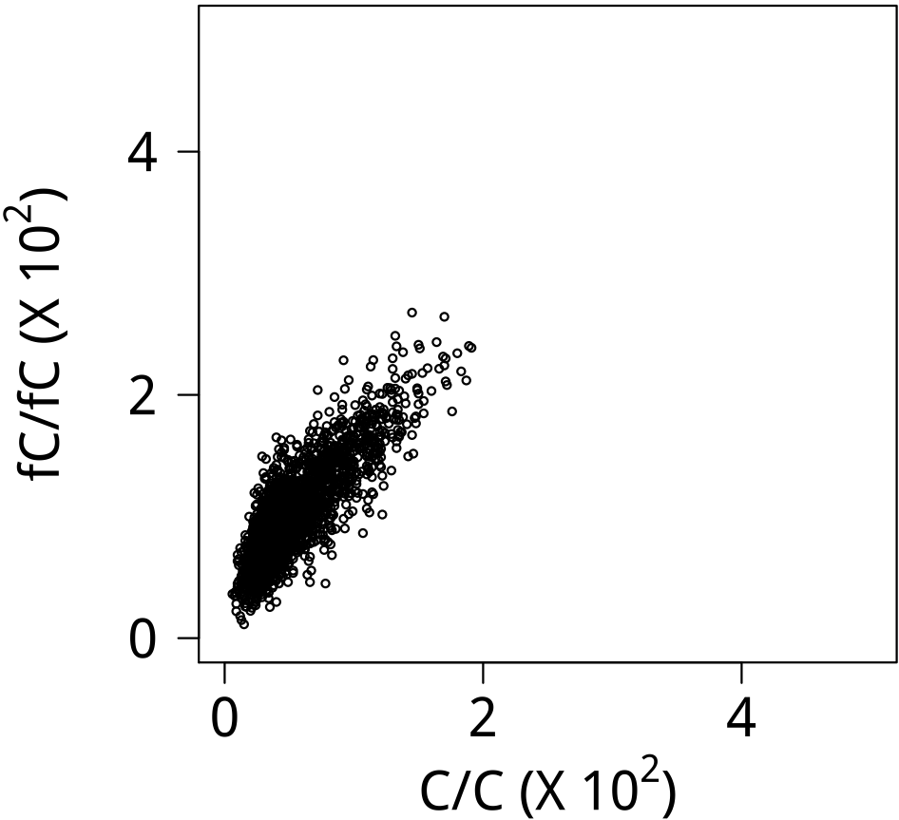
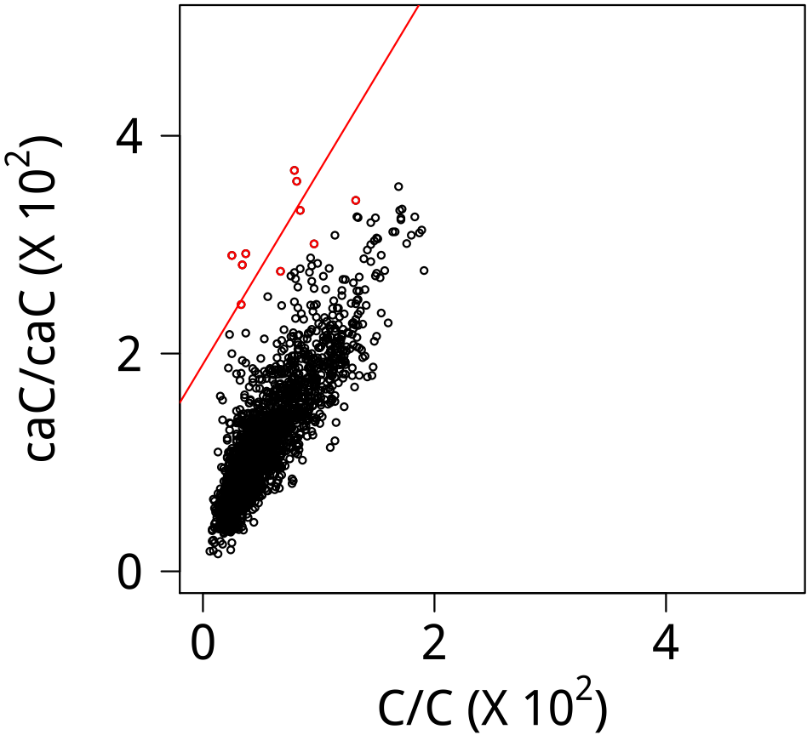

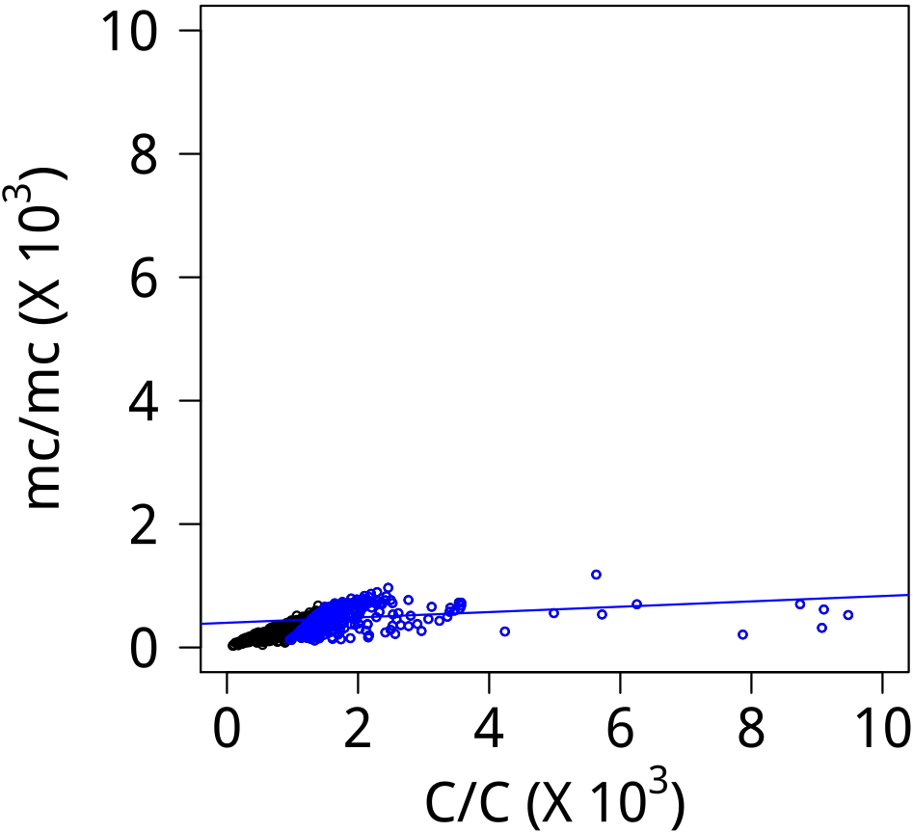
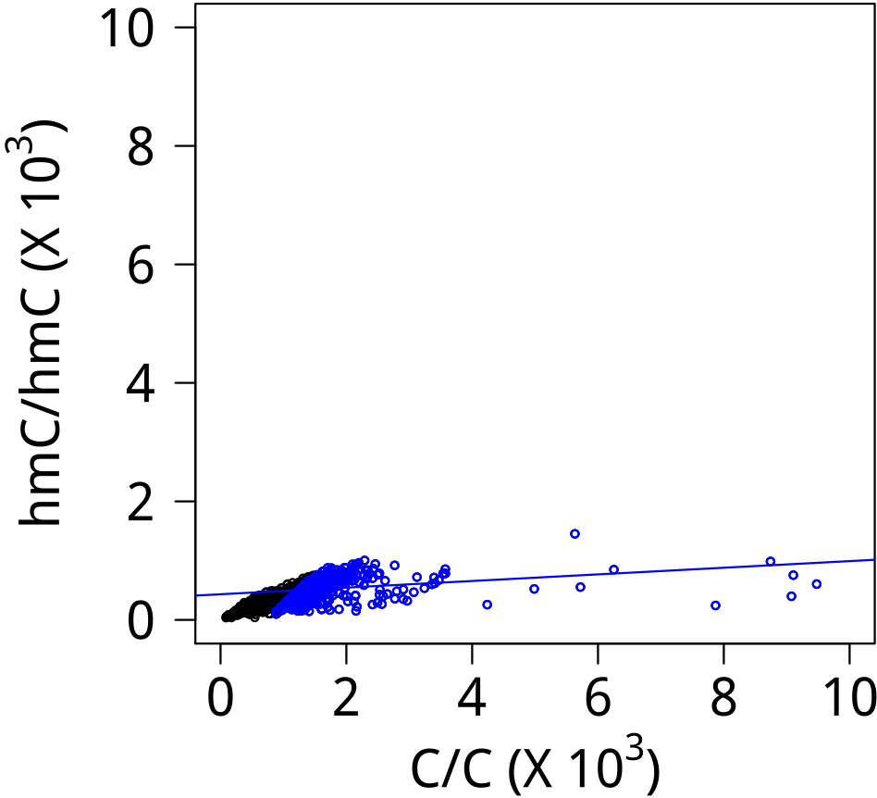
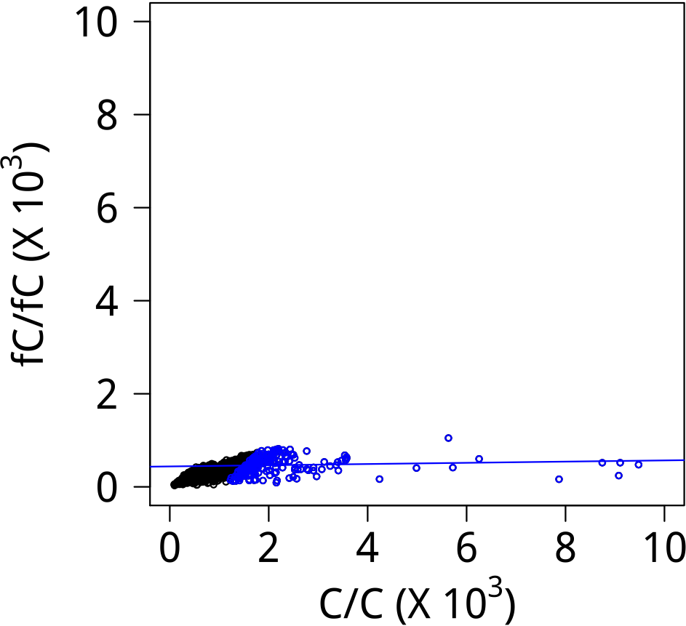
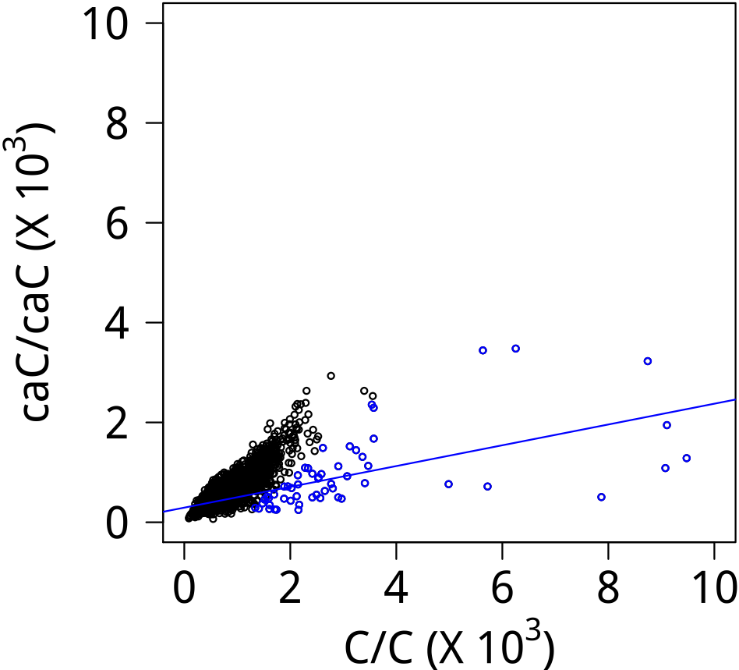




Supplementary Data 7
CEBPγ
Logo (E)
Logo (S)
CRX
Logo (E)
Logo (S)
CTCF
Logo (E)
Logo (S)
DMTF1
Logo (E)
Logo (S)

Slide 2
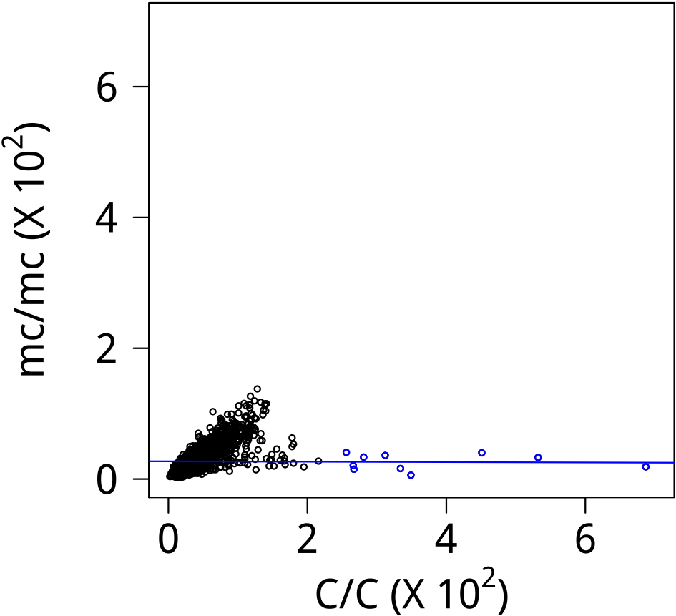
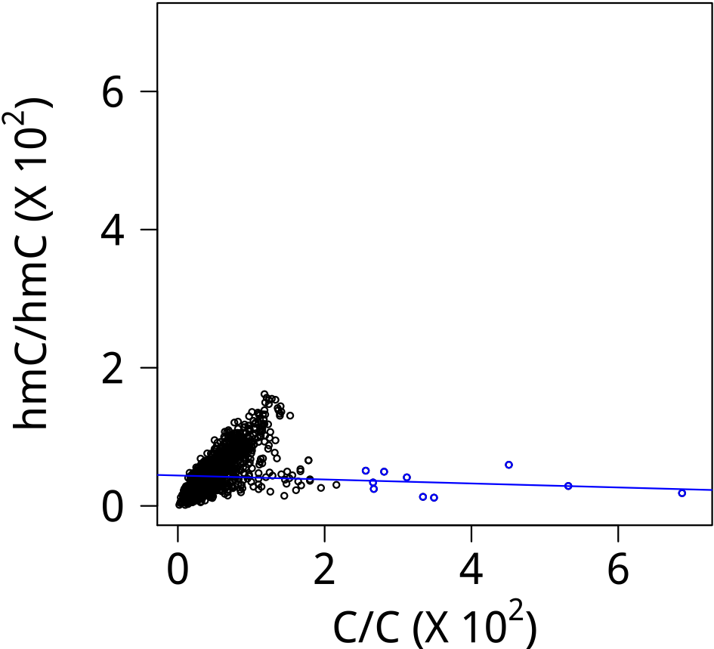
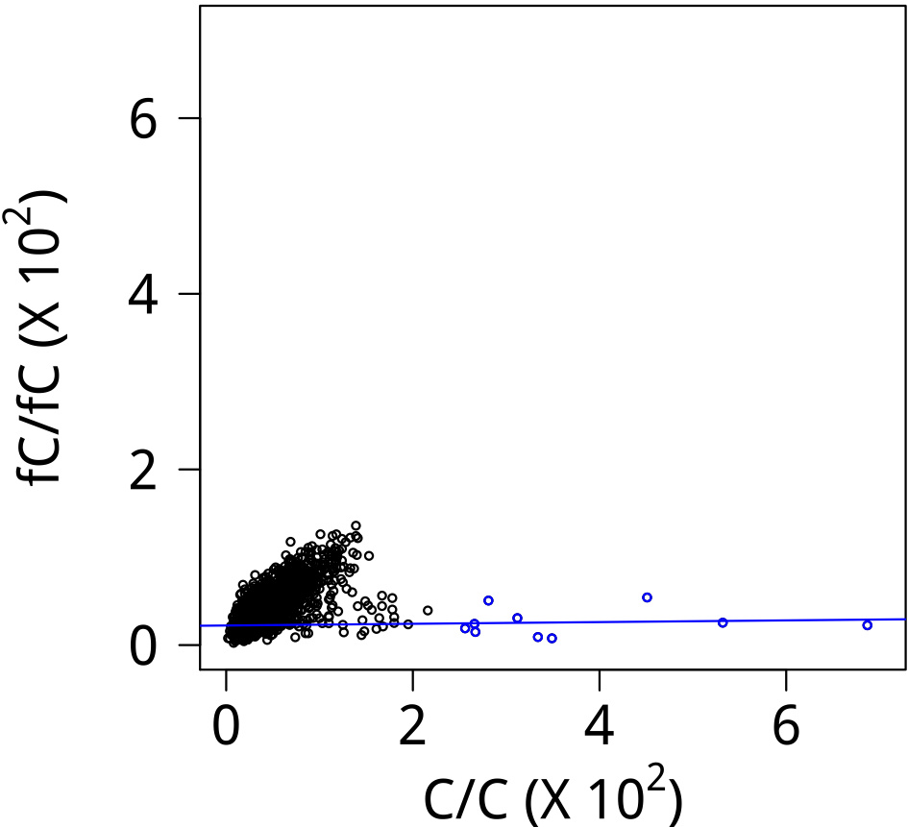
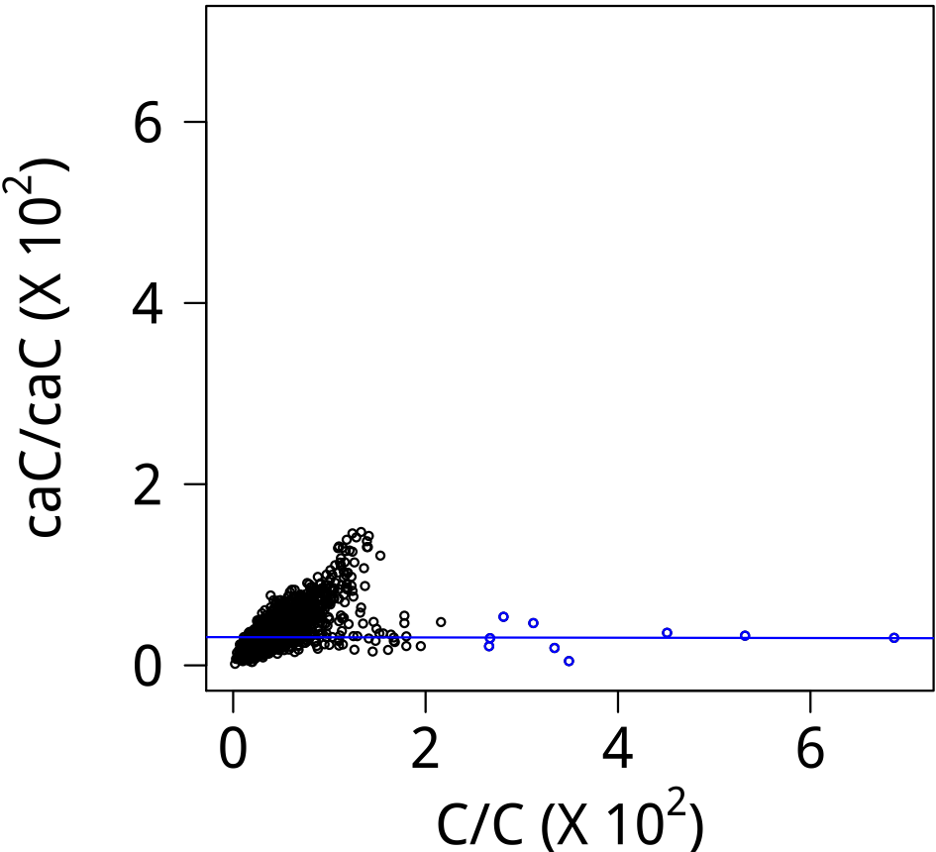


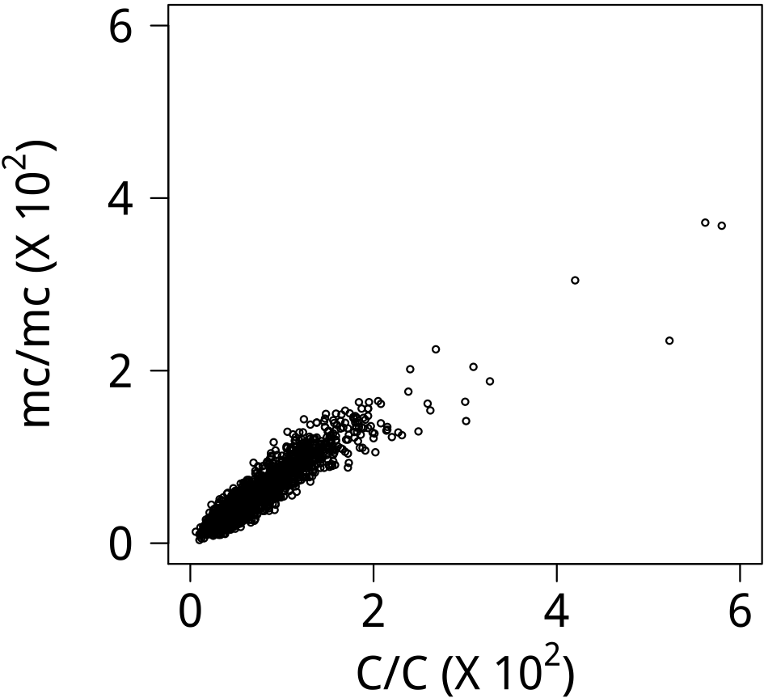
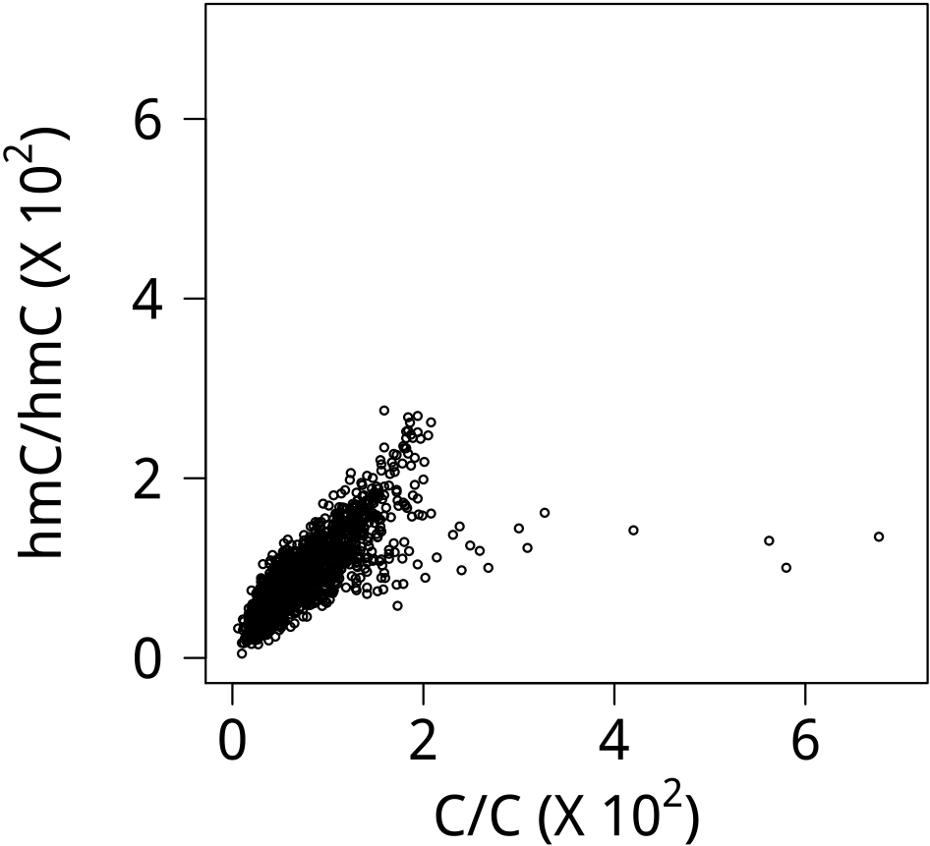
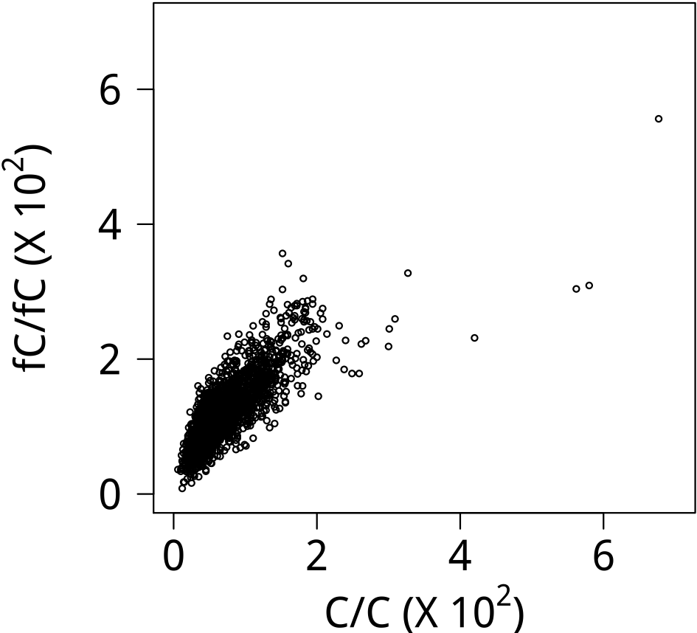
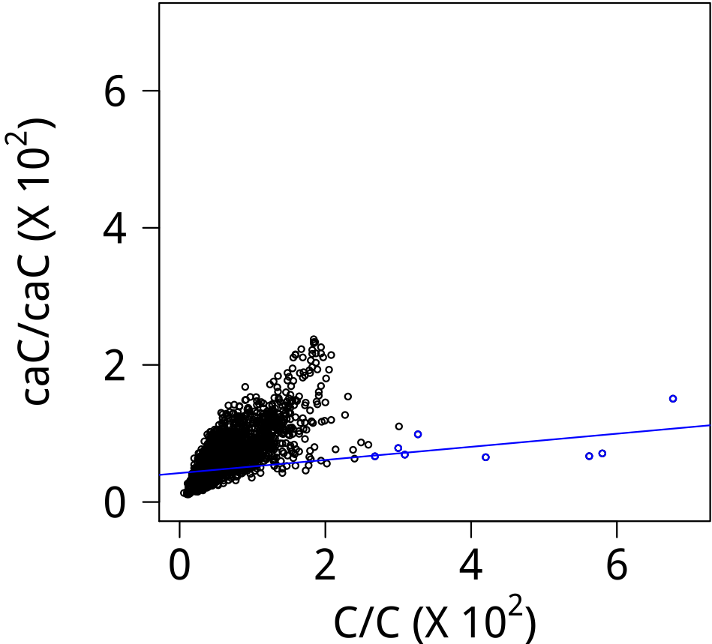

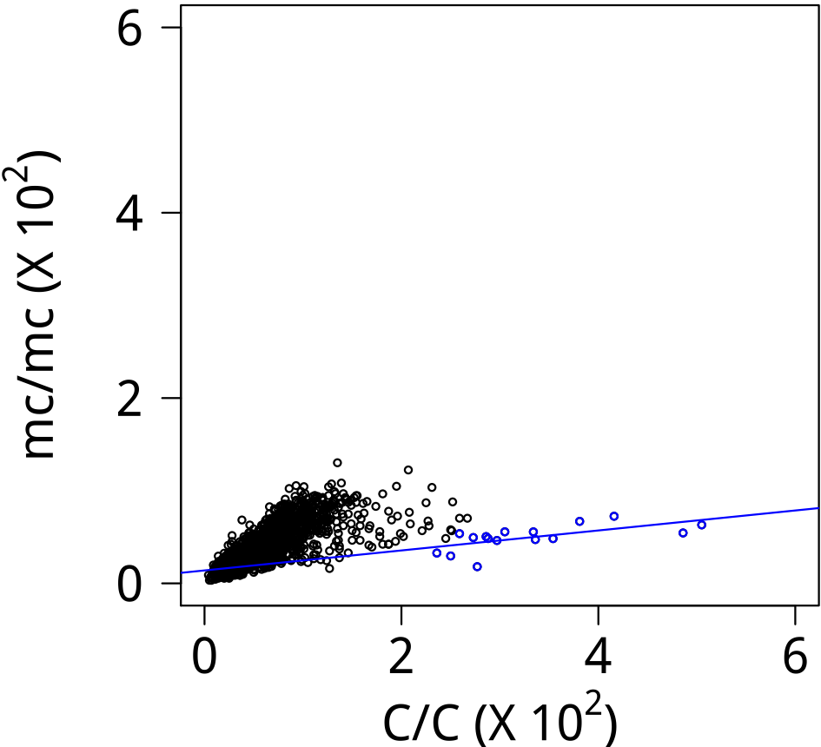
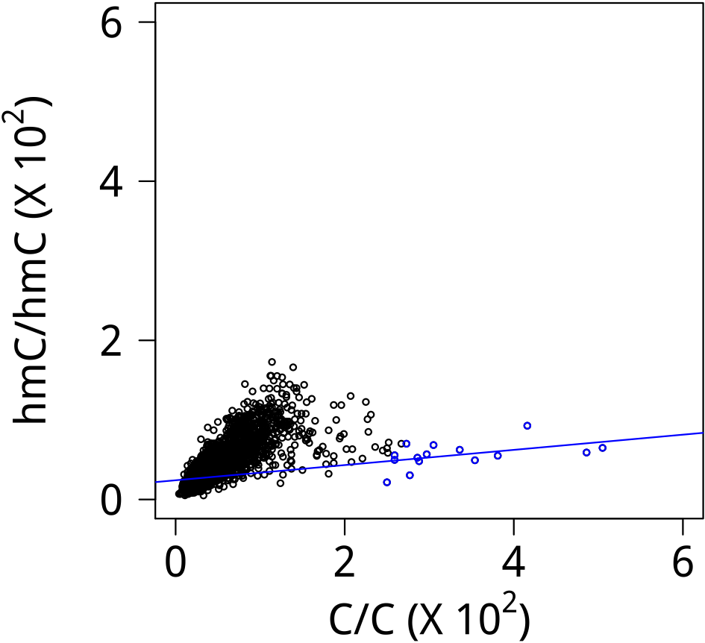
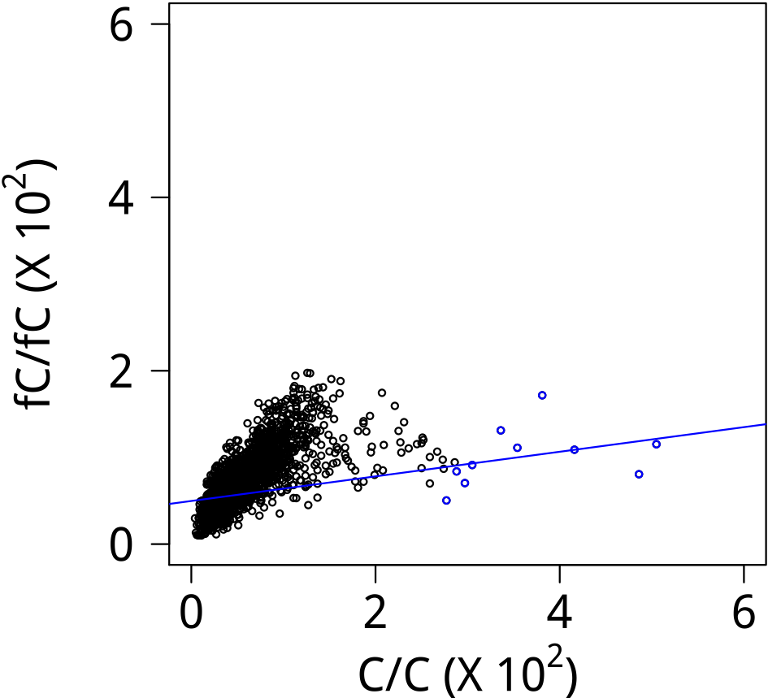
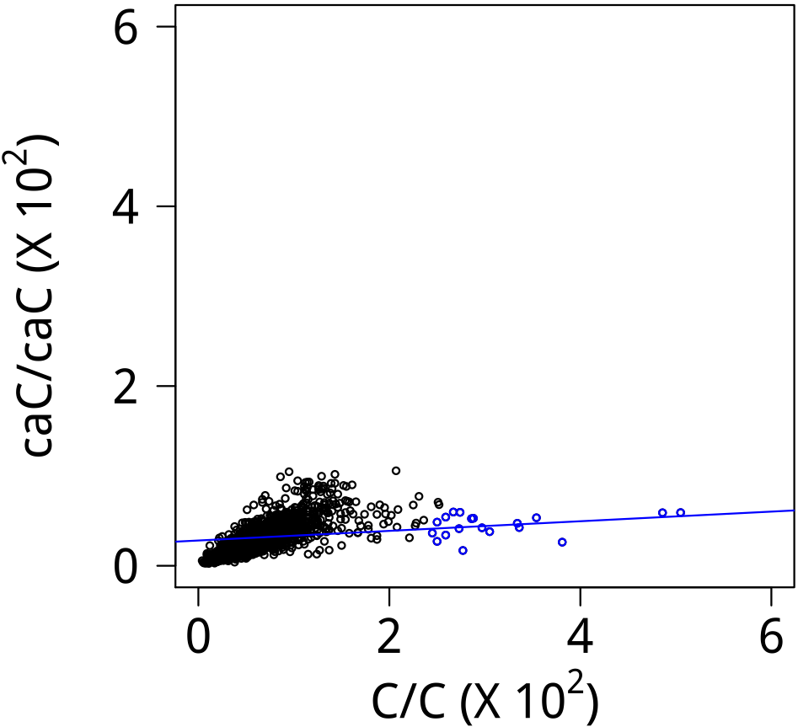




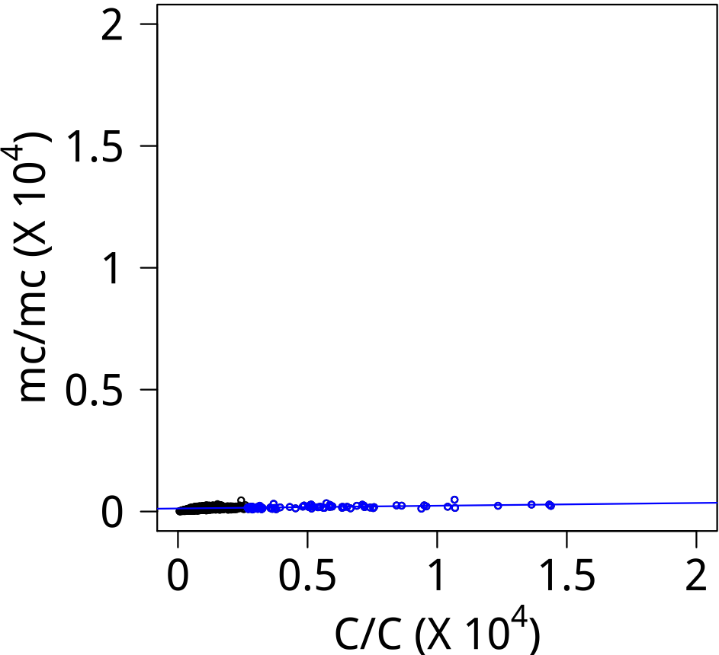
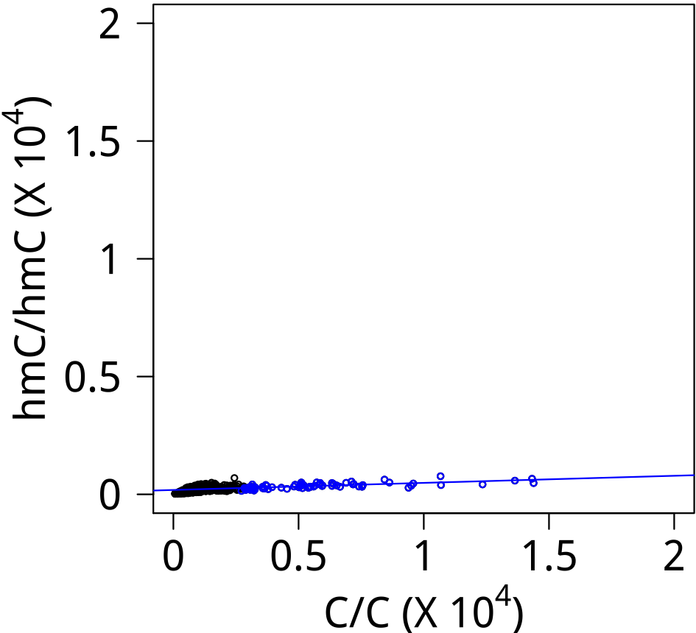
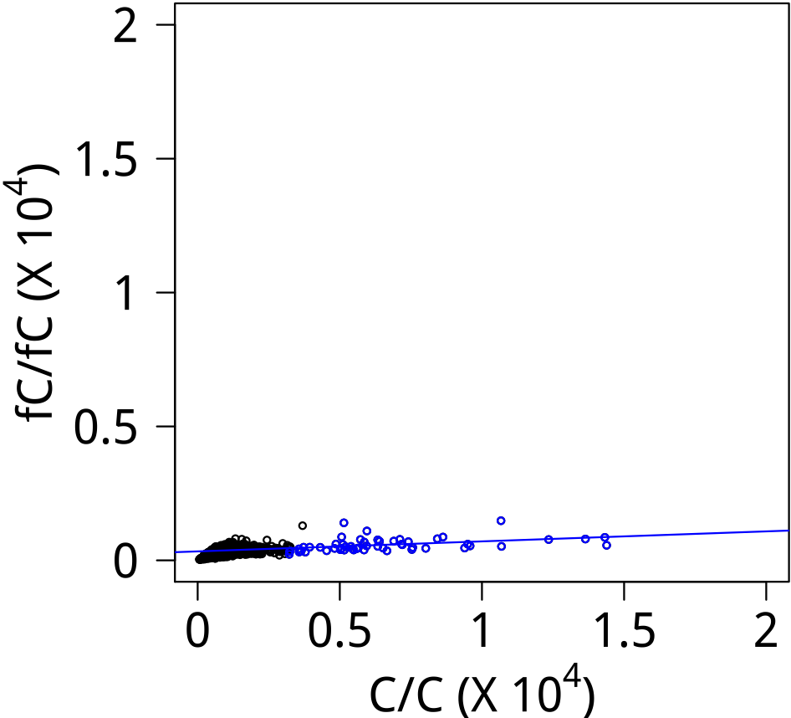
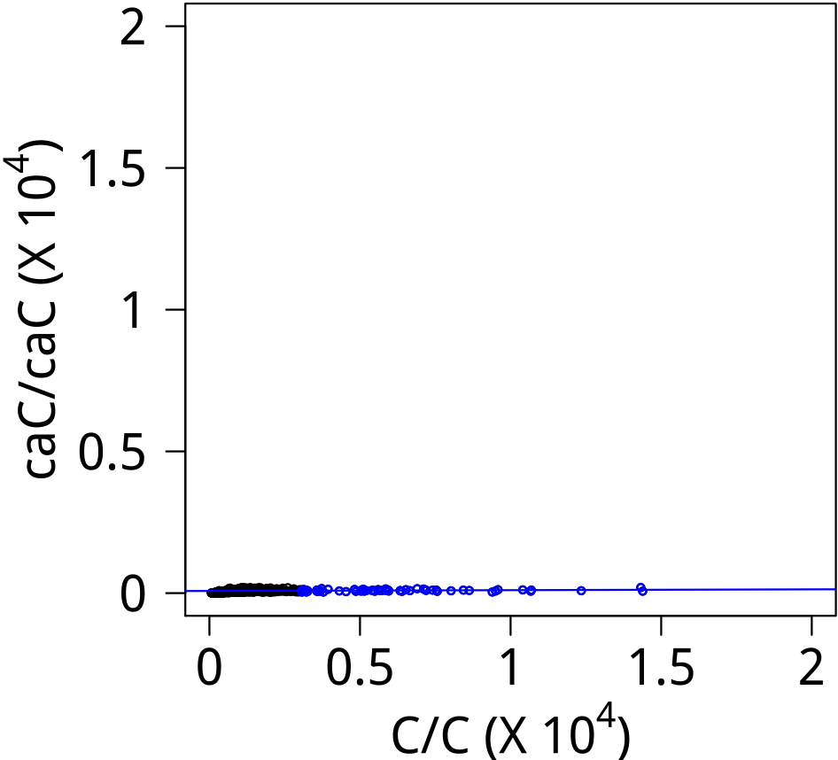




E2F1
Logo (E)
Logo (S)
EGR2
Logo (E)
Logo (S)
ELF1
Logo (E)
Logo (S)
ELK1
Logo (E)
Logo (S)

Slide 3
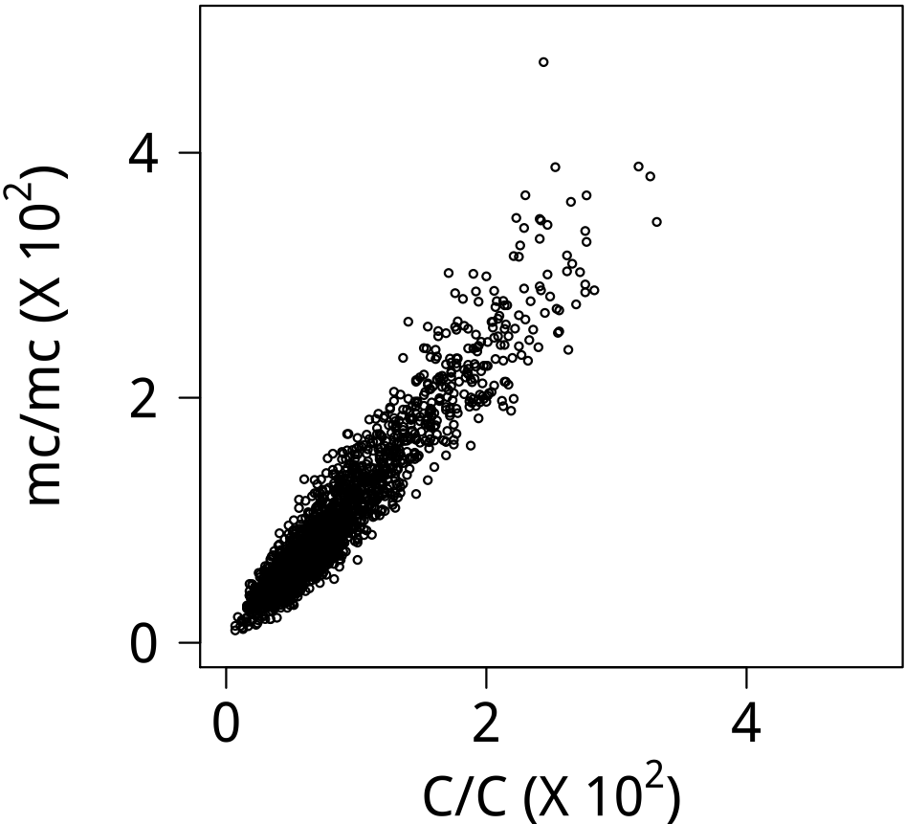
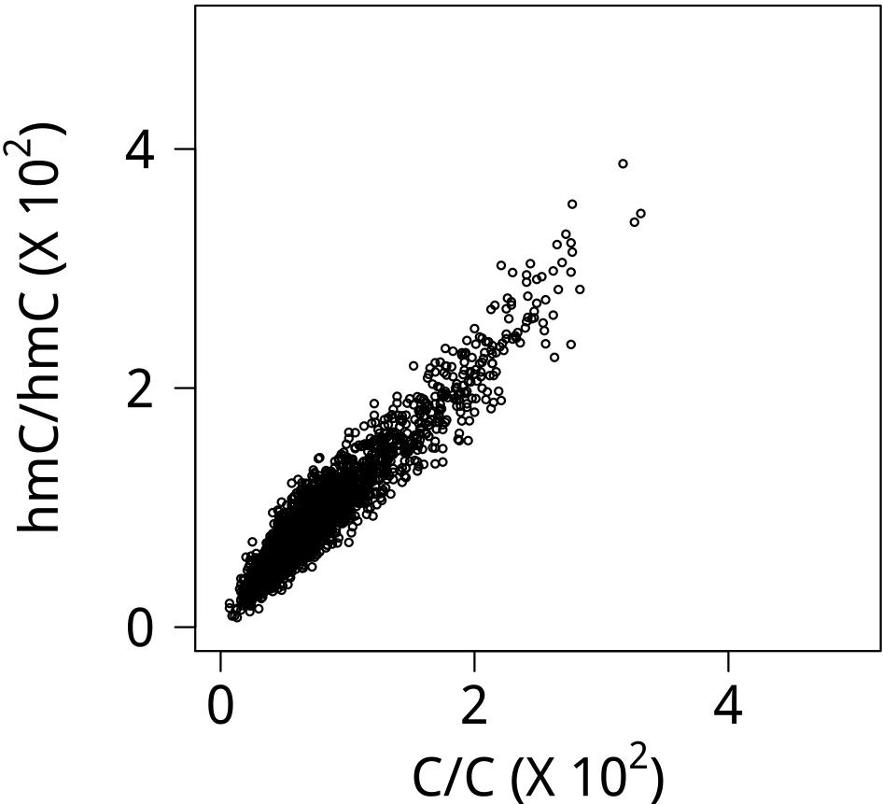
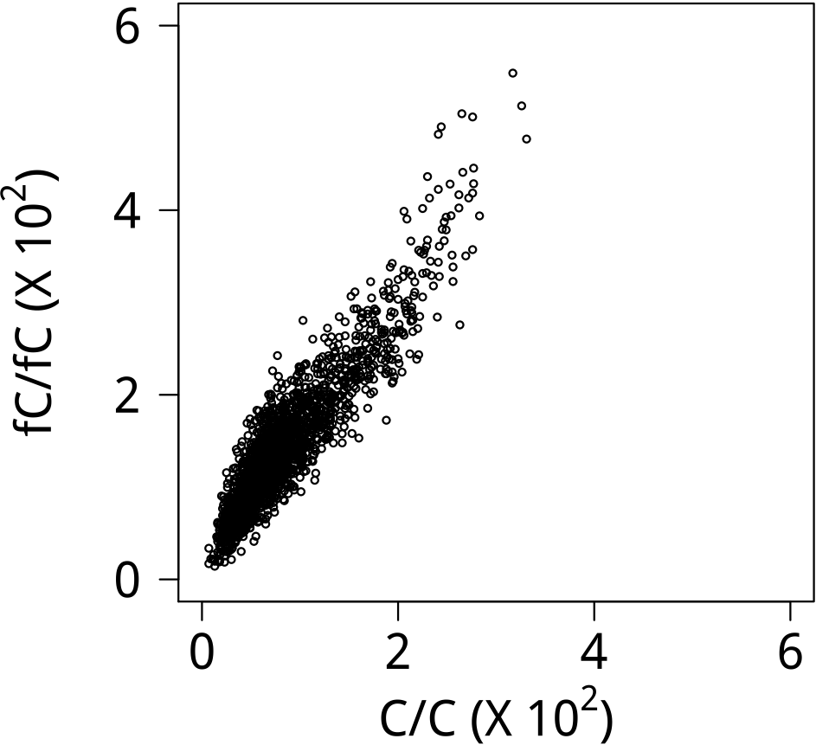
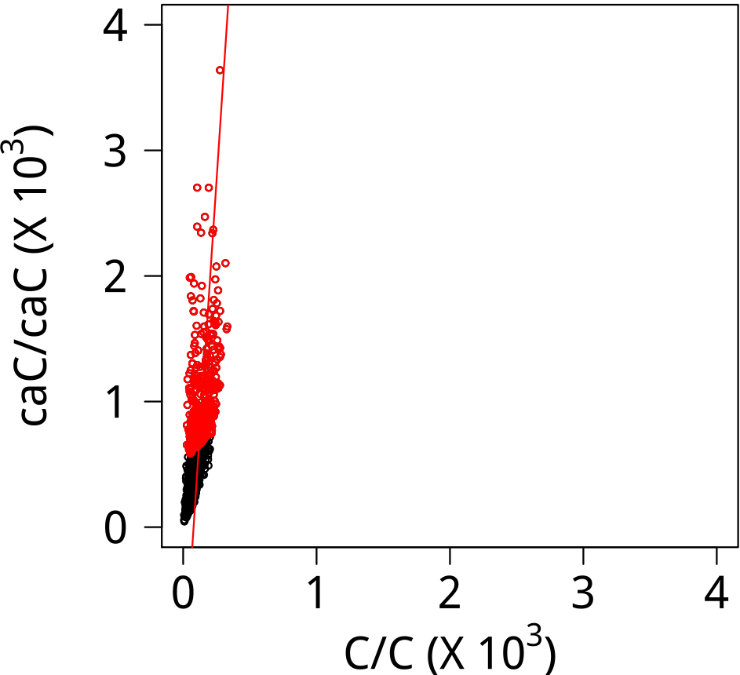

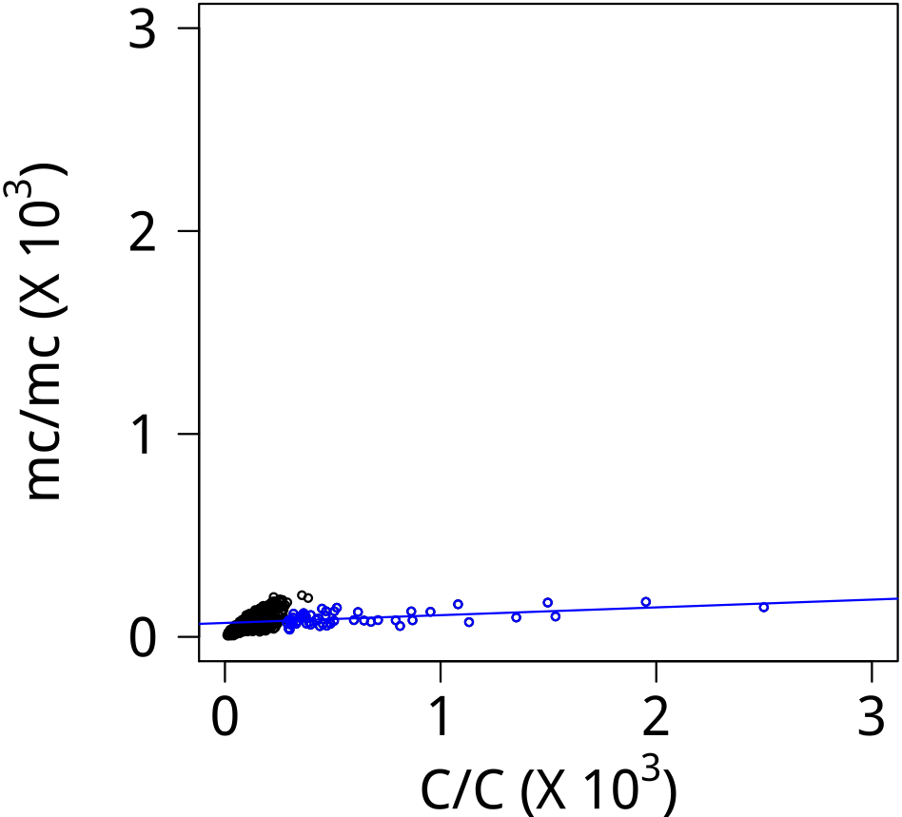
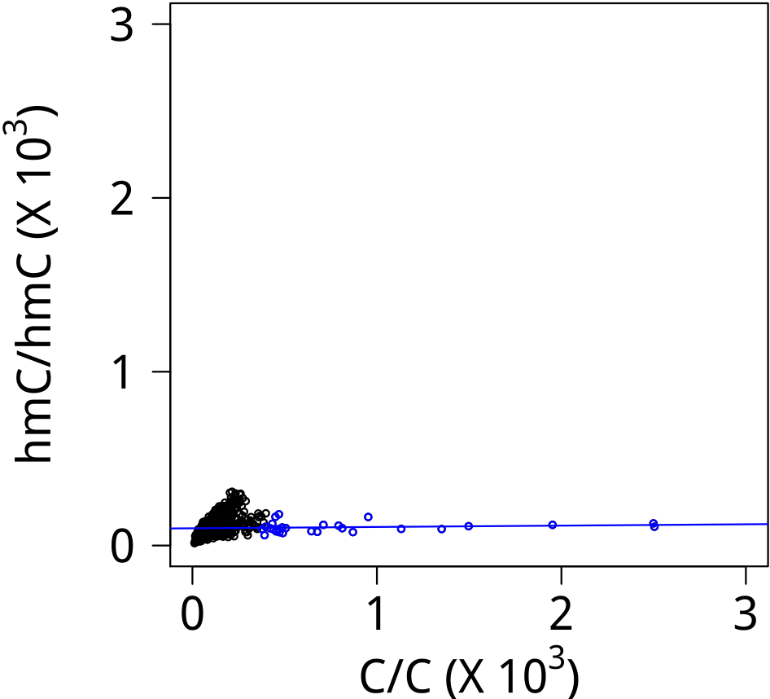
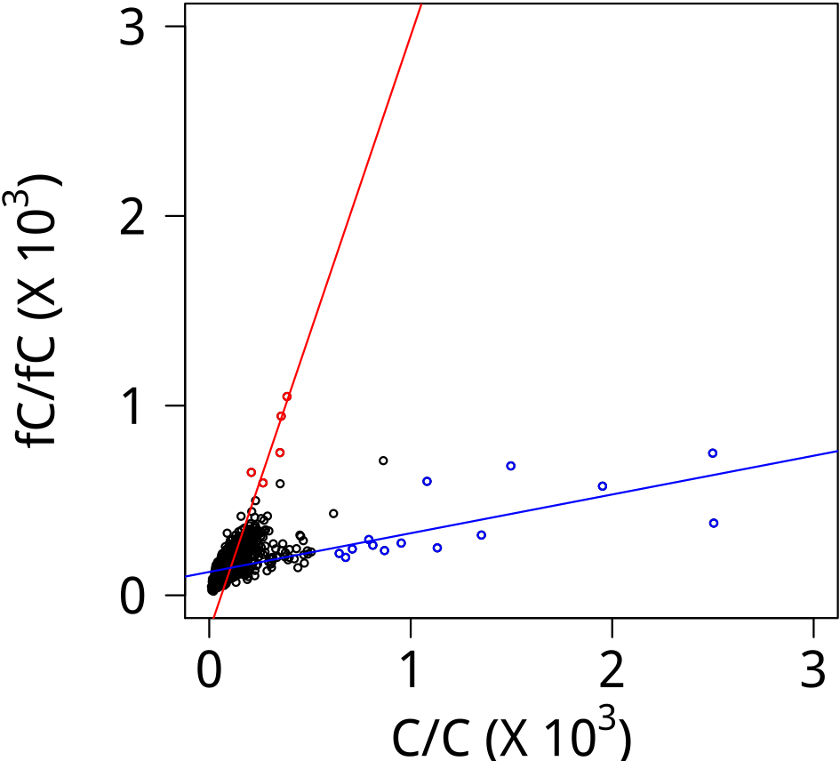
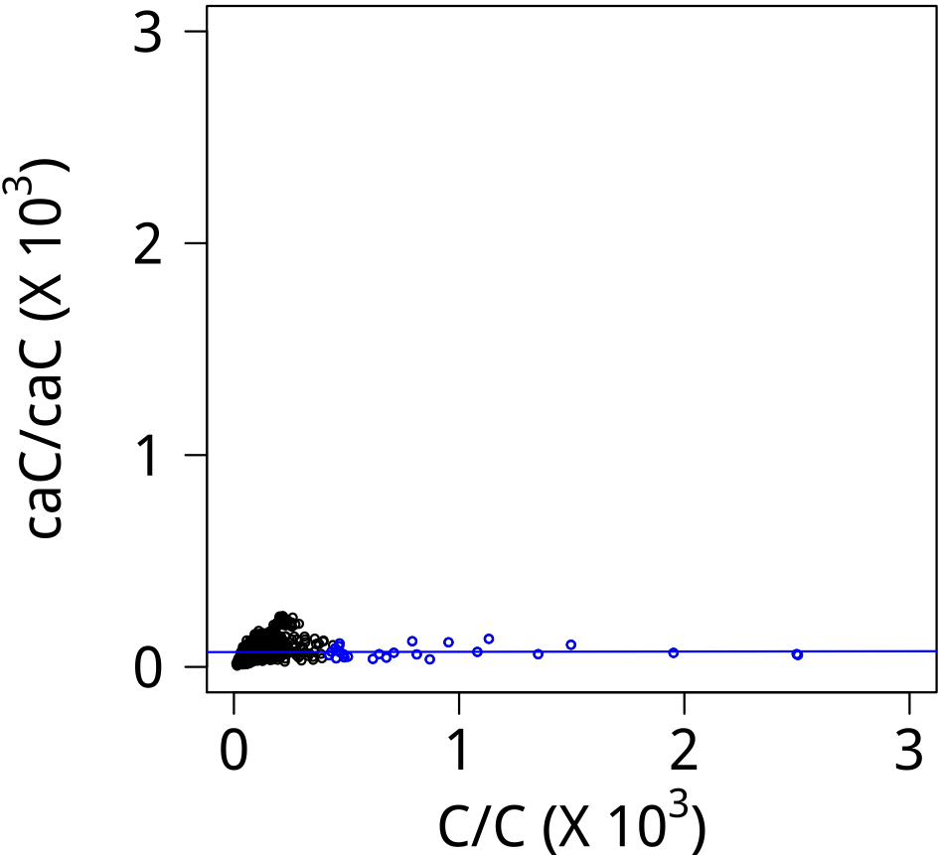





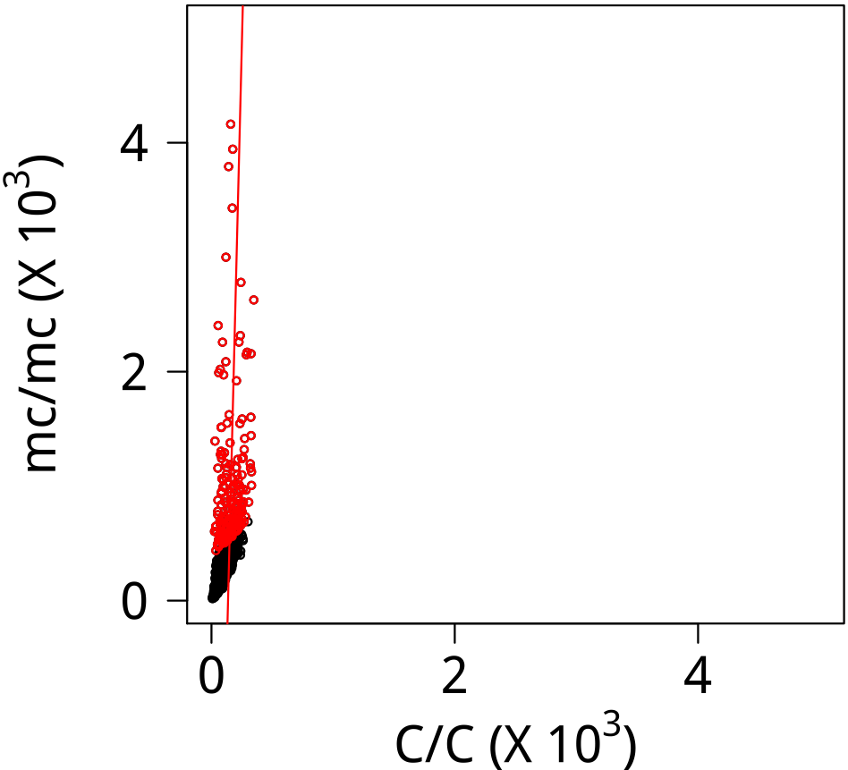
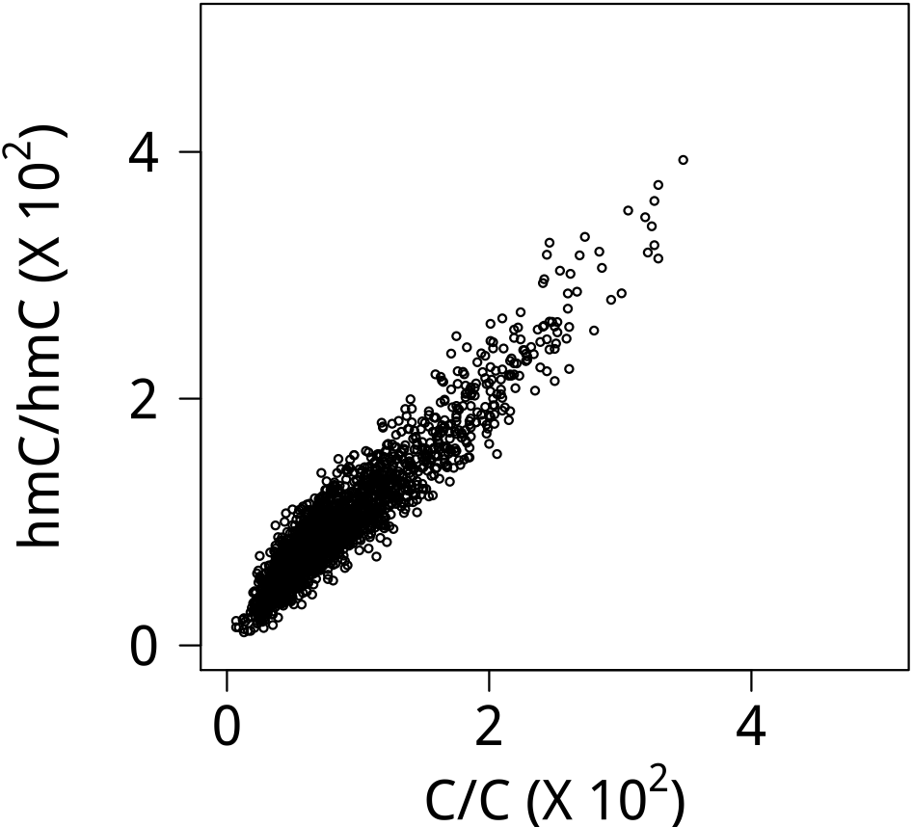
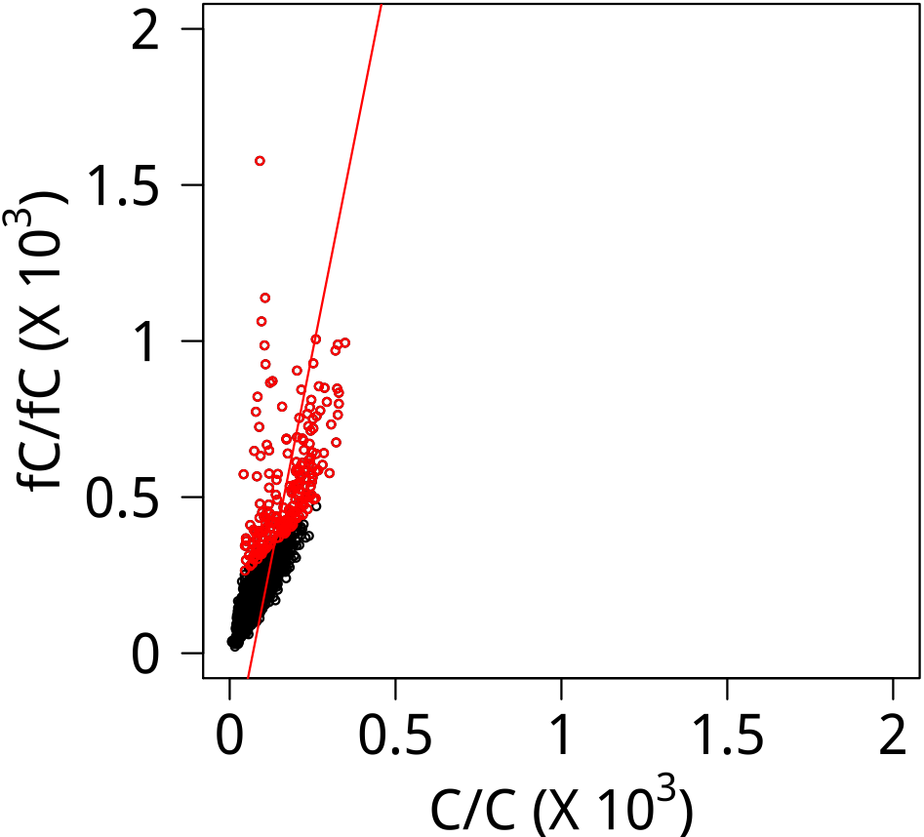
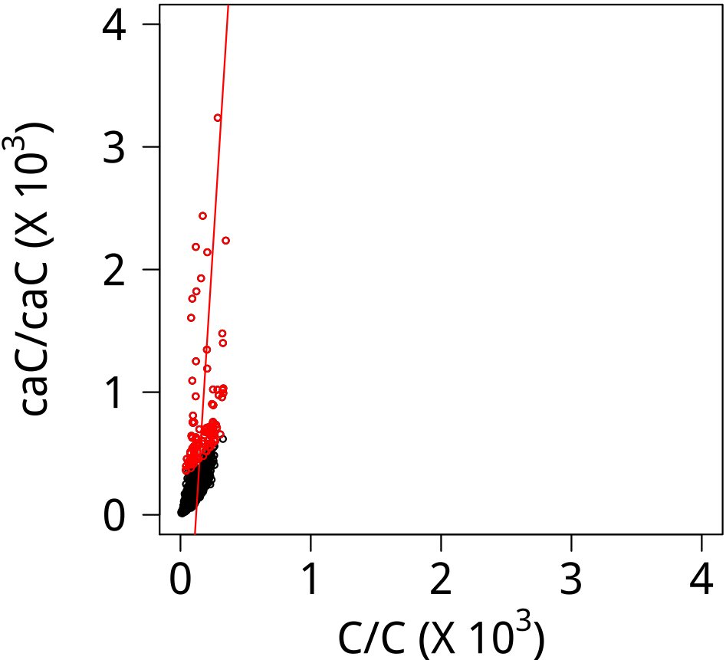



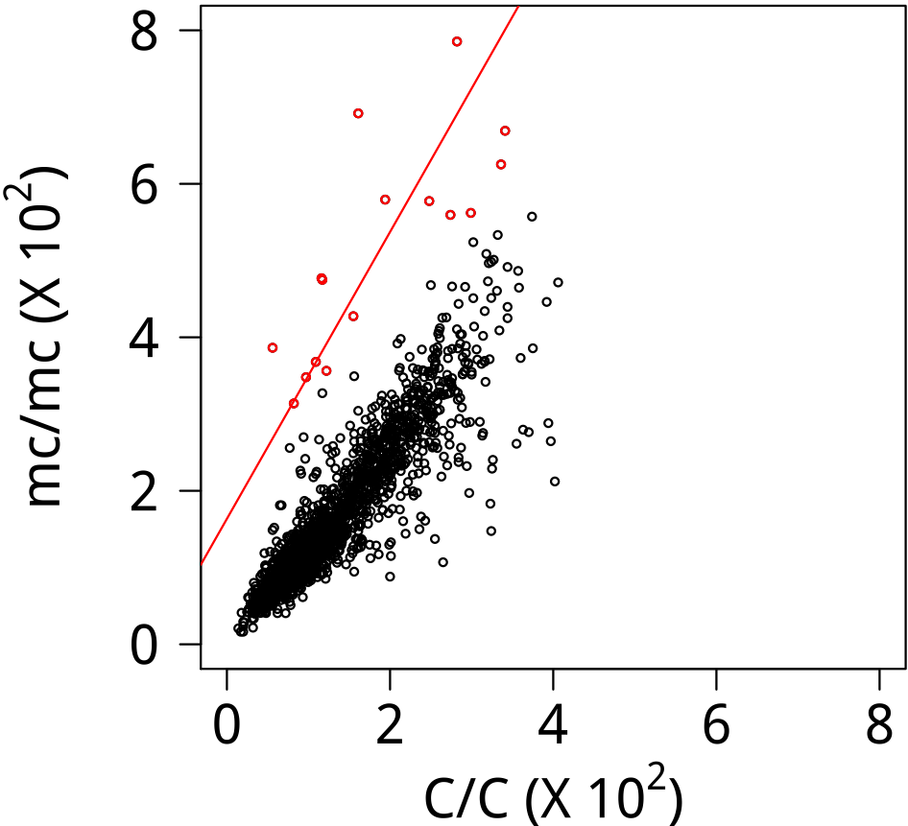
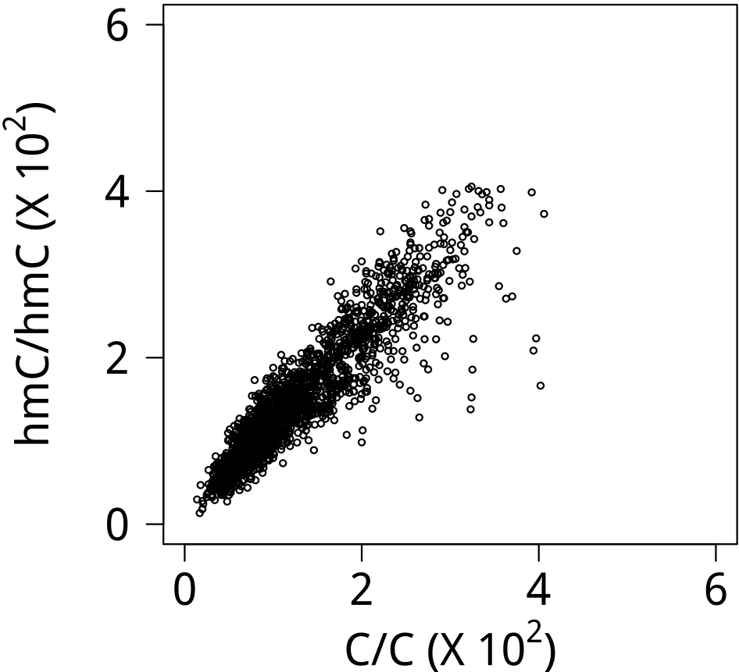
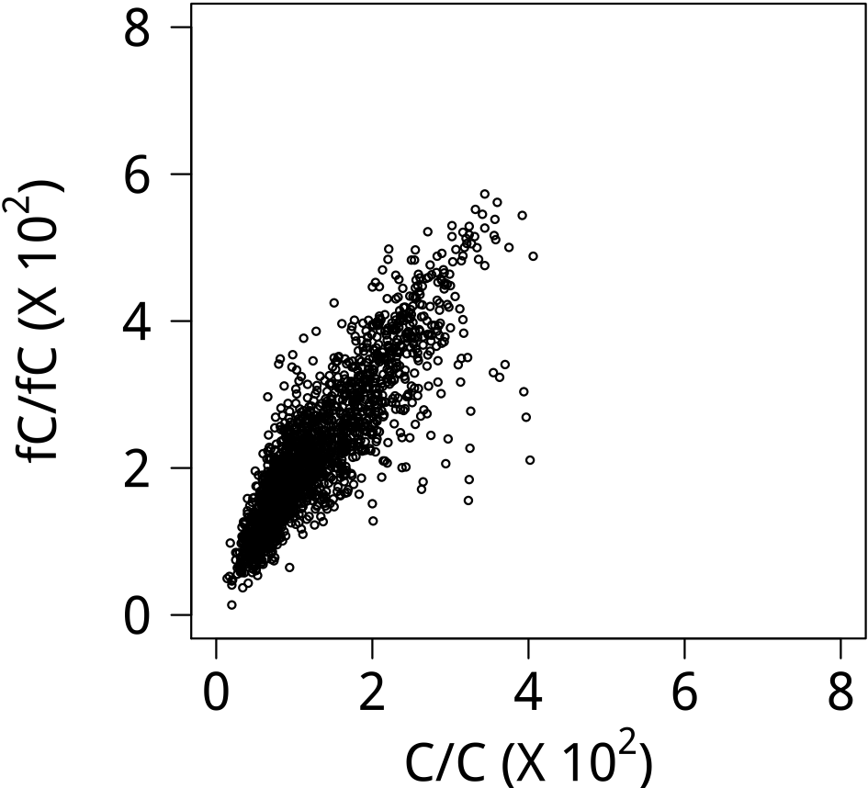
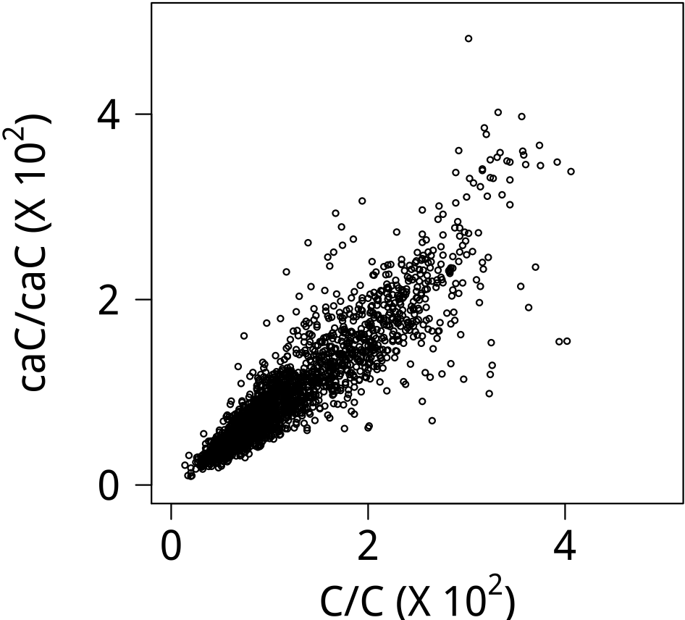

EN2
Logo (E)
Logo (S)
ETS1
Logo (E)
Logo (S)
FOXC2
Logo (E)
Logo (S)
FOXP4
Logo (E)
Logo (S)

Slide 4
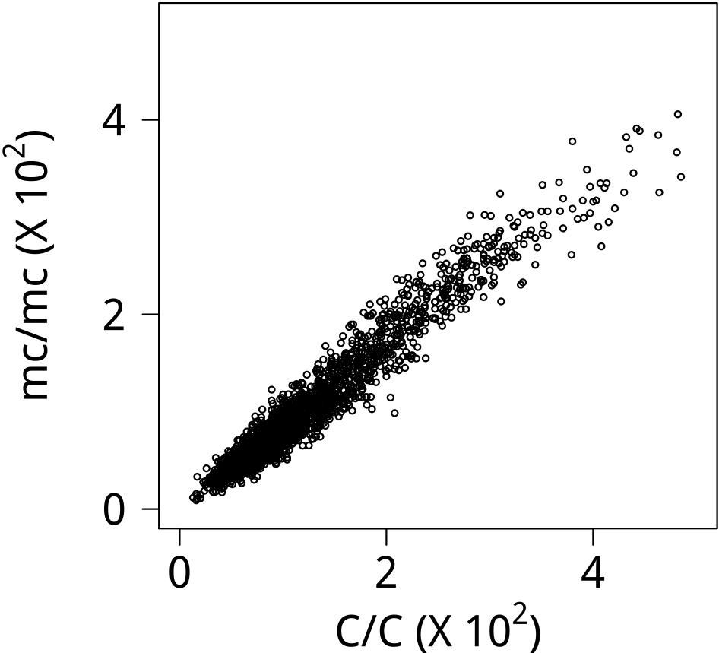
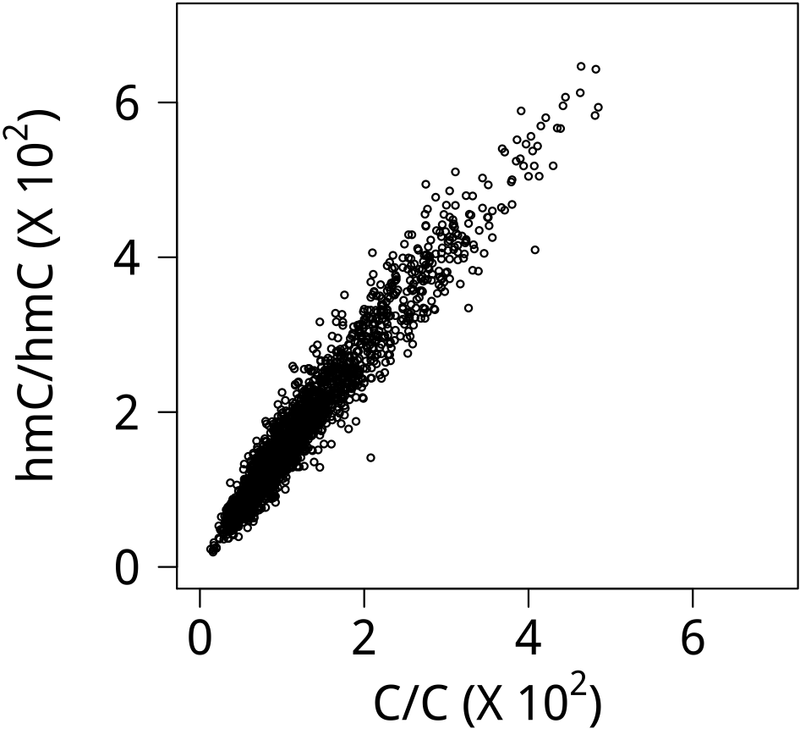

























HMBOX1
Logo (E)
Logo (S)
HOMEZ
Logo (E)
Logo (S)
HSF1
Logo (E)
Logo (S)
HSF2
Logo (E)
Logo (S)

Slide 5






















IRX2
Logo (E)
Logo (S)
LHX4
Logo (E)
Logo (S)
LIN28A
Logo (E)
Logo (S)
MEIS1
Logo (E)
Logo (S)

Slide 6






























MEIS2
Logo (E)
Logo (S)
MEIS3
Logo (E)
Logo (S)
METTL3
Logo (E)
Logo (S)
MLX
Logo (E)
Logo (S)

Slide 7






















MYOD1
Logo (E)
Logo (S)
NFATC1
Logo (E)
Logo (S)
NHLH1
Logo (E)
Logo (S)
NHLH2
Logo (E)
Logo (S)

Slide 8




























NR2E1
Logo (E)
Logo (S)
NRF1
Logo (E)
Logo (S)
OTX1
Logo (E)
Logo (S)
OVOL2
Logo (E)
Logo (S)

Slide 9


























PKNOX1
Logo (E)
Logo (S)
PKNOX2
Logo (E)
Logo (S)
PRDM16
Logo (E)
Logo (S)
PURA
Logo (E)
Logo (S)

Slide 10


























RFX2
Logo (E)
Logo (S)
SFMBT1
Logo (E)
Logo (S)
SPDEF
Logo (E)
Logo (S)
STAT5A
Logo (E)
Logo (S)

Slide 11






















TAL2
Logo (E)
Logo (S)
TBX2
Logo (E)
Logo (S)
TBX3
Logo (E)
Logo (S)
TBX20
Logo (E)
Logo (S)

Slide 12





























TFAP2A
Logo (E)
Logo (S)
TFAP2B
Logo (E)
Logo (S)
TFAP2C
Logo (E)
Logo (S)
TFAP2E
Logo (E)
Logo (S)

Slide 13


























TULP4
Logo (E)
Logo (S)
USF1
Logo (E)
Logo (S)
USF2
Logo (E)
Logo (S)
ZBED2
Logo (E)
Logo (S)

Slide 14





















ZBTB7A
Logo (E)
Logo (S)
ZBTB7B
Logo (E)
Logo (S)
ZNF187
Logo (E)
Logo (S)
ZNF256
Logo (E)
Logo (S)

Slide 15




















ZNF449
Logo (E)
Logo (S)
ZNF468
Logo (E)
Logo (S)
ZNF691
Logo (E)
Logo (S)
ZSCAN21
Logo (E)
Logo (S)

Slide 16





ZSCAN5A
Logo (E)
Logo (S)

