Slide 1
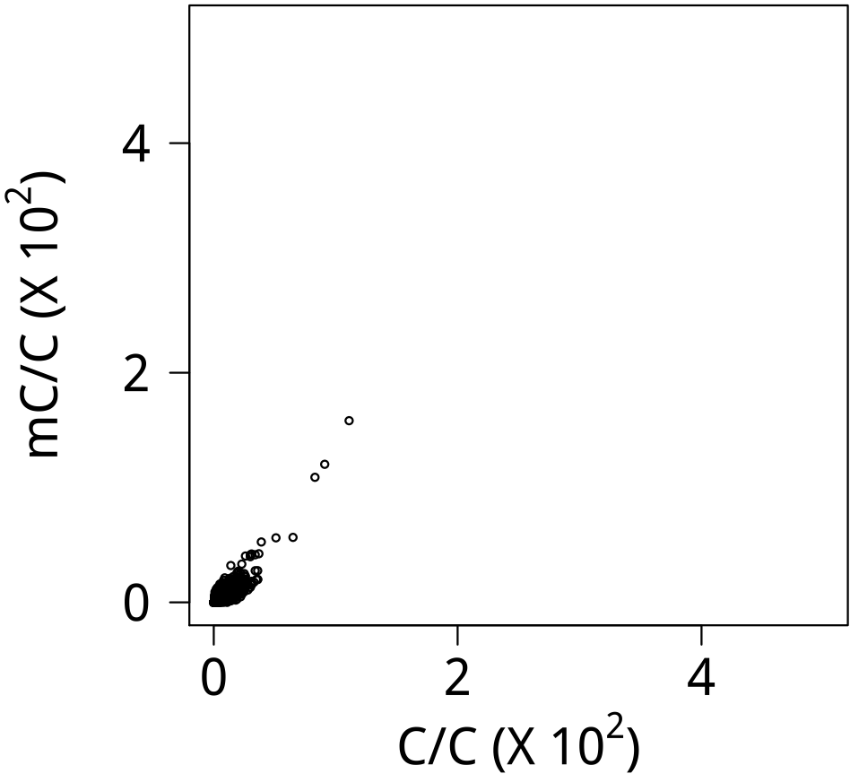
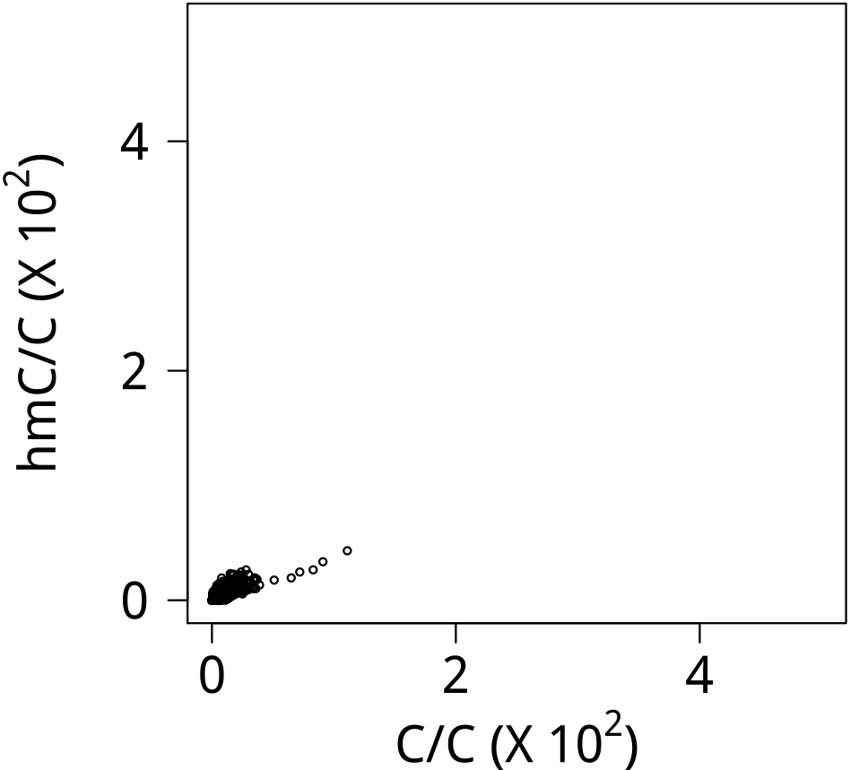
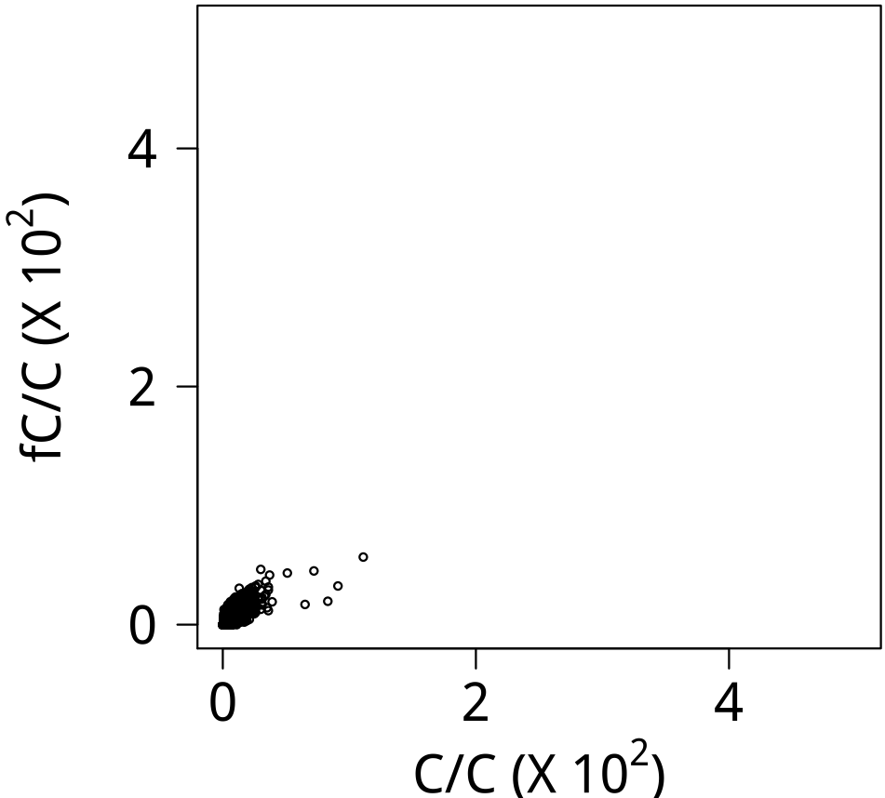
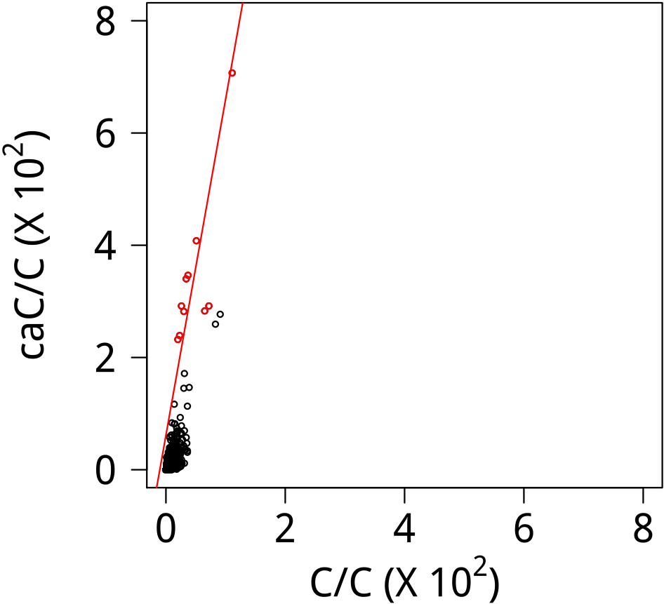

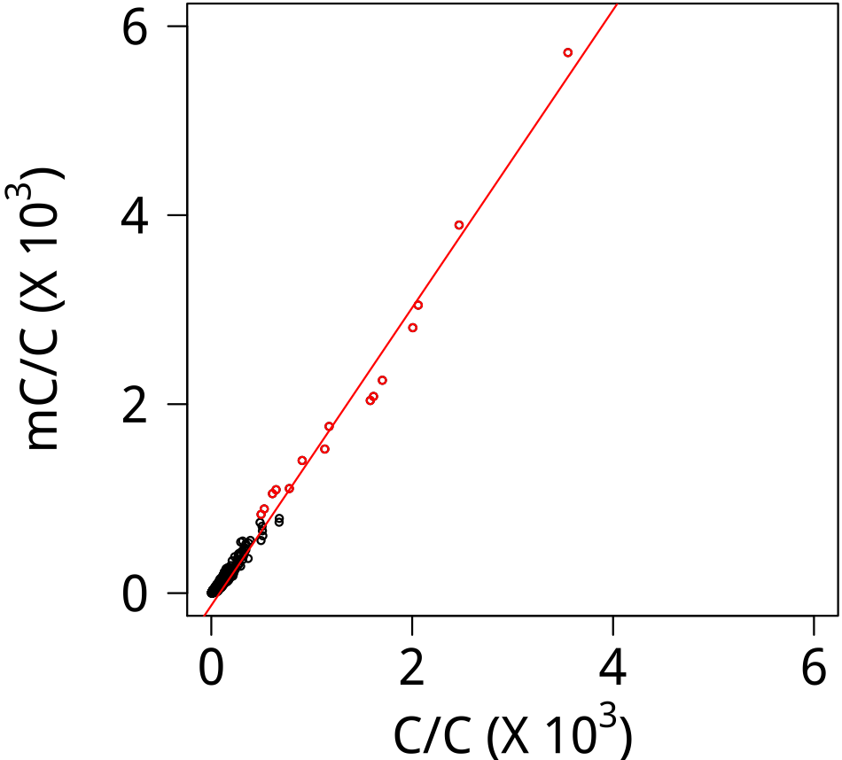
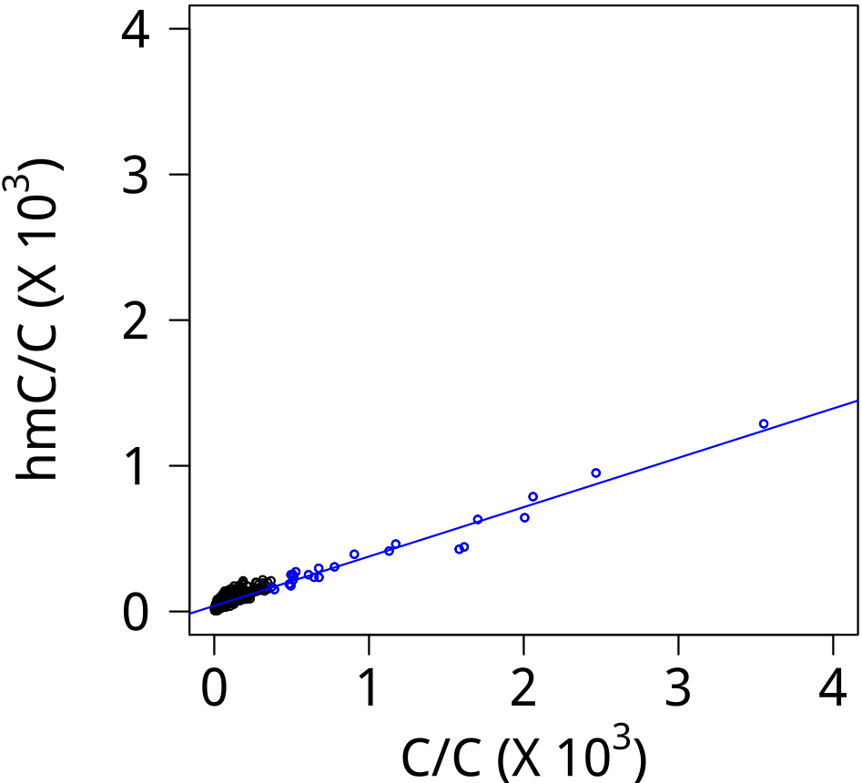
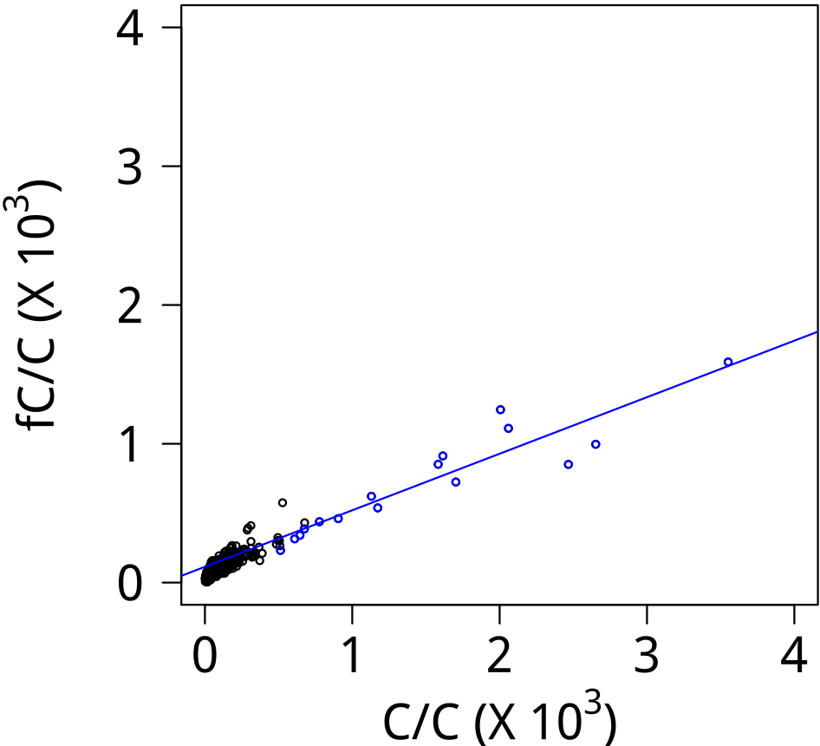
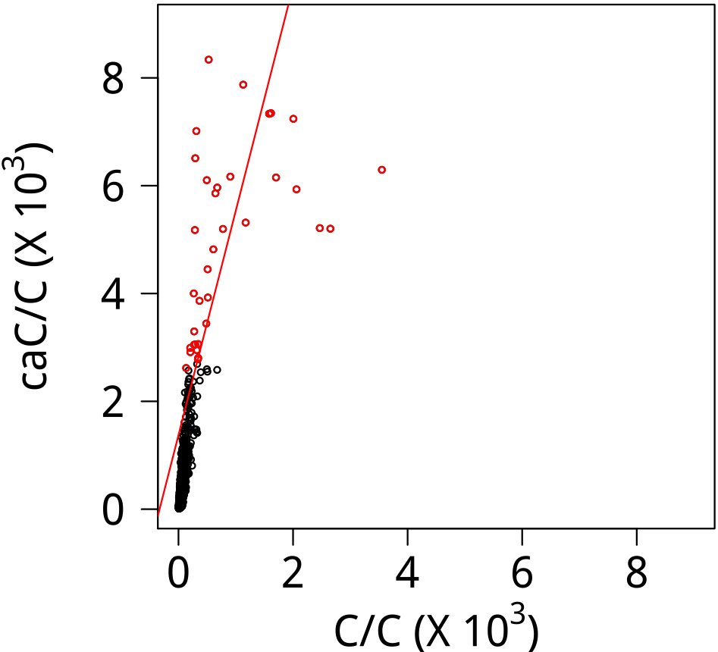




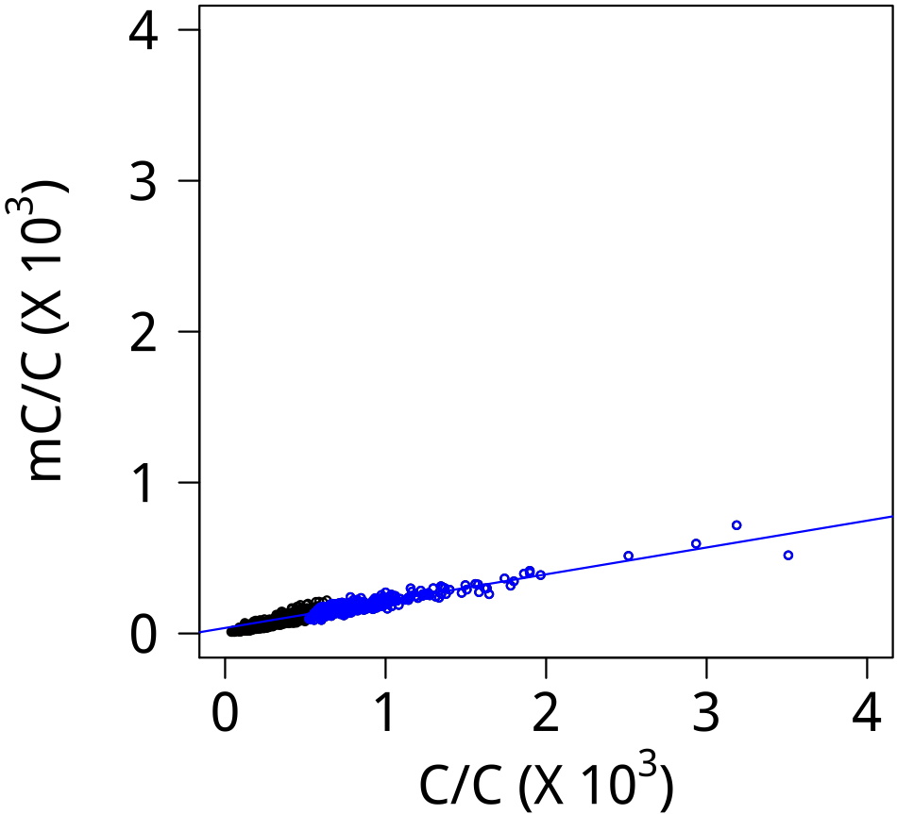
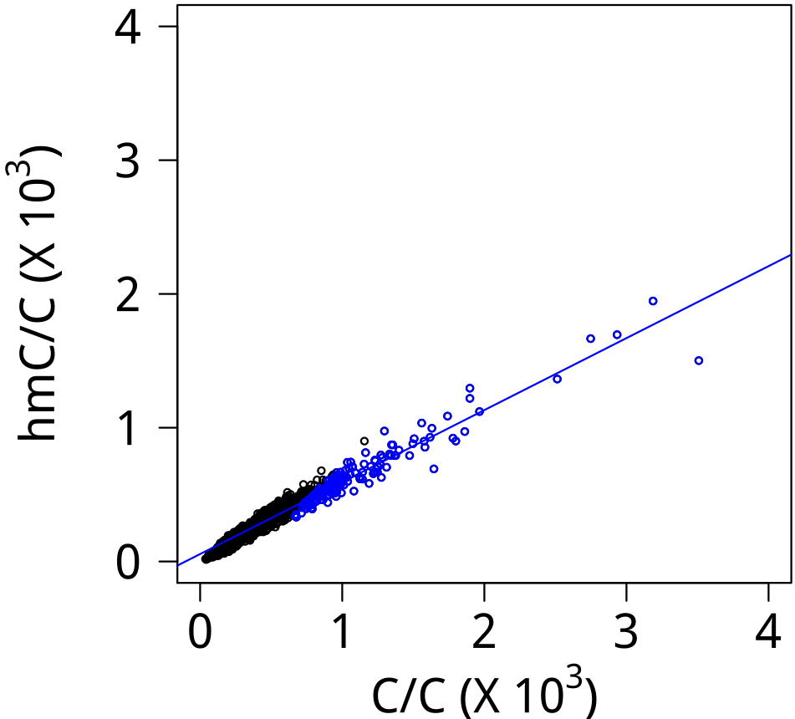
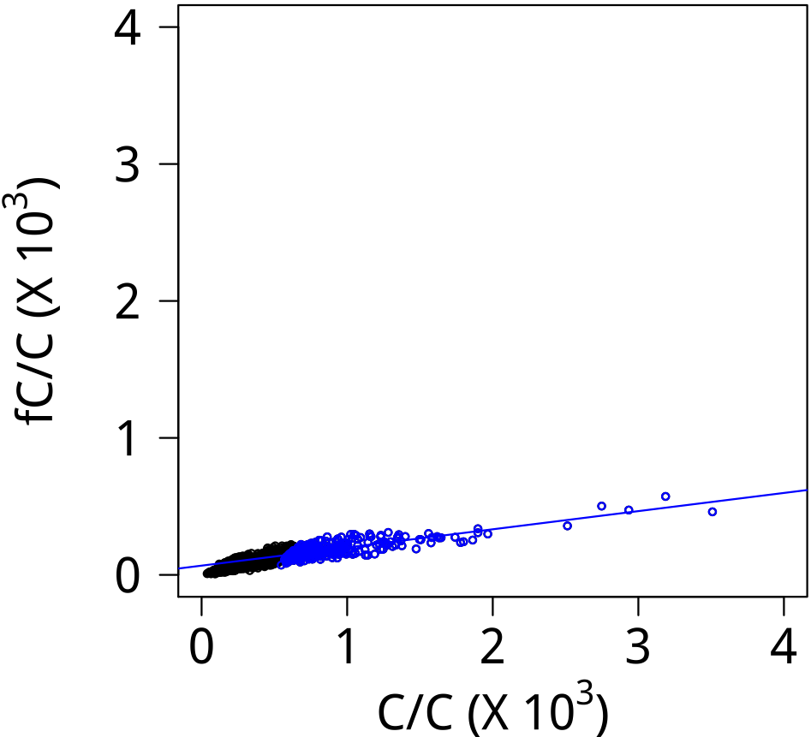
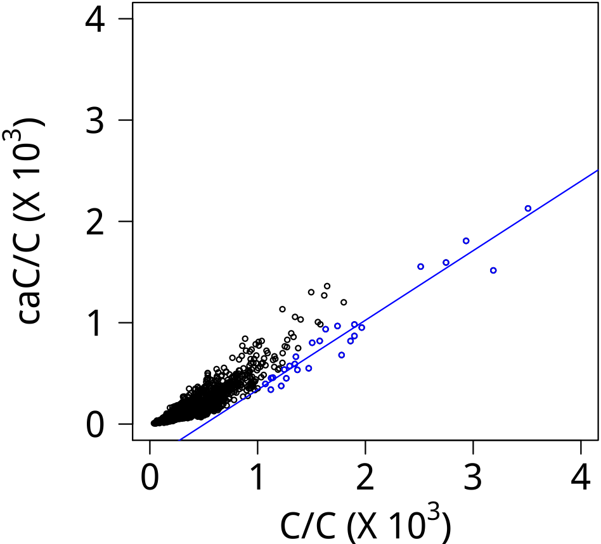




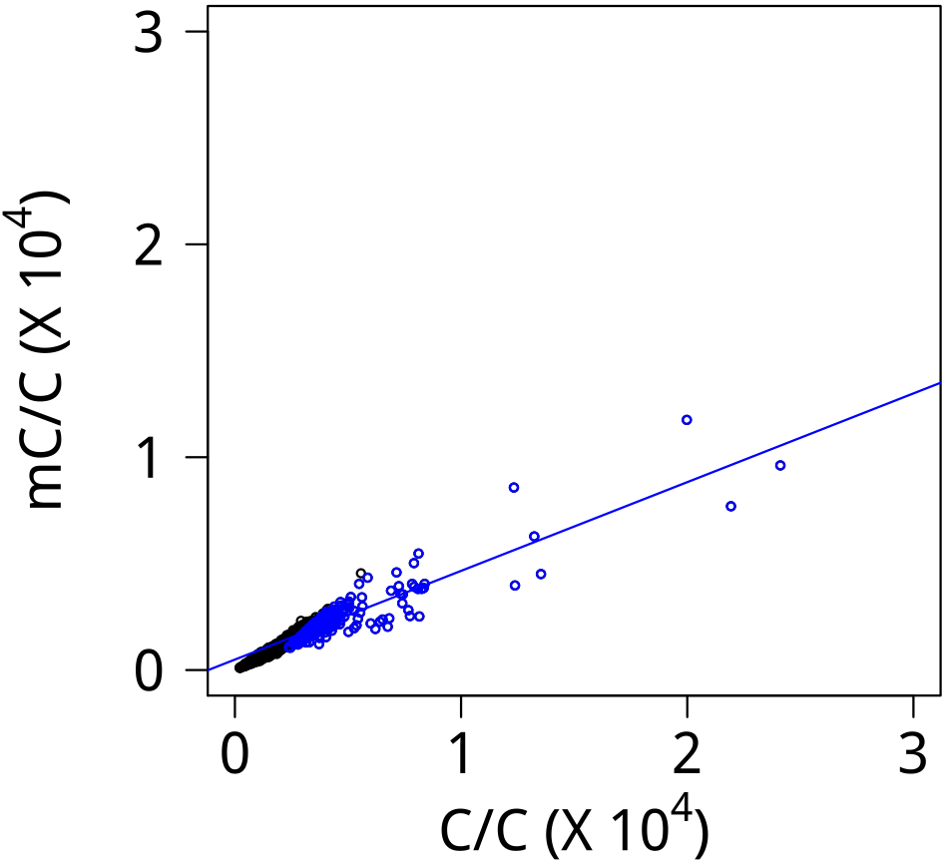
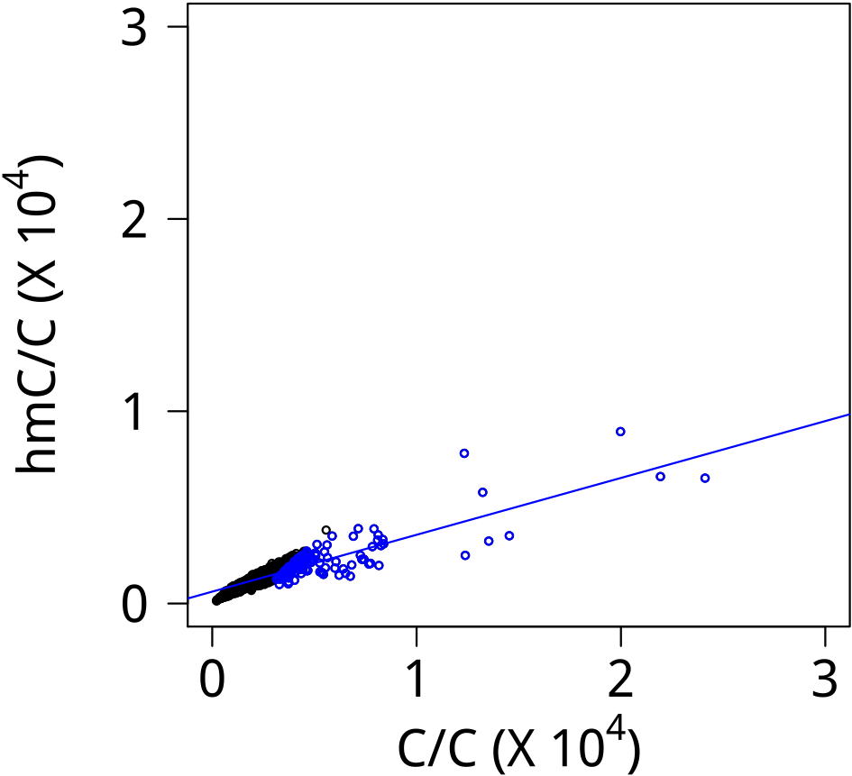
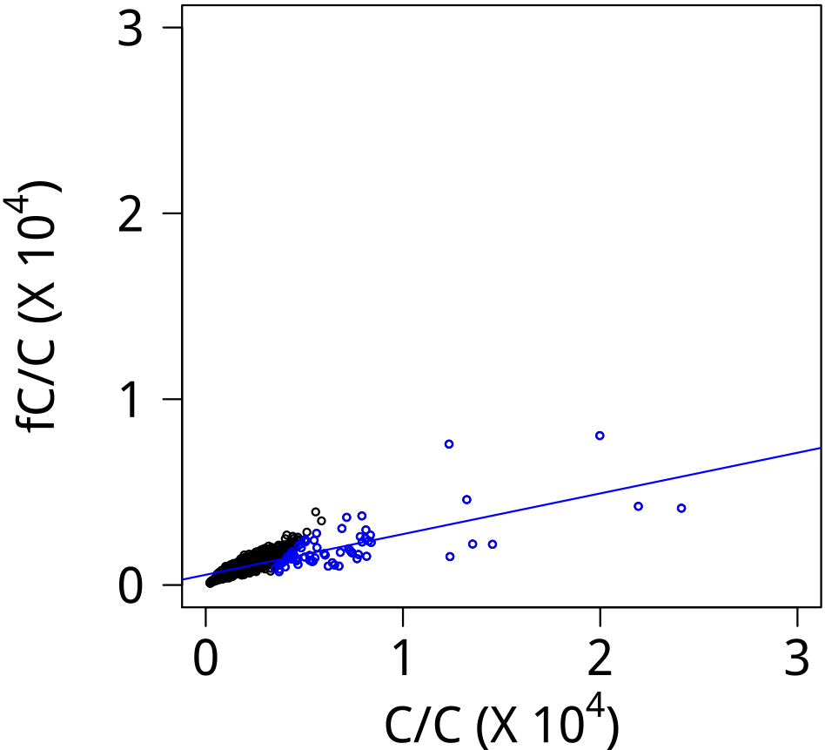
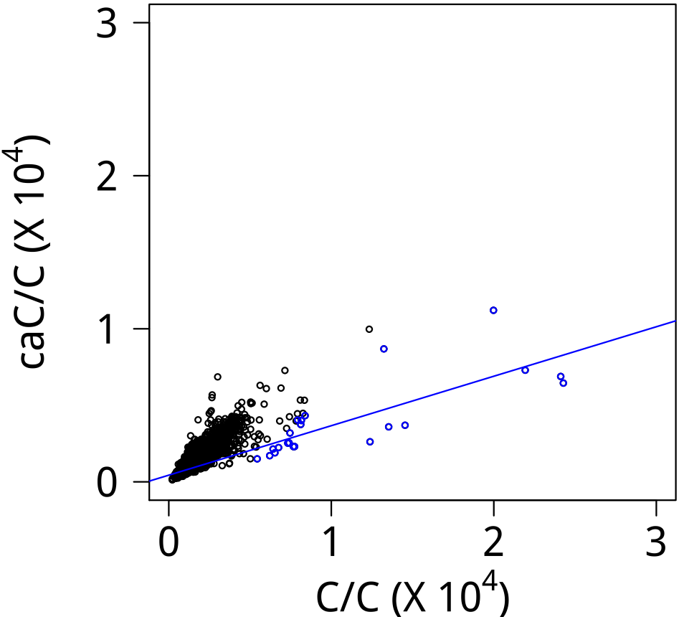




Supplementary Data 8
CEBPβ
Logo (E)
Logo (S)
CEBPγ
Logo (E)
Logo (S)
CRX
Logo (E)
Logo (S)
DMTF1
Logo (E)
Logo (S)

Slide 2
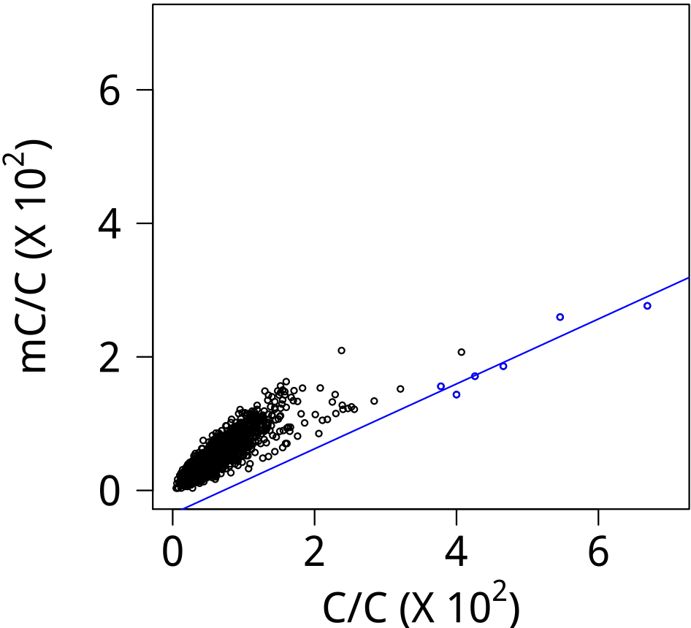
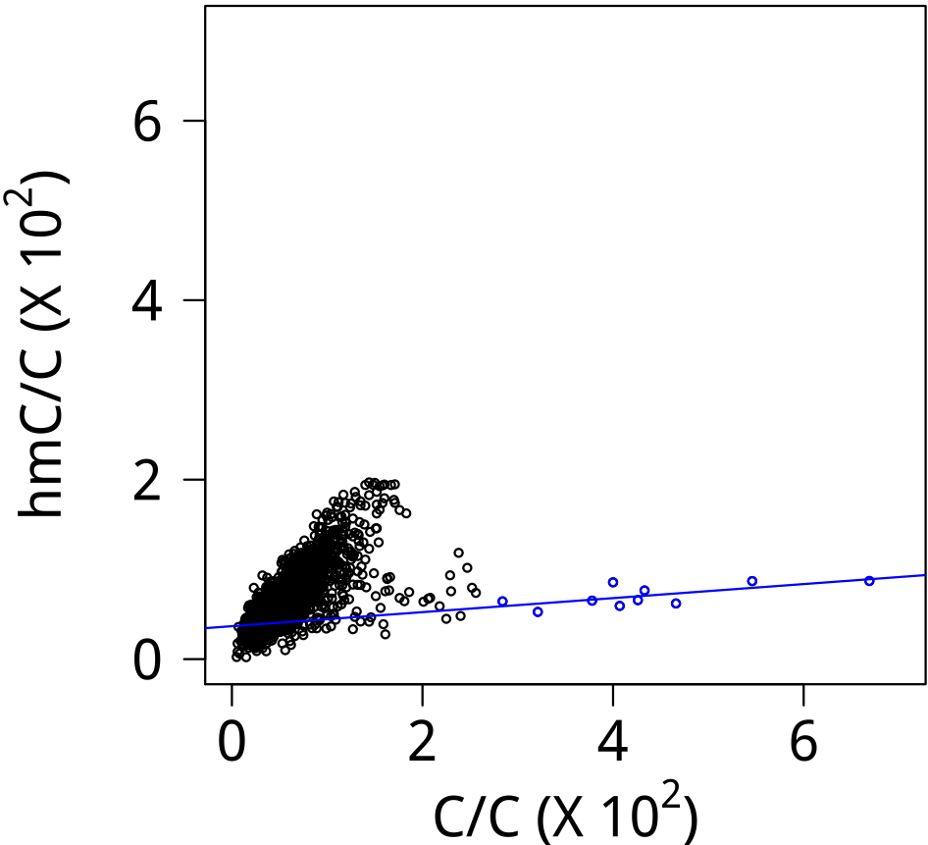
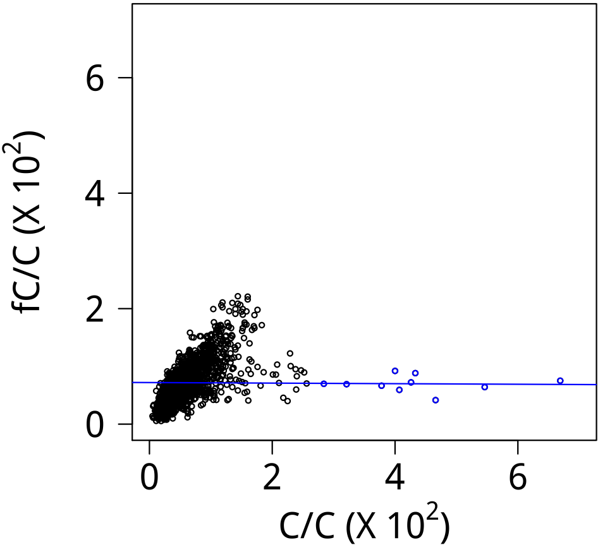
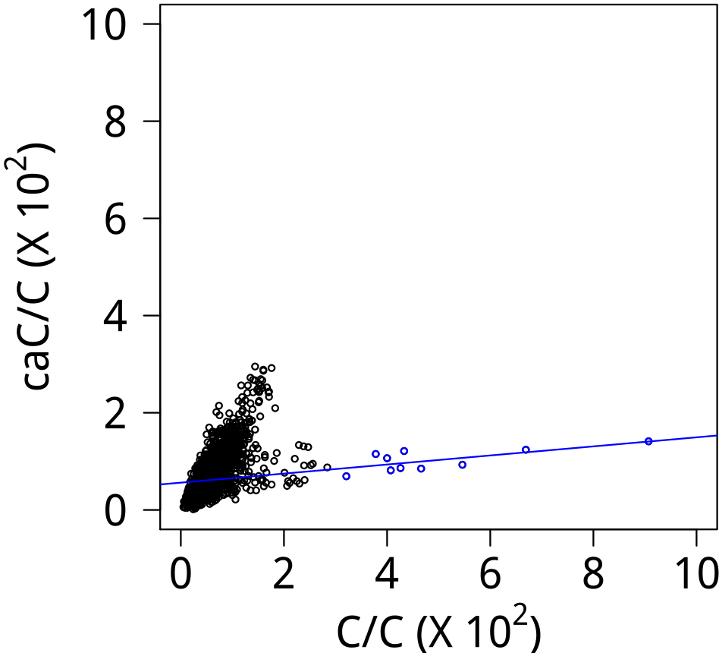



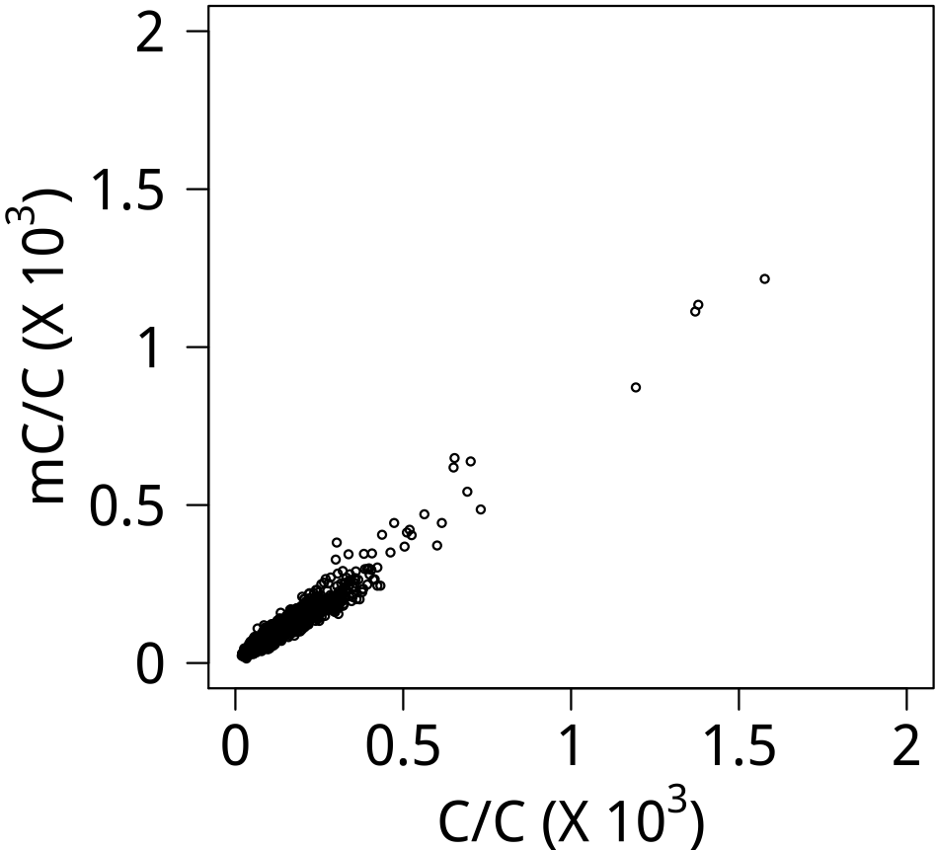
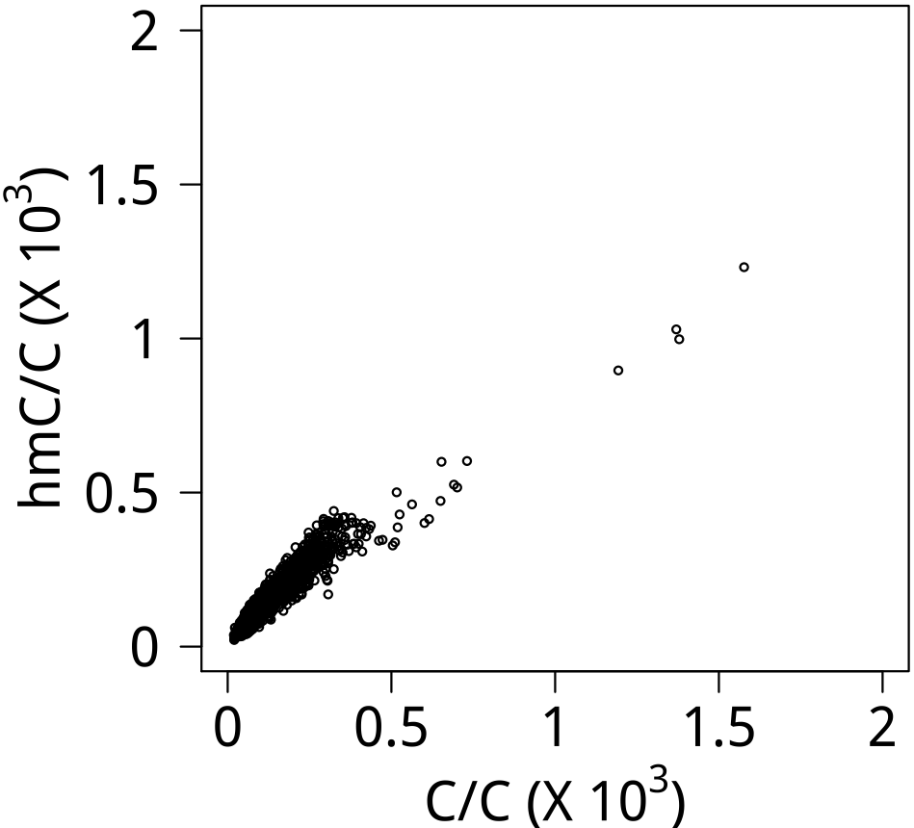
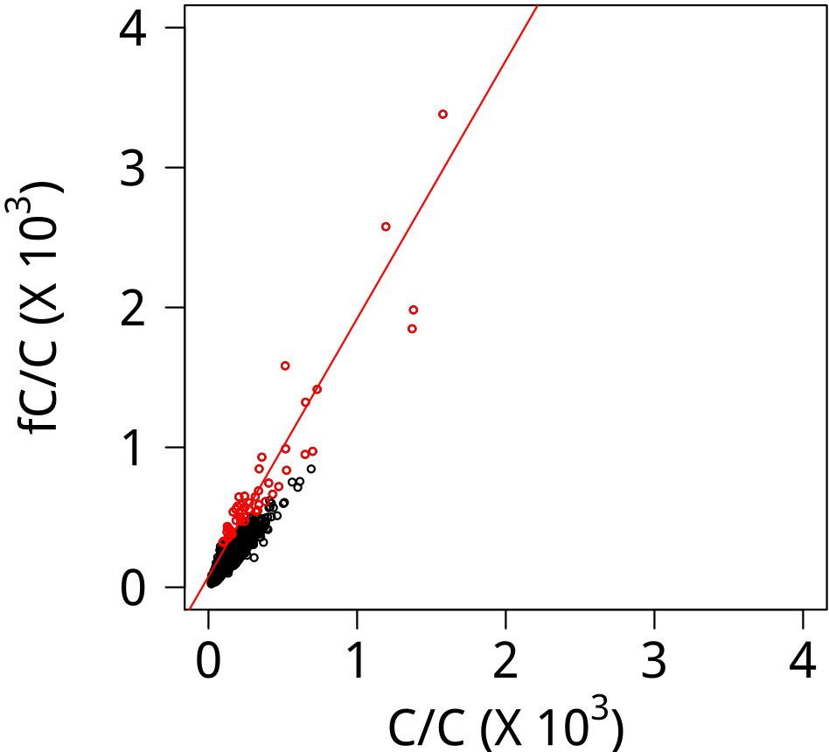
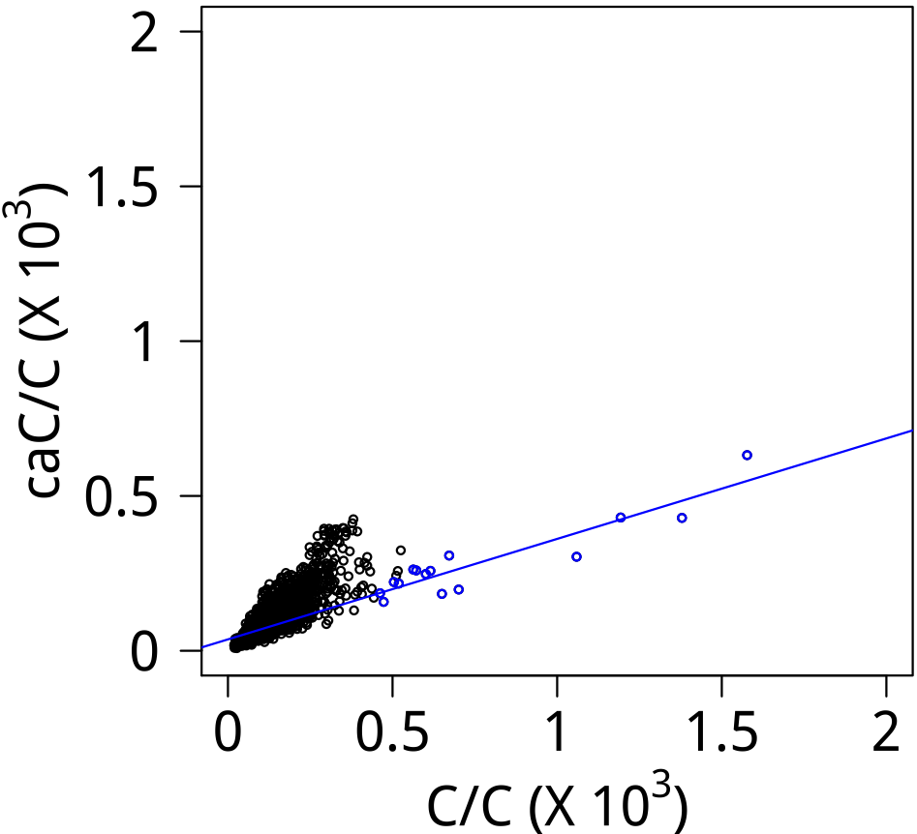


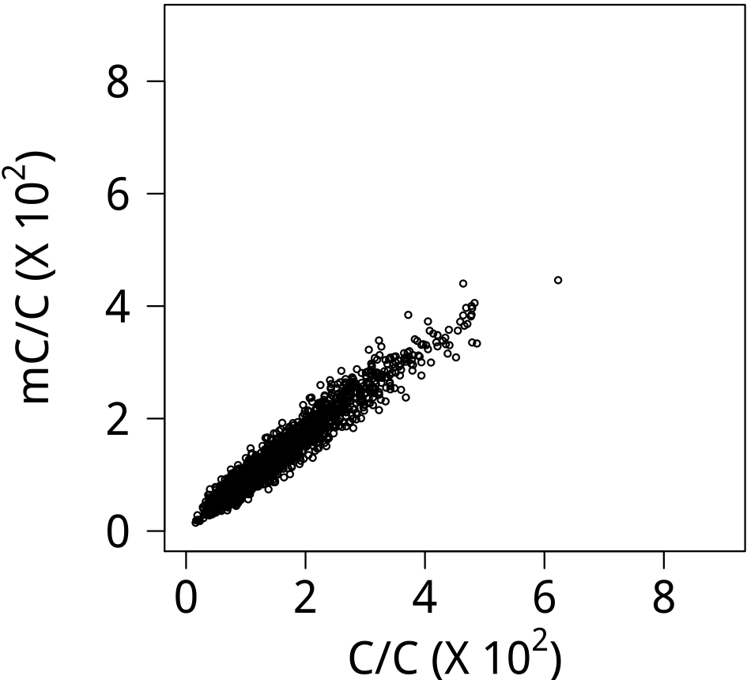
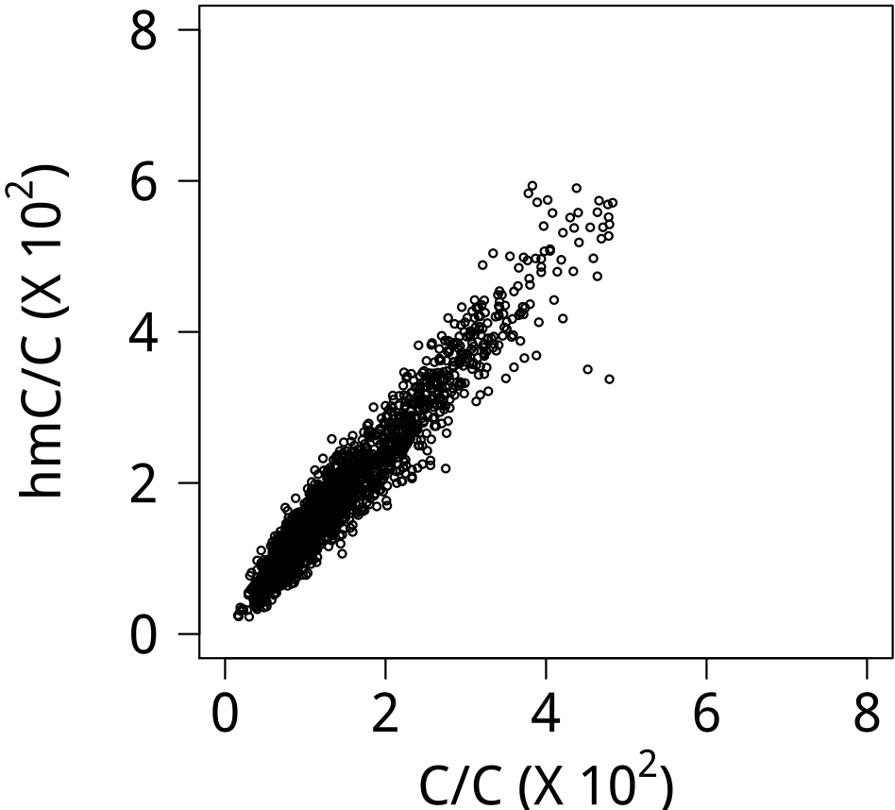
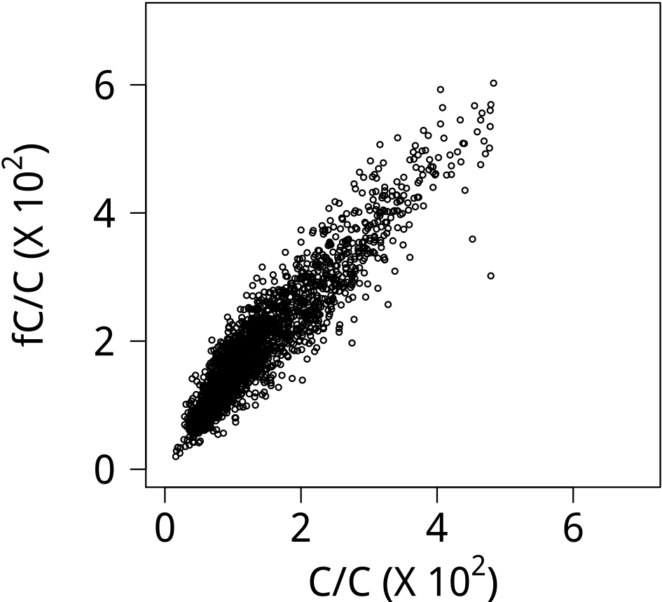
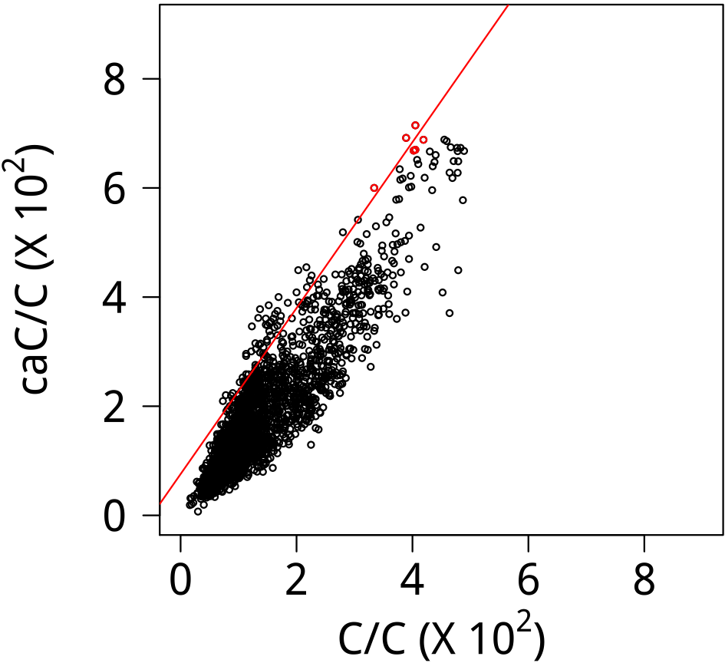

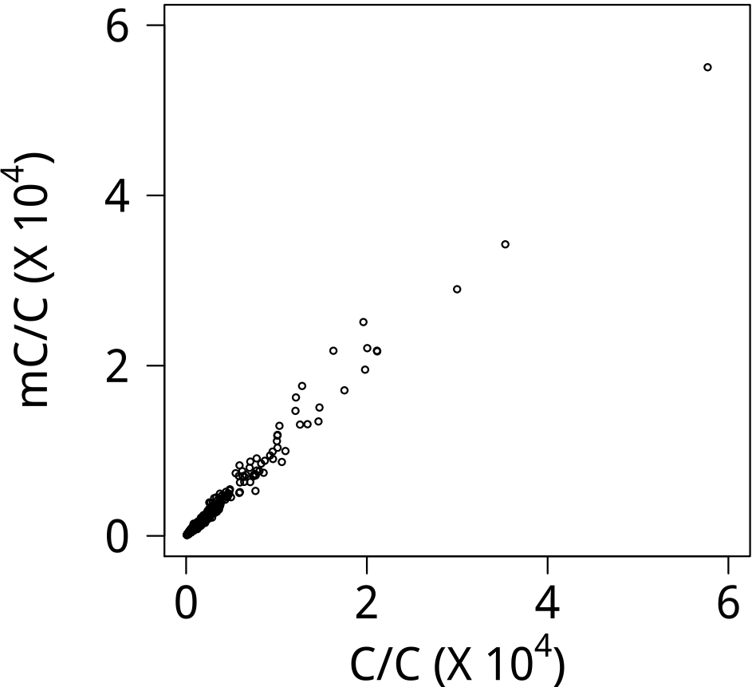
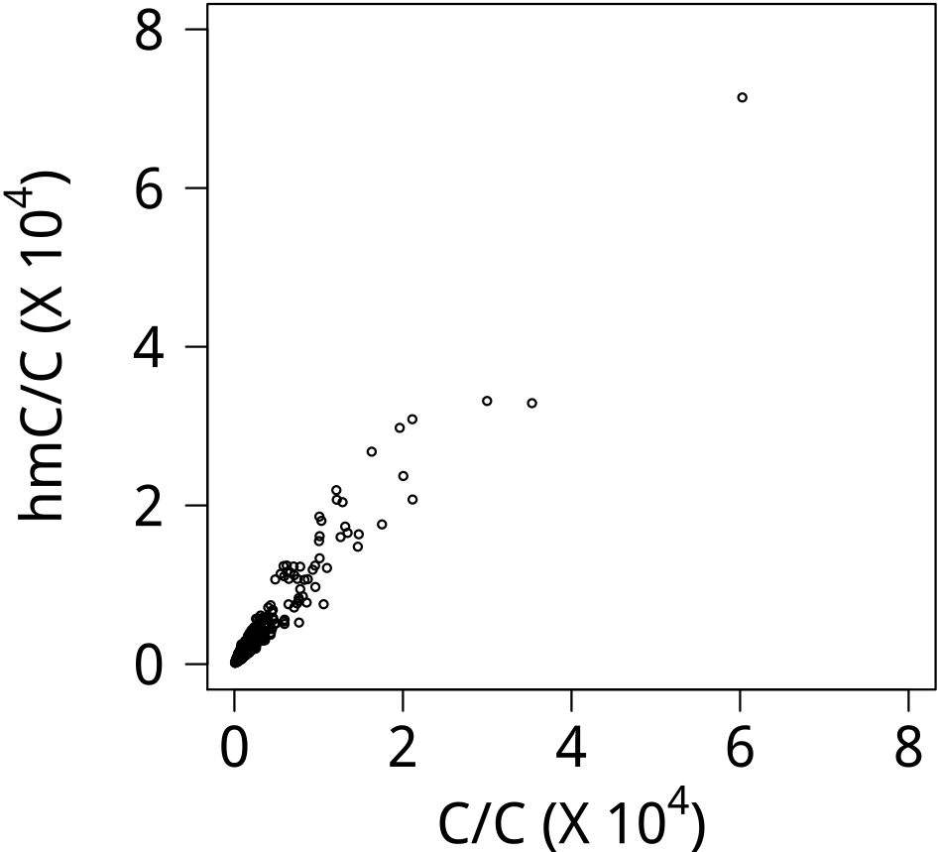
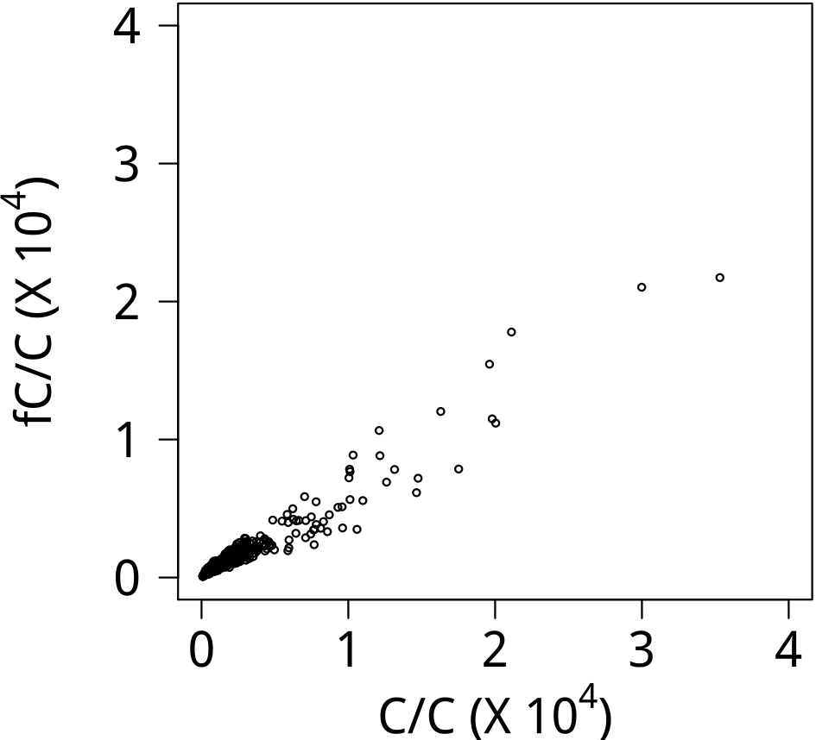
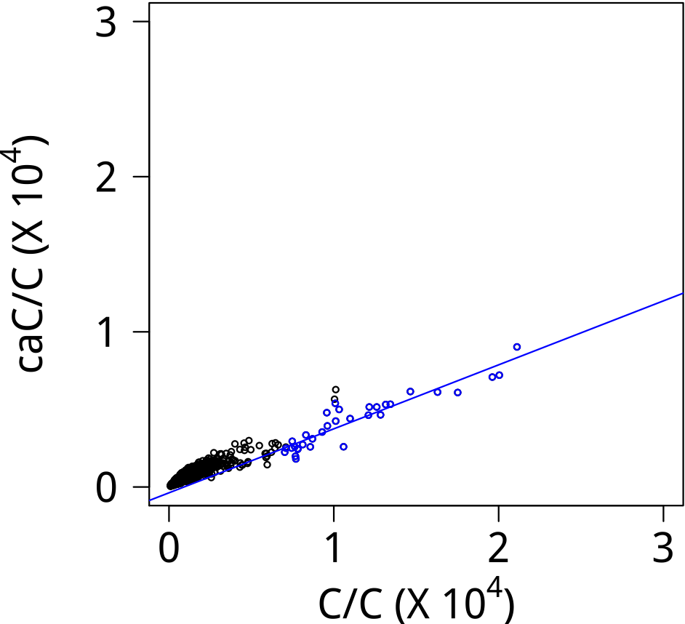

E2F1
Logo (E)
Logo (S)
EGR2
Logo (E)
Logo (S)
ELF2
Logo (E)
Logo (S)
ELK1
Logo (E)
Logo (S)

Slide 3
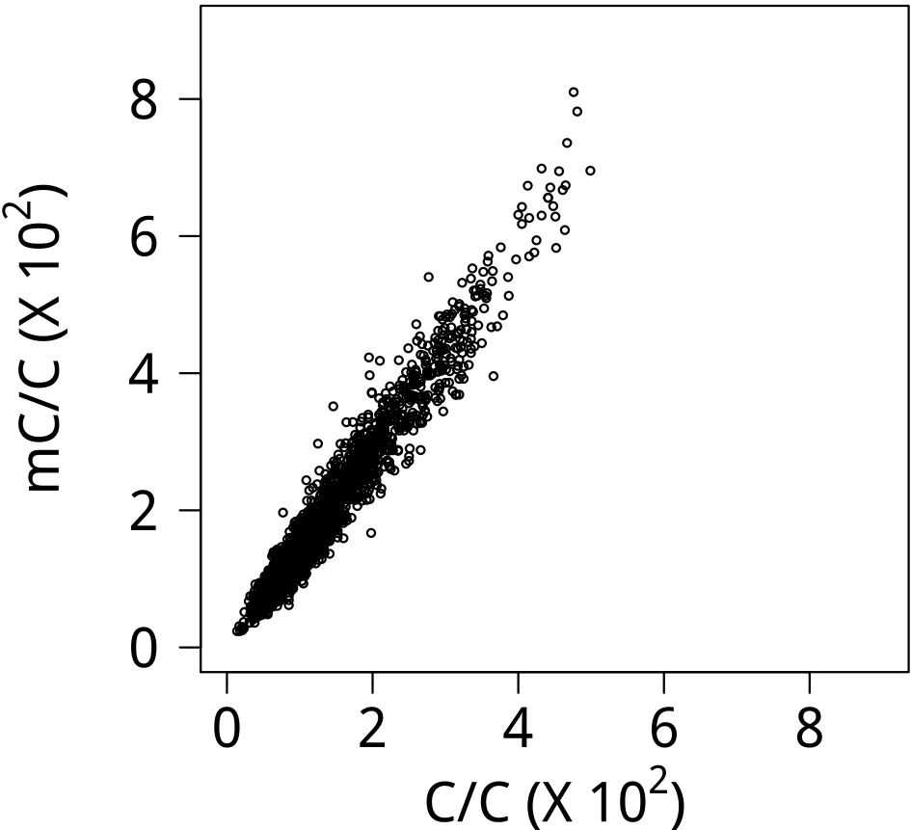
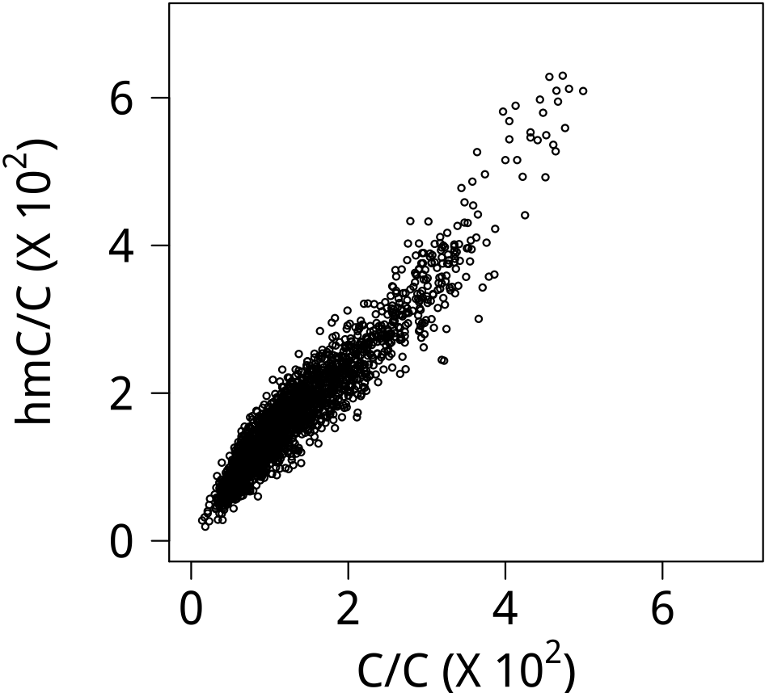
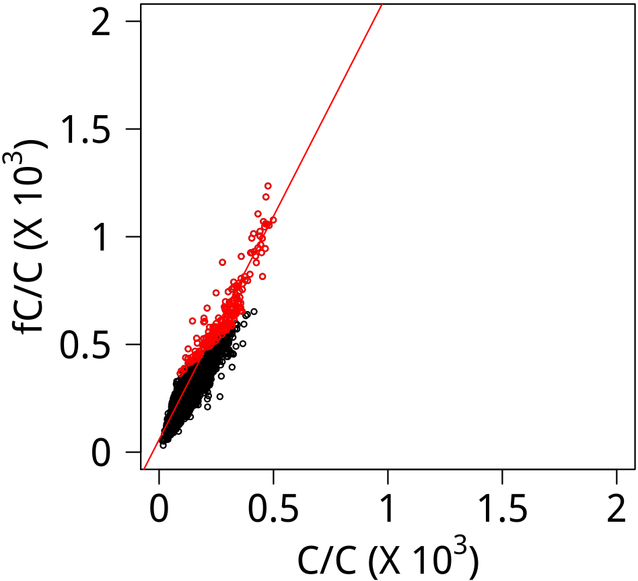
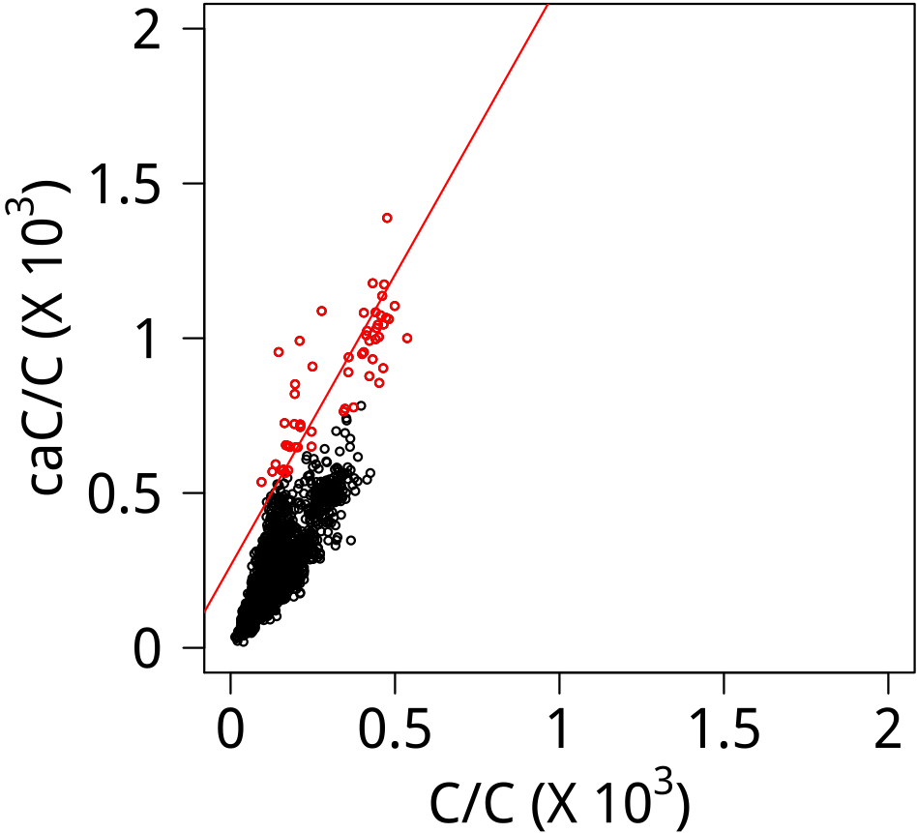


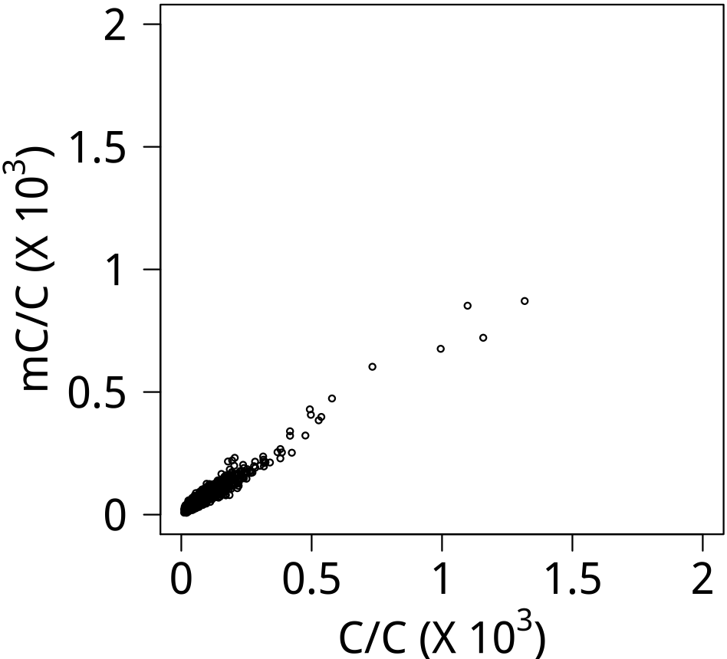
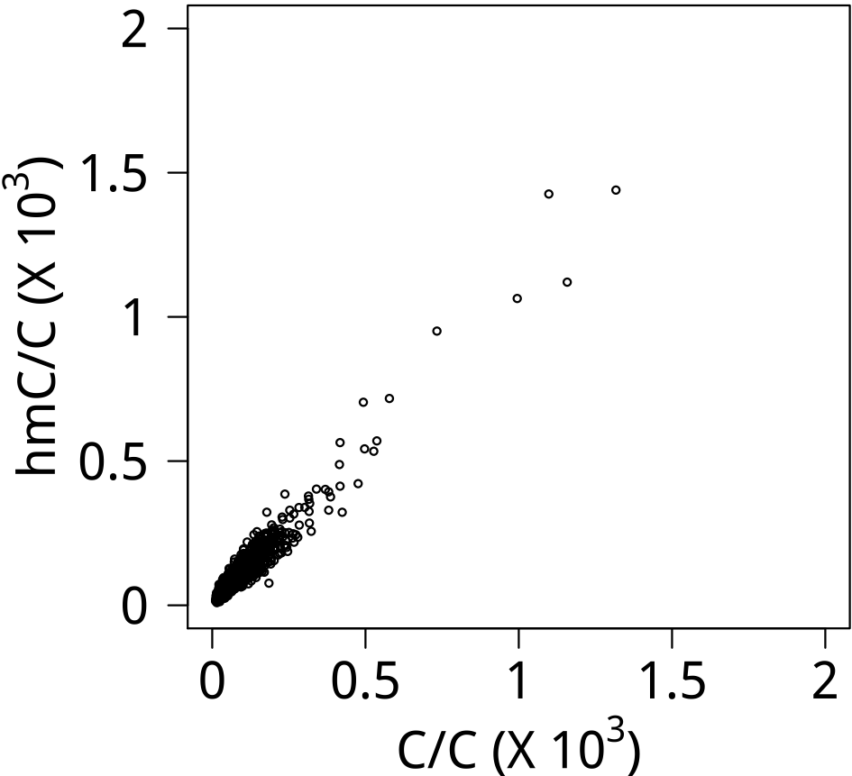
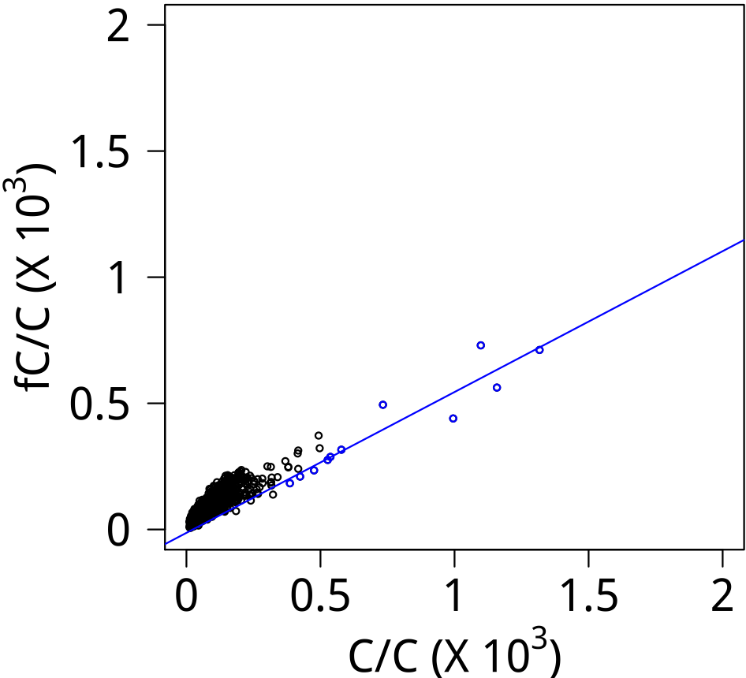
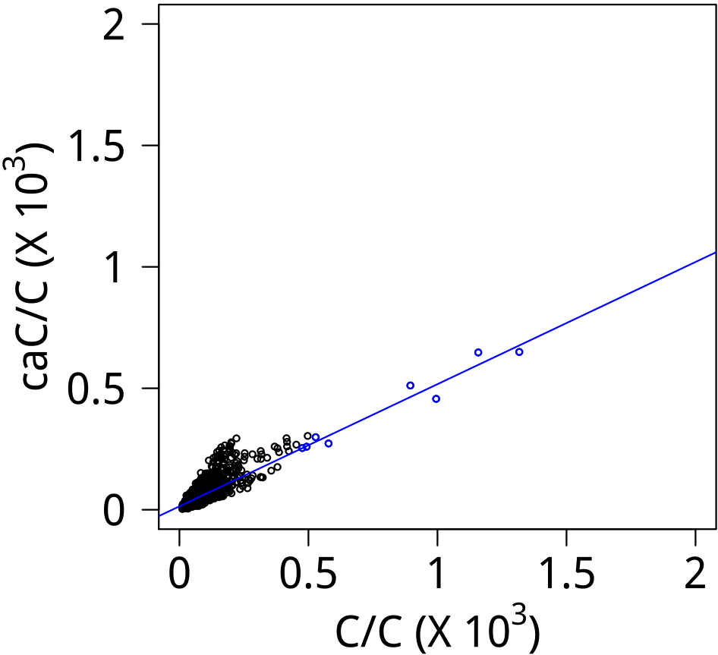


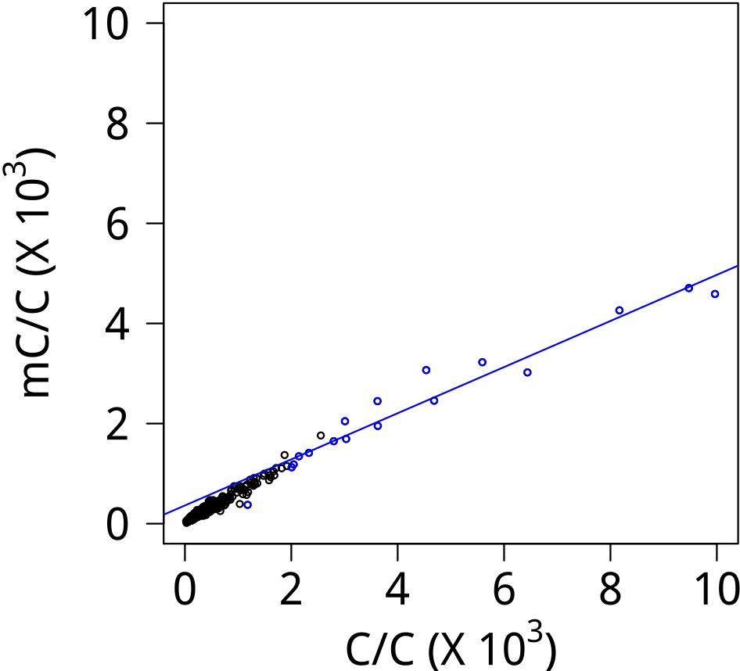
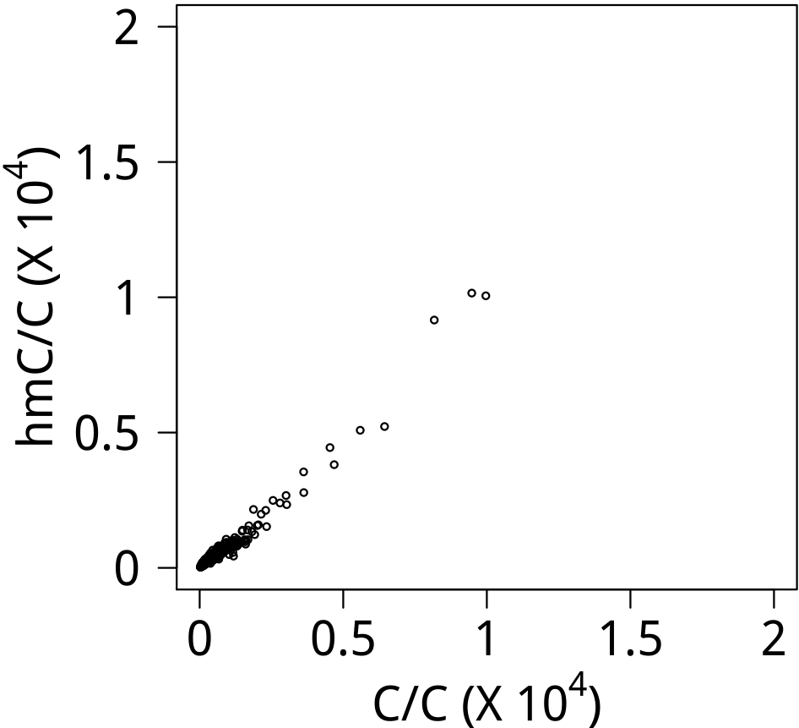
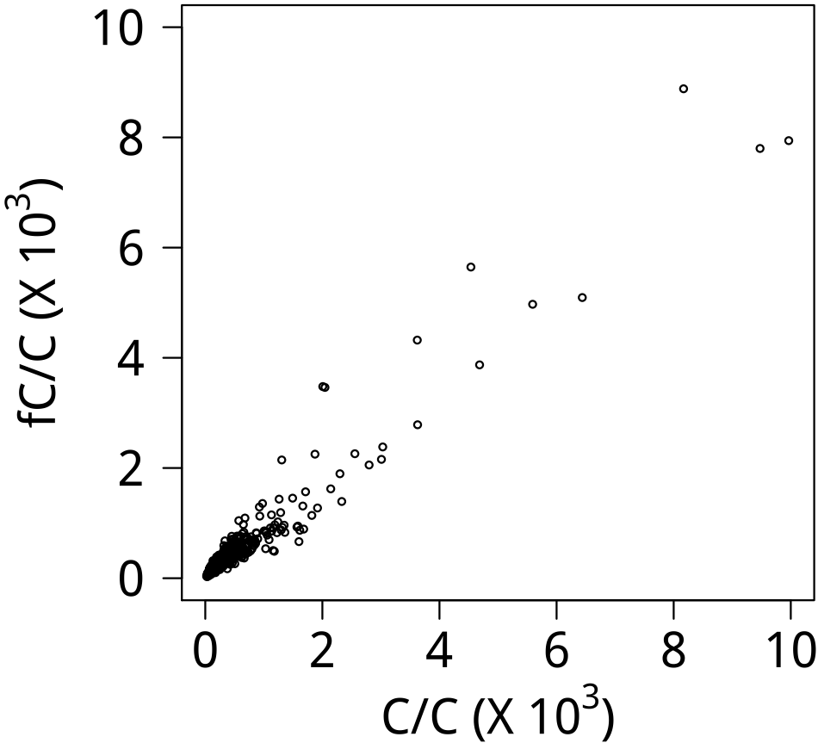
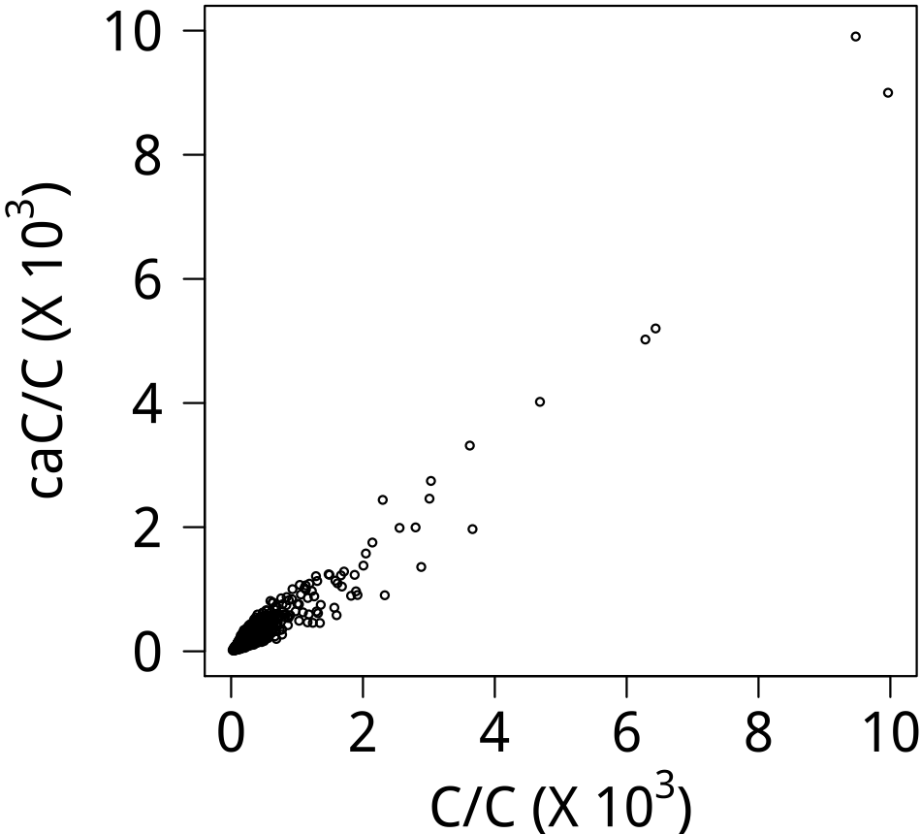

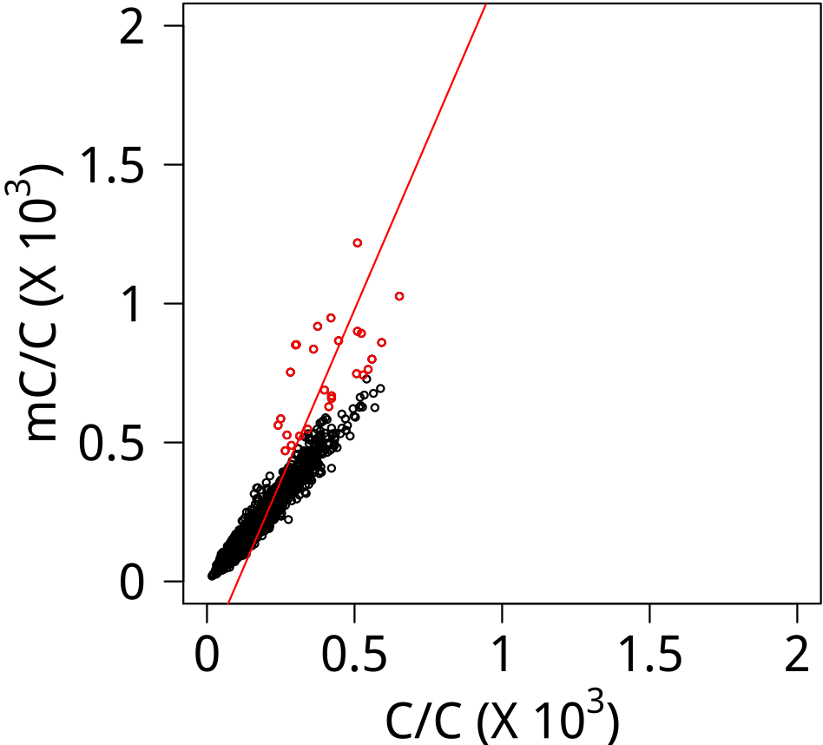
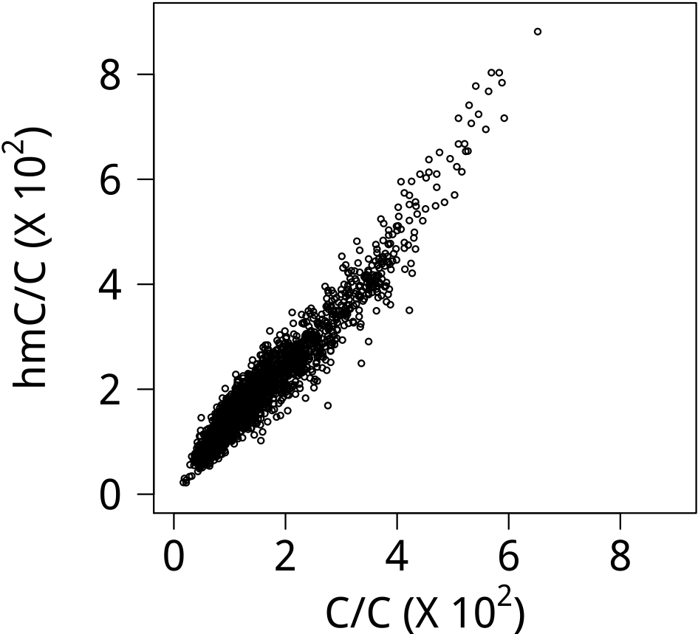
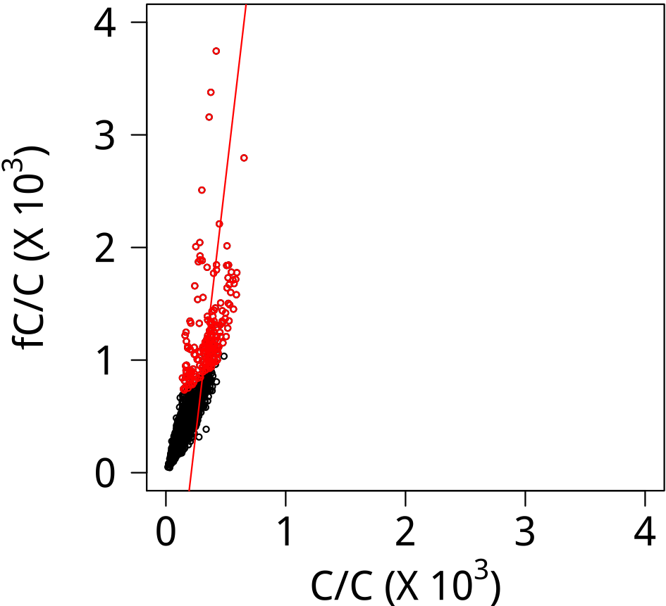
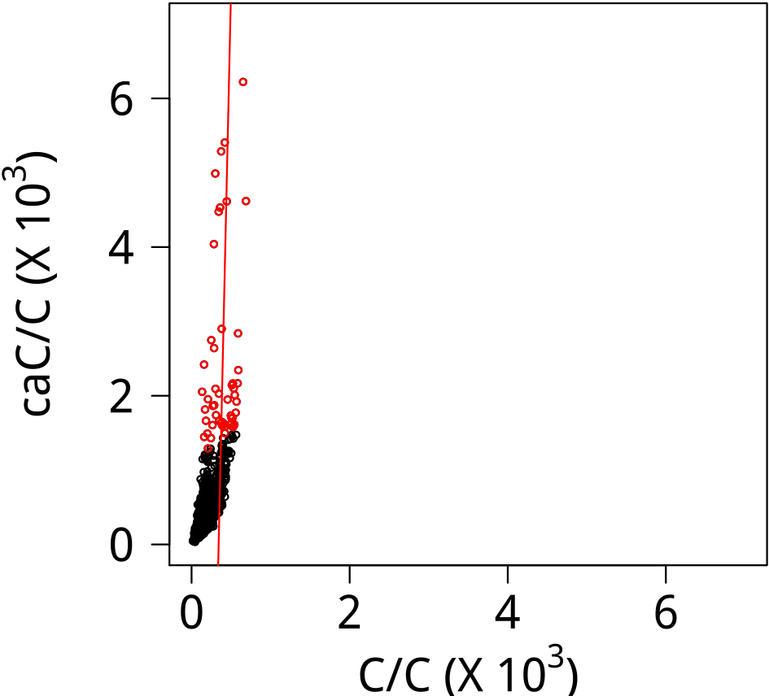



EN2
Logo (E)
Logo (S)
ERG
Logo (E)
Logo (S)
ETS1
Logo (E)
Logo (S)
FOXC2
Logo (E)
Logo (S)

Slide 4
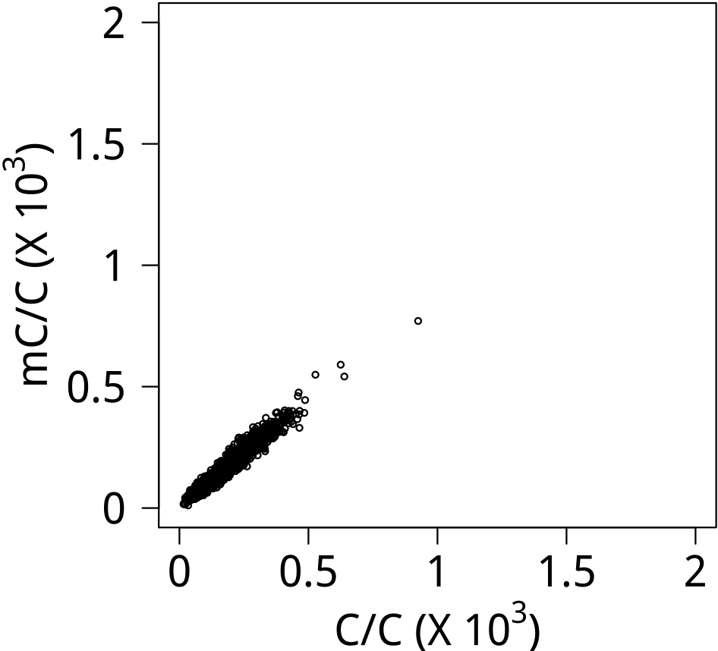
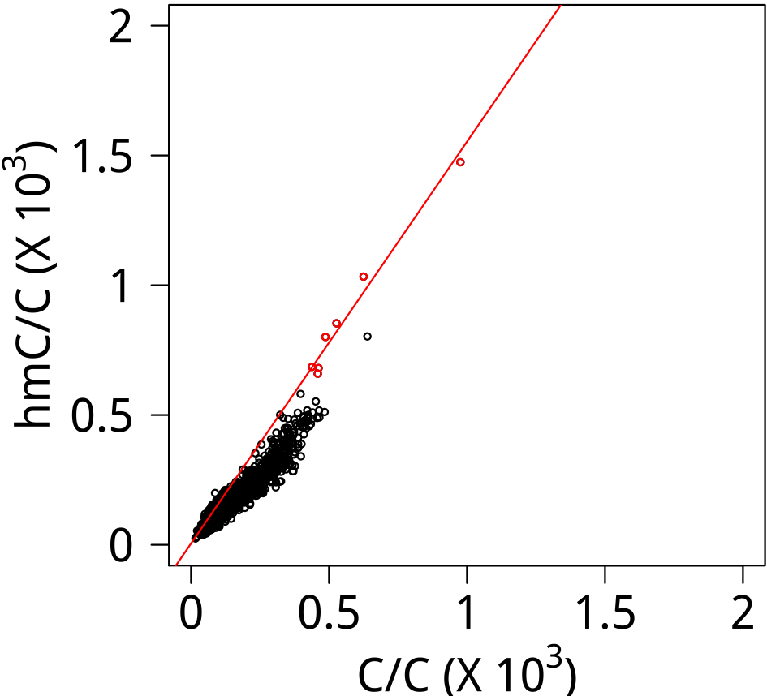





















FOXP4
Logo (E)
Logo (S)
GRHL2
Logo (E)
Logo (S)
HMBOX1
Logo (E)
Logo (S)
HMGN2
Logo (E)
Logo (S)

Slide 5






























HOMEZ
Logo (E)
Logo (S)
HSF1
Logo (E)
Logo (S)
HSF2
Logo (E)
Logo (S)
JDP2
Logo (E)
Logo (S)

Slide 6

























LHX4
Logo (E)
Logo (S)
MAGEA4
Logo (E)
Logo (S)
MEIS1
Logo (E)
Logo (S)
MEIS2
Logo (E)
Logo (S)

Slide 7































MEIS3
Logo (E)
Logo (S)
METTL3
Logo (E)
Logo (S)
MLX
Logo (E)
Logo (S)
NFATC1
Logo (E)
Logo (S)

Slide 8



























NHLH2
Logo (E)
Logo (S)
NR2E1
Logo (E)
Logo (S)
NRF1
Logo (E)
Logo (S)
OTUD4
Logo (E)
Logo (S)

Slide 9




























OTX1
Logo (E)
Logo (S)
OVOL2
Logo (E)
Logo (S)
PKNOX1
Logo (E)
Logo (S)
PKNOX2
Logo (E)
Logo (S)

Slide 10





















POU6F1
Logo (E)
Logo (S)
PPP1R13L
Logo (E)
Logo (S)
RBPJ
Logo (E)
Logo (S)
RFX2
Logo (E)
Logo (S)

Slide 11






















RHOXF1
Logo (E)
Logo (S)
RXRA
Logo (E)
Logo (S)
SATB2
Logo (E)
Logo (S)
SFMBT1
Logo (E)
Logo (S)

Slide 12
























SMARCE1
Logo (E)
Logo (S)
SPDEF
Logo (E)
Logo (S)
STAT5A
Logo (E)
Logo (S)
TBX2
Logo (E)
Logo (S)

Slide 13






















TBX3
Logo (E)
Logo (S)
TBX20
Logo (E)
Logo (S)
TBXT
Logo (E)
Logo (S)
TERF1
Logo (E)
Logo (S)

Slide 14























TFAP2B
Logo (E)
Logo (S)
TFAP2D
Logo (E)
Logo (S)
TFAP2E
Logo (E)
Logo (S)
TRIM24
Logo (E)
Logo (S)

Slide 15


























TRIM28
Logo (E)
Logo (S)
USF1
Logo (E)
Logo (S)
USF2
Logo (E)
Logo (S)
YBX1
Logo (E)
Logo (S)

Slide 16






















ZBTB7B
Logo (E)
Logo (S)
ZCRB1
Logo (E)
Logo (S)
ZFP36L2
Logo (E)
Logo (S)
ZNF187
Logo (E)
Logo (S)

Slide 17











ZNF213
Logo (E)
Logo (S)
ZNF518A
Logo (E)
Logo (S)

