Slide 1
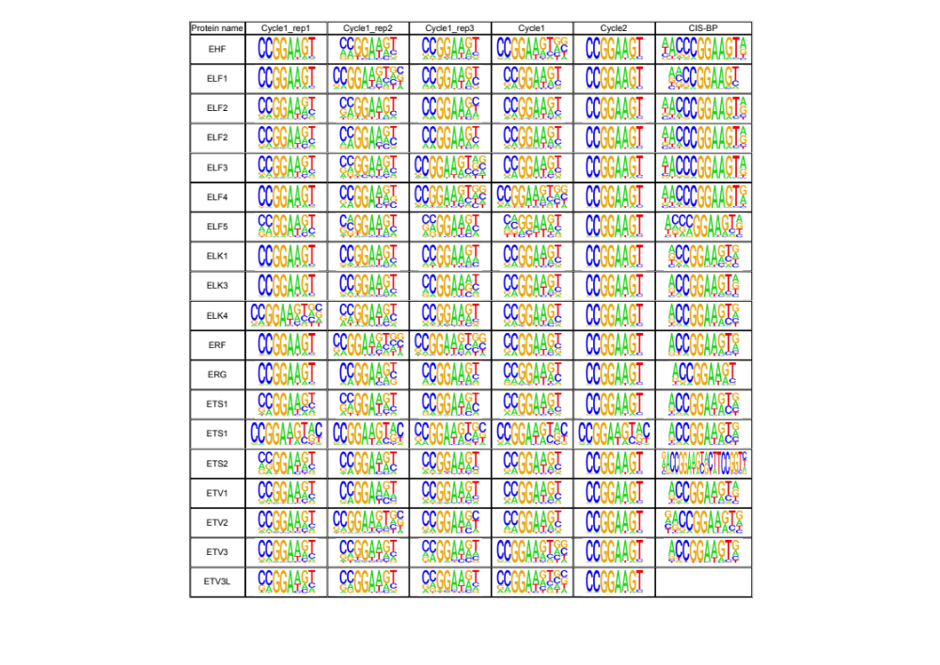
Supplementary Data 2. Consensus sequences identified for ETS protein by DAPPL using 16-mer DNA library.

Slide 2
