Slide 1
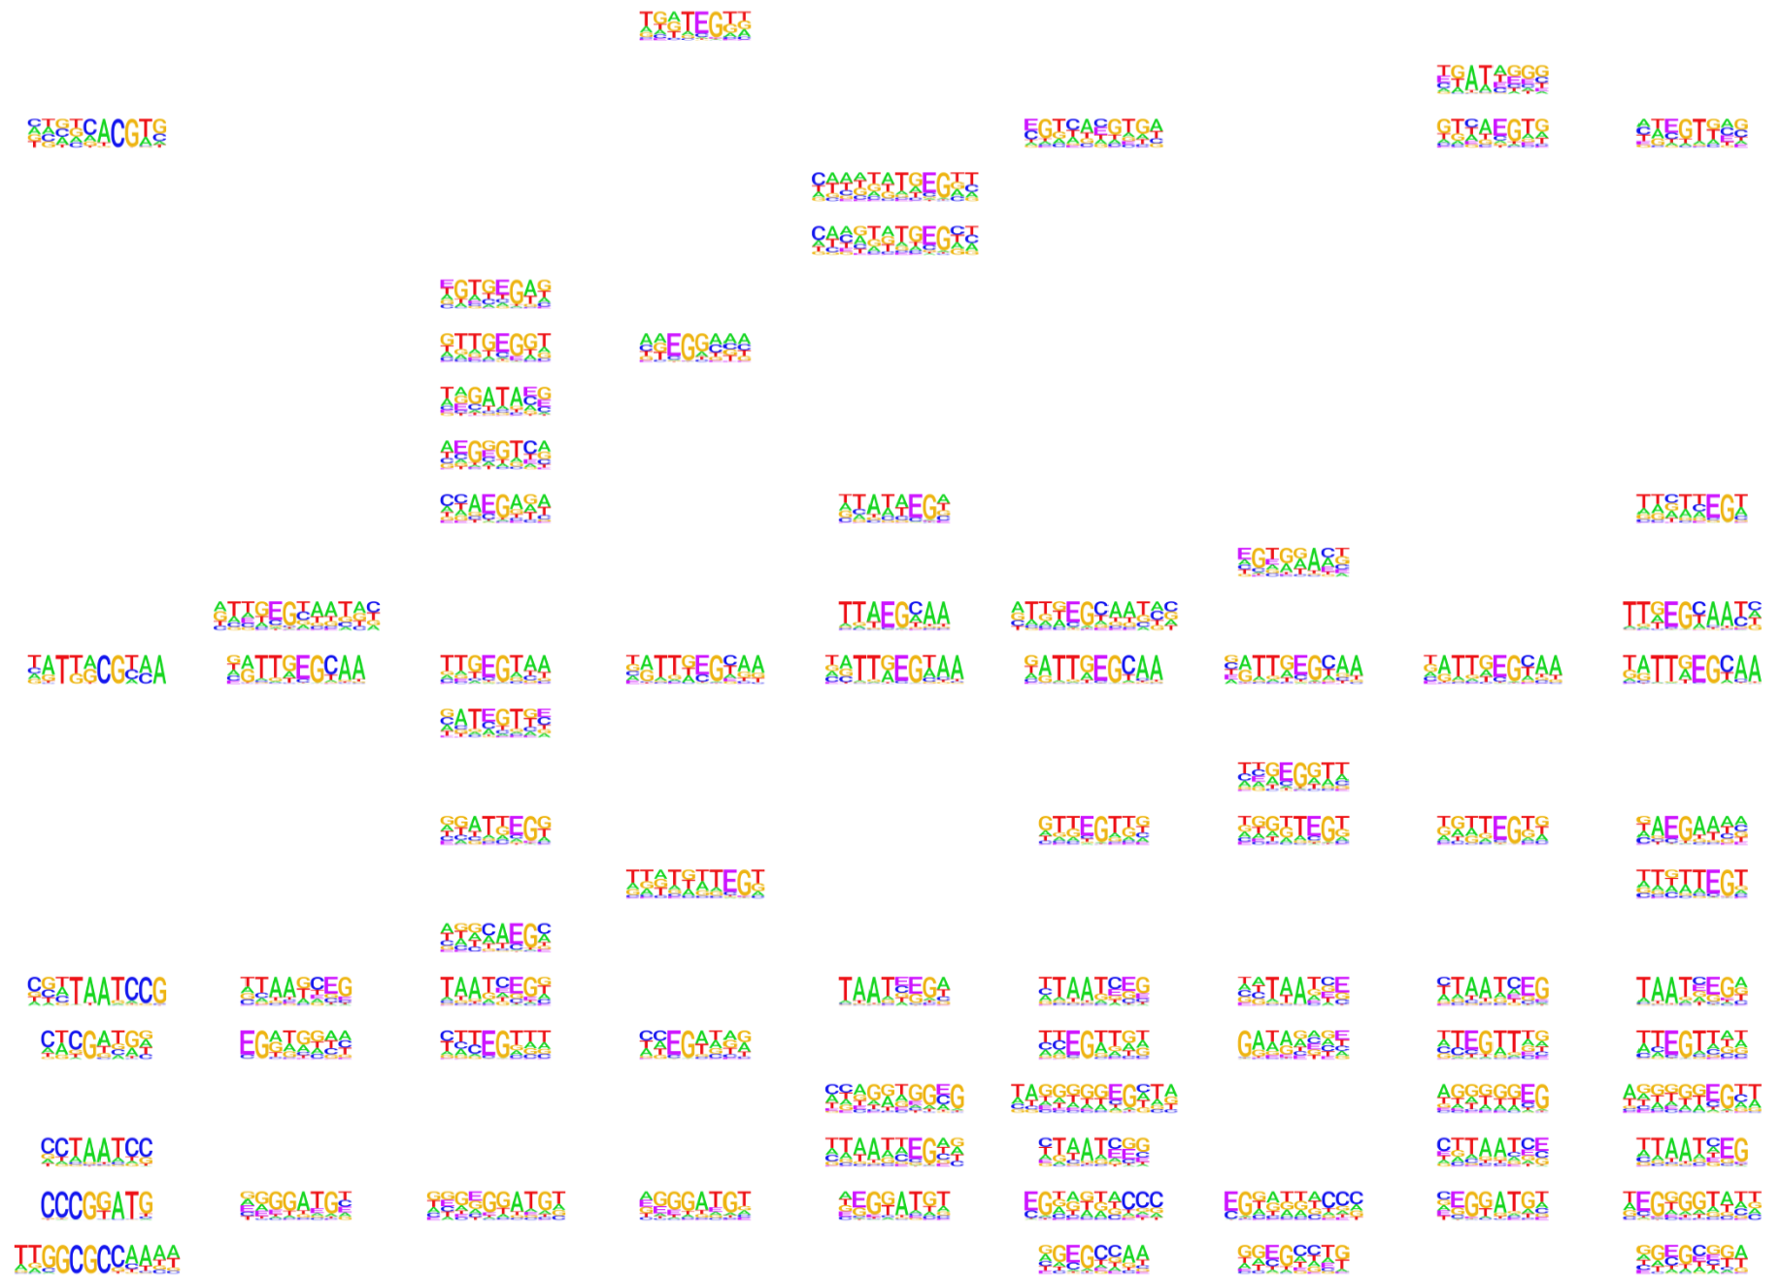
Supplementary Data 4. Identified readers for different symmetric and hemi modifications.
 | Unmodified | Symmetric-modified |  |  |  | Hemi-modified
 | C | mC | hmC | fC | caC | mC | hmC | fC | caC
ADNP
ARID3B
ARNT
ASCL1
ASCL2
ATF1
ATF2
BLOC1S1
BRD9
BTF3
CBFA2T3
CEBPB
CEBPG
CHD4
CIZ1
CNBP
CPSF4
CREB1
CRX
CSDA
CTCF
DMBX1
DMTF1
E2F1
Notes:
USF1 229/29758, overlap enhance 且enhance 有gene link的是10个 map to 197 genes. Peaks overlap 27 gene promtors
USF2 68/6948, overlap enhance 且enhance 有gene link的是4个 map to 27 genes. Peaks overlap 27 gene promtors

Slide 2
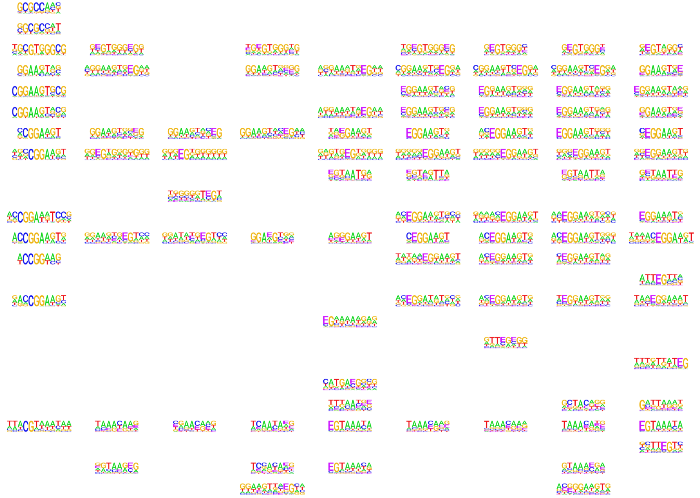
 | Unmodified | Symmetric-modified |  |  |  | Hemi-modified
 | C | mC | hmC | fC | caC | mC | hmC | fC | caC
E2F4
E2F5
EGR2
ELF1
ELF2
ELF4
ELK1
ELK3
EN2
ENO1
ERG
ETS1
ETV4
EZH2
FEV
FEZF2
FKBP1A
FOSL1
FOSL2
FOXA3
FOXC2
FOXP3
FOXP4
GABPA
Notes:
USF1 229/29758, overlap enhance 且enhance 有gene link的是10个 map to 197 genes. Peaks overlap 27 gene promtors
USF2 68/6948, overlap enhance 且enhance 有gene link的是4个 map to 27 genes. Peaks overlap 27 gene promtors

Slide 3
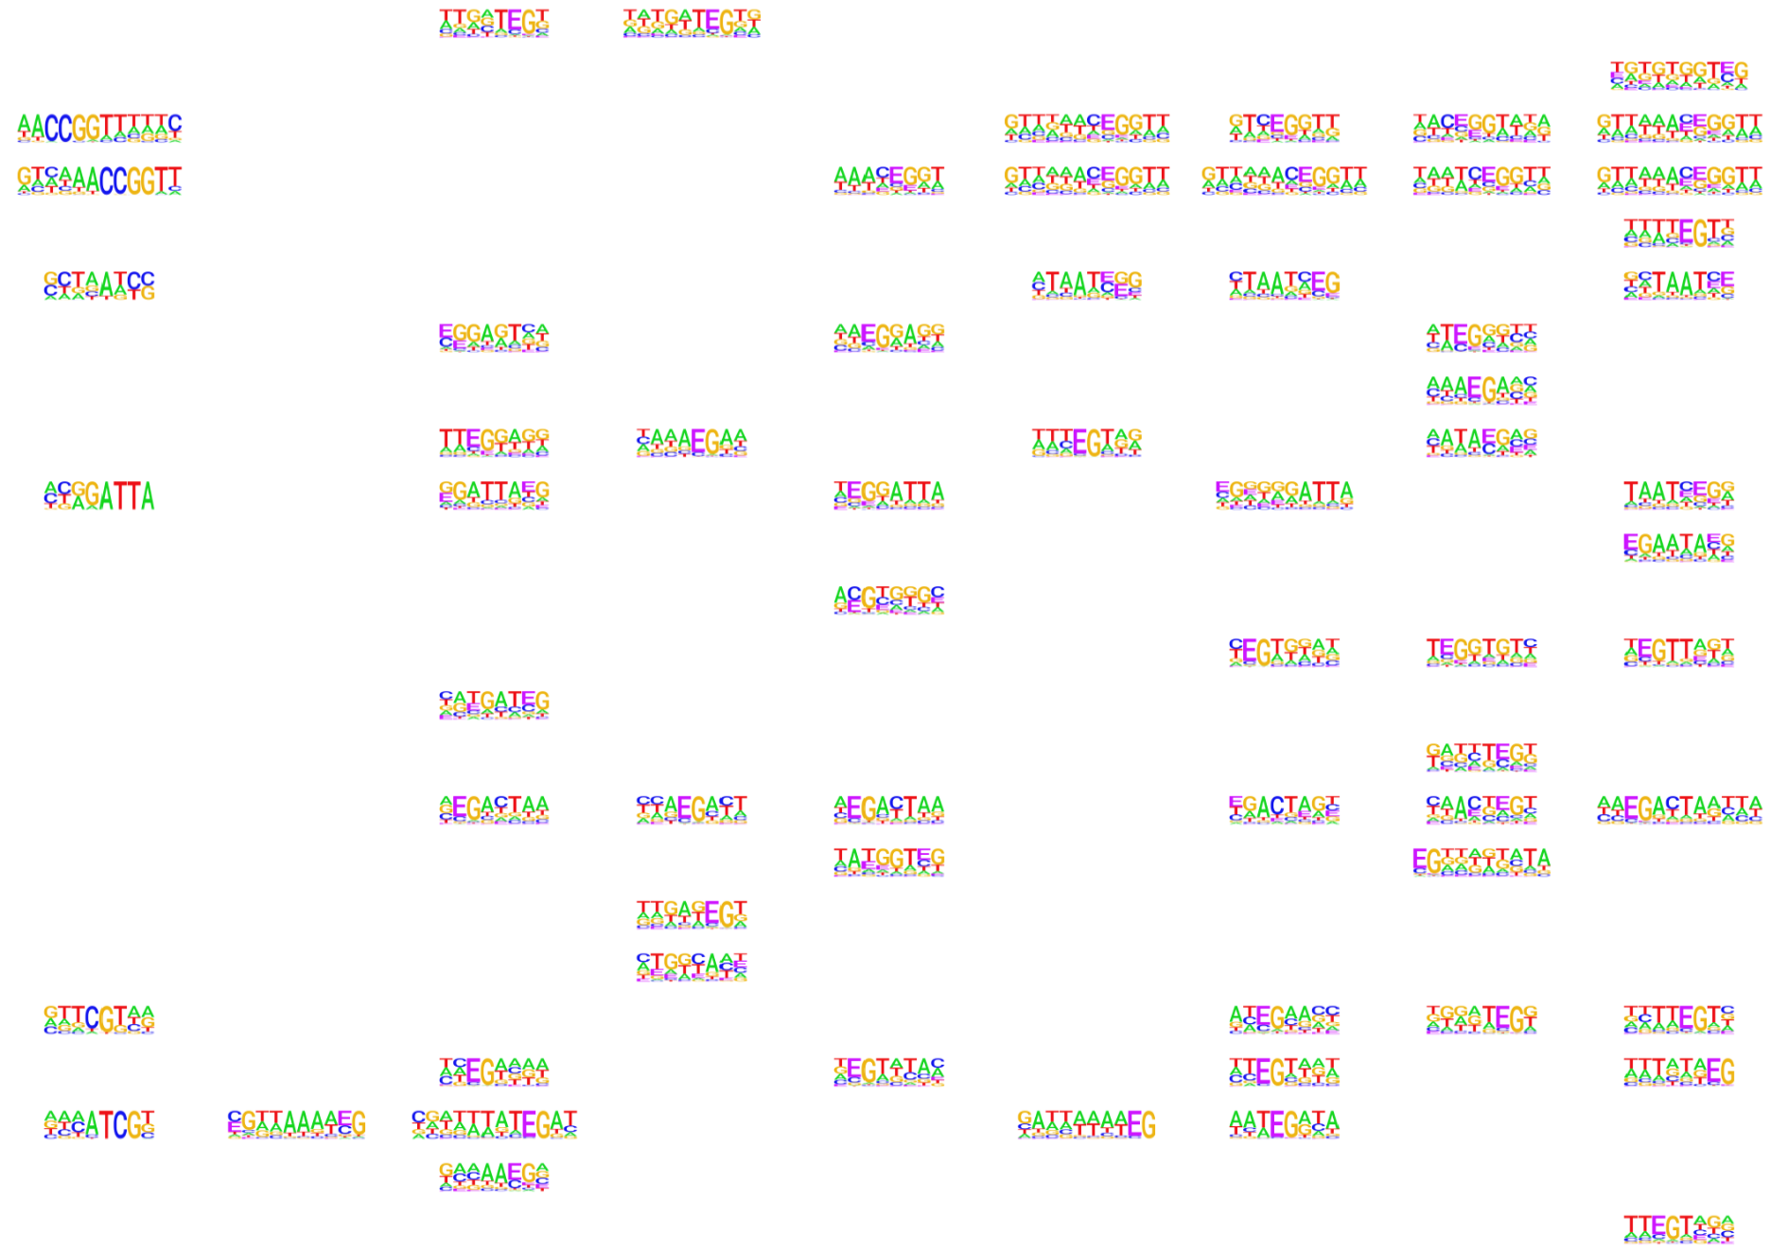
 | Unmodified | Symmetric-modified |  |  |  | Hemi-modified
 | C | mC | hmC | fC | caC | mC | hmC | fC | caC
GATAD2A
GLI3
GRHL1
GRHL2
GRHL3
GSC
GTF2B
GTF2F2
GTF2I
GTF2IRD1
HCLS1
HES1
HEXIM1
HIC2
HKR1
HMBOX1
HMG20A
HMGA1
HMGB1
HMGN2
HMGN5
HOMEZ
HOXB1
HOXB6
Notes:
USF1 229/29758, overlap enhance 且enhance 有gene link的是10个 map to 197 genes. Peaks overlap 27 gene promtors
USF2 68/6948, overlap enhance 且enhance 有gene link的是4个 map to 27 genes. Peaks overlap 27 gene promtors

Slide 4
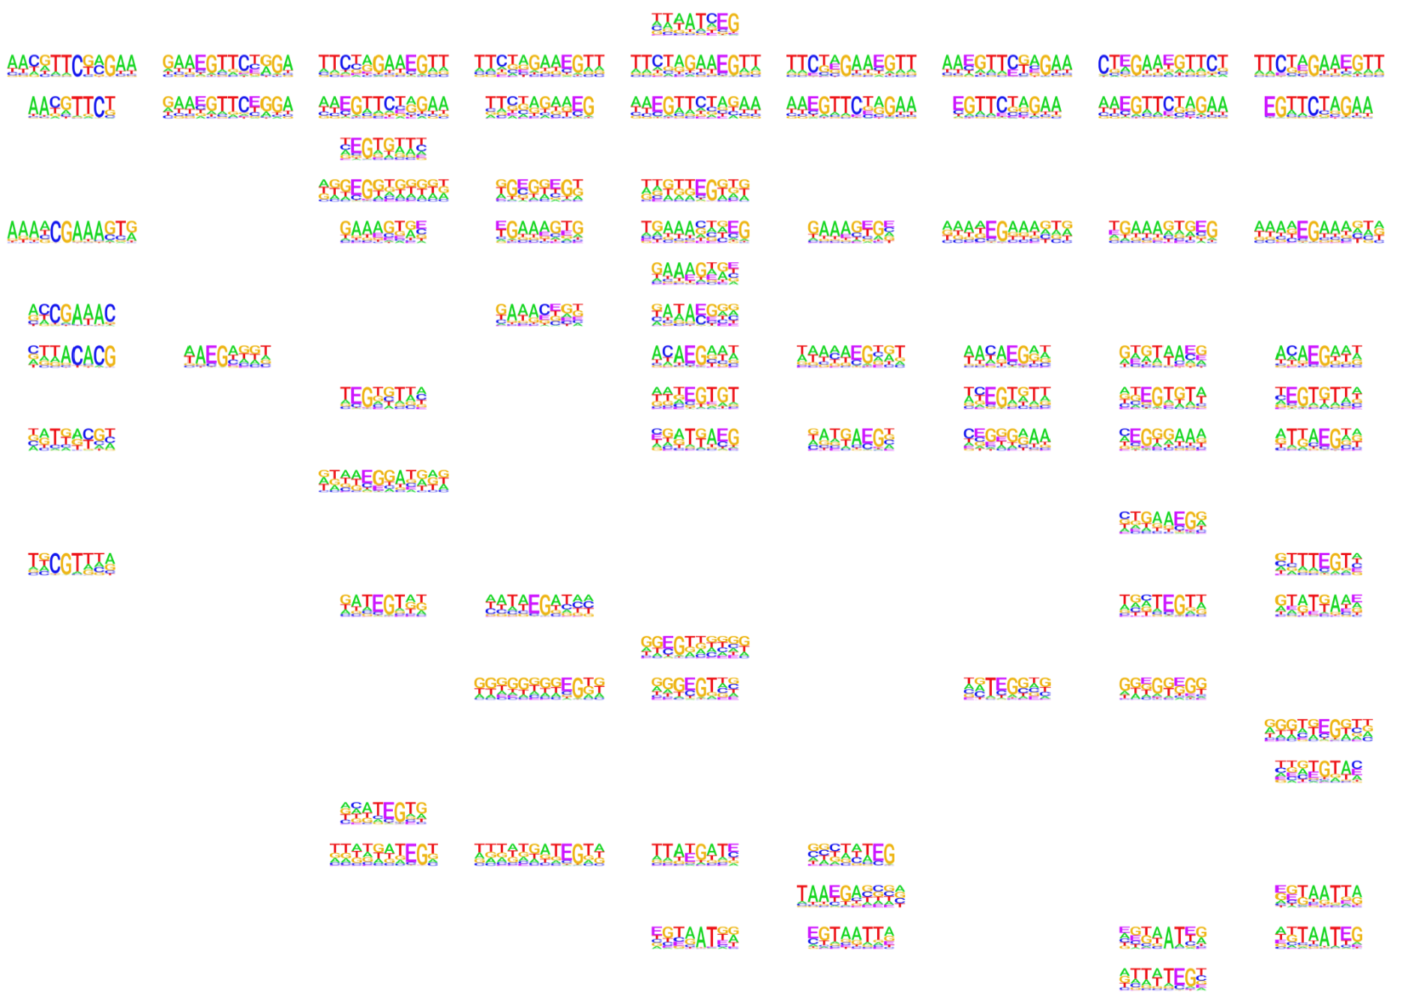
 | Unmodified | Symmetric-modified |  |  |  | Hemi-modified
 | C | mC | hmC | fC | caC | mC | hmC | fC | caC
HOXC8
HSF1
HSF2
ILF2
ILF3
IRF2
IRF3
IRF6
IRX2
IRX3
JDP2
KBTBD10
KCNIP2
KDM4D
KHDRBS1
KLF12
KLF15
KLF3
KLHL36
KLHL4
LARP1
LHX2
LHX4
LHX5
Notes:
USF1 229/29758, overlap enhance 且enhance 有gene link的是10个 map to 197 genes. Peaks overlap 27 gene promtors
USF2 68/6948, overlap enhance 且enhance 有gene link的是4个 map to 27 genes. Peaks overlap 27 gene promtors

Slide 5
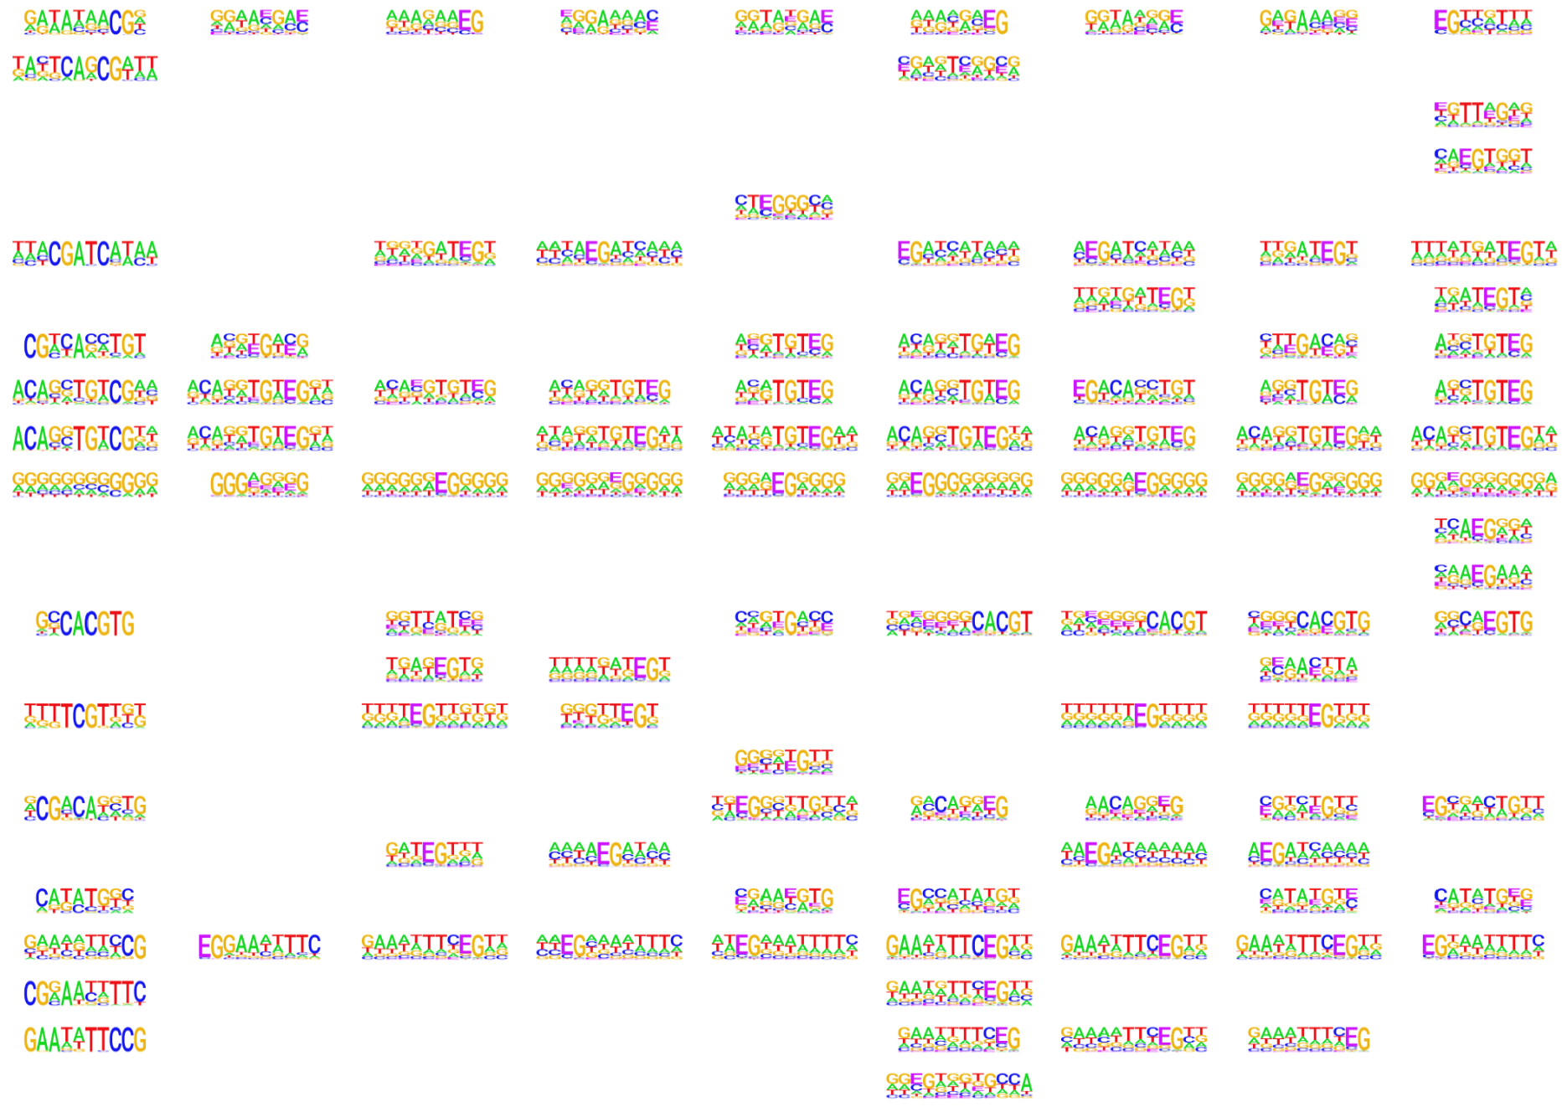
 | Unmodified | Symmetric-modified |  |  |  | Hemi-modified
 | C | mC | hmC | fC | caC | mC | hmC | fC | caC
LIN28A
MAFG
MAGEA4
MAX
MAZ
MBD4
MECP2
MEIS1
MEIS2
MEIS3
METTL3
MITF
MLLT3
MLX
MNDA
MYEF2
MYF6
MYOD1
NCOA3
NEUROD2
NFATC1
NFATC3
NFATC4
NFIA
Notes:
USF1 229/29758, overlap enhance 且enhance 有gene link的是10个 map to 197 genes. Peaks overlap 27 gene promtors
USF2 68/6948, overlap enhance 且enhance 有gene link的是4个 map to 27 genes. Peaks overlap 27 gene promtors

Slide 6
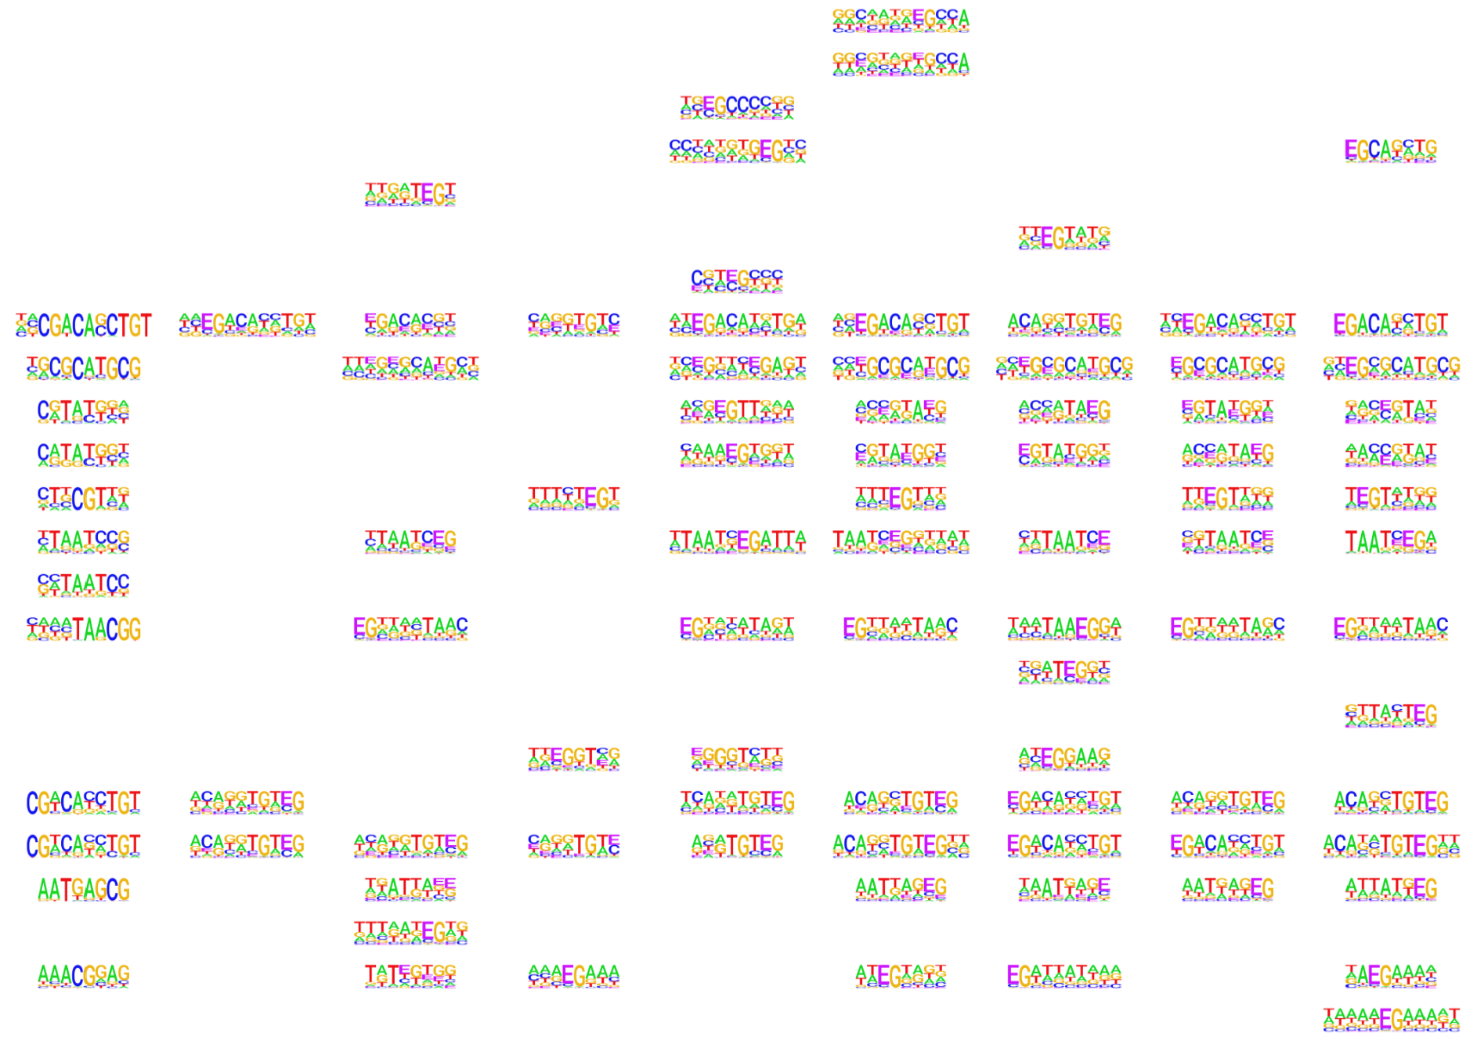
 | Unmodified | Symmetric-modified |  |  |  | Hemi-modified
 | C | mC | hmC | fC | caC | mC | hmC | fC | caC
NFIC
NFIX
NHLH1
NHLH2
NKX2
NR1D1
NR2C2
NR2E1
NRF1
OLIG2
OLIG3
OTUD4
OTX1
OTX2
OVOL2
PBX2
PIR
PITX1
PKNOX1
PKNOX2
POU6F1
PPARG
PPP1R13L
PRDM1
Notes:
USF1 229/29758, overlap enhance 且enhance 有gene link的是10个 map to 197 genes. Peaks overlap 27 gene promtors
USF2 68/6948, overlap enhance 且enhance 有gene link的是4个 map to 27 genes. Peaks overlap 27 gene promtors

Slide 7
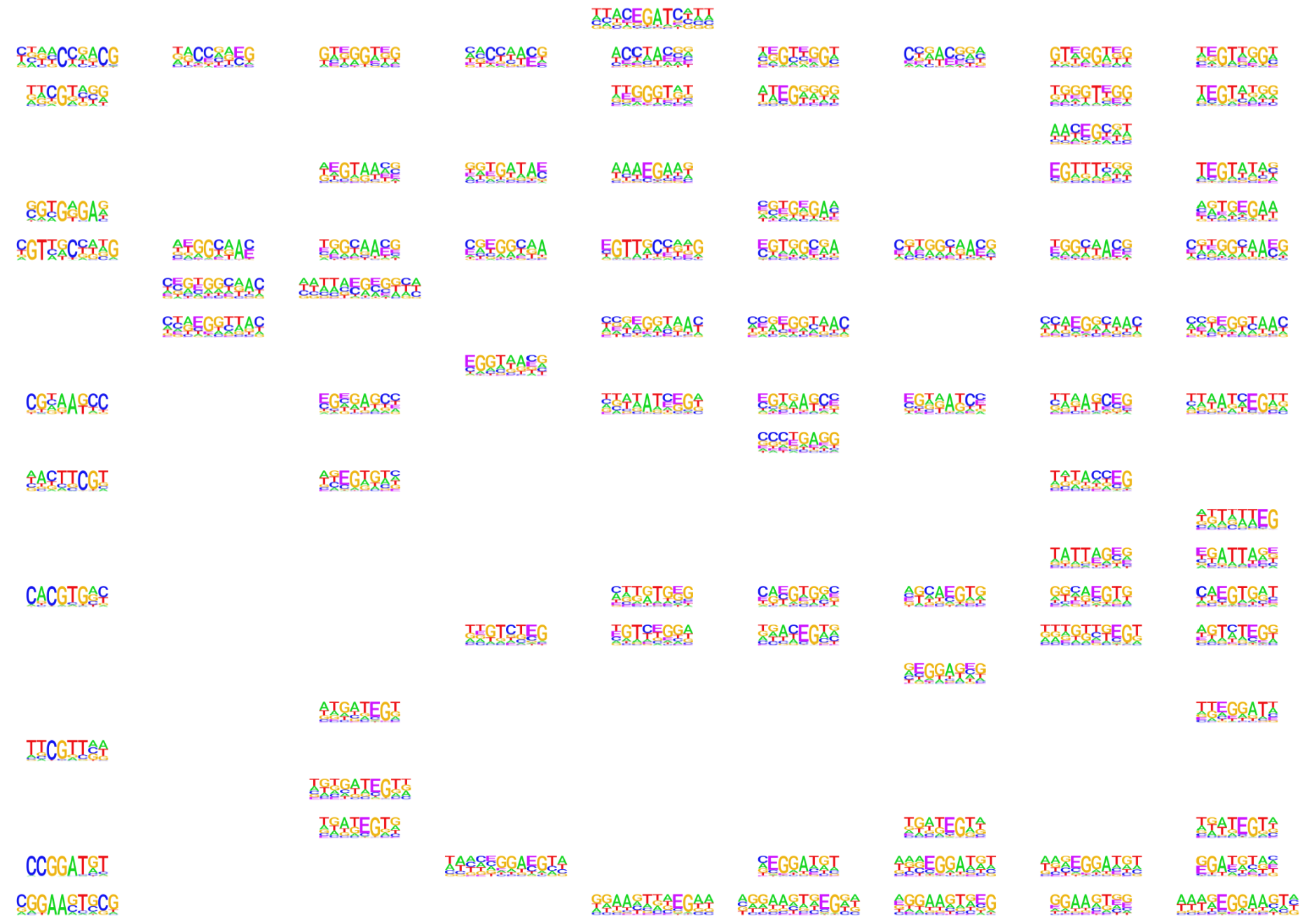
 | Unmodified | Symmetric-modified |  |  |  | Hemi-modified
 | C | mC | hmC | fC | caC | mC | hmC | fC | caC
PRDM16
PURA
PURG
RAB18
RAN
RBPJ
RFX2
RFX3
RFX4
RFX5
RHOXF1
RNF135
RXRA
RXRG
SATB2
SFMBT1
SMAD3
SMAD6
SMARCC1
SMARCE1
SNAI3
SOX5
SPDEF
SPI1
Notes:
USF1 229/29758, overlap enhance 且enhance 有gene link的是10个 map to 197 genes. Peaks overlap 27 gene promtors
USF2 68/6948, overlap enhance 且enhance 有gene link的是4个 map to 27 genes. Peaks overlap 27 gene promtors

Slide 8
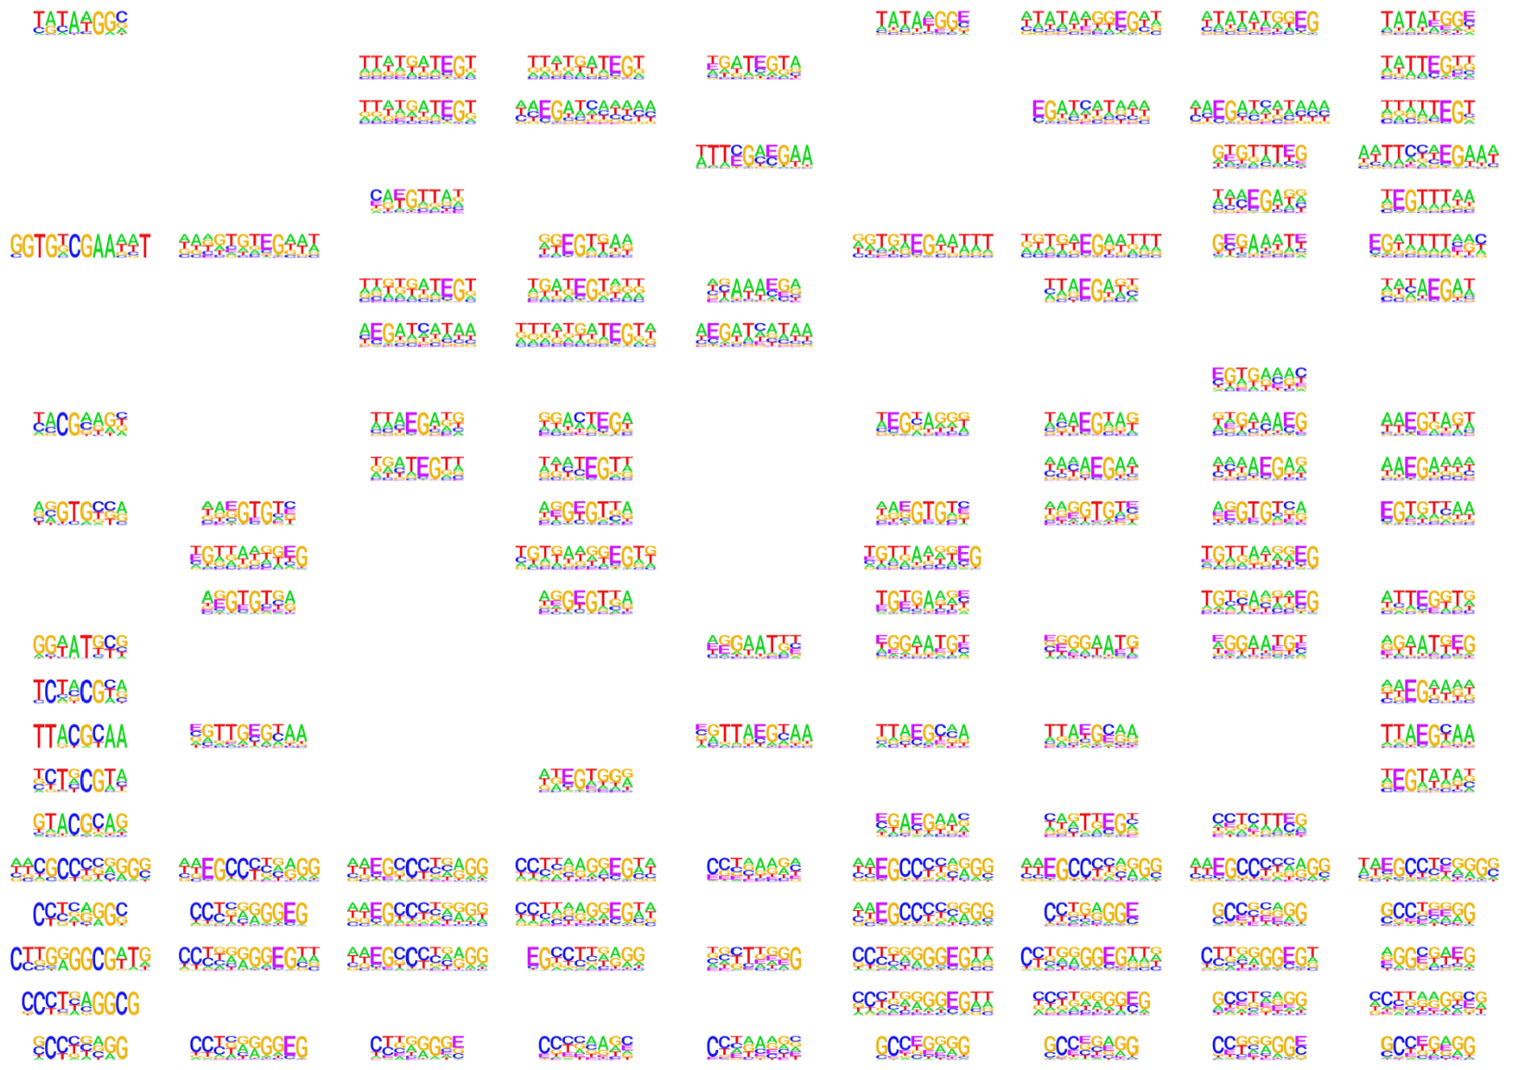
 | Unmodified | Symmetric-modified |  |  |  | Hemi-modified
 | C | mC | hmC | fC | caC | mC | hmC | fC | caC
SRF
SSX3
SSX4
STAT5A
SUPT5H
TBXT
TAF7
TAF9
TAL1
TAL2
TARP
TBX2
TBX20
TBX3
TEAD2
TEAD4
TEF
TERF1
TFAM
TFAP2A
TFAP2B
TFAP2C
TFAP2D
TFAP2E
Notes:
USF1 229/29758, overlap enhance 且enhance 有gene link的是10个 map to 197 genes. Peaks overlap 27 gene promtors
USF2 68/6948, overlap enhance 且enhance 有gene link的是4个 map to 27 genes. Peaks overlap 27 gene promtors

Slide 9
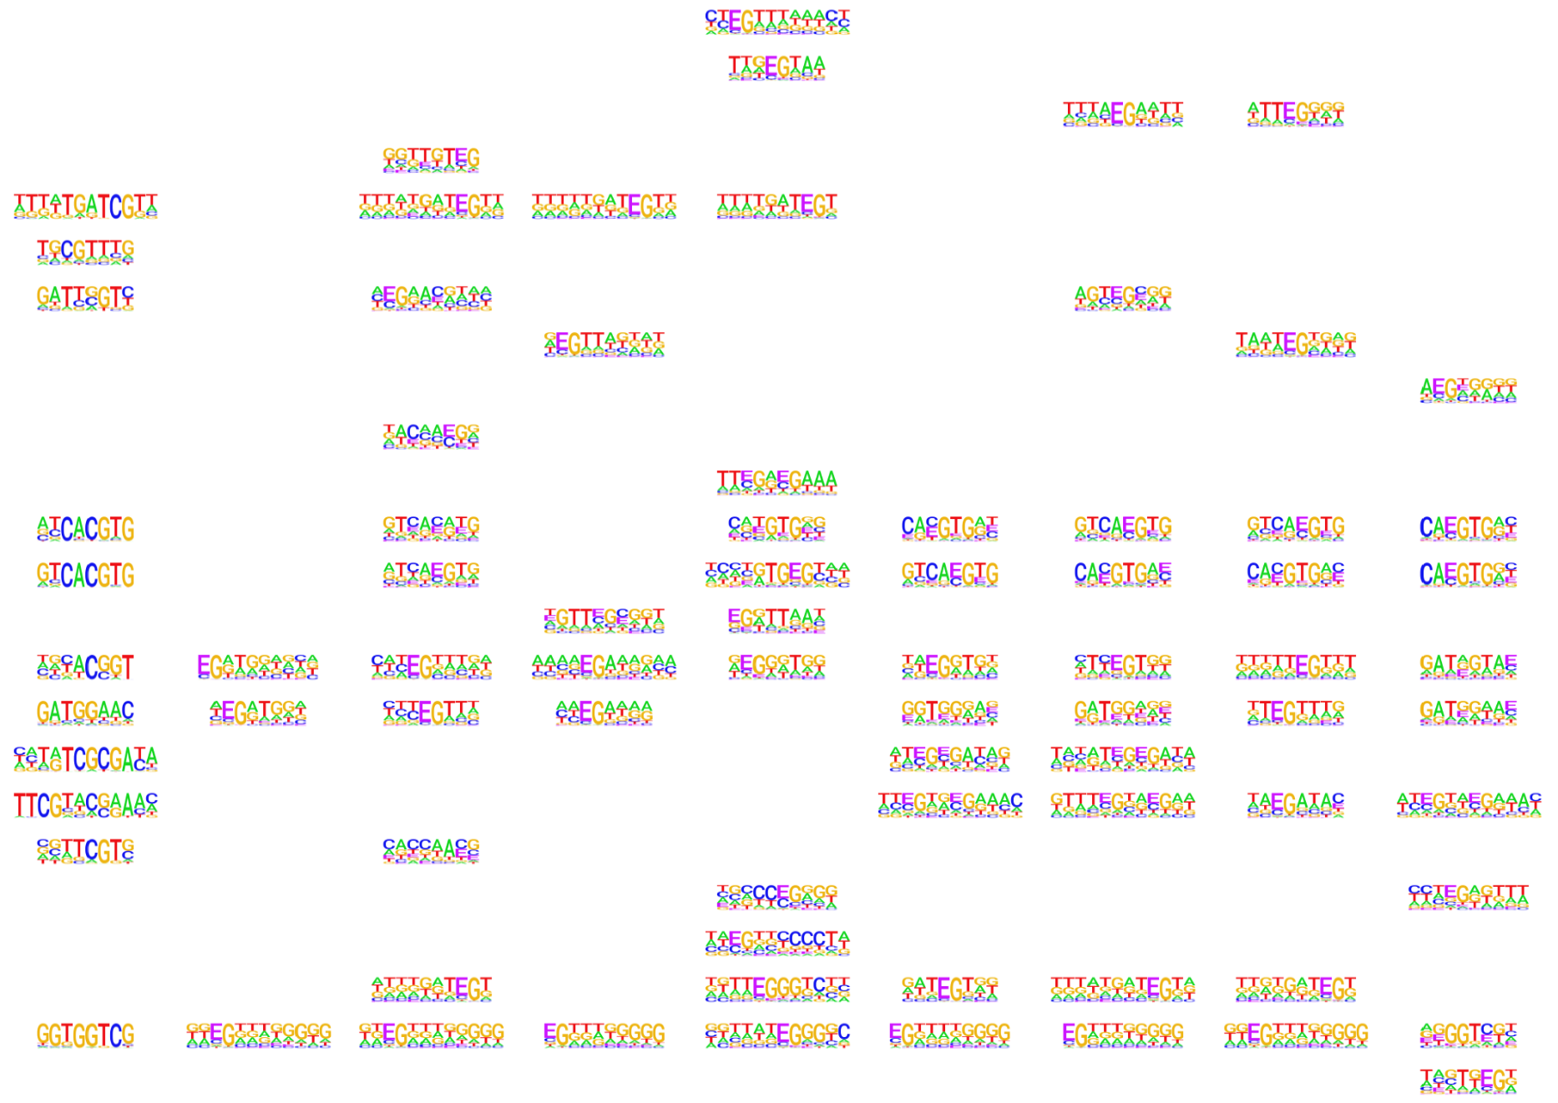
 | Unmodified | Symmetric-modified |  |  |  | Hemi-modified
 | C | mC | hmC | fC | caC | mC | hmC | fC | caC
TFCP2
TFDP2
TGIF2LX
TIMELESS
TP53
TRIM24
TRIM28
TRIM32
TRIM69
TSNAX
TULP4
USF1
USF2
WBP11
YBX1
YBX2
ZBED1
ZBED2
ZBTB39
ZBTB46
ZBTB48
ZBTB7A
ZBTB7B
ZCCHC8
Notes:
USF1 229/29758, overlap enhance 且enhance 有gene link的是10个 map to 197 genes. Peaks overlap 27 gene promtors
USF2 68/6948, overlap enhance 且enhance 有gene link的是4个 map to 27 genes. Peaks overlap 27 gene promtors

Slide 10
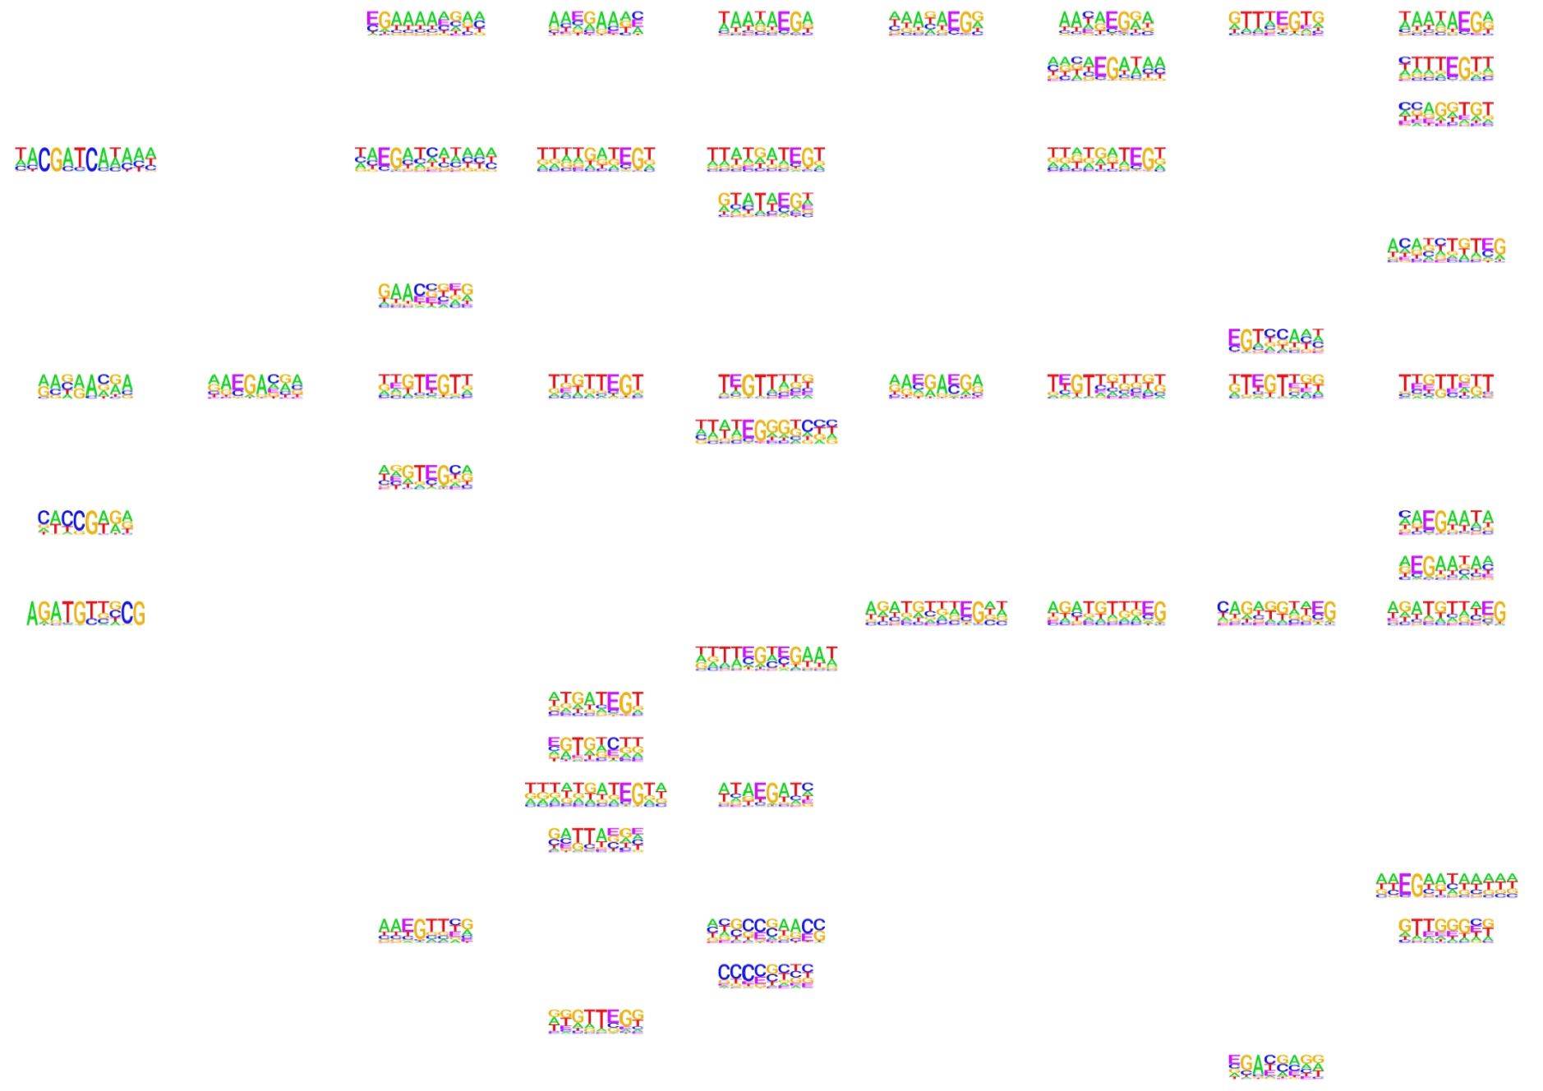
 | Unmodified | Symmetric-modified |  |  |  | Hemi-modified
 | C | mC | hmC | fC | caC | mC | hmC | fC | caC
ZCRB1
ZEB2
ZFP36L2
ZHX1
ZMYM3
ZNF140
ZNF177
ZNF180
ZNF187
ZNF19
ZNF207
ZNF213
ZNF232
ZNF238
ZNF256
ZNF26
ZNF280D
ZNF326
ZNF410
ZNF434
ZNF449
ZNF468
ZNF48
ZNF503
Notes:
USF1 229/29758, overlap enhance 且enhance 有gene link的是10个 map to 197 genes. Peaks overlap 27 gene promtors
USF2 68/6948, overlap enhance 且enhance 有gene link的是4个 map to 27 genes. Peaks overlap 27 gene promtors

Slide 11
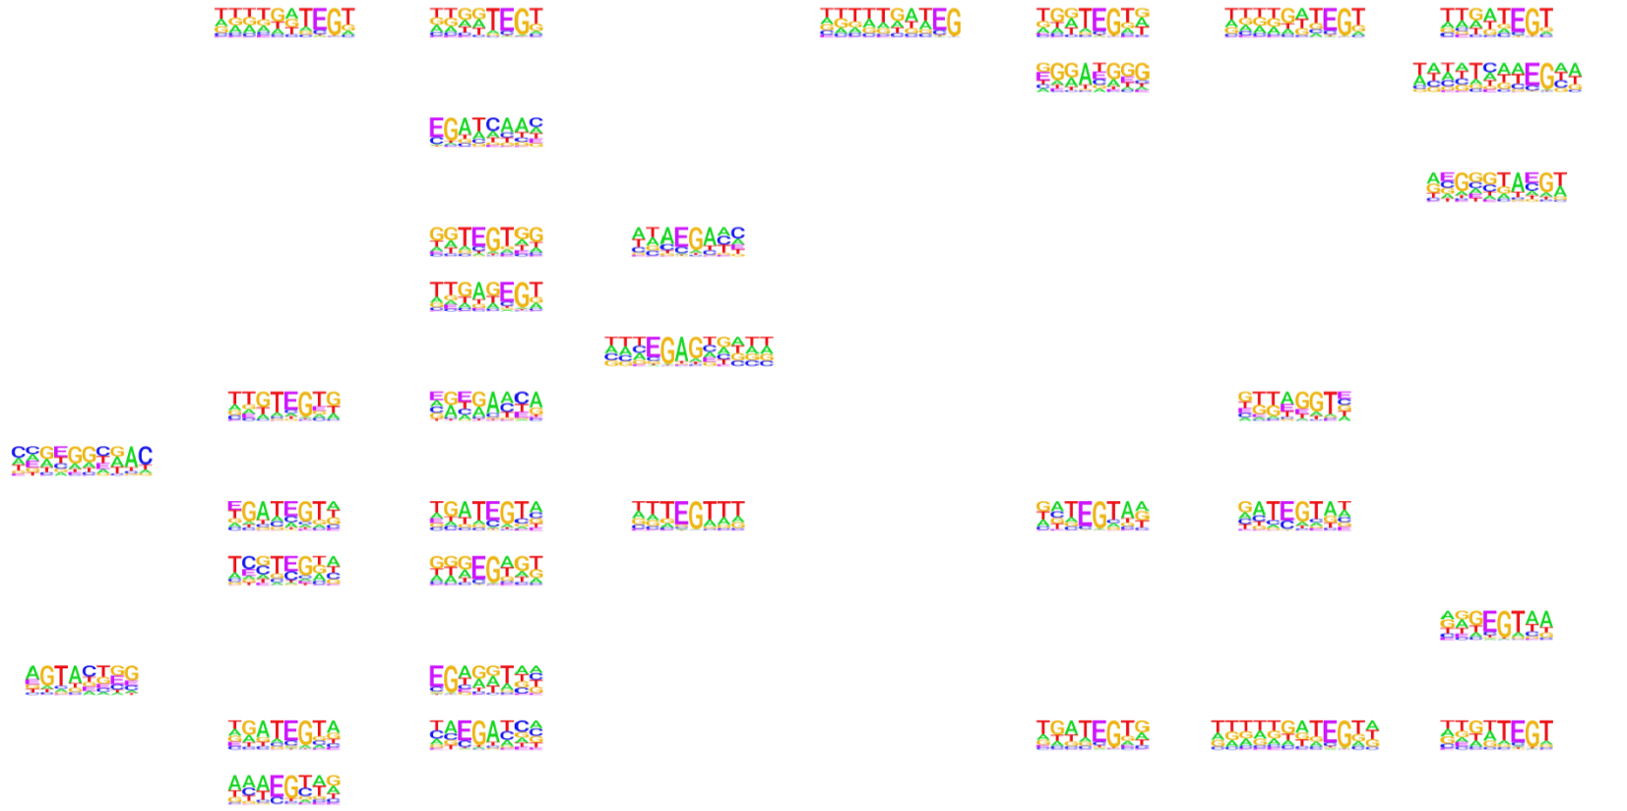
 | Unmodified | Symmetric-modified |  |  |  | Hemi-modified
 | C | mC | hmC | fC | caC | mC | hmC | fC | caC
ZNF518A
ZNF530
ZNF592
ZNF596
ZNF606
ZNF655
ZNF691
ZNF784
ZNF785
ZNF830
ZRANB2
ZSCAN20
ZSCAN21
ZSCAN5A
ZXDC
Notes:
USF1 229/29758, overlap enhance 且enhance 有gene link的是10个 map to 197 genes. Peaks overlap 27 gene promtors
USF2 68/6948, overlap enhance 且enhance 有gene link的是4个 map to 27 genes. Peaks overlap 27 gene promtors

