Slide 1
Supplementary Tables and Figures

Slide 2
Supplementary Table 1. Summarized clinical information of patients in the Tissue Microarray (TMA) from Baylor Scott and White Discovery cohort, examined using imaging mass cytometry (IMC) and Nanostring Geo Mx Digital Spatial Profiling (refer Supplementary Figure 1 for H&E images). The P values were calculated using two sided t-test for all variables except for median survival where the P value was calculated using log-rank test.
Variable | Black American (BA, n=26, Value ± SD) | White American (WA, n=31, Value ± SD) | P value BA vs WA
Age | 58.2 ± 10.89 | 60.06 ± 13.00 | 0.4
Regions of Interest (ROI) | 47 | 51
Tumor Center Immune Poor | 10 | 14
Tumor Center Immune Rich | 17 | 15
Tumor Periphery Immune Poor | 1 | 0
Tumor Periphery Immune Rich | 19 | 22
Tumor Grade |  |  | 0.06
Grade 1 | 0 | 1
Grade 2 | 2 | 7
Grade 3 | 24 | 23
Tumor Stage |  |  | 0.18
Stage 1 | 9 | 14
Stage 2 | 12 | 16
Stage 3 | 3 | 0
Stage 4 | 1 | 1
Unknown | 2 | 0
BMI | 35.14 ± 9.09 | 29.16 ± 6.09 | 0.07
Mets detected at surgical resection of primary tumor
Yes | 1 | 1
No | 25 | 30
Unknown | 0 | 0
Neoadjuvant Chemotherapy
Yes | 2 | 2
No | 24 | 29
TP53 Mutation H
Yes | 1 | 4
No | 25 | 27
PIK3CA Mutation H
Yes | 2 | 3
No | 14 | 11
Unknown | 10 | 17
PIK3CA Mutation E
Yes | 4 | 6
No | 12 | 8
Unknown | 10 | 17
Median Survival (months) | 131.5±61.5 | 126±44.6 | 0.51

Slide 3
Supplementary Table 2. Summarized clinical information of patients in the Tissue Microarray (TMA) from Roswell Park Validation cohort, examined using imaging mass cytometry (IMC). The P values were calculated using two sided t-test for all variables except for median survival where the P value was calculated using log-rank test.
Variable | Black American (n=15, Value ± SD) | White American (n=31, Value ± SD) | P value
Tumor Grade |  |  | 0.16
Grade 1 | 0 | 0
Grade 2 | 0 | 2
Grade 3 | 13 | 29
Unknown | 2 | 0
Tumor Stage |  |  | 0.10
Stage 1 | 3 | 9
Stage 2 | 6 | 18
Stage 3 | 5 | 4
Stage 4 | 1 | 0
Unknown | 0 | 0
AGE | 53.66 ± 14.54 | 56.83 ± 15.19 | 0.5
Median Survival (months) | 79.00 ± 38.09 | 98.00 ± 34.13 | 0.7

Slide 4
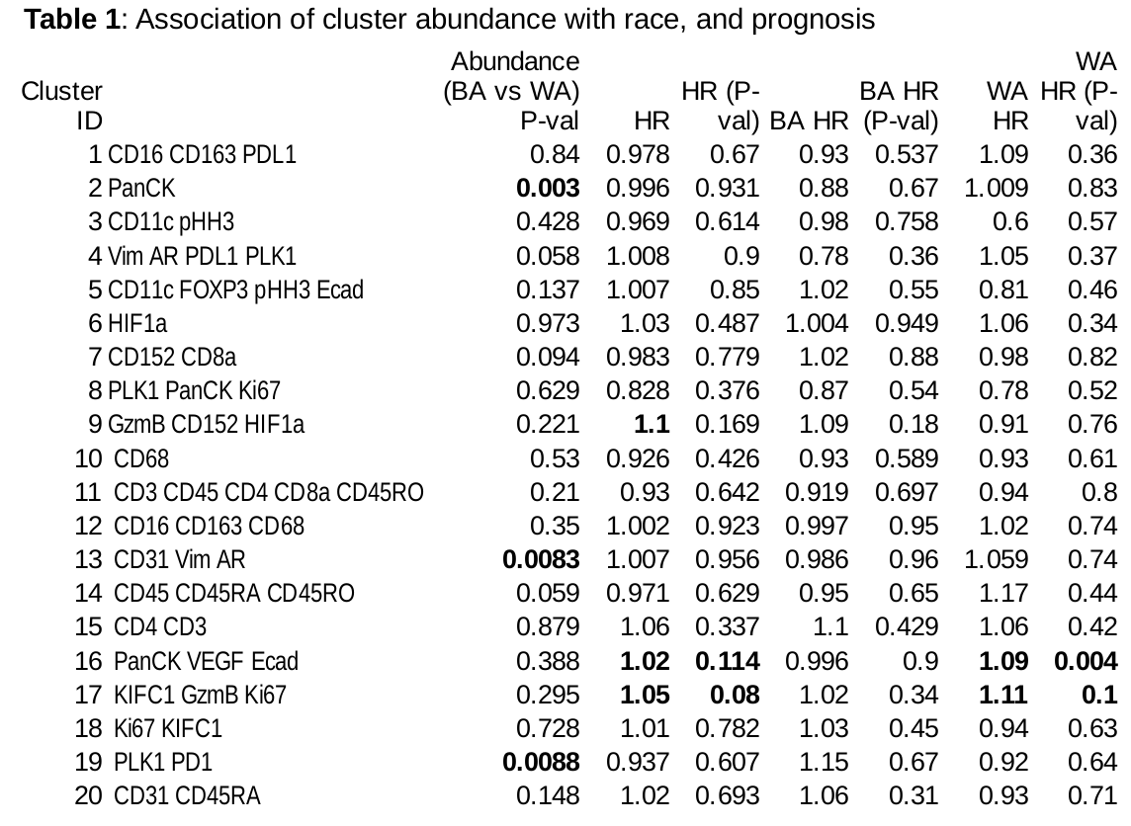
Supplementary Table 3. Association of cluster abundance with patient race and TNBC prognosis. P values in abundance are computed with t-test (1-sided). P values in HR comparisons are computed with Wald test (1-sided).

Slide 5
Supplementary Table 4: List of antibodies and the metal tags used for Imaging Mass Cytometry (IMC) analysis of BSW-Discovery samples examined in Tissue Microarray format.
Metal | Antibody
143Nd | Vimentin
144Nd | PLK1
145Nd | AR
146Nd | CD16
147Sm | CD163
148Nd | Pan Cytokeratin
150Nd | PD-L1
151Eu | CD31
152Sm | CD45
154Sm | CD11c
155Gd | FOXP3
156Gd | CD4
158Gd | E-Cadherin
159Tb | CD68
161Dy | CD152/CTLA4
162Dy | CD8a
163Dy | VEGF
164Dy | HIF1a
165Ho | PD-1
166Er | CD45RA
167Er | Granzyme B
168Er | Ki-67
170Er | CD3
173Yb | CD45RO
175Lu | KIFC1
176Yb | pHH3

Slide 6
Supplementary Table 5: List of antibodies and the metal tags used for Imaging Mass Cytometry (IMC) analysis of BSW2 validation samples
Metal Tag | Antibody
143Nd | Vimentin
144Nd | PLK1
145Nd | AR
146Nd | CD16
147Sm | CD163
148Nd | Pan Cytokeratin
149Sm | CD31
150Nd | PD-L1
151Eu | PD-1
152Sm | CD45
154Sm | CD11c
155Gd | FOXP3
156Gd | CD4
158Gd | E-Cadherin
159Tb | CD68
161Dy | CD152/CTLA4
162Dy | CD8a
163Dy | VEGF
164Dy | MPO
165Ho | HIF1a
166Er | CD45RA
167Er | Granzyme B
168Er | Ki-67
170Er | CD3
173Yb | CD45RO
175Lu | KIFC1
176Yb | pHH3

Slide 7
Supplementary Table 6: List of antibodies and the metal tags used for Imaging Mass Cytometry (IMC) analysis of Roswell Park validation samples
Metal Tag | Antibody
143Nd | Vimentin
144Nd | PLK1
145Nd | AR
146Nd | CD16
147Sm | CD163
148Nd | Pan Cytokeratin
149Sm | CD31
150Nd | PD-L1
151Eu | PD-1
152Sm | CD45
154Sm | CD11c
155Gd | FOXP3
156Gd | CD4
158Gd | E-Cadherin
159Tb | CD68
160Gd | CD14
161Dy | CD152/CTLA4
162Dy | NOS2
163Dy | VEGF
164Dy | MPO
165Ho | HIF1a
166Er | CD45RA
167Er | Granzyme B
168Er | Ki-67
169Tm | Arginase-1
170Er | CD3
173Yb | CD45RO
175Lu | KIFC1
176Yb | pHH3
Pr141 | CD8a
Nd142 | CD20

Slide 8
TMA 1 TMA 2 TMA 4 TMA 6
TMA 7 TMA 8 TMA 9 TMA 10
Supplementary Figure 1. Hematoxylin Eosin (H&E) images of tissue microarrays (n=8) containing the 57 TNBC patient-derived tumors analyzed by Immune mass cytometry (IMC) and Nanostring GeoMx whole transcriptome analysis, in this study. Black boxes represent the tissues that were analyzed using IMC and Nanostring GeoMx. The ROI markings for the analyzed tissues are shown in Supplementary Figure 2.

Slide 9
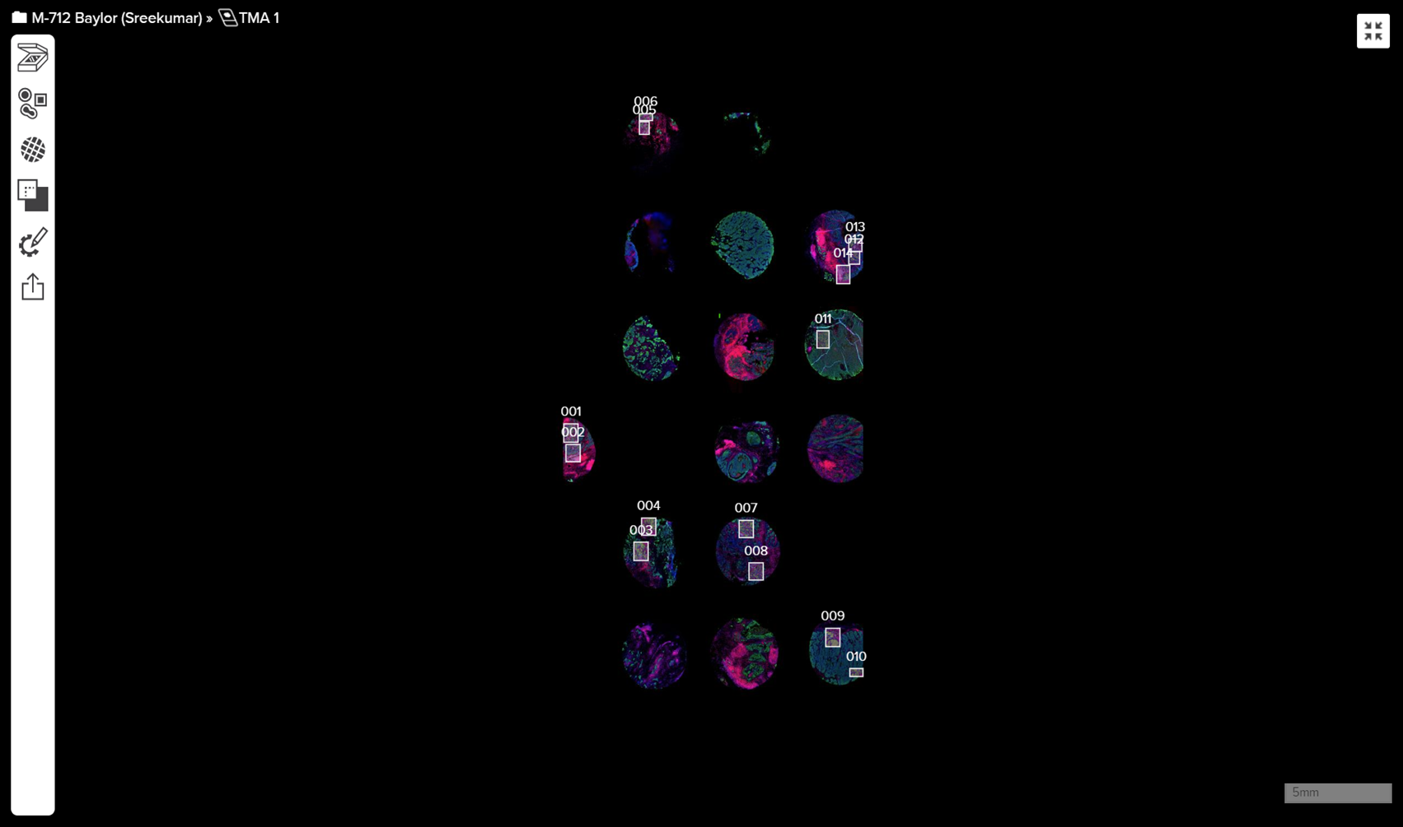
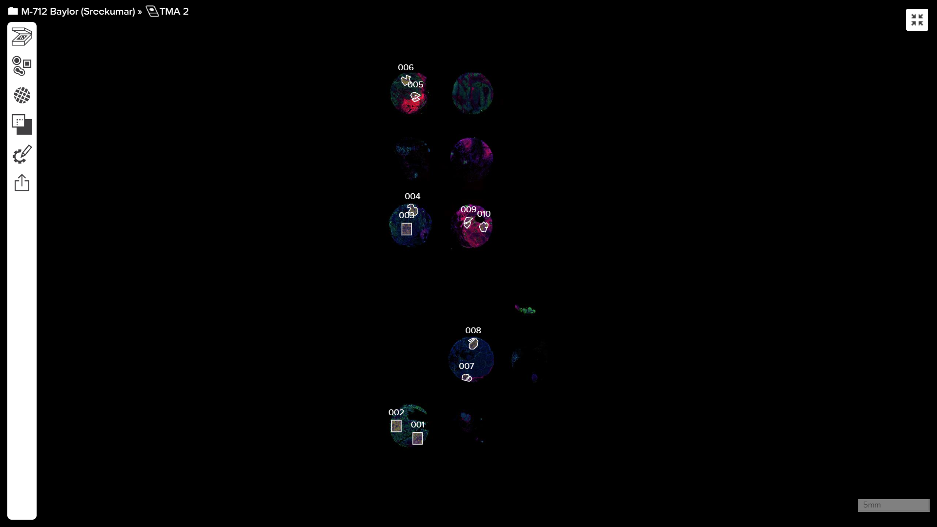
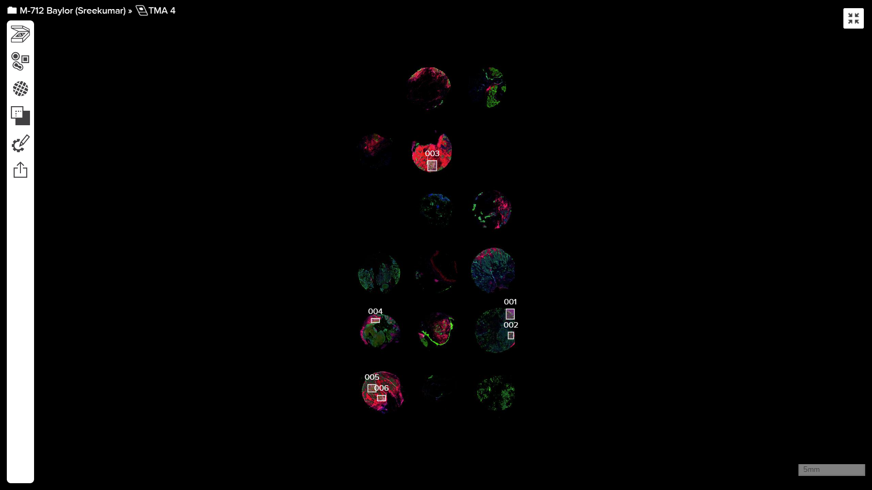
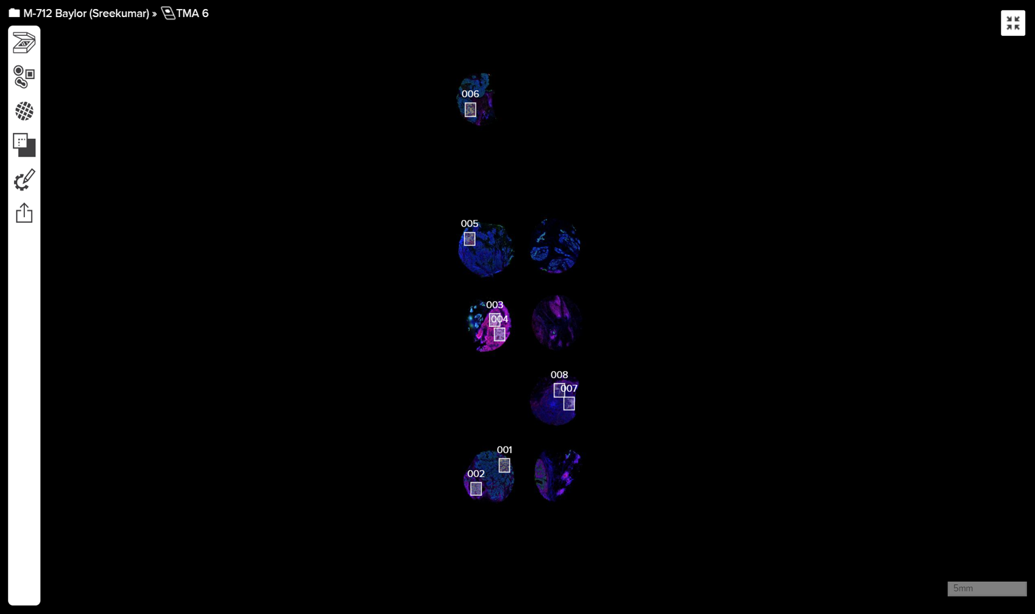
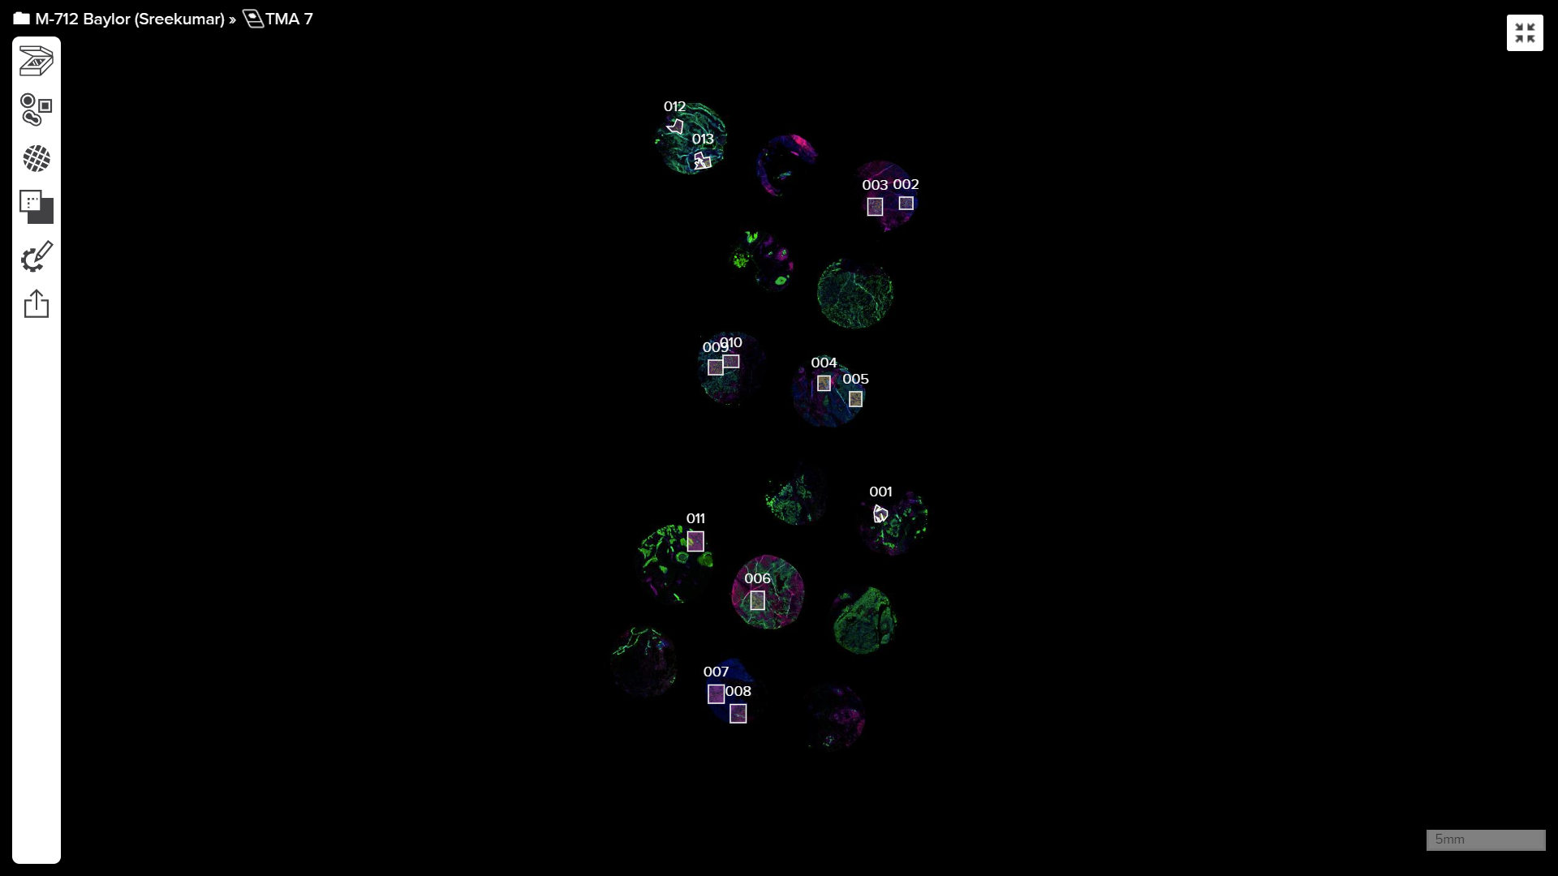
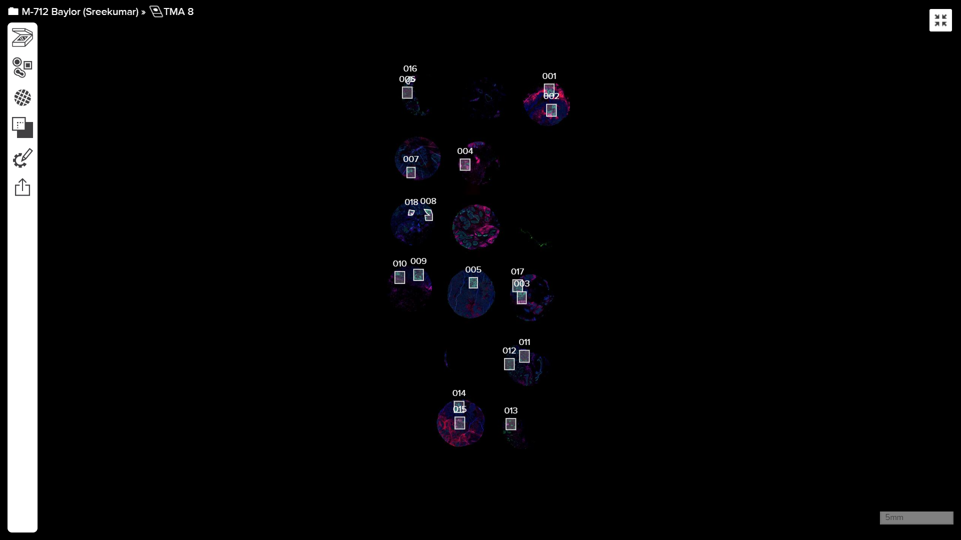
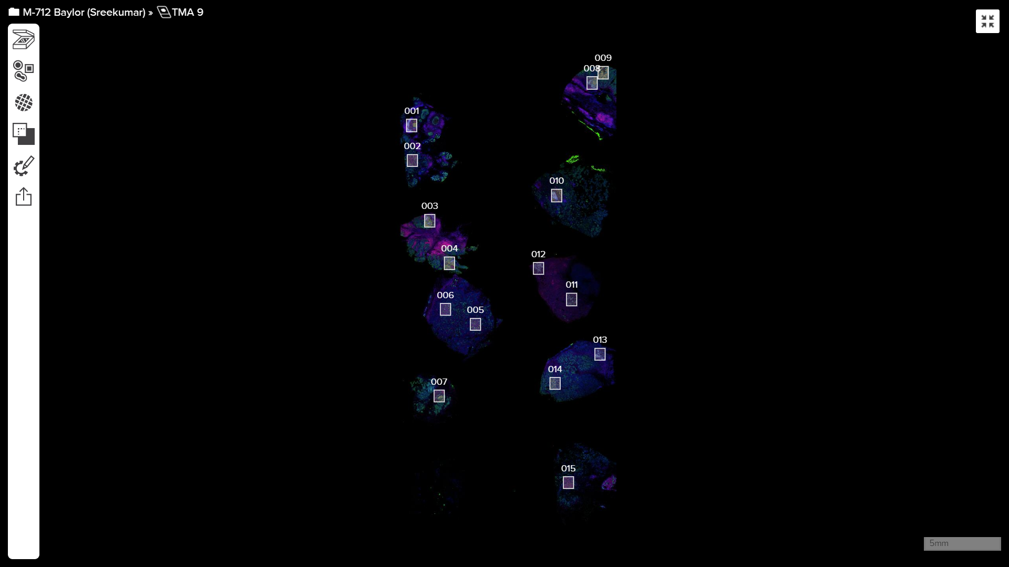
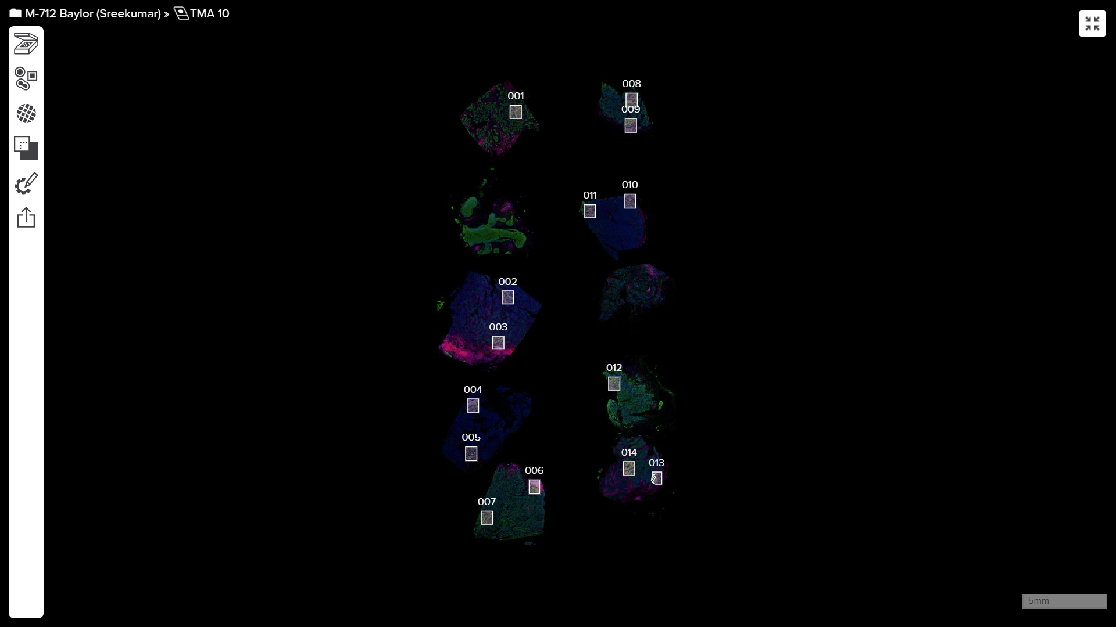
TMA 1
TMA 2
TMA 4
TMA 6
TMA 7
TMA 8
TMA 9
TMA 10
Supplementary Figure 2. Photomicrographs of tissue microarrays (n=8) containing the 57 TNBC patient-derived tumors analyzed by Immune mass cytometry (IMC) and Nanostring GeoMx whole transcriptome analysis, in this study. Boxes represent the regions of interest (ROI) that were analyzed using IMC and Nanostring GeoMx. Each slide was stained using Pan-Cytokeratin (PanCK, green) marking epithelial cells and CD45 (red) marking immune cells. In majority of the tissues 2 ROIs were analyzed using IMC and Nanostring GeoMx platforms. The only ROI that was marked TPIP is in TMA 1 marked as ROI number 004 in the figure.

Slide 10
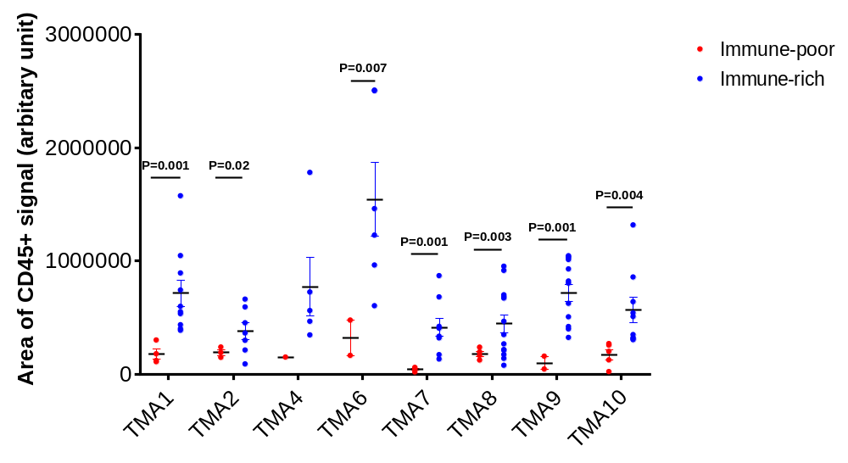
Supplementary Figure 3. Dot plot showing the total area of CD45+ signal (quantified by Image J software) measuring the total immune cells within each Region Of Interest (ROI) within each tumor, in each of the Tissue Microarrays (TMAs) that were analyzed. Each dot represents a single ROI where, red dots represent the Immune-poor ROIs and blue dots represent Immune-rich ROIs. Immune rich and immune poor ROIs were originally defined by assessment of H&E images by two independent breast pathologists and were quantified separately. For every TMA, significantly more immune cells were quantified in immune rich vs immune poor ROIs. Data are presented as dots in each series with mean values represented by a line and SEM as error bars. Statistical significance computed using Unpaired t-test with Welch’s correction. Source data are provided as a Source Data file.

Slide 11
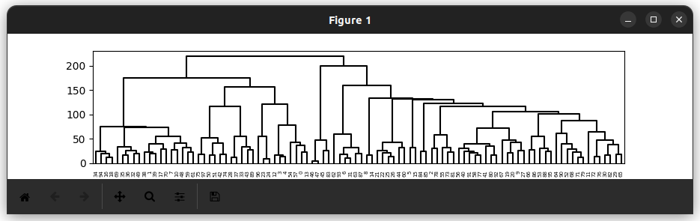
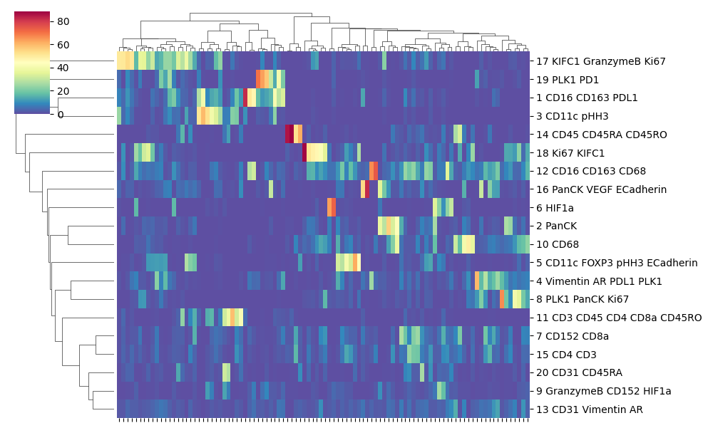
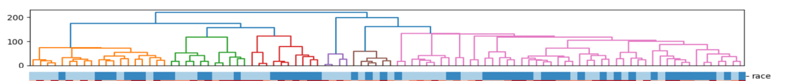
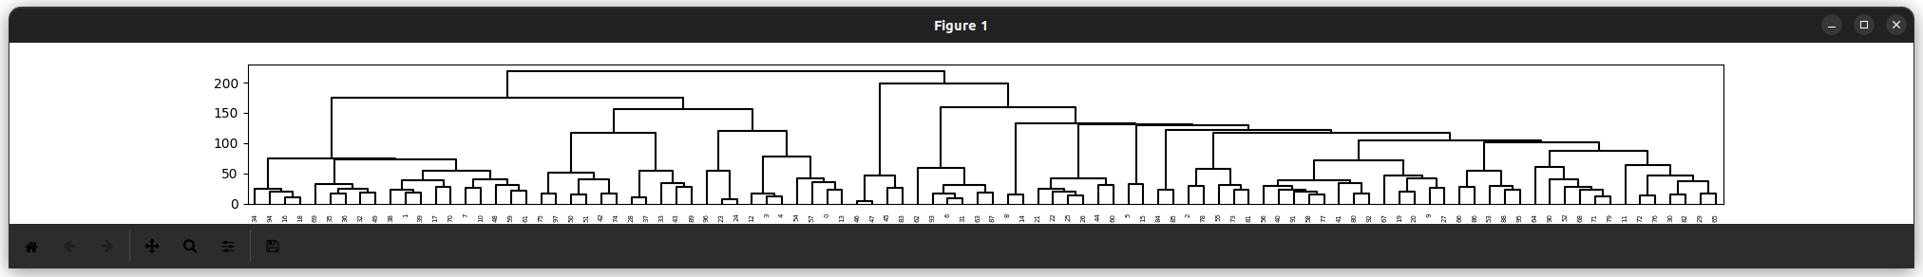
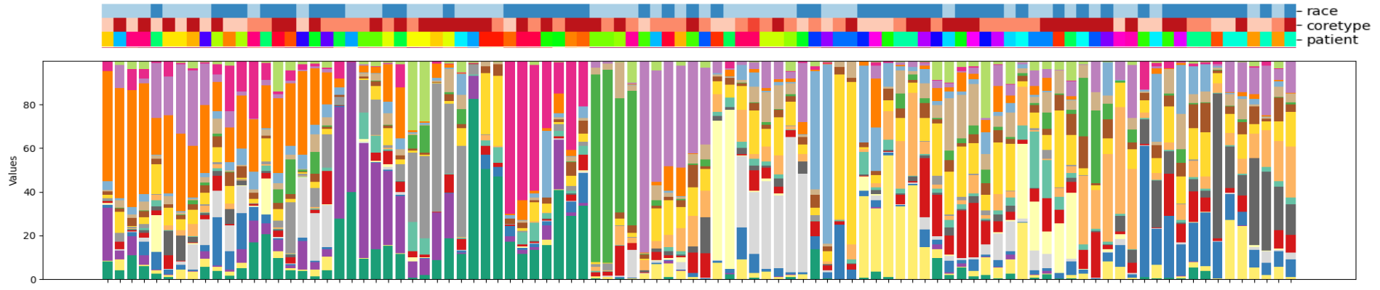
a
Proportion
Race of patient ROI
BA
WA
b
Coretype
Patient ROIs
Race
TCIP
TPIR
TCIR
Patients
BA
WA
Stacked Proportion
Patient ROIs
BA-specific
5 CD11c FOXP3 pHH3 ECadherin
20 CD31 CD45RA
WA-specific
7 CD152 CD8a
19 PLK1 PD1
Supplementary Figure 4. a) Hierarchical heat map showing the relative abundance of the 20 single-cell clusters in BA and WA TNBC. Relative abundance is expressed as proportion of total number of cells per ROI belong to each cluster. b) Stacked bar plot showing the distribution of the 20 single-cell clusters in each region of interest (ROI) within the BA and WA TNBC tissues. Two ROIs were examined in majority of the BA and WA TNBC tumors. Clusters that are slightly more abundant in subsets of BA or WA TNBC are described. These include cluster 5 containing CD11c, FOXP3, pHH3 and E-Cadherin (P=0.049), as well as cluster 20 containing CD31 and CD45RA (P=0.046) that were higher in a subset of AA TNBC (t-test). Similarly, cluster 7 containing CD152 and CD8a (P=0.07), as well as cluster 19 containing PLK1 and PD1 are slightly more abundant in a subset of WA TNBC samples (P=0.052) (t-test). Legend: For the colored ribbon describing the patients on the top of this heat map, each color represents a unique patient. Each patient has two ROIs indicated by the same color. Source data are provided as a Source Data file.

Slide 12
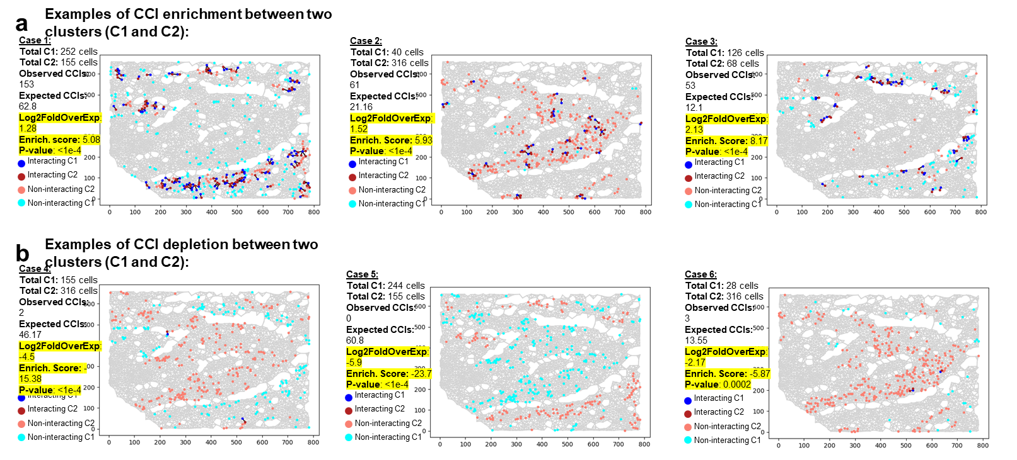
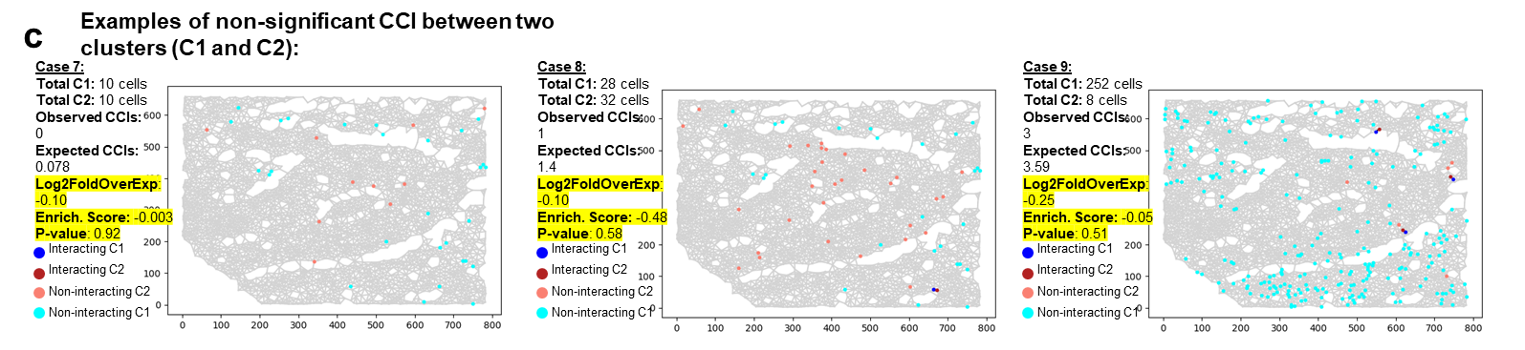
Supplementary Figure 5. Giotto functions by randomly reshuffling cell type labels across the spatial grid to establish a baseline level of cell-to-cell interactions (CCIs) among cell types while preserving the relative abundance and total number of cells. This approach accounts for variations in cellular diversity and prevalence, ensuring that the control "baseline" is adjusted for different regions of interest (ROIs). After 1,000 label randomizations, a null distribution of the expected interactions from random cell distribution is generated. The method then computes fold-enrichment z-scores (and P-values) by comparing the actual number of CCIs in the ROI with this null distribution. P-values were thus generated by permutation test (n=1,000 permutations).We present data from a single ROI, showing nine distinct spatial arrangements of interacting cell types. These scenarios were generated to demonstrate how Giotto’s algorithm works across varying cluster abundances and diversities, ranging from tens to hundreds of cells per cluster. The figure overlays the spatial positions of interacting cells. (a) CCI enrichment in three cases involving two interacting cell clusters, C1 and C2: Case 1, where C1 and C2 have similar numbers of cells; Case 2, where C2 has eight times more cells than C1; and Case 3, where there is a two-fold difference in cell numbers. Despite variations in abundance and diversity between C1 and C2, Giotto correctly identifies significant CCI enrichment with corresponding significant P-values, supported by spatial maps showing C1:C2 interactions (indicated by blue and dark red dots). (b) In contrast, a negative enrichment score reflects reduced CCIs or cluster exclusion. This panel illustrates this in Cases 4, 5, and 6: Cases 4 and 5 have similar cell numbers in C1 and C2, whereas Case 6 exhibits a 10-fold disparity in cell numbers. In all three cases, C1 and C2 do not interact but are spatially separated (light-red and cyan dots in the spatial maps). In these scenarios, the CCI scores are significantly negative. (c) Cases 7-9 show minimal or no interaction between C1 and C2, with Giotto assigning low CCI scores ranging from -0.4 to -0.001, indicating non-significant interactions.

Slide 13
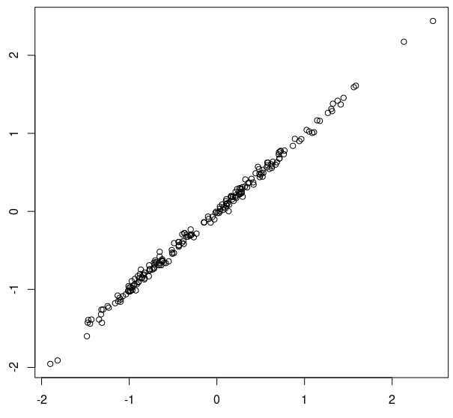
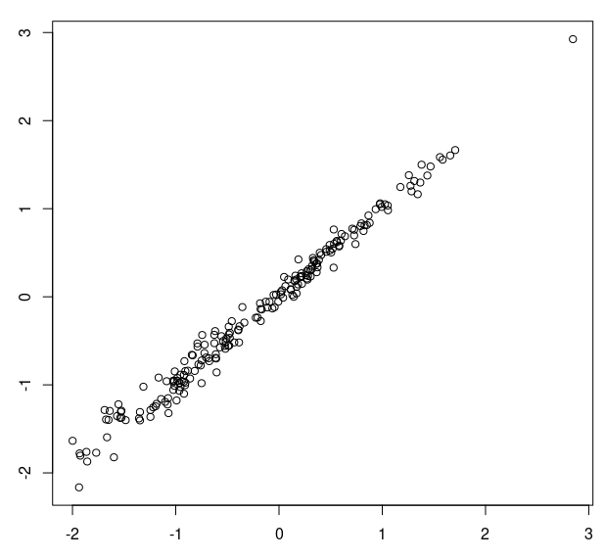
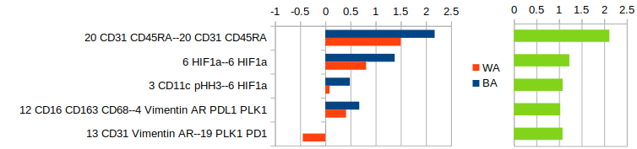
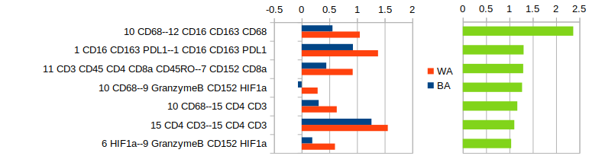
a b
R²=0.998
R²=0.992
Low-grade-removed
BA coefficient
Low-grade-removed
WA coefficient
Original BA coefficient
Original WA coefficient
c
d
Supplementary Figure 6. Linear Mixed Modeling (LMM) of BSW-discovery cohort after removal of low-grade tumors. a) Scatter plot showing the comparison of BA-coefficients determined by LMM before and after removal of low grade tumors. b) same as in a) but comparing WA-coefficients. c) Top BA-associated spatially resolved cell-cell interactions in BA-TNBC. d) same as in c) but showing the top WA-associated spatially resolved cell-cell interactions in WA-TNBC. Source data are provided as a Source Data file.

Slide 14
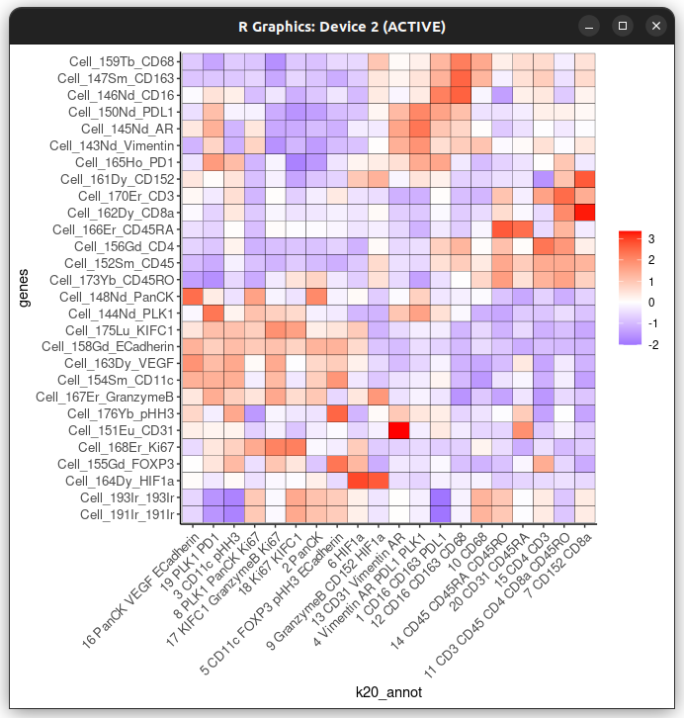
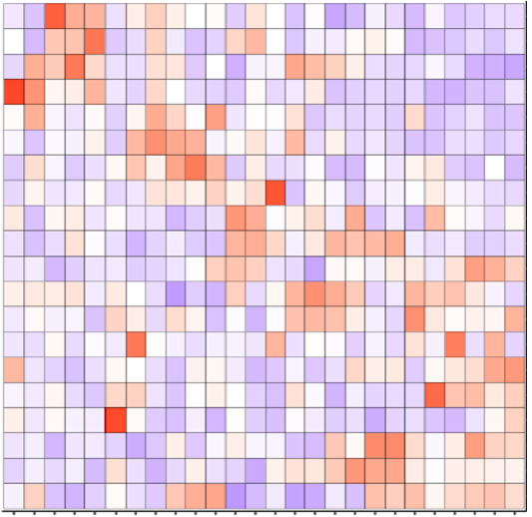
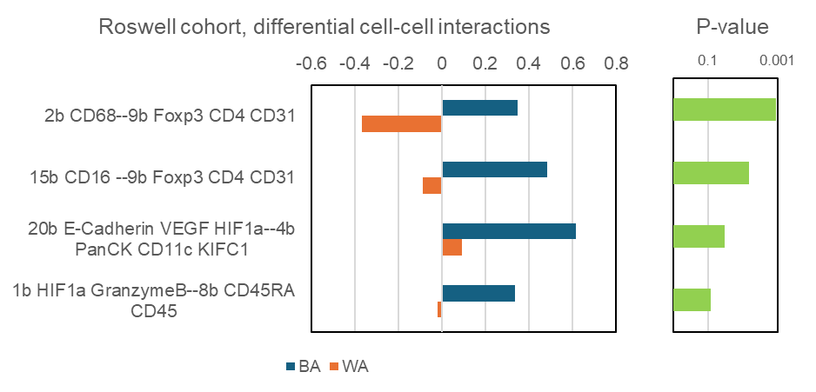
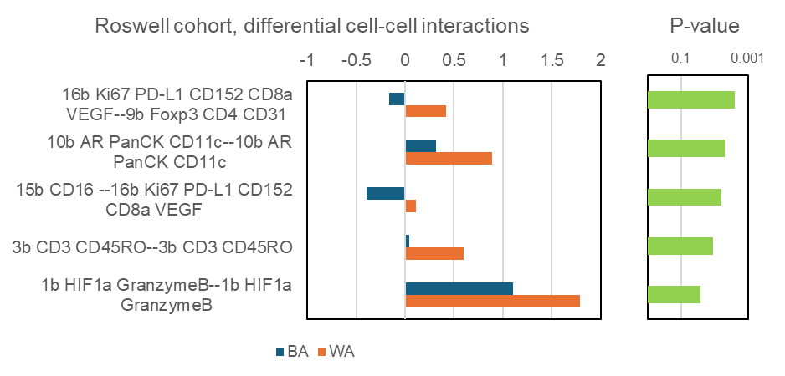
Roswell Park Validation Set
a
Clustering
7b M2 Macrophages (CD163, CD16)
2b Myeloid cells (CD68)
15b M2 Macrophages (CD16)
1b Activated Cytotoxic cells in hypoxic microenvironment (HIF1a, Gzmb)
8b Naïve T cells (CD45RA, CD45)
6b T-Helper cells (CD45, CD4, CD45RO)
3b Memory T cells (CD3, CD45RO)
19b Endothelial cells (CD31)
5b Epithelial Mesenchymal cells (PLK1, Vim, AR, pHH3)
14b Immunosuppressive Tumor cells (Vim, PLK1, PD-1)
13b Mitotic cell (KIFC1)*
18b Tregs (PD-L1, PD-1, CD8a, Foxp3, Ki67)
16b Exhausted Cytotoxic T cells (CD8a, Ki67, PD-L1, PD1, CD152, VEGF)
9b Tregs and Endothelial cells (Foxp3, CD4, CD31)
20b Other cells in Hypoxic microenvironment (E-cad, VEGF, HIF1a)*
11b Other cells undergoing mitosis (pHH3)*
17b Exhausted T cells (CD152)
4b Proliferating Tumor cells (PanCK, CD11c, KIFC1)
10b Tumor cells (AR, PanCK, CD11c)
12b Naïve T cells (CD45RA)
HIF1a
GranzymeB
CD163
CD16
CD68
CD152
CD4
CD45
CD45RO
CD3
CD45RA
PLK1
Vimentin
CD31
CD8a
PD-L1
PD-1
AR
CD11c
PanCK
Ki67
PHH3
Foxp3
KIFC1
Ecad
VEGF
b
BA Cell-Cell Interactions
-0.6 -0.4 -0.2 0 0.2 0.4 0.6 0.8 0.1 0.001
Myeloid cells-Tregs and Endothelial cells
(2b CD68–9b Foxp3 CD4 CD31)
M2 macrophages-Endothelial and Tregs
(15b CD16—9b Foxp3 CD4 CD31)
Hypoxic endothelial cells -Proliferating Tumor
(20b E-cad, VEGF, HIF1a—4b PanCK, CD11c, KIFC1)
Hypoxic activated Cytotoxic cells- Naïve T cells
(1b HIF1a, Gzmb—8b CD45RA, CD45)
BA
WA
Coeff P value
c
WA Cell-Cell Interactions
-1 -0.5 0 0.5 1 1.5 2 0.1 0.001
Exhausted Cytotoxic T cells-Tregs & Endothelial cells
(16b CD8a Ki67 PD-L1 PD1 CD152—9b Foxp3 CD4 CD31)
Tumor cells-Tumor cells
(10b AR PanCK CD11c—10b AR PanCK CD11c)
M2 macrophages–Exhausted Cytotoxic T cells
(15b CD16—16b CD8a Ki67 PD-L1 PD1 CD152)
Memory T cells - Memory T cells
(3b CD3 CD45RO—3b CD3 CD45RO)
BA
WA
Hypoxic activated Cytotoxic cells- Hypoxic activated
Cytotoxic cells (1b HIF1a Gzmb—1b HIF1a Gzmb )
Coeff P value
Supplementary Figure 7. a) Heat map showing the 20 clusters, their markers and cell types, from the imaging mass cytometry data obtained from the 46 TNBC tumors from the Roswell Park Cancer Institute validation cohort. These tumors were analyzed in a tissue microarray (TMA) setting. Black boxes indicate markers that are significant using t-statistics. Clusters associated with tumor characteristics are indicated in red fonts. b) Top four spatially resolved cell-cell interactions in BA (blue bars) compared to WA (orange bars) TNBC, with associated significance computed using -log10 P value (green bars) (ANOVA test). c) Top five spatially resolved cell-cell interactions in BA (blue bars) compared to WA (orange bars) TNBC, with associated significance computed using -log10 P value (green bars) (ANOVA test). Source data are provided as a Source Data file.

Slide 15
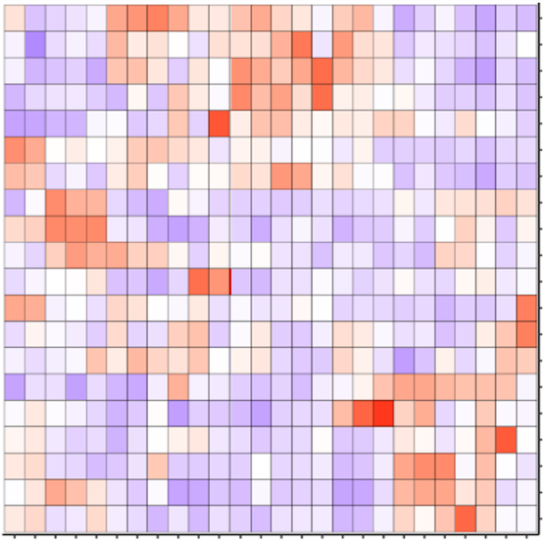
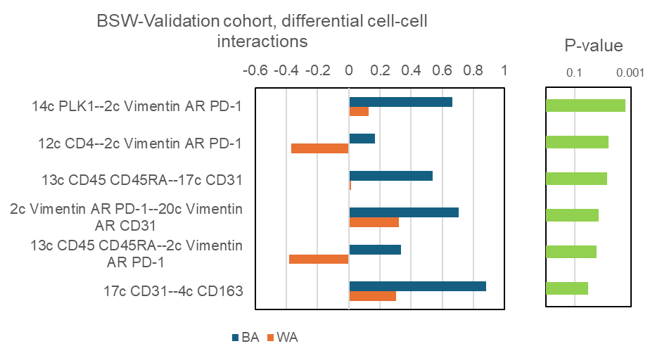
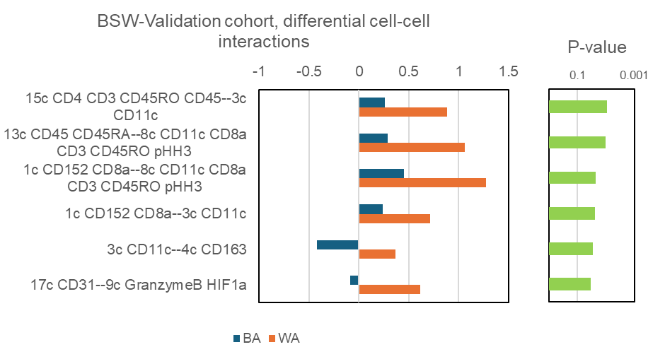
Baylor Scott and White (BSW) Validation Set
a
Clustering
19c Exhausted Immune cells (PLK1, PDL1, PD1, pHH3, Foxp3, CD152)
10c Angiogenic Tumor cells (PanCK, VEGF)
7c Proliferating Tumor cells (Ki67, PanCK, Foxp3, KIFC1)
18c Proliferating Tumor cells (Ki67, E-cad, Foxp3, KIFC1)
5c Hypoxia (HIFα)
2c Epithelial-Mesenchymal cells (Vim, AR, PD1)
11c Unknown (E-cad)
4c M2 Macrophages (CD163)
16c M2 Macrophages (CD16, CD163, CD68)
6c Monocytes or Macrophages (CD16, PDL1, CD68)
9c Activated Cytotoxic cells in hypoxic microenvironment (HIF1a, Gzmb)
20c Endothelial-Mesenchymal cells (CD31,Vim, AR)
17c Endothelial cells (CD31, Gzmb)
14c Tumor (PLK1)
8c Cytotoxic T cells (CD11c, CD8a, CD3, CD45RO, pHH3)
1c Exhausted Cytotoxic T cells (CD152, CD8a)
13c Naïve T cells (CD45, CD45RA)
15c T-Helper cells (CD4, CD3, CD45RO, CD45)
12c T-Helper cells (CD4)
3c Dendritic cells (CD11c)
AR
Vim
CD163
CD16
CD68
PDL1
PLK1
PD1
PHH3
GzmB
HIF1a
KIFC1
Foxp3
Ecad
PanCK
Ki67
VEGF
CD152
CD8a
CD45RO
CD3
CD4
CD11c
CD45
CD45RA
CD31
b
BA Cell-Cell Interactions
-0.6 -0.4 -0.2 0 0.2 0.4 0.6 0.8 0.1 0.001
Tumor – Epithelial Mesenchymal cells
(14c PLK1—2c Vim AR PD1)
T-Helper cells – Epithelial Mesenchymal cells
(12c CD4—2c Vim AR PD1)
Naïve T cells - Endothelial cells
(13c CD45 CD45RA—2c CD31 GzmB)
Epithelial Mesenchymal cells- Endothelial
Mesenchymal cells (2c Vim AR PD1—20c CD31 Vim AR)
Naïve T cells - Epithelial Mesenchymal cells
(13c CD45 CD45RA—2c Vim AR PD1)
BA
WA
Endothelial cells- M2 Macrophages
(17c CD31 GzmB—4c CD163)
Coeff P value
c
WA Cell-Cell Interactions
-1 -0.5 0 0.5 1 1.5 0.1 0.001
Helper-T cells – Dendritic cells
(15c CD4 CD3 CD45RO CD45—3c CD11c)
Naïve T cells – Cytotoxic T cells
(13c CD45 CD45RA—8c CD11c CD8a CD3 CD45RO pHH3)
Exhausted Cytotoxic T cells- Cytotoxic T cells
(1c CD152 CD8a—8c CD11c CD8a CD3 CD45RO pHH3)
Exhausted Cytotoxic T cells-Dendritic cells
(1c CD152 CD8a—3c CD11c)
Dendritic cells-M2 Macrophages
(3c CD11c—4c CD163)
BA
WA
Endothelial cells-Hypoxic Cytotoxic cells
(17c CD31—9c GzmB HIF1α)
Coeff P value
Supplementary Figure 8. a) Heat map showing the 20 clusters, their markers and cell types, from the imaging mass cytometry data obtained from the 10 TNBC tumors from the Baylor Scott and White in the validation cohort. These tumors were analyzed in a tissue microarray (TMA) setting. Black boxes indicate markers that are significant using t-statistics. Clusters associated with tumor characteristics are indicated in red fonts. b) Top six spatially resolved cell-cell interactions in BA (blue bars) compared to WA (orange bars) TNBC, with associated significance computed using -log10 P value (green bars) (ANOVA test). c) Top five spatially resolved cell-cell interactions in BA (blue bars) compared to WA (orange bars) TNBC, with associated significance computed using -log10 P value (green bars) (ANOVA test). Source data are provided as a Source Data file.

Slide 16
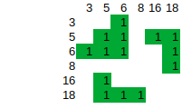
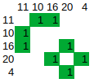

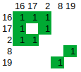

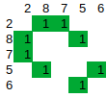

BSW Discovery IMC
Roswell Park IMC
BSW Validation IMC
►
►
►
►
►►
►
►
►
►
►
►
►
►
BA-Community 2
Ecad VEGF CD11c FOXP3►,
Ki67 KIFC1►, PanCK►, HIF1a►
PHH3 FOXP3►, Ecad VEGF►, PanCK CD11c►, Ki67 VEGF PD-L1►
KIFC1 Ecad Ki67►, PanCK VEGF PD-L1►
Endothelial cells-Proliferating Tumor Attenuated Dendritic cells
►►
►
►
►►
►
►►
►►
WA-Community 2
NA
VEGF Ecad ►, Ki67 KIFC1►, PanCK►, PLK1 PD1►
Proliferating Tumor with PD1 expression
Ki67 KIFC1►, PanCK►, PLK1 PD1►
►
►►
►
►►
►
WA-Community 3
NA
NA
CD68 CD163 ►, CD20►, PLK1 VIM►, CD45►
B cell-Macrophage
NA
►►►►►
►►
NA
WA-Community 4
Foxp3 CD4 ►, CD31►, KIFC1►, PLK1 Ecad►
Treg, Endothelial
Supplementary Figure 9. Additional BA and WA communities (see main text) identified in three imaging mass cytometry (IMC) datasets from Baylor Scott and White (BSW) Discovery, as well as validation cohorts from Roswell Park Cancer Institute and BSW2. Each heatmap shows the cell-type interactions between specific cell-type clusters (indicated in row and column labels) in each IMC dataset. A community is defined as a group of connecting cell-type interactions. So, for example, BA-Community-2 in Roswell Park IMC is made of connecting interactions between clusters 11, 10, 16, 20, 4. Members of the community are indicated at the bottom of each community. BA-Community 2 is shared across all the three IMC datasets. NA describes absence of the community in the respective dataset. Thus for example, WA-Community 2 was seen only in the BSW Discovery and BSW Validation dataset but not in the Roswell Park Cancer Institute dataset.

Slide 17
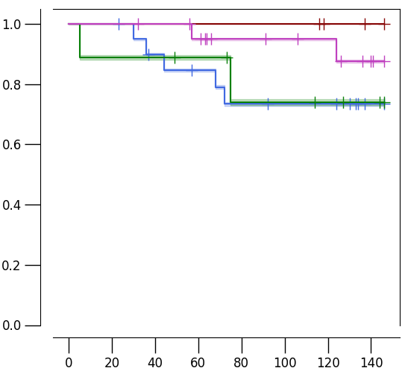
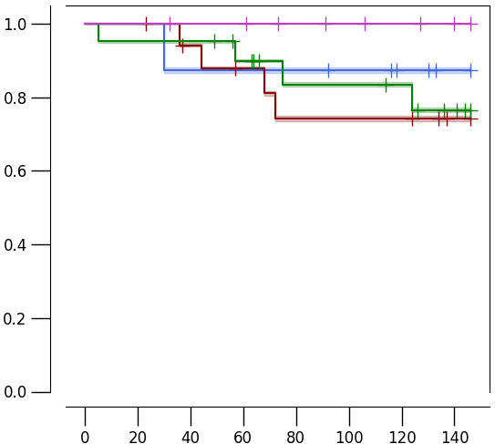
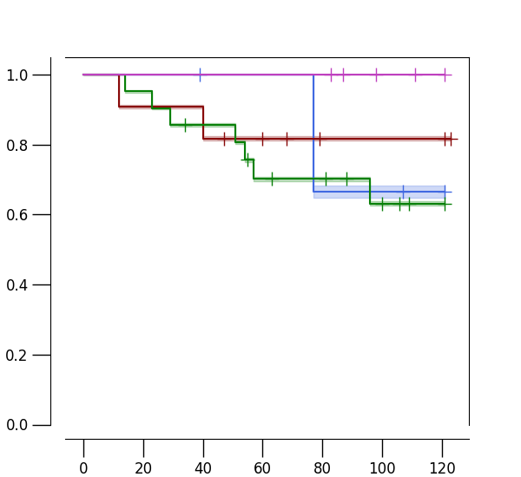
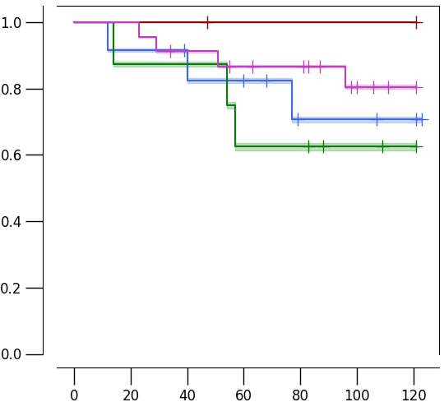
BSW Discovery IMC
a
BA-communities (Multi-groups)
b
WA-communities (Multi-groups)
Probability of Overall Survival
Probability of Overall Survival
BA-communities-low, BA patients
BA-communities-high, BA patients
WA-communities-low, WA patients
WA-communities-high, WA patients
BA-communities-low, WA patients
BA-communities-high, WA patients
WA-communities-low, BA patients
WA-communities-high, BA patients
Months
Months
c
Roswell Park Validation IMC
BA-Communities (Multi-groups)
d
WA-Communities (Multi-groups)
Probability of Overall Survival
Probability of Overall Survival
BA-communities-low, BA patients
BA-communities-high, BA patients
WA-communities-low, WA patients
WA-communities-high, WA patients
BA-communities-low, WA patients
BA-communities-high, WA patients
WA-communities-low, BA patients
WA-communities-high, BA patients
Months
Months
Supplementary Figure 10. Race-specific prognostic impact of BA and WA
communities. a) Kaplan-Meir curves showing a significant association of BA-community genes in BA patients (P=0.0523) but moderately significant in WA patients (P=0.097), in the BSW-Discovery cohort. b) Kaplan-Meir curves showing a significant association of WA-community genes in WA patients (P=0.07) but not significant in BA patients (P=0.26), in the BSW-Discovery cohort. c) Kaplan-Meir curves showing a moderately significant association of BA-community genes in BA patients (P=0.1) but not significant in WA patients (P=0.46), in the Roswell Park validation cohort. d) Kaplan-Meir curves showing a significant association of WA-community genes in WA patients (P=0.045) but not significant in BA patients (P=0.29), in the Roswell Park validation cohort. All tests adjust for age, stage, and BMI in the case of BSW-Discovery, and age & stage in the case of Roswell Park. Statistical significance computed with Ward test.

Slide 18
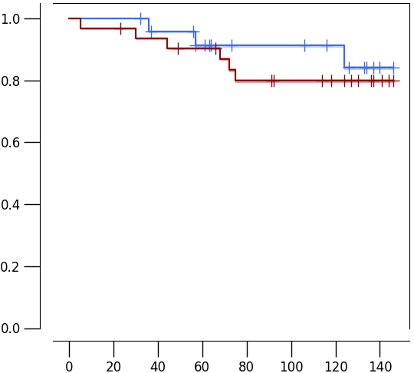
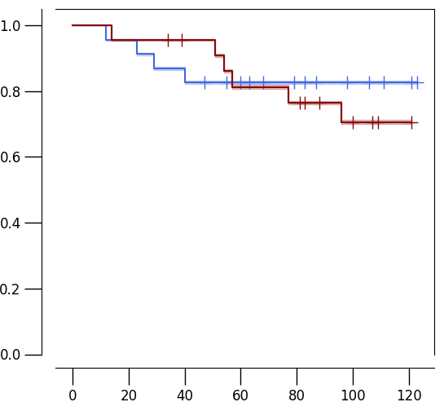
a b
BSW-discovery Roswell Park
Probability of Overall Survival
Probability of Overall Survival
P-value: ns
P-value: ns
Months
Months
Supplementary Figure 11: Combined KM plot showing the prognostic value when scores of BA-communities and scores of WA-communities are combined per patient. a) BSW-discovery cohort, b) Roswell Park Cohort. Red lines indicates BA+WA communities-high. Blue lines indicates BA+WA communities-low. “ns” means not significant (log-rank test).

Slide 19
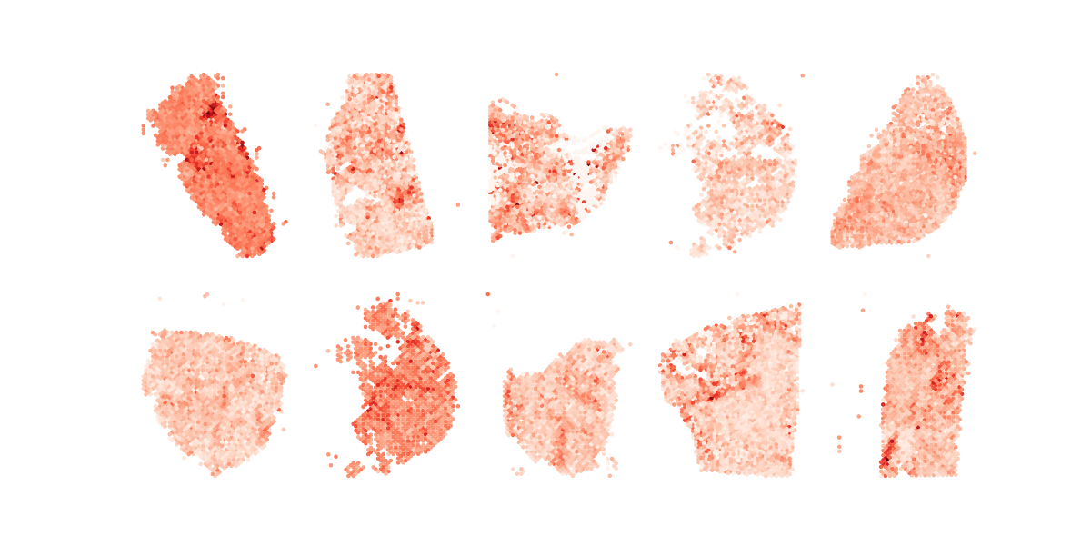
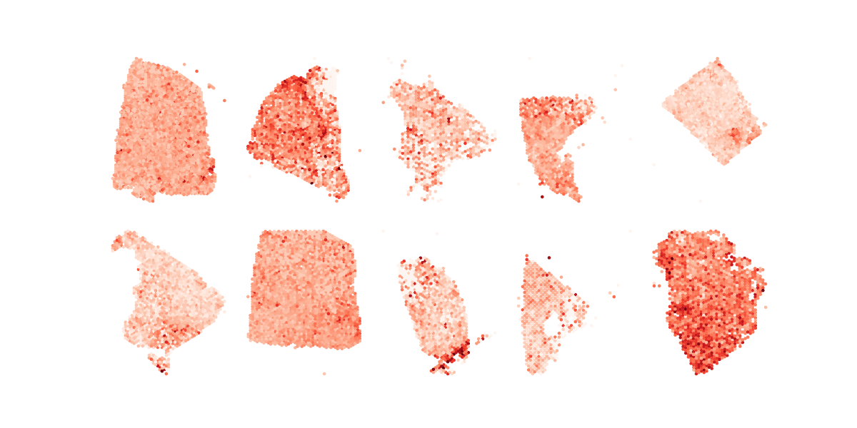
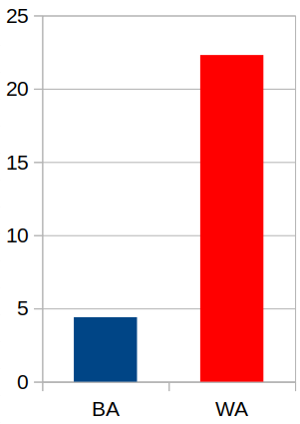
WA-Community-1:
CTLA4 CD8A CD4 CD163 CD68 PTPRC HIF1A GZMB PLK1 PDCD1 CD3E CD3D CD3G
BA patients
WA patients
P=0.04
Number of spots
Supplementary Figure 12. Spatial distribution of WA-Community-1 interactions in BA and WA TNBC tumors based on spatial transcriptomics data. Using published spatial transcriptomics data (PMC9812886), the localization of genes associated with WA-Community-1 (Exhausted Cytotoxic T cells, Helper T cells, Macrophages, and Hypoxia) was assessed in both BA and WA TNBC patients. The genes related to WA-Community-1 were uniformly dispersed throughout thetumors in WA patients, without any discernible clustering. In addition, genes linked to WA-Community-1 interactions were more prevalent in WA tumors compared to BA tumors. Bottom: number of spots expressing WA-Community 1 query genes in BA and WA patients (10 each). P-value derived from t-test. Source data are provided as a Source Data file.

Slide 20
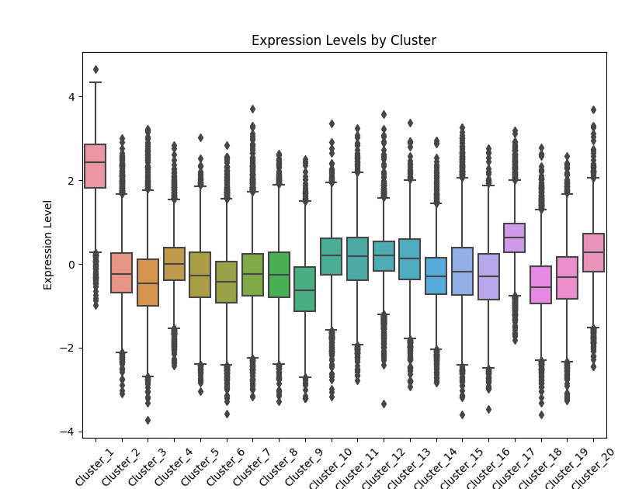
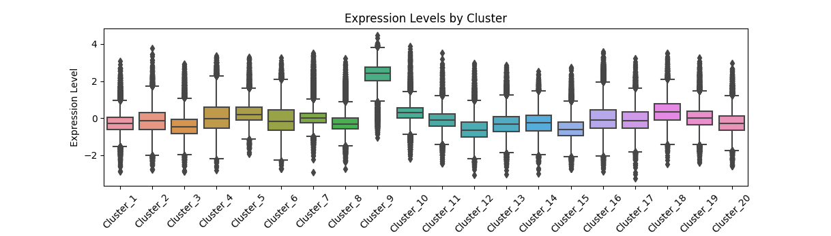
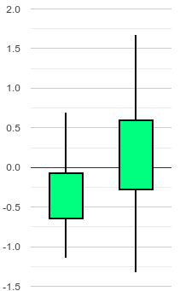
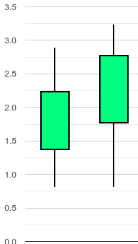
a
b
P=0, t-statistics =120
c
P=0, t-statistics =95
c
P= 0.05
d
P= 0.03
Interaction Coefficient
Interaction Coefficient
BA WA BA WA
Supplementary Figure 13. a) increased abundance of MPO in cluster 1 in Roswell Park validation cohort. b) same as in a) but in cluster 9 BSW2 validation cohort. c) Increased interaction of neutrophils identified using myeloperoxidase (MPO) with exhausted T cells in WA compared to BA TNBC in the Roswell Park validation cohort .d) same as in c) but for BSW2 validation cohort. P value using t-test. Source data are provided as a Source Data file. Box plots represent the median (center line), interquartile range (25%–75%; bounds of the box), and whiskers extending to the 1.5 IQRs.

Slide 21
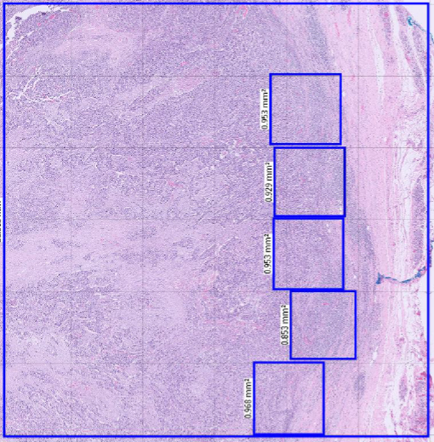
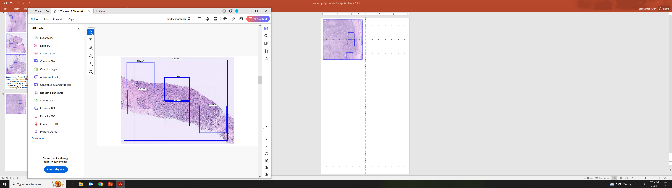
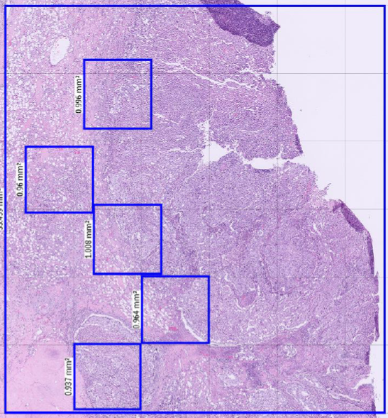
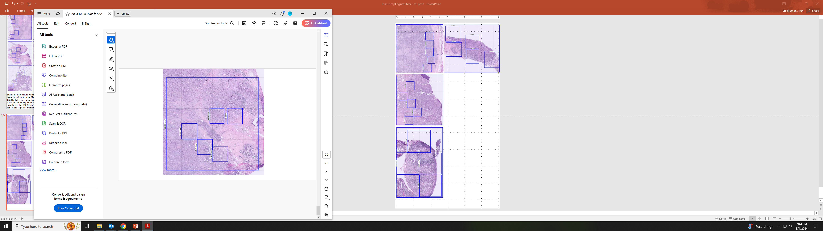
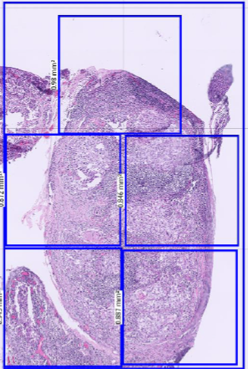
a.
d.
0.968 mm³
0.984 mm³
b.
e.
0.996 mm³
1 mm³
c.
Supplementary Figure 14: H&E images of 5 BA TNBC tissues from BSW2 cohort used for Immune Mass Cytometry (IMC: a-e) and 4 tissues for 10X Spatial Transcriptomics Analysis (10X ST: a-d) in the validation study. Big blue box denotes the area that was examined using 10X ST and the smaller blue boxes denote the region of interest (ROI) used for IMC. Each blue box is ~ 1mm by 1mm (refer to measurements in the inset).
0.98 mm³

Slide 22





a.
d.
1.016 mm³
1.008 mm³
b.
e.
1.018 mm³
1.023 mm³
c.
1 mm³
Supplementary Figure 15: H&E images of 5 WA TNBC tissues from BSW2 cohort used for Immune Mass Cytometry (IMC) and 10X Spatial Transcriptomics Analysis (10X ST) in the validation study. Big blue box denotes the area that was examined using 10X ST and the smaller blue boxes denote the region of interest (ROI) used for IMC. Each blue box is ~ 1mm by 1mm (refer to measurements in the inset).

Slide 23






9847-MB-3
9847-MB-1
9847-MB-4
9847-MB-6
9847-MB-2
9847-MB-5
Supplementary Figure 16: H&E images of 6 BA TNBC tissues from the Georgia cohort used 10X Spatial Transcriptomics Analysis (10X ST) in the validation study. Each H&E image shown above is a 20X image. Cores 9847-MB3 and MB1 are 6 mm in diameter. Cores 9847-MB4, MB6, MB2 and MB5 are 3 mm in diameter.

Slide 24




9847-MB-8
9847-MB-10
9847-MB-11
9847-MB-12
Supplementary Figure 17: H&E images of 4 WA TNBC tissues from the Georgia cohort used 10X Spatial Transcriptomics Analysis (10X ST) in the validation study. Each H&E image shown above is a 20X image. All the cores are 6 mm in diameter.

Slide 25


PanCK compartment (BA: N=26, WA: N=31)
P=0.07 P=0.33
Expression
Supplementary Figure 18 . GeoMX analysis of BA and WA Niche ESGs: No significant difference in enrichment of BA or WA communities was observed in the epithelial compartments (PanCK) comparing BA and WA TNBC. Significance was computed using T-tests. Box plots represent the median (center line), interquartile range (25%–75%; bounds of the box), and whiskers extending to the 1.5 IQRs. Points that fall outside this range are displayed independently. Source data are provided as a Source Data file.

Slide 26

Inflamed
NKG7, IL2RG, IL7R, CCL5, CORO1A, LCK, TRBC1, GZMB, CCL5, CXCL13, WARS
P=8.9x10⁻¹⁷
Excluded
THBS, ASPN, COL10A1, GREM1, IGFBP5
P=0.00097
Ignored
COL5A1, SPON1, FAP, SPOCK1, COL1A1, CPE, MMP2
P=1.6x10⁻⁷
Supplementary Figure 19: Comparison between BA and WA niche-associated
extended signature genes and the spatial phenotype signature genes from
Hammerl et al Nat Comm 2021. Overlapping genes are indicated in the
middle panel. The statistical P-values are computed using hypergeometric test.

