Slide 1
Supplementary Information
A Hedgehog-Foxf axis coordinates dental follicle-derived alveolar bone formation
Nagata et al.

Slide 2
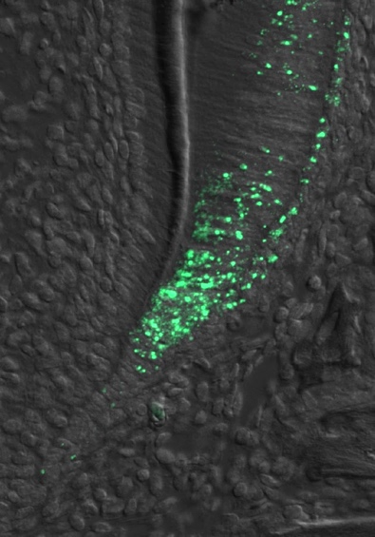
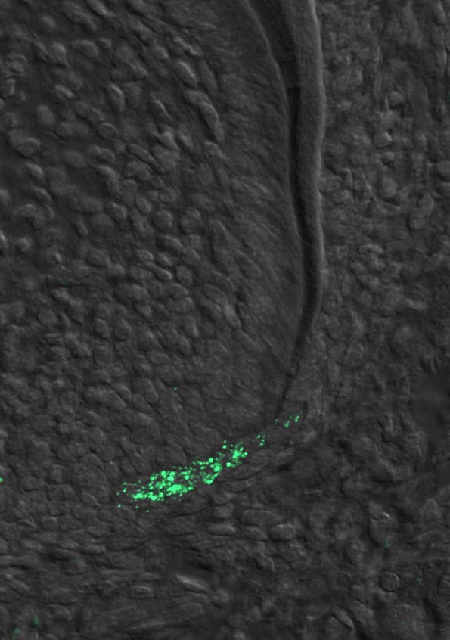
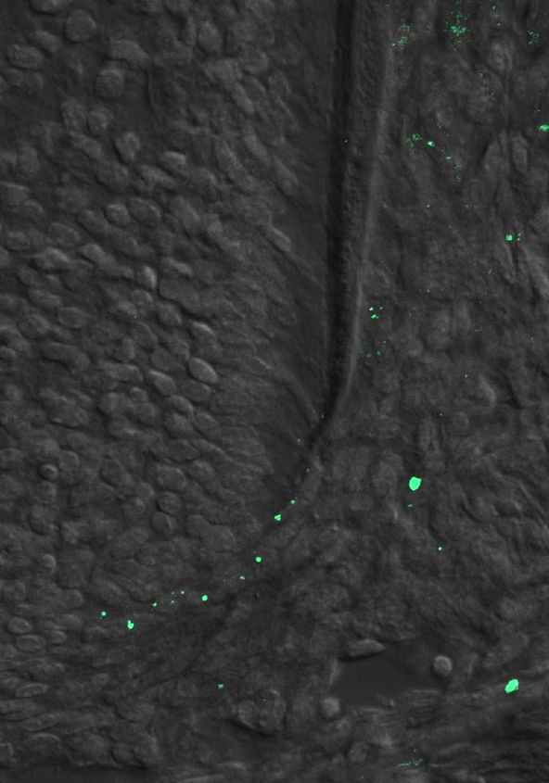
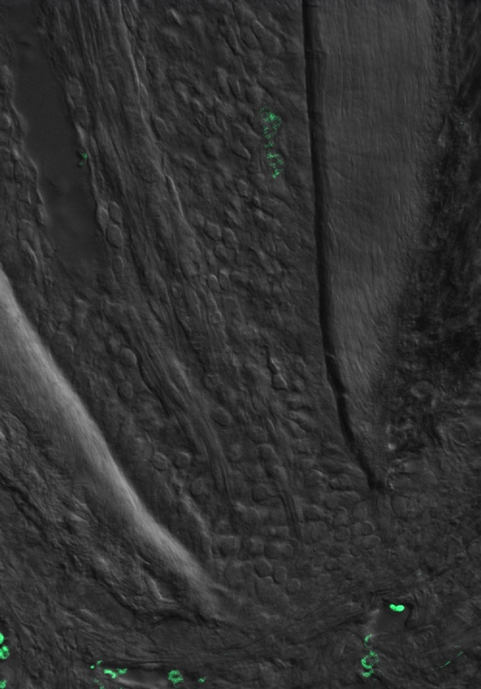
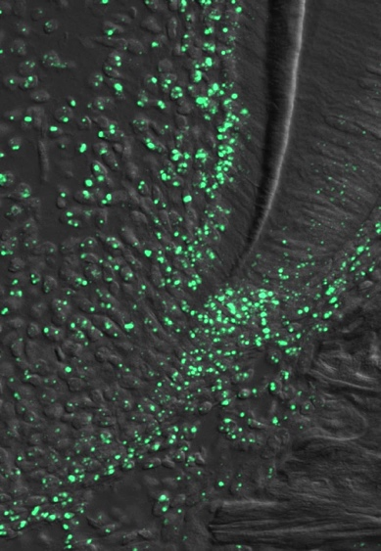
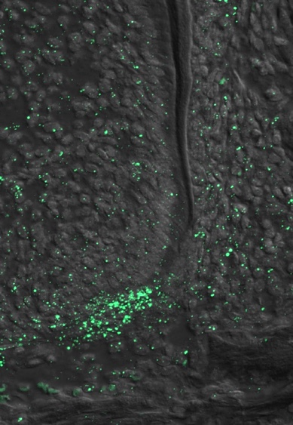
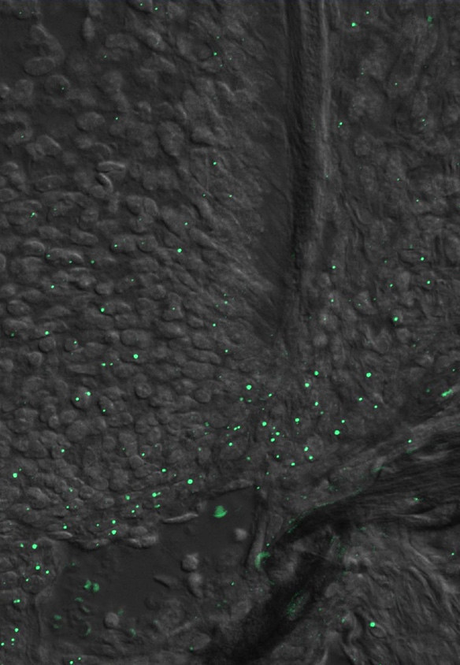
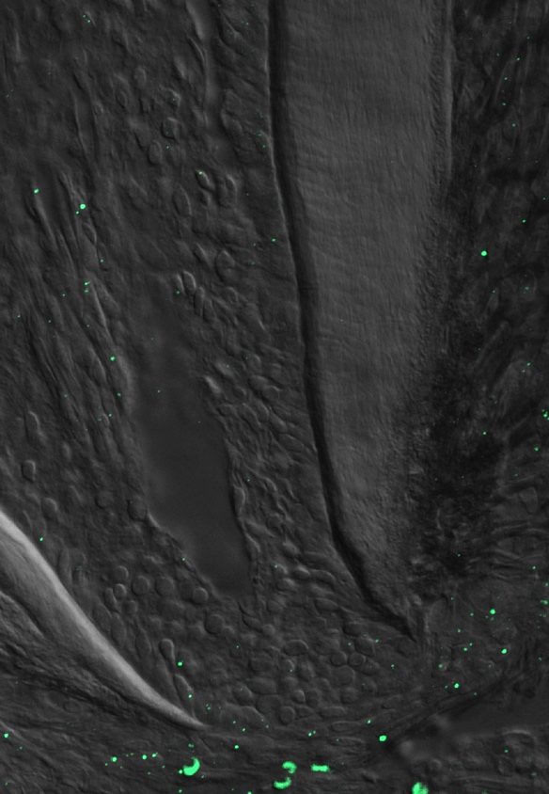
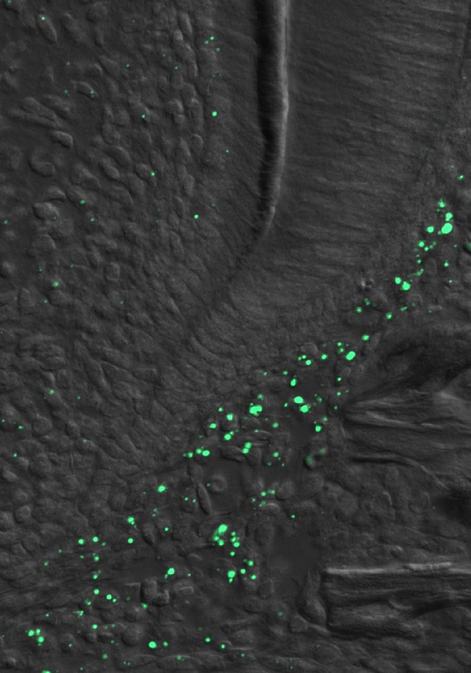
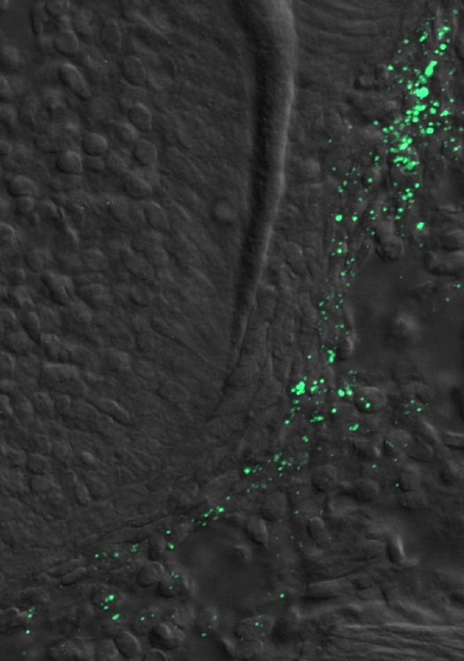
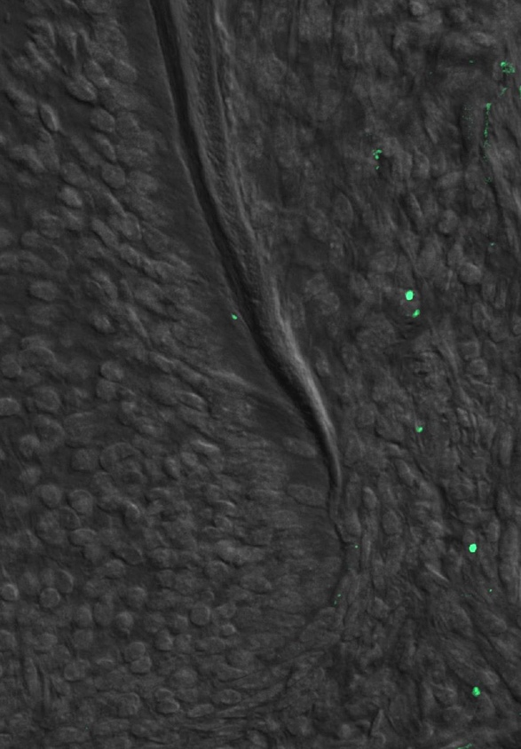
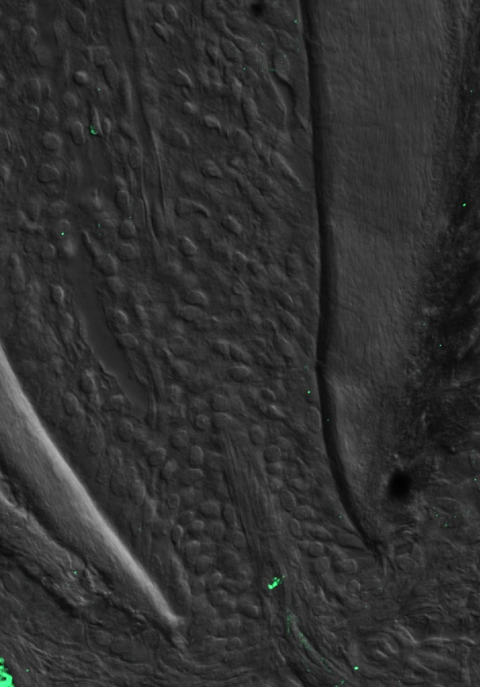
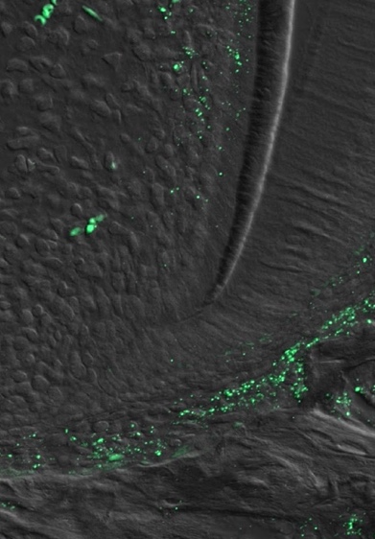
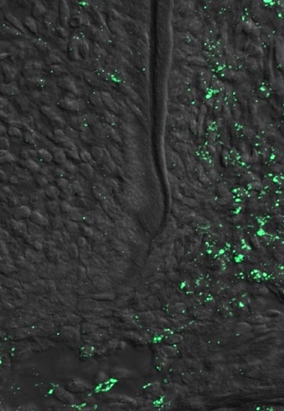
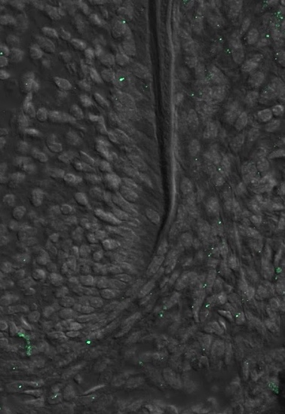
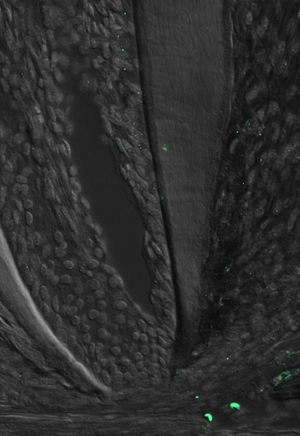
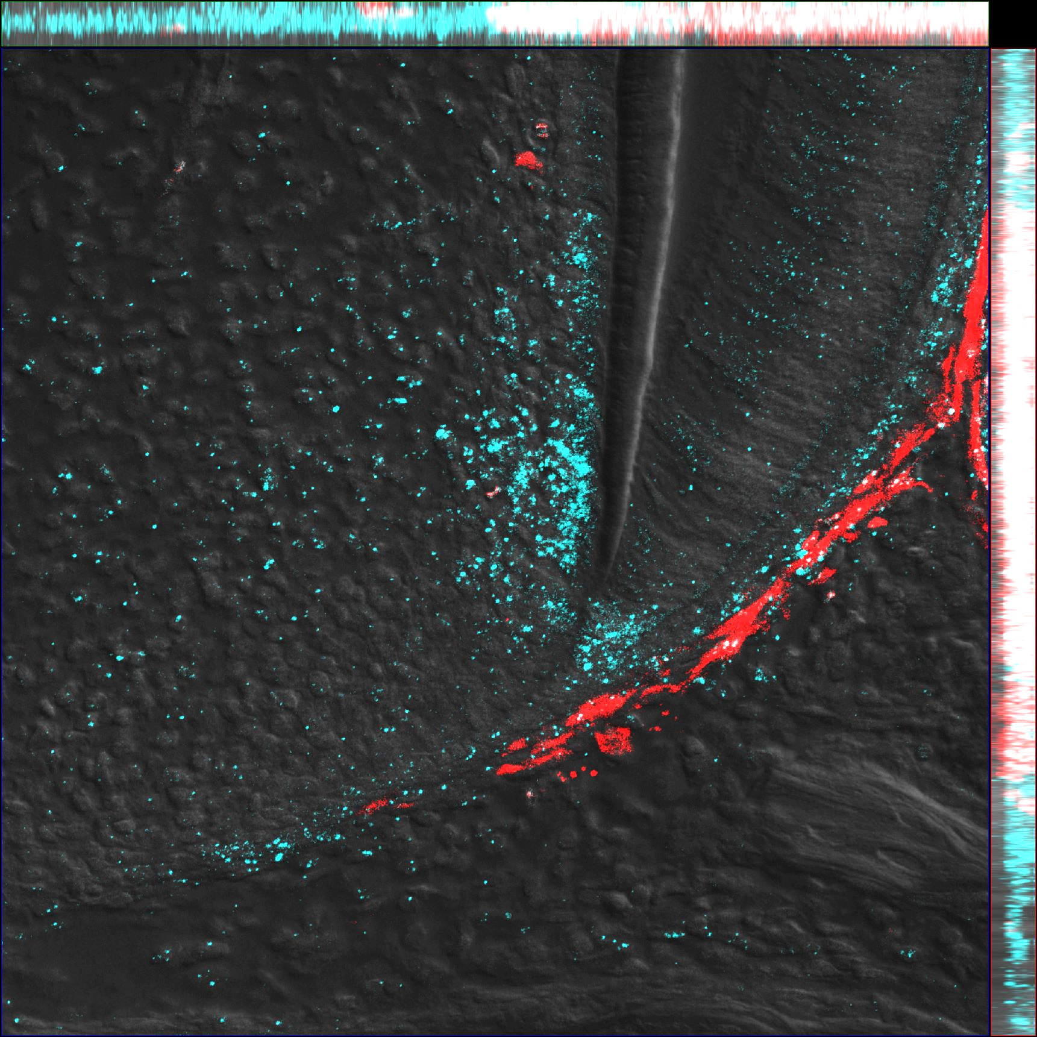
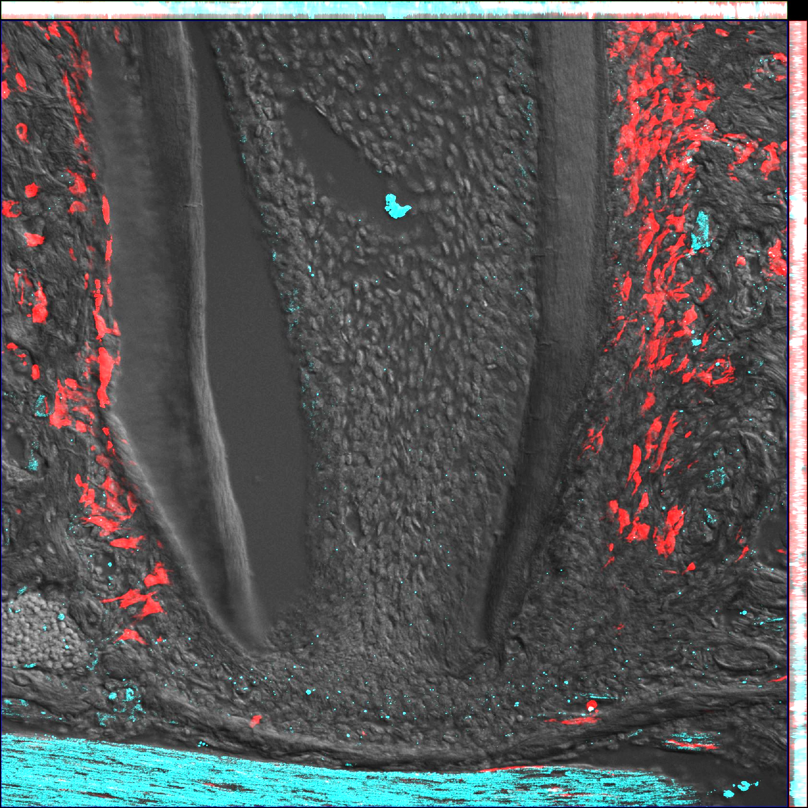
a
Shh in situ hybridization
Ptch1 in situ hybridization
P3
P8
P15
P25
P3
P8
P15
P25
Od
Am
D
DP
DP
PDL
DF
Shh
Ptch1
Gas1 in situ hybridization
Hhip in situ hybridization
P3
P8
P15
P25
P3
P25
P8
P15
P25
Hhip
Gas1
b
Pthrp-creER; R26R^{tdTomato/+}
Ptch1
Ptch1
P5 TAMP3
P20 TAMP3
Ptch1/PTHrP^{CE}-P3
Supplementary Figure 1. Hedgehog-related gene expression during tooth root formation.
(a) Hedgehog-related gene expression during tooth root formation form P3 to P25. RNAscope assay for Shh, Ptch1, Hhip and Gas1. Scale bars: 50 μm (b) RNAscope assay for Gli1. DP: dental papilla/pulp, DF: dental follicle, Od: odontoblasts, Am: ameloblasts, D: dentin, PDL: periodontal ligament. Scale bars: 50μm (left panels), 20μm (right panels).
Notes:
ShhGFP;
071519-no1392574-DOB070819-no1-ShhGFPCre+DISP3
072519-no1392574-DOB070819-no6-ShhGFPCre+DISP8
050622-080119-CK5-no1392574-DOB070819-no8-ShhGFPCre+DISP14-RM4-3 40xZ
050622-092319-no1392340-DOB081319-no11-ShhGFP+DISP20-RM2-1 40xZ
Scale bar:50um
Gli1GFP;
080819-no1392605-DOB080219-no2-Gli1eGFP+DISP3-RM1-3 20xZ 40xZ
RNAscope: 121819-no1522361-DOB120919-no5-ShhGFP+PTHLHmC+DisP3-RM2-3-Gli1
Scale bar:200um, 50um
Gli1creER
111019-no1522349-DOB110119-no1-ColGFP+Gli1CE+TAMP3-DISP5-RM1-3 10x
Scale bar:200um, 50um

Slide 3
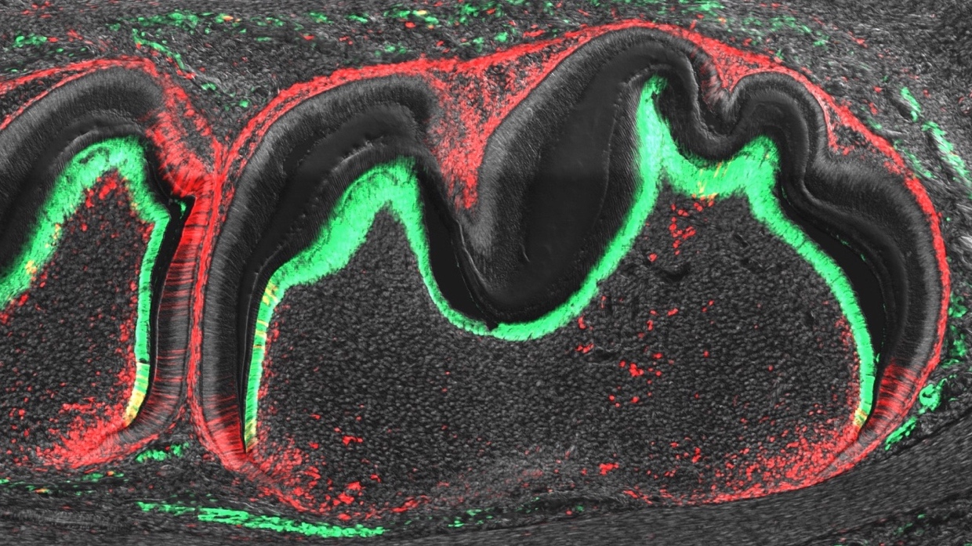
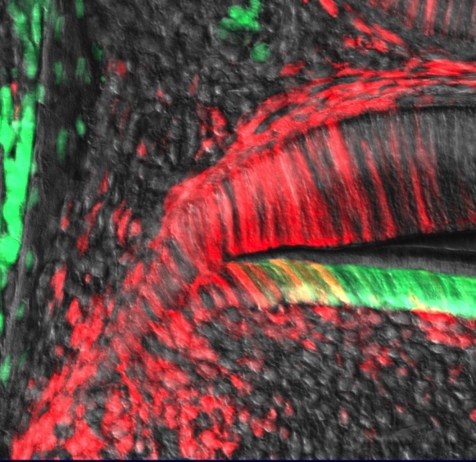
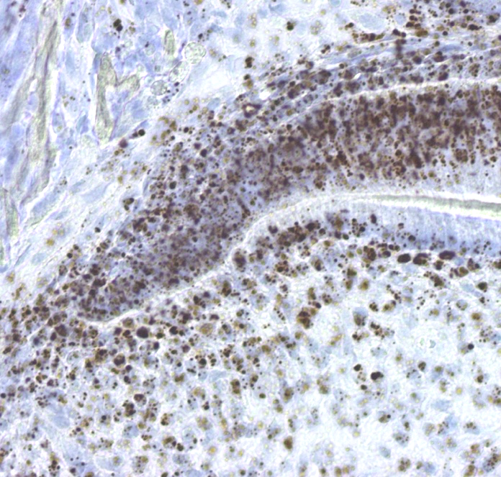
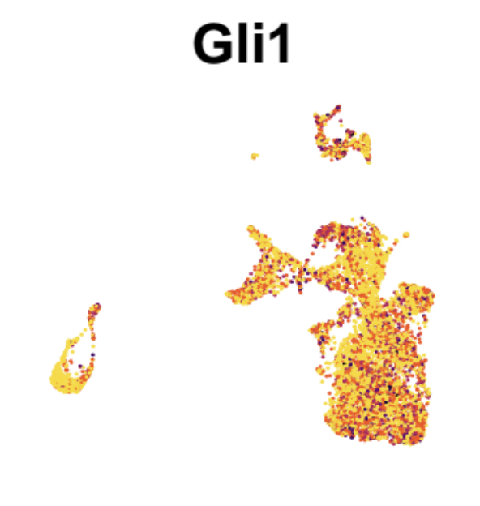
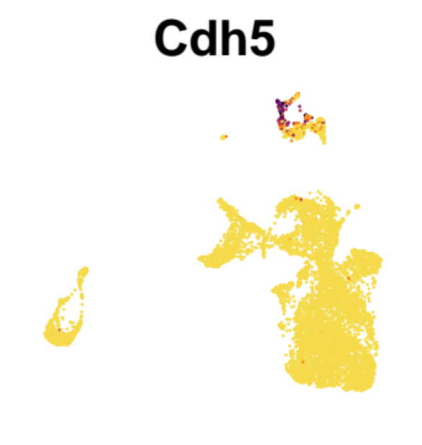
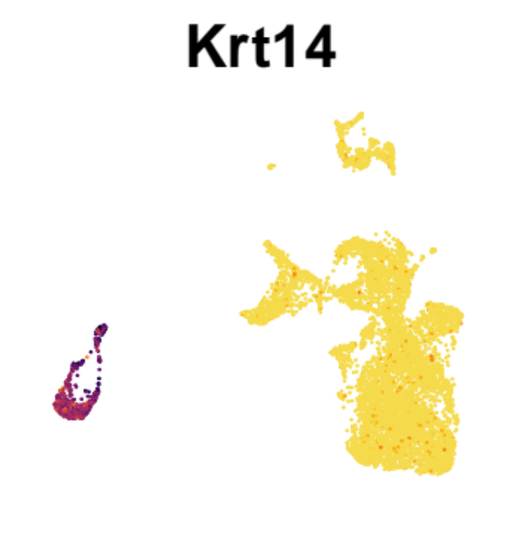
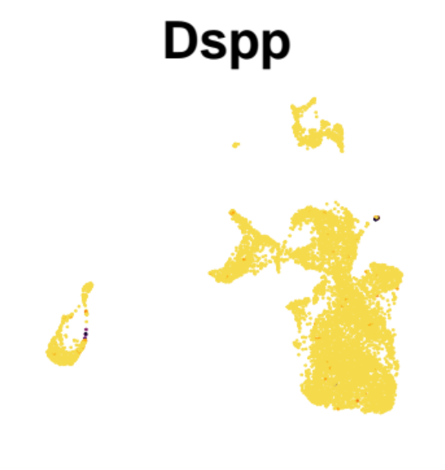
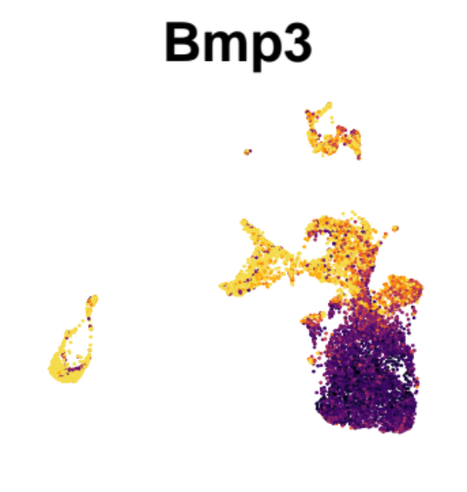
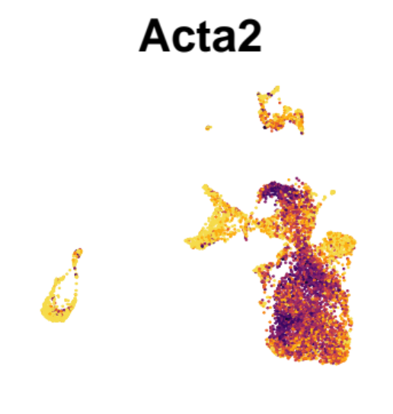
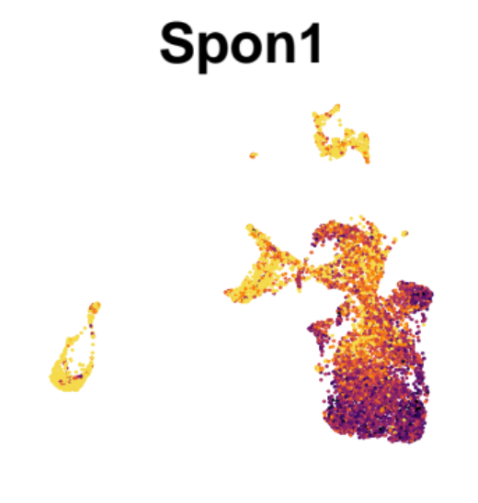
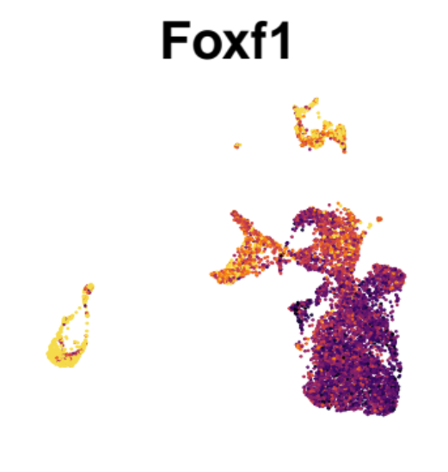
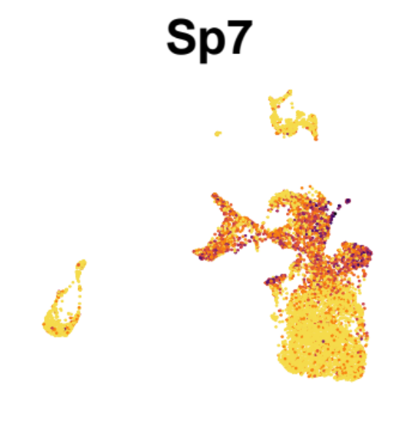
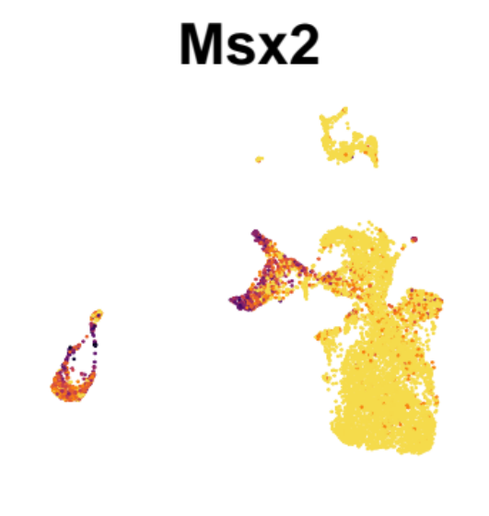
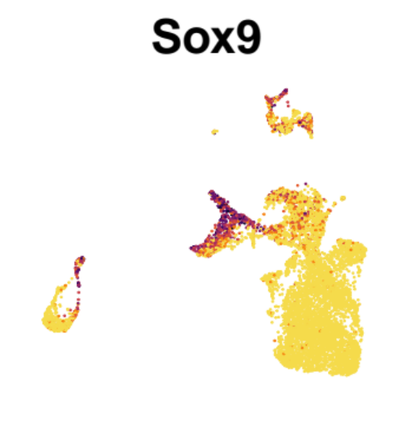
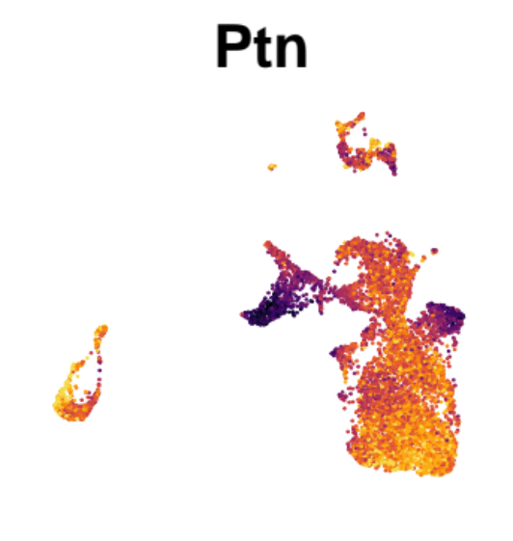
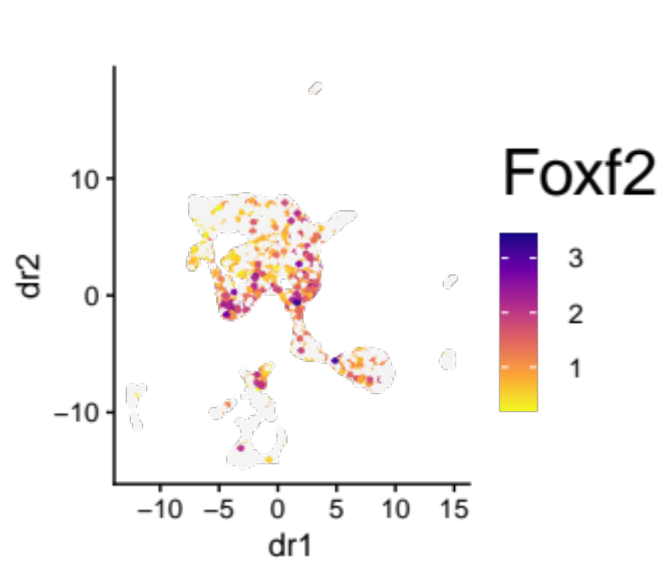
Col1a1(2.3kb)-GFP; Gli1-creER; R26R^{tdTomato}: P5 (Tamoxifen at P3)
a
a’
b
Gli1
DP
Od
Am
DF
Col1a1-GFP/Gli1^{CE}-P3 /DIC/DAPI
c
Gli1-GFP; Pthrp-creER;R26R^{tdTomato}
Tamoxifen
FACS
scRNA-seq
(10x)
P3
P6
Mandible
Gli1-GFP⁺
PTHrP^{CE}-tdT⁺
d
Hedgehog responsible genes
Cluster 6: Endothelial
Cluster 7,9: Epithelial
Cluster 10: Odontoblast
Gli1
Cdh5
Krt14
Dspp
Cluster 0, 3, 5: Dental follicle
Bmp3
Acta2
Spon1
Foxf1
Cluster 1, 4: Dental papilla
Cluster 2: Apical papilla
Sp7
Msx2
Sox9
Ptn
Low
expression
High
expression
Supplementary Figure 2. Single-cell RNA-seq analysis of Gli1-GFP⁺ cells.
(a,b) P5 mandibular first molars (M1) of Col1a1(2.3kb)-GFP; Gli1-creER; R26R^{tdTomato} mice (pulsed at P3). (a’): high magnification of the dotted area. (b): RNAscope assay for Gli1. DP: dental pulp, DF: dental follicle, Od: odontoblasts, Am: Ameloblasts. Scale bars: 200μm (a), 50μm (a’,b).
(c) Workflow of scRNA-seq. (d) UMAP feature plots of cell-type specific markers. High expression: Purple, Low expression: yellow.
Notes:
ShhGFP;
071519-no1392574-DOB070819-no1-ShhGFPCre+DISP3
072519-no1392574-DOB070819-no6-ShhGFPCre+DISP8
050622-080119-CK5-no1392574-DOB070819-no8-ShhGFPCre+DISP14-RM4-3 40xZ
050622-092319-no1392340-DOB081319-no11-ShhGFP+DISP20-RM2-1 40xZ
Scale bar:50um
Gli1GFP;
080819-no1392605-DOB080219-no2-Gli1eGFP+DISP3-RM1-3 20xZ 40xZ
RNAscope: 121819-no1522361-DOB120919-no5-ShhGFP+PTHLHmC+DisP3-RM2-3-Gli1
Scale bar:200um, 50um
Gli1creER
111019-no1522349-DOB110119-no1-ColGFP+Gli1CE+TAMP3-DISP5-RM1-3 10x
Scale bar:200um, 50um

Slide 4
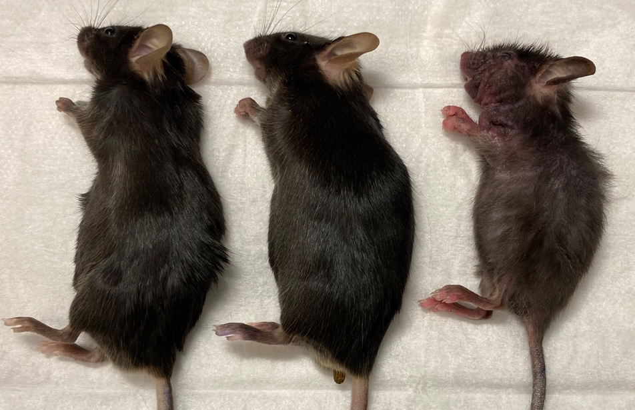
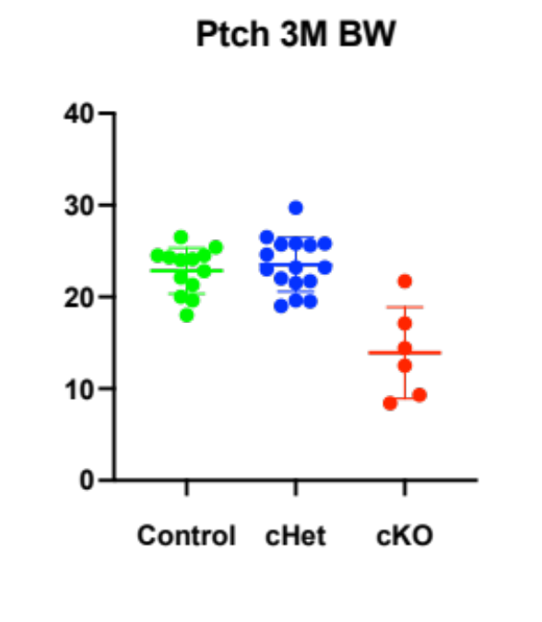
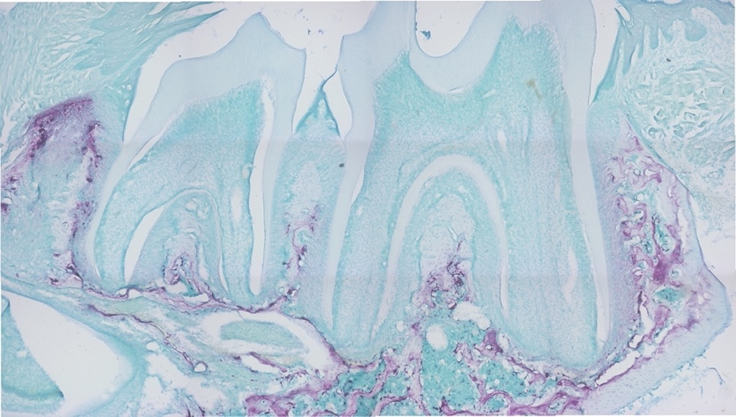
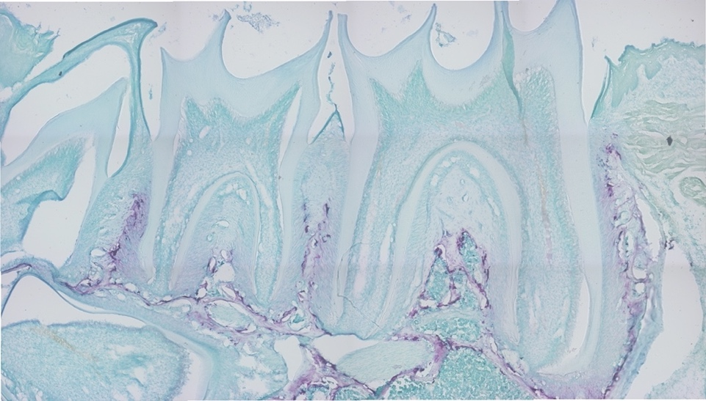
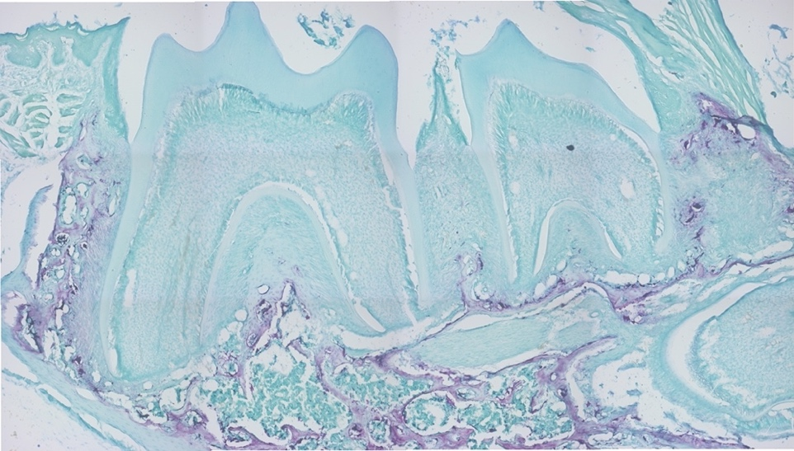
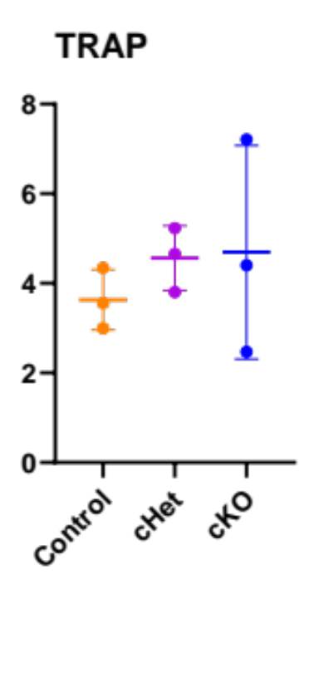
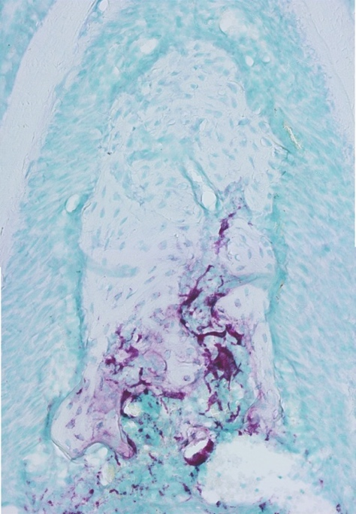
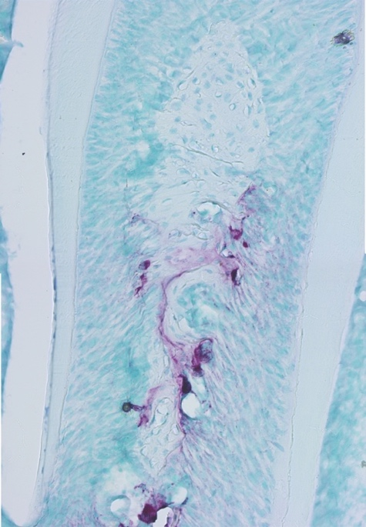
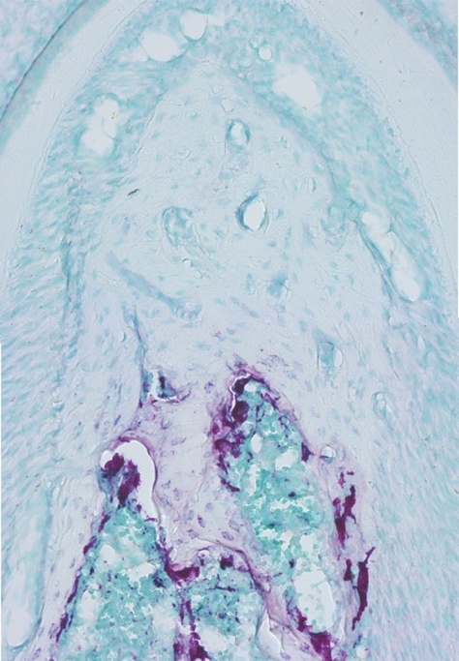
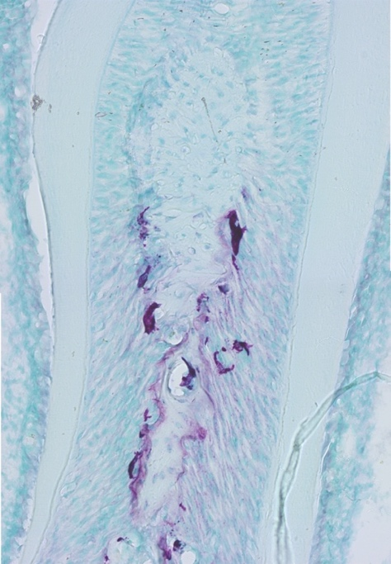
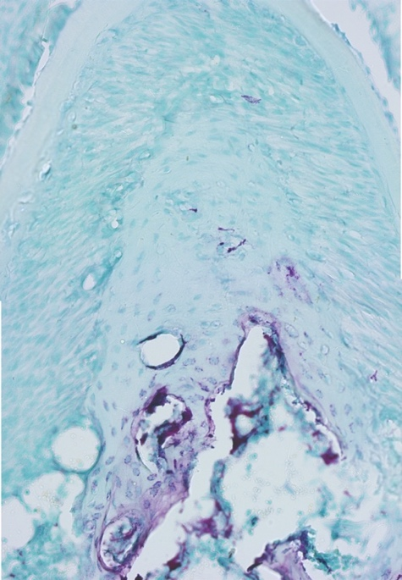
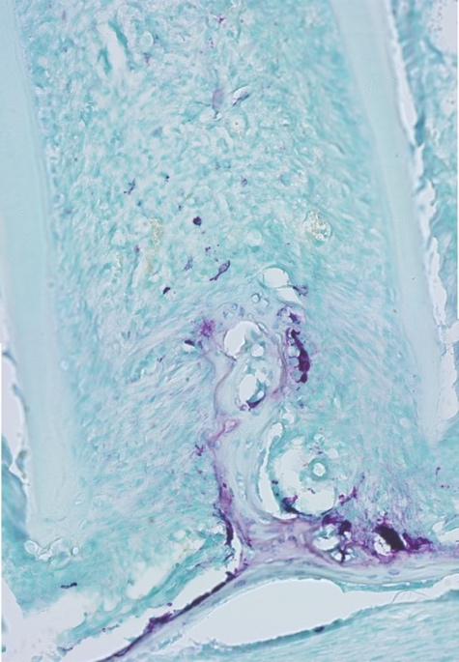
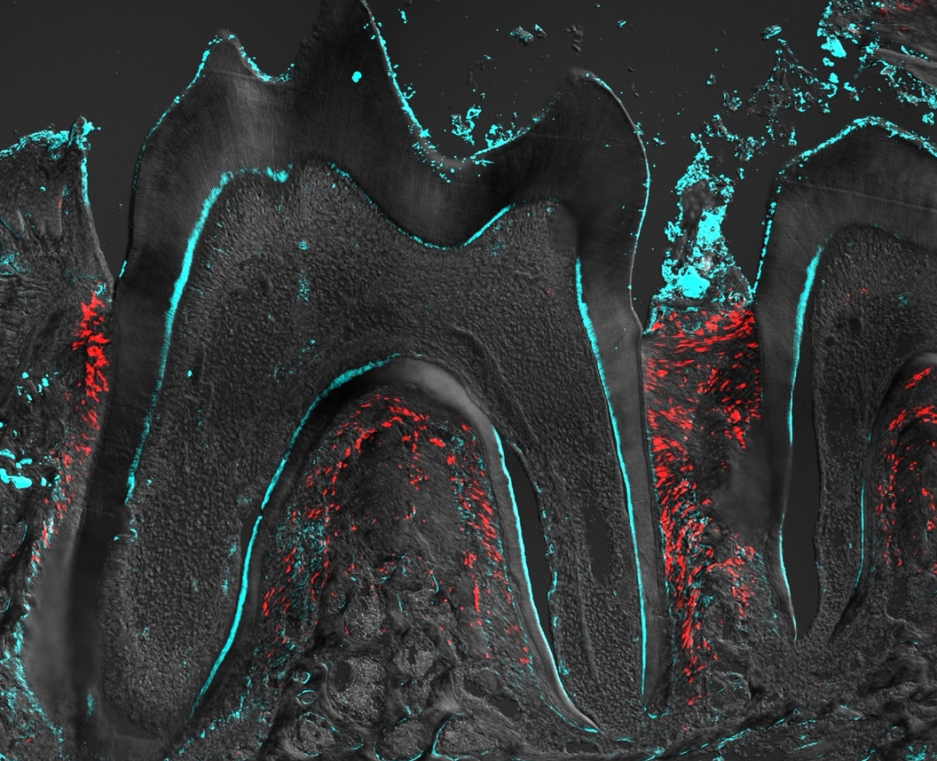
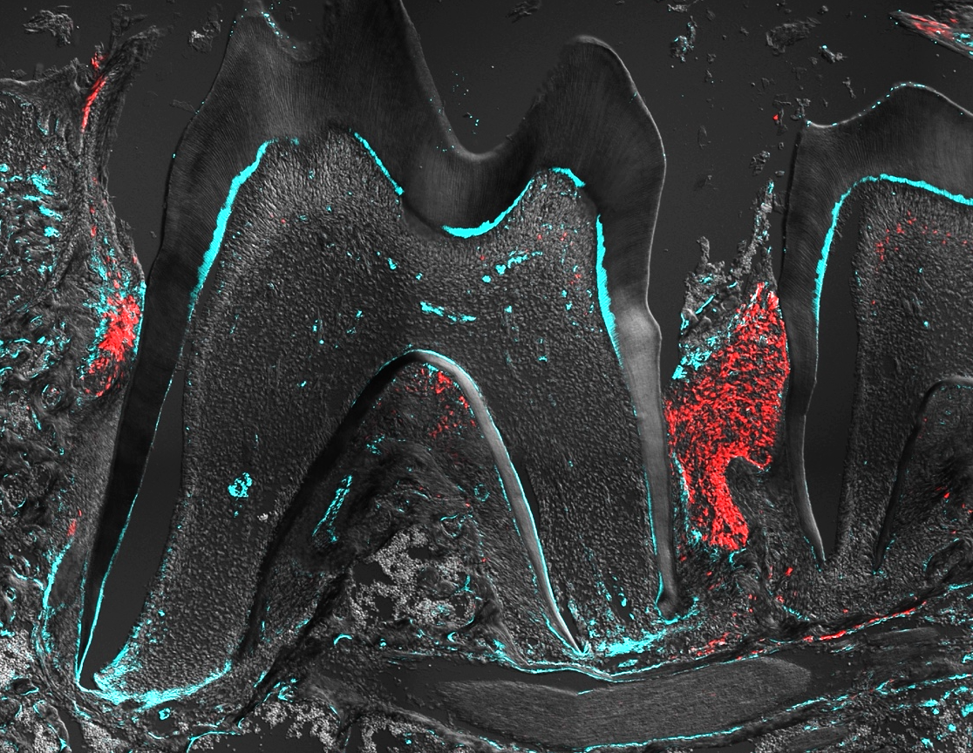
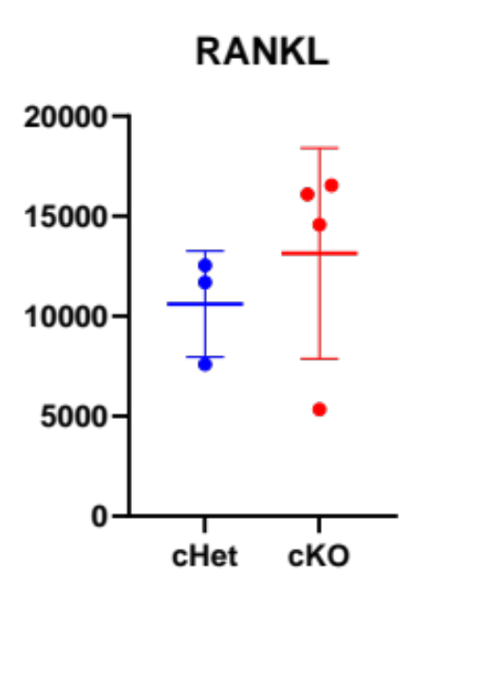
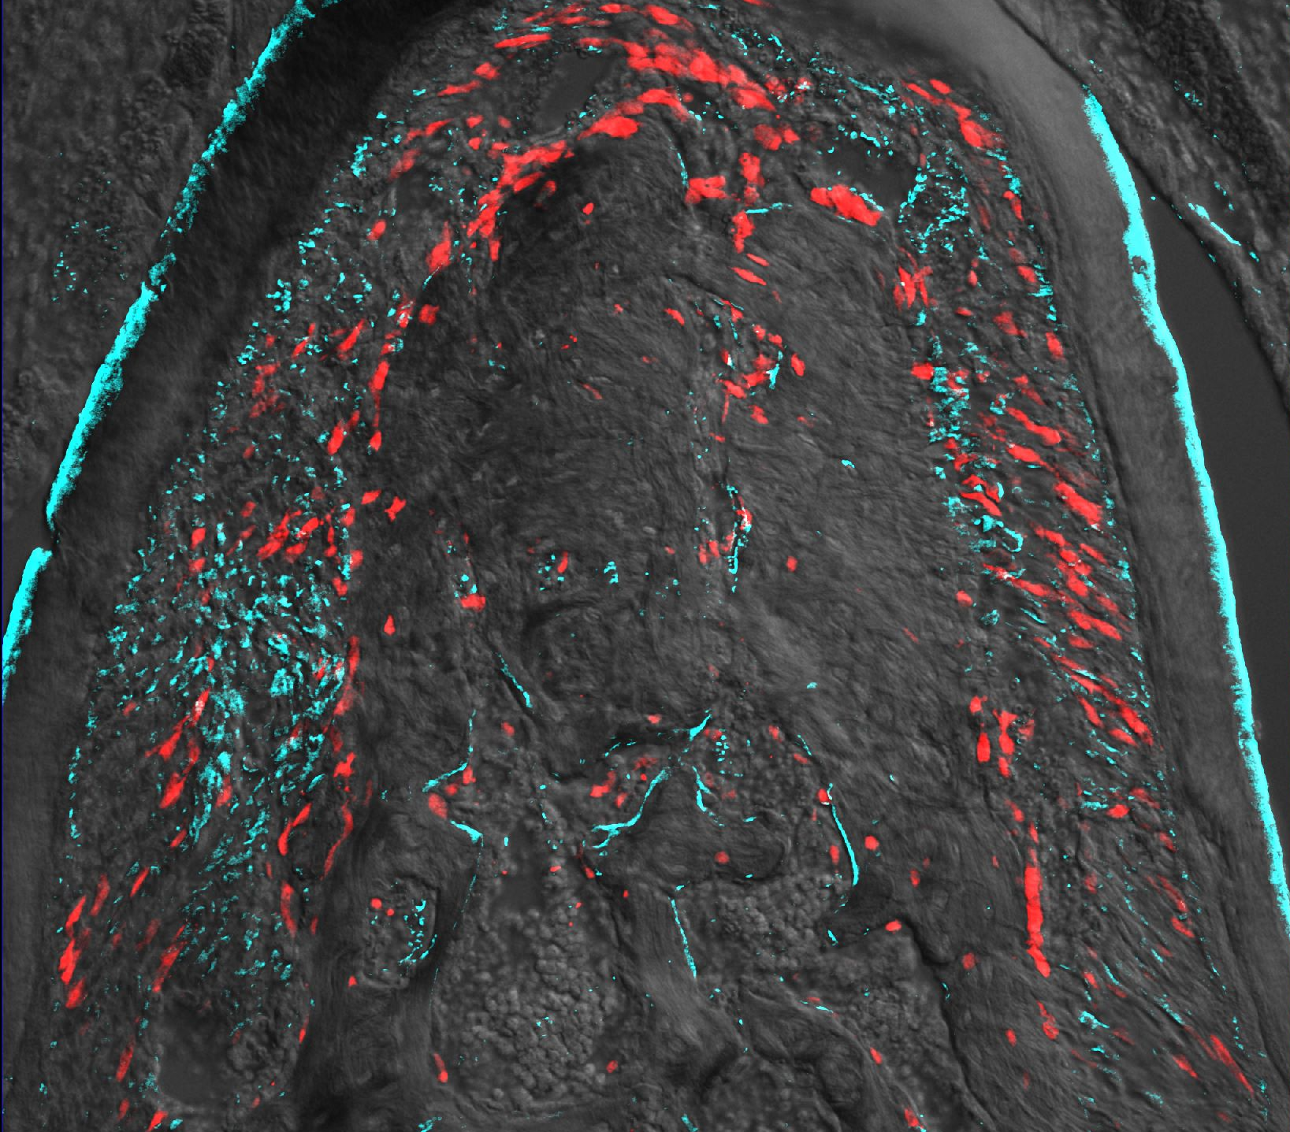

a
Control
DF-Ptch1
cHet
DF-Ptch1
cKO
g
****
p<0.0001
****
3 months
Body weight
Control
DF-Ptch1 cKO
DF-Ptch1 cHet
b
Ptch1^{fl/fl}
Pthrp-creER; Ptch1^{fl/+}
Pthrp-creER; Ptch1^{fl/fl}
Control
DF-Ptch1 cHet
DF-Ptch1 cKO
Tam P3
TRAP
TRAP
TRAP
TRAP⁺ osteoclasts/mm
Control
DF-Ptch1 cKO
DF-Ptch1 cHet
P25
c
Pthrp-creER; Ptch1^{fl/fl}; R26R^{tdTomato/+}
Pthrp-creER; Ptch1^{fl/+}; R26R^{tdTomato/+}
DF-Ptch1 cHet
DF-Ptch1 cKO
μm²
RANKL⁺ cells
P25 TAMP3
DF-Ptch1 cKO
DF-Ptch1 cHet
RANKL/PTHrP^{CE}-P3
Supplementary Figure 3. Deletion of Ptch1 in PTHrP⁺ DF cells & Impact of Hedgehog activation in PTHrP⁺ DF cells on osteoclast formation.
(a) Gross appearance and body weight at 3 months. ****P<0.0001, one-way ANOVA followed by the Mann-Whitney U test. n = 13 (Control), n = 16 (DF-Ptch1 cHet), n = 6 (DF-Ptch1 cKO). (b) TRAP staining of mandibular molars at P25. n = 3 per each group. Scale bars: 500 μm (upper panel), 50 μm (lower panel). (c) Quantification of RANKL expression in tdT⁺ cells. n = 3 (DF-Ptch1 cHet), n = 4 (DF-Ptch1 cKO). Scale bars: 500 μm (upper panel), 100 μm (lower panel). Exact P value is indicated in the figures. Source data are provided as a Source Data file.
Notes:
ShhGFP;
071519-no1392574-DOB070819-no1-ShhGFPCre+DISP3
072519-no1392574-DOB070819-no6-ShhGFPCre+DISP8
050622-080119-CK5-no1392574-DOB070819-no8-ShhGFPCre+DISP14-RM4-3 40xZ
050622-092319-no1392340-DOB081319-no11-ShhGFP+DISP20-RM2-1 40xZ
Scale bar:50um
Gli1GFP;
080819-no1392605-DOB080219-no2-Gli1eGFP+DISP3-RM1-3 20xZ 40xZ
RNAscope: 121819-no1522361-DOB120919-no5-ShhGFP+PTHLHmC+DisP3-RM2-3-Gli1
Scale bar:200um, 50um
Gli1creER
111019-no1522349-DOB110119-no1-ColGFP+Gli1CE+TAMP3-DISP5-RM1-3 10x
Scale bar:200um, 50um

Slide 5














a
Pthrp-creER BAC transgenic mice
No Tamoxifen
tdTomato
Rosa26
tdTomato(-)
RP23-27F7
CreER^{T2}
WPRE
rGHpA
loxP Stop loxP
E10
131kb
82kb
Pr_{PTHrP}
CreER^{T2}
E7
E8
E9
Ptch1 locus
Ptch1(+)
x
+Tamoxifen
tdTomato(+)
Pthrp-CreER; Ptch1^{fl/+};
R26R^{tdTomato/tdTomato}
Ptch1^{fl/fl}
tdTomato
Rosa26
E7
E10
Ptch1(-)
b
Ptch1 locus
Pthrp-creER; Ptch1^{fl/+}; R26R^{tdTomato}
Pthrp-creER; Ptch1^{fl/fl}; R26R^{tdTomato}
%
DF-Ptch1 cHet
DF-Ptch1 cKO
Merged
Ptch1
Merged
Ptch1
Tam P3
DP
Ptch1 (Ex8-9) mRNA
in tdT⁺ DF cells at P5
P5
DF
AB
Ptch1 (Ex8-9)/PTHrP^{CE}-P3/DIC/DAPI
c
DF-Ptch1 cHet
DF-Ptch1 cKO
%
*
Merged
Ptch1
Merged
Ptch1
p=0.0286
Tam P3
Tam P3
Ptch1 (Ex8-9) mRNA
in tdT⁺ DF cells at P8
DP
P8
AB
● DF-Ptch1 cKO
● DF-Ptch1 cHet
P8
DF
Ptch1 (Ex8-9)/PTHrP^{CE}-P3/DIC/DAPI
Tamoxifen
d
Pthrp-creER;
Ptch1^{fl/+}; R26R^{RGBow/RGBow}
Pthrp-creER;
Ptch1^{fl/fl}; R26R^{RGBow/RGBow}
DF-Ptch1 cHet
DF-Ptch1 cKO
P3
P18
Tam P3
%
G⁺B⁺
PDL
R⁺G⁺
D
D
Frequencies
of clones
R⁺B⁺
PDL
B⁺
AB
C
G⁺
R⁺
C
AB
DF-Ptch1 cHet
P18
DF-Ptch1 cKO
GFP/mOrange2/mKate2/DIC/DAPI
Supplementary Figure 4. In vivo lineage-tracing strategy & Ptch1 inactivation in PTHrP⁺ DF cells.
(a) Diagram of a tamoxifen-inducible creER system. Upon tamoxifen injection, the loxP-flanked tandem polyA sequences in the Rosa26 locus and loxP-flanked Ptch1 exon 8 and 9 are excised. The targeted cells – in this case, PTHrP-creER⁺ cells – permanently express tdTomato while lacking Ptch1. (b,c) RNAscope analysis of exon 8-9 of Ptch1 mRNA at P5 and P8. Green: Ptch1 (exon 8-9) expression, Red: PTHrP^{CE}-P3 cells, White dotted area: PTHrP-creER- tdT⁺ cells. n = 3 per each group. Scale bar: 50 μm. Quantification of Ptch1 (exon 8-9) mRNA expression levels in tdT⁺ DF cells. n = 3 per each group (c), n = 4 per each group (d). (d) In vivo clonal analysis. Pthrp-creER; Ptch1^{fl/+}; R26R^{RGBow/RGBow} (DF-Ptch1 cHet), Pthrp-creER; Ptch1^{fl/fl}; R26R^{RGBow/RGBow} (DF-Ptch1 cKO). M1&M2 interdental area at P18. Quantification of frequencies of each color combination. n = 3 (DF-Ptch1 cHet), n = 4 (DF-Ptch1 cKO). Green: GFP, red: mOrange2, blue: mKate2. Scale bar: 50 μm. DP: dental papilla, DF: dental follicle, D: dentin, C: cementum, PDL: periodontal ligament, AB: alveolar bone. *P<0.05. one-way ANOVA followed by the Mann-Whitney U test. All data are mean ± SD. Exact P value is indicated in the figures. Source data are provided as a Source Data file.
Notes:
b: Scale bar: 50um
P=0.0286

Slide 6



















a
b
mm
***
p=0.0001
%
****
***
Ptch1^{fl/fl}; R26R^{tdTomato}
Pthrp-creER; Ptch1^{fl/+}; R26R^{tdTomato}
p<0.0001
p=0.0008
Control
DF-Ptch1 cHet
Tam P3
Merged
Smo
M2 CEJ-ABC at P25
Smo mRNA
in DF cells at P8
P8
PBS LDE225 PBS LDE225
● DF-Ptch1 cHet
● Control
c
Ptch1-cHet
Ptch1-cKO
Smo/PTHrP^{CE}-P3/DAPI/DIC
mm
**
p=0.0070
***
p=0.0004
**
p=0.0061
d
PBS
LDE225
LDE225
or
vehicle (PBS)
M2 CEJ-ABC at 8weeks
Tam
P3
P4-13 P20
PBS LDE225 PBS LDE225
mm
p=0.0069
mm
p=0.0314
Ptch1-cHet
Ptch1-cKO
**
*
mm
M1
M1
M1 CEJ-ABC
M2 CEJ-ABC
M1 root length
PBS
LDE225
PBS
LDE225
PBS
LDE225
e
DF-Ptch1 cHet + LDE225
DF-Ptch1 cKO + PBS
DF-Ptch1 cKO + LDE225
P20 Tam P3
GAS1/PTHrP^{CE}-P3/DAPI/DIC
Supplementary Figure 5. Smo antagonist LDE225 induces defective alveolar bone formation when administered during the onset of tooth root formation.
(a) RNAscope analysis of Smo mRNA at P8. Green: Smo, Red: PTHrP^{CE}-P3 cells. Right panels: Quantification of Smo mRNA expression levels in DF cells. n = 3 per each group (b,c) Quantification of mandibular second molar (M2) CEJ-ABC distance at P25 (a) and 8 weeks (b). n = 8 per each group (b), n = 3 (DF-Ptch1 cHet + PBS), n = 6 (DF-Ptch1 cHet + LDE225), n = 4 (DF-Ptch1 cKO + PBS), n = 5 (DF-Ptch1 cKO + LDE225) (c). (d) LDE225 administration induced substantial defects in the alveolar bone in physiological condition. Composite 3D surface model overlay of the mandible and quantitative 3D-µCT analysis of the distance between cement-enamel junction and alveolar bone crest (CEJ-ABC) and M1 root length. n = 4 (PBS), n = 3 (LDE225). M1: mandibular first molar, M2: mandibular second molar. (e) Immunostaining of Hedgehog-responsive GAS1 at P20 alveolar bones in LDE225-treated (left, right) and PBS-treated (center) DF-Ptch1cHet (left) and DF-Ptch1 cKO (center, right) molars. Green: GAS1. Scale bars: 50 μm. one-way ANOVA followed by the Mann-Whitney U test (a,b) and two-sided unpaired t-test (c). *P<0.05 **P<0.01, ***P<0.001, **** P<0.0001. All data are mean ± SD. Exact P value is indicated in the figures. Source data are provided as a Source Data file.
Notes:
M2 CEJ-ABC at P25
cHet+PBS: 0.20+0.03
cHet+LDE: 0.19+0.02
cKO+PBS: 0.31+0.00
cKO+LDE: 0.21+0.03
M2 CEJ-ABC at P8W
cHet+PBS: 0.22+0.04
cHet+LDE: 0.19+0.01
cKO+PBS: 0.36+0.08
cKO+LDE: 0.30+0.05
Tm Oc Interradicular at P25
cHet+PBS: 48.3+7.3
cHet+LDE: 45.0+12.5
cKO+PBS: 11.5+4.6
cKO+LDE: 37.5+12.2

Slide 7








Vertical extraoral incision
on right buccal surface
Superficial masseter
incision
Deep masseter
incision
Right mandibular
buccal bone
10 mm
Φ1.0 mm
Suture skin using
6-0 silk sutures
Suture masseter using
7-0 absorbable sutures
Φ1.0 mm defect
on buccal bone
Drill hole surgery using
rotatory instruments
Supplementary Figure 6. Experimental procedure of periodontal drill-hole surgery.
Step-by-step demonstration of surgical procedures. A vertical extraoral incision was made at the right mandible under a stereoscopic microscope. The masseter muscle was excised to expose the buccal plate. A 0.9 mm diameter stainless steel bur was used to with a rotary instrument (Fine Science Tools) to carefully drill through the buccal bone, periodontal ligament, cementum, dentin of the furcation and the mesial root of mandibular first molar. The dimension of the periodontal defect in the buccal area was 1.0 mm diameter in width, 1.0 mm at maximum depth. The masseter and the skin were sutured with 7-0 resorbable sutures and 6-0 silk.
Notes:
Defect: Φ1.0mm
(Bur :Φ 0.9mm)

Slide 8





a
Ptch1^{Het}
∆Ptch1
b
KEGG
Ptch1^{Het}
∆Ptch1
c
REACTOME
d
GO
NES
Supplementary Figure 7. Bulk RNA-seq analysis of Hedgehog-activated PTHrP⁺ DF cells.
(a) Volcano plot showing differentially expressed genes (DEGsbetween PTHrP^{CE}-Ptch1^{Het}-P3 cells (Ptch1^{Het}) and PTHrP^{CE}-∆Ptch1-P3 cells (∆Ptch1). Total of 28 genes were differentially expressed with an adjusted P-value cut-off of 0.05 (DESeq2). Blue dots: DEGs upregulated in Ptch1^{Het} (16 genes), Red dots: DEGs upregulated in ∆Ptch1 (12 genes).
(b-d) GSEA analysis. Top 10 enriched pathways for Ptch1^{Het} and ∆Ptch1 ranked by Normalized Enrichment Score (NES) based on GSEA gene set enrichment analysis. Categories based on KEGG (b), Reactome (c), or Gene ontology (GO) (d) database.
Notes:
A; 051419 P3-P8
cHet: 1.27 + 0.64 %
cKO: 1.03 + 0.37 %

Slide 9









a
Tamoxifen
0.25mg
Pthrp-creER; R26R^{Tomato}
c
Foxf1
Foxf2
P3
P8
Clonal isolation
Ps1: Secondary colony formation
*
*
1
2
3
10~14d
1
2
3
p=0.0117
p=0.0483
1
2
3
14d
Ps0: Colony-forming DF cells
>Ps2: Expansion
Normalized to GAPDH
2 10 50 μM
Control
2 10 50 μM
b
~30,000 cells/cm²
Control
SAG
SAG
Pthrp-creER; R26R^{Tomato}: P8 DF cells (Tamoxifen at P3)
Ptch
Smo
Passage-0
Passage-1
Passage-2
Passage-9
Control
2 10 50 μM
Control
2 10 50 μM
Single colony isolation & subculture
SAG
SAG
Supplementary Figure 8. Pthrp-creER⁺ DF cells are responsive to Hedgehog stimulation ex vivo.
(a) Diagram of colony-forming assay of established independent clones of PTHrP⁺ DF cells at P8 (pulsed at P3). (b) Passaging of individual PTHrP⁺ DF cells colonies. Inset: magnified view of single colony. Red: tdTomato. Scale bars: 5 mm, 1 mm (inset). (c) Expression of Hedgehog-related genes in PTHrP⁺ DF cells. PTHrP⁺ DF cells were stimulated with Smoothened (Smo) agonist SAG, and determined mRNA level of Foxf1, Foxf2, Ptch and Smo after 48 hours of SAG administration. *P<0.05, one-way ANOVA followed by the Mann-Whitney U test. All data are mean ± SD. Exact P value is indicated in the figures. Source data are provided as a Source Data file.

Slide 10













a
Tamoxifen
0.25mg
ΔFoxf1
DF-Foxf1 cKO
PTHrP⁺
DF cells
ΔFoxf2
DF-Foxf2 cKO
P3
P25
ΔFoxf1Δ Foxf2
DF-Foxf1; Foxf2 dKO
Pthrp-creER; Foxf1^{fl/+}; R26R^{tdTomato}
Pthrp-creER; Foxf1^{fl/fl}; R26R^{tdTomato}
DF-Foxf1 cHet
DF-Foxf1 cKO
b
c
Tam P3
b’
c’
P25
PTHrP^{CE}-P3/DIC/DAPI
d
Pthrp-creER; Foxf2^{fl/+}; R26R^{tdTomato}
Pthrp-creER; Foxf2^{fl/fl}; R26R^{tdTomato}
DF-Foxf2 cHet
DF-Foxf2 cKO
d
e
Tam P3
d’
e’
P25
PTHrP^{CE}-P3/DIC/DAPI
g
DF-Foxf1/Foxf2 dKO
Pthrp-creER; Foxf1^{fl/fl}; Foxf2^{fl/fl}; R26R^{tdTomato}
b
Control
DF-Foxf1;Foxf2 dKO
f
Tam P3
f’
Mandible. Superimposed at the mandible border
M1
M2
P25
Mandibular molars.
Superimposed at the crown
PTHrP^{CE}-P3/DIC/DAPI
Supplementary Figure 9. Dispensable roles of Foxf1/Foxf2 in steady-state PTHrP⁺ DF cells.
(a) Conditional deletion of Foxf1 and/or Foxf2 in PTHrP-creER⁺ DF cells. (b,c) Foxf1 single mutant (DF-Foxf1 cHet & cKO) molars. (d,e) Foxf2 single mutant (DF-Foxf2 cHet & cKO) molars. (f) Foxf1/Foxf2 double mutant (DF-Foxf1/Foxf2 dKO) molars. Scale bars: 500 μm (b-f), 50 μm (b’-f’).
(g) Composite 3D surface model overlay. Superimposition registered on mandibles and mandibular molars. Red: DF-Foxf1/Foxf2 dKO molars, Light blue: Control molar, Beige: DF-Foxf1/Foxf2 dKO mandible, Light green: Control mandible. M1: mandibular first molar, M2: mandibular second molar.
Notes:
Scale bar: 500 um, 50 um
Foxf1fl
cHet: 070620-no1613309-DOB052920-no3-rp945+Foxf1fl+T3-DIS25-LM1-1 10x 20xZ
cKO: 070620-no1613309-DOB052920-no1-rp945+Foxf1flfl-T3-DIS25-LM4-1 10x 20xZ
Foxf2fl
cHet: 092220-no1613297-DOB081620-no2-OcGFP+945+Foxf2fl+TAMP3-25-LM2-2 10x 20xZ
cKO: 061621-no1936306-DOB032621-no2-OcnG+945+Foxf2flfl-TP3-25-LM2-2 10x 20xZ
Foxf1flfl;Foxf2flfl
Foxf1flfl;Foxf2fl/+
Foxf1fl+;Foxf2flfl

Slide 11
Growing molars
This paper
Dental
follicle (DF)
PTHrP⁺ DF cells differentiate into alveolar bone osteoblasts, PDL fibroblasts and cementoblasts,.
Constitutive activation of Hedgehog signaling in PTHrP⁺ DF cells cause alveolar bone loss without any disturbance of tooth root formation and Foxf1 is a critical downstream gene of Hedgehog signaling.
Hedgehog-Foxf
Osteoblast
Dental papilla
PDL fibroblast
Apical papilla (AP)
PTHrP⁺ DF cell
Hertwig’s epithelial
root sheath
Cementoblast
Canonical Wnt
The companion paper
Odontoblast
CXCL12⁺ AP cells differentiate into odontoblasts, PDL fibroblasts, cementoblasts.
Inactivation of canonical Wnt signaling in CXCL12⁺ AP cells cause failure of tooth root formation without alveolar bone destruction.
CXCL12⁺ AP cell
PDL fibroblast
Cementoblast
Supplementary Figure 10. Different role between PTHrP⁺ DF cells and Cxcl12⁺ AP cells during tooth root formation.
PTHrP⁺ DF cells contribute to alveolar bone formation via Hedgehog-dependent manner. Constitutive activation of Hedgehog signaling by Ptch1 deletion in PTHrP⁺ DF cells lead to alveolar bone loss without any disturbance of tooth root formation. In contrast, CXCL12⁺ AP cells contribute to tooth root formation via Wnt signaling. Inactivation of Wnt signaling by β-Cat deletion in CXCL12⁺ AP cells lead to shorter roots without affecting surrounding alveolar bones.

Slide 12
Supplementary methods: Gating strategies for flow cytometry analysis
Single cells were first gated using FSC and SSC denominators to exclude debris and doublets of cells. The hematopoietic lineage cells were identified by CD45 staining. For collecting dental mesenchymal cells including PDL cells and osteoblasts, CD45 negative cell populations were isolated. For each gating strategy, negative 'unstained' control samples were always used as a reference to determine the demarcation between the positive and negative populations.

