Slide 1
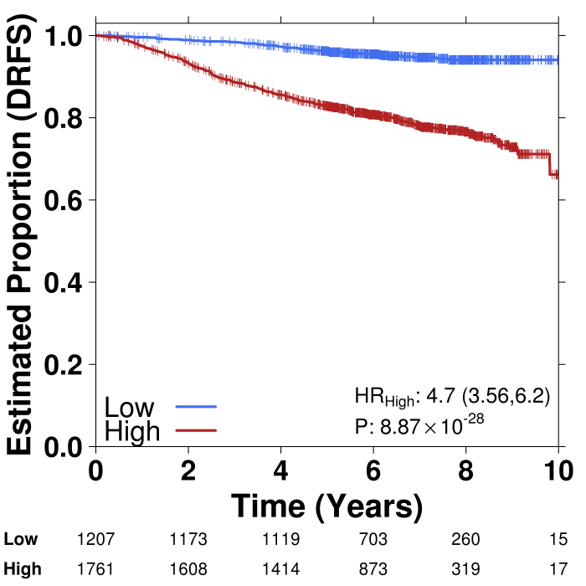
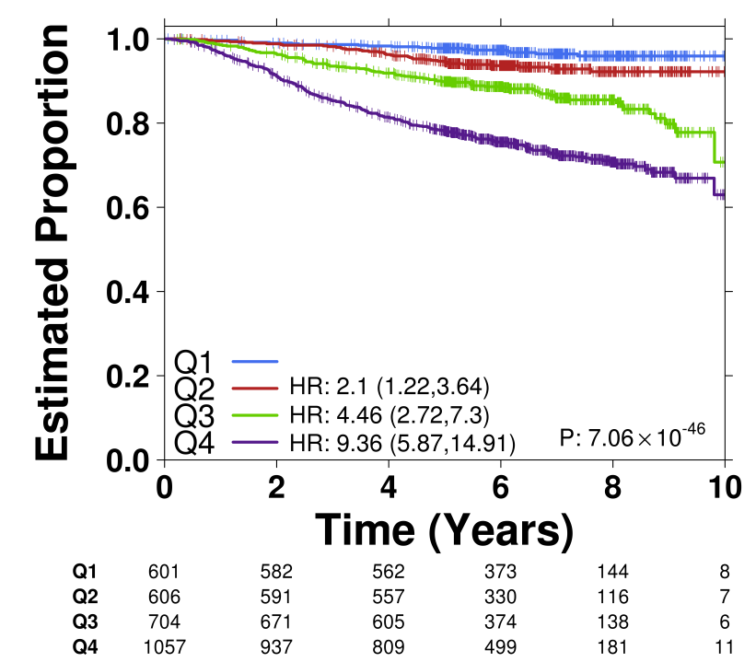
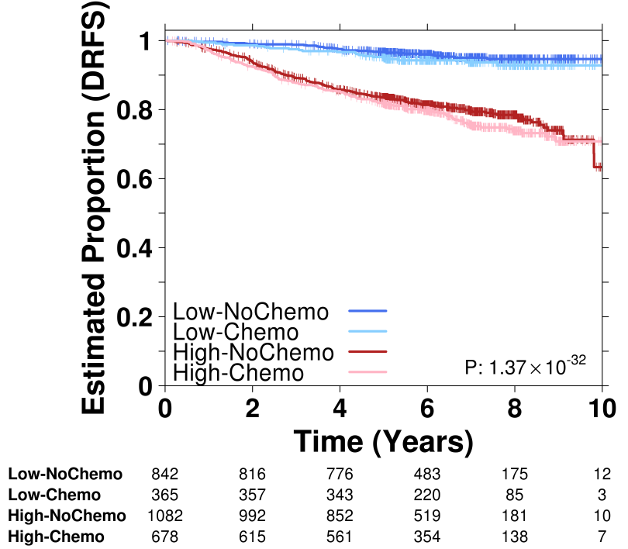
95-Gene Risk Signature: Validated in All Patients
(Endocrine/Endocrine+Adjuvant Chemotherapy)
A
B
C
Notes:
Supplementary Figure 4

