Slide 1
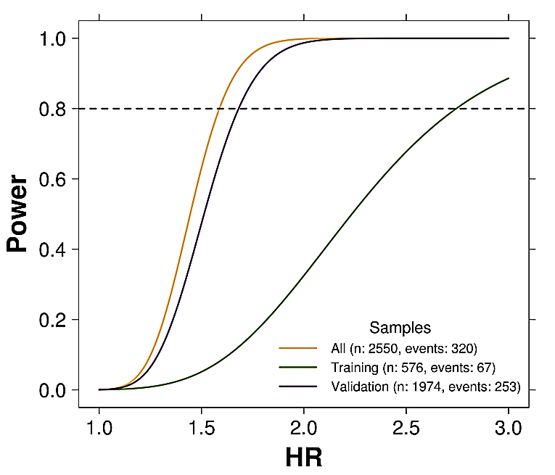
A
Total of 5-year treatment
RANDMONISATION
Tamoxifen
Exemestane
2.5 years
Exemestane
B
C
4,736 patients TEAM Pathology Biobank
sufficient RNA and successfully assayed
n=3825
Training Cohort
n=790
Validation Cohort
n=3,035
Endocrine treated only = 576
Endocrine + adjuvant = 214
Endocrine treated only = 1974
Endocrine + adjuvant =1062
Notes:
Supplementary Figure 8

