Slide 1



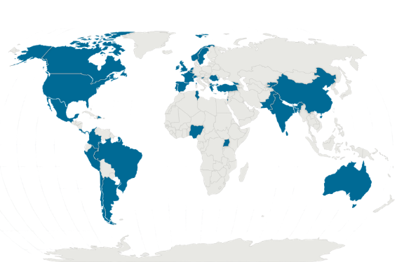


Question: How do primary healthcare professionals (PCPs) globally perceive and use systemic corticosteroids (SCS) for asthma and COPD?
Population
314 primary care prescribers
62 community pharmacists
Outcomes measured
PCPs’ reported perceptions and practices of SCS use in asthma and COPD:
reported availability and use of clinical guidelines
indications and patterns of SCS prescribing or dispensing
perceived appropriateness of SCS use in different clinical scenarios
provision of SCS “action packs” for patient-initiated use
perceptions of OTC availability and self-medication with SCS
Findings
SCS perceived as overused in asthma and COPD - frequently outside guideline recommendations by ≈60% prescribers and 57% pharmacists
Causes of overuse: limited access to inhaled or biologic therapies and gaps in knowledge
Despite ~60% reporting mandatory prescriptions, OTC availability still observed (oral 48%; injectable 36%), with variation across countries
Self-medication rates also high (oral: adults ~50%, children 34%; injectable: adults 30%, children 17%)
67% of prescribers would issue repeat prescriptions without clinical review, which may increase risk to patient safety
Use of SCS for long-term management:
Asthma: 23% prescribers, vs 59.7% of community pharmacists
COPD: 9.7% prescribers vs 46.8% of community pharmacists
What does this study add?
Addresses a key evidence gap in reported SCS use in primary care
Reports consistent perceptions of widespread SCS overuse across settings
Highlights a disconnect between guideline recommendations and reported practices
Clarifies research needs, including the use of OTC and dispensing data
Study design
Cross-sectional, observational study using online scenario-based self-administered questionnaire
Recommendations
Stronger SCS stewardship in primary care
e.g. community pharmacy databases
Improve clinicians’ and public confidence and competence in exacerbation management and awareness of risks of long-term SCS use
Improve access to inhaled corticosteroid therapies, blood eosinophil testing and biologics (when indicated for CRDs)
National strategies for appropriate SCS use
e.g. emergency use out of hospital; stop-start guidance; dose, frequency and duration
Location
41 countries
LMIC 46.3% HICs 53.7%
Franceschini J, Williams S, Fitch N, Fonte P, Correia-de-Sousa J, Kaplan A, van Boven JFM, Salvi S, Khoo EM. Global perceptions and practices on systemic corticosteroid use for asthma and COPD in primary care: results from a multinational survey on prescribers and community pharmacists. [Journal Name]. [Year];[Volume(Issue)]:[Pages].
June 2026

