Slide 1
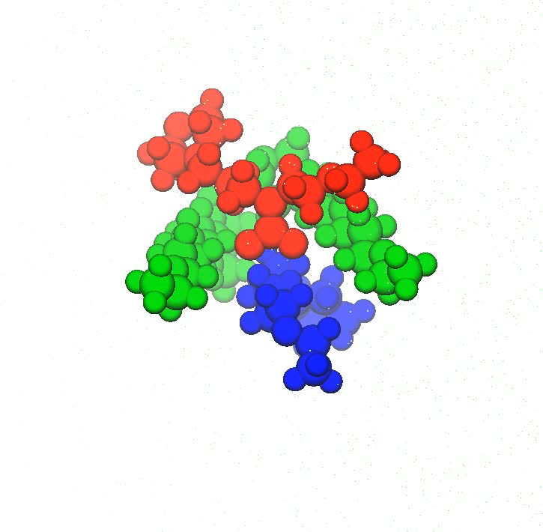
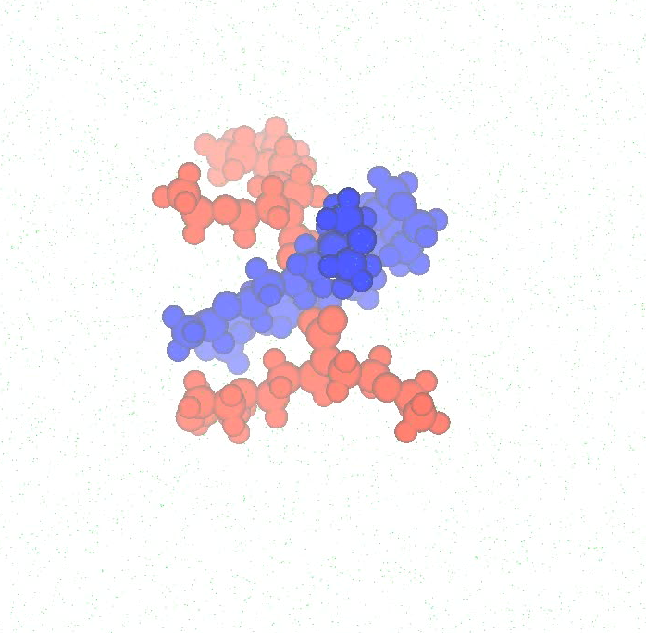
Examples of E⁴(0.25) and E⁴(0.5) clusters in a 25 mol% CO2 loading system from a 1-μs classical molecular dynamics trajectory
~ E⁴(0.25)
E⁴(0.5)
2E(0) - E(0)⁺ - E(1)⁻
2E(0)⁺ - 2E(1)⁻

