Slide 1
Supplementary Data Uncropped blot images
III-6 of F8398
II-4 of F8398
III-3 of F8398
2.5 kb ladder
IV-2 of F8398
1 kb ladder
control
1 kb ladder
control
10 kb
5 kb
2 kb
Figure 4b

Slide 2
II-6 (F6906)
affected
λ/HindIII
II-7 (F6906)
unaffected
λ/HindIII
23.1 kb
9.4 kb
6.6 kb
4.4 kb
2.3 kb
23.1 kb
9.4 kb
6.6 kb
23.1 kb
4.4 kb
9.4 kb
6.6 kb
2.3 kb
4.4 kb
2.3 kb
Supplementary
Figure 7a
Figure 2e
Figure 2e and Supplementary Figure 7a
Figure 2f
λ/HindIII
λ/HindIII
23.1 kb
23.1 kb
9.4 kb
9.4 kb
6.6 kb
6.6 kb
4.4 kb
4.4 kb
Figure 6c

Slide 3
λ/HindIII
λ/HindIII
23.1 kb
23.1 kb
9.4 kb
9.4 kb
6.6 kb
6.6 kb
4.4 kb
4.4 kb
Figure 6f
pBR328/BglI + pBR328/HinfI
λ/HindIII
23.1 kb
9.4 kb
6.6 kb
4.4 kb
2.3 kb
2.0 kb
Supplementary Figure 7b
Notes:
pBR328のBglⅠ切断断片とpBR328のHinfⅠ

Slide 4
pBR328/BglI + pBR328/HinfI
λ/HindIII
λ/HindIII
23.1 kb
9.4 kb
6.6 kb
4.4 kb
2.3 kb
2.0 kb
Supplementary Figure 7c

Slide 5
pBR328/BglI + pBR328/HinfI
λ/HindIII
λ/HindIII
23.1 kb
9.4 kb
6.6 kb
4.4 kb
2.3 kb
2.0 kb
Supplementary Figure 7d

Slide 6
Supplementary Figure 11a

Slide 7
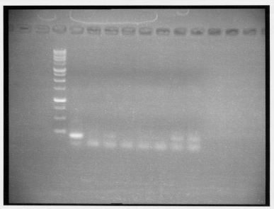
Supplementary Figure 14b

