Slide 1


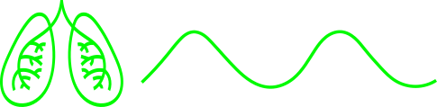
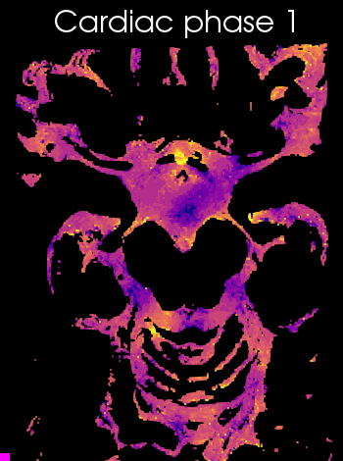
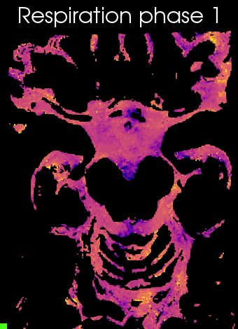
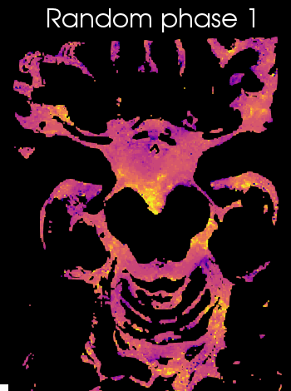
Suppl. video 2: Animation of CSF-mobility change across driving forces in the subarachnoid space around the circle of Willis
CSF-mobility change from the mean value over phases (in %) across the cardiac (left), respiration (middle) and random (right) cycles in one representative individual (same data as in Fig. 3, but as a gif). Please note that a linear interpolation was applied between the phases to visually smoothen the video.
-10
CSF-mobility change (%)
10

