Slide 1
Supplementary Information
Correction of a Disease Mutation using CRISPR/Cas9-assisted Genome Editing in Japanese Black Cattle
Mitsumi Ikeda¹, Shuichi Matsuyama², Satoshi Akagi³, Katsuhiro Ohkoshi¹, Sho Nakamura², Shiori Minabe², Koji Kimura⁴ and Misa Hosoe¹
¹Institute of Agrobiological Sciences, NARO, Ikenodai 2, Tsukuba, Ibaraki, 305-8602, Japan
²Institute of Livestock and Grassland Science, NARO, Senbonmatsu 768, Nasushiobara, Tochigi, 329-2793, Japan
³Institute of Livestock and Grassland Science, NARO, Ikenodai 2, Tsukuba, Ibaraki, 305-0901, Japan
⁴Okayama University Graduate School of Environmental and Life Science, Tsushima-Naka 1-1-1, Kita-ku, Okayama, 700-8530, Japan

Slide 2
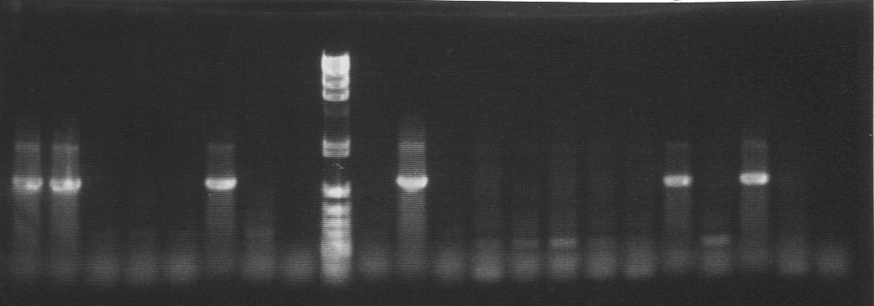
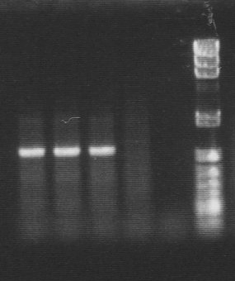
#820-1
#820-1
colony no.
1
2
3
4
5
PC
NC
M
1
2
PC
NC
M
kb
1.2
1.3
5’ junction
3’ junction
primer set
1st: F1 x R1
2nd: F2 x R2
1st: F3 x R3
2nd: F4 x R4
Fig. S1 Screening of recombinant BFF cells. In Experiment No. 2 (see Table 1), five colonies derived from #820-1 were subcloned and subjected to junction PCR analysis. Colonies no. 1 and 2 showed the expected PCR fragment size for both the 5’ and 3’ junction. These two clones were picked from same dish; thus, they were characterized as identical clones that were derived from a single recombinant cell. M indicates DNA size marker (λ/HindIII + φX174/HincII).

Slide 3
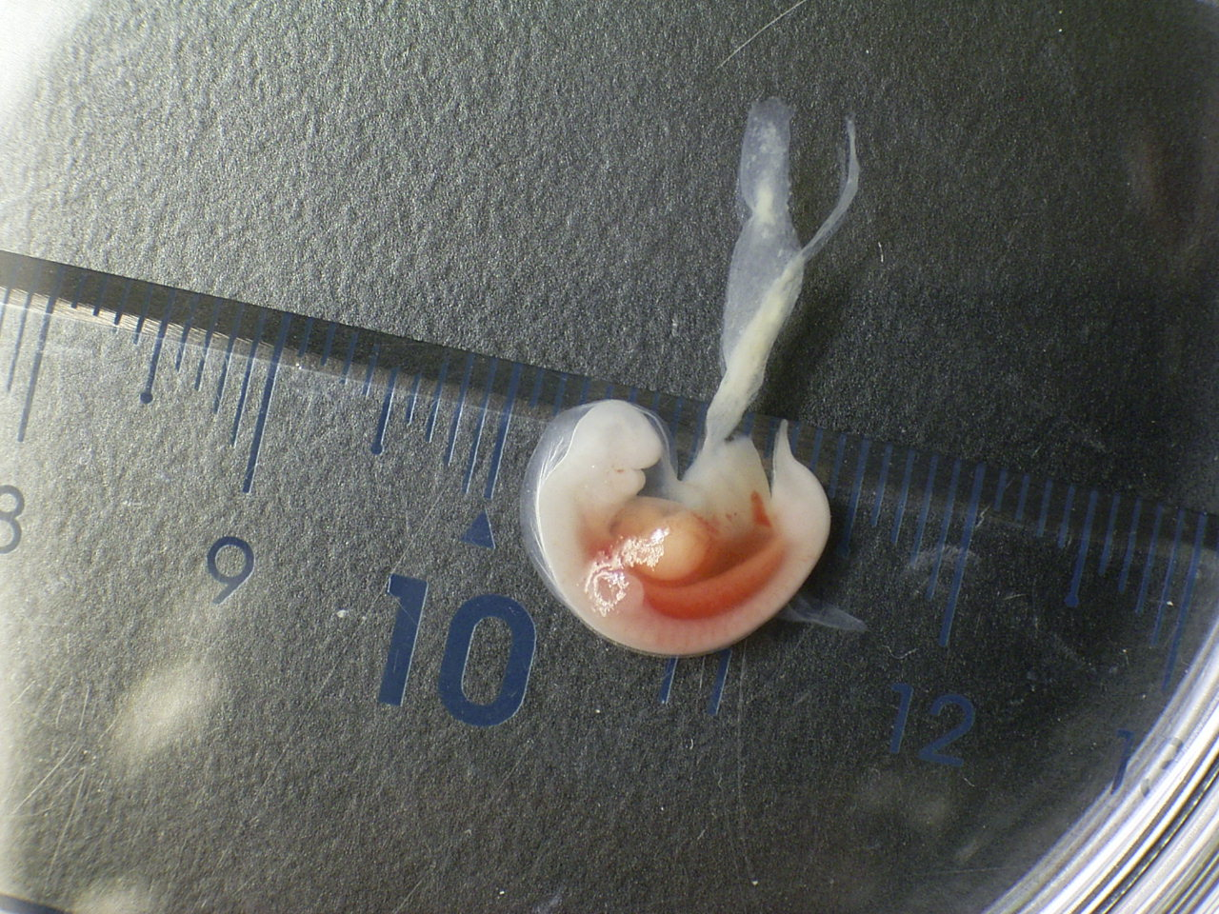
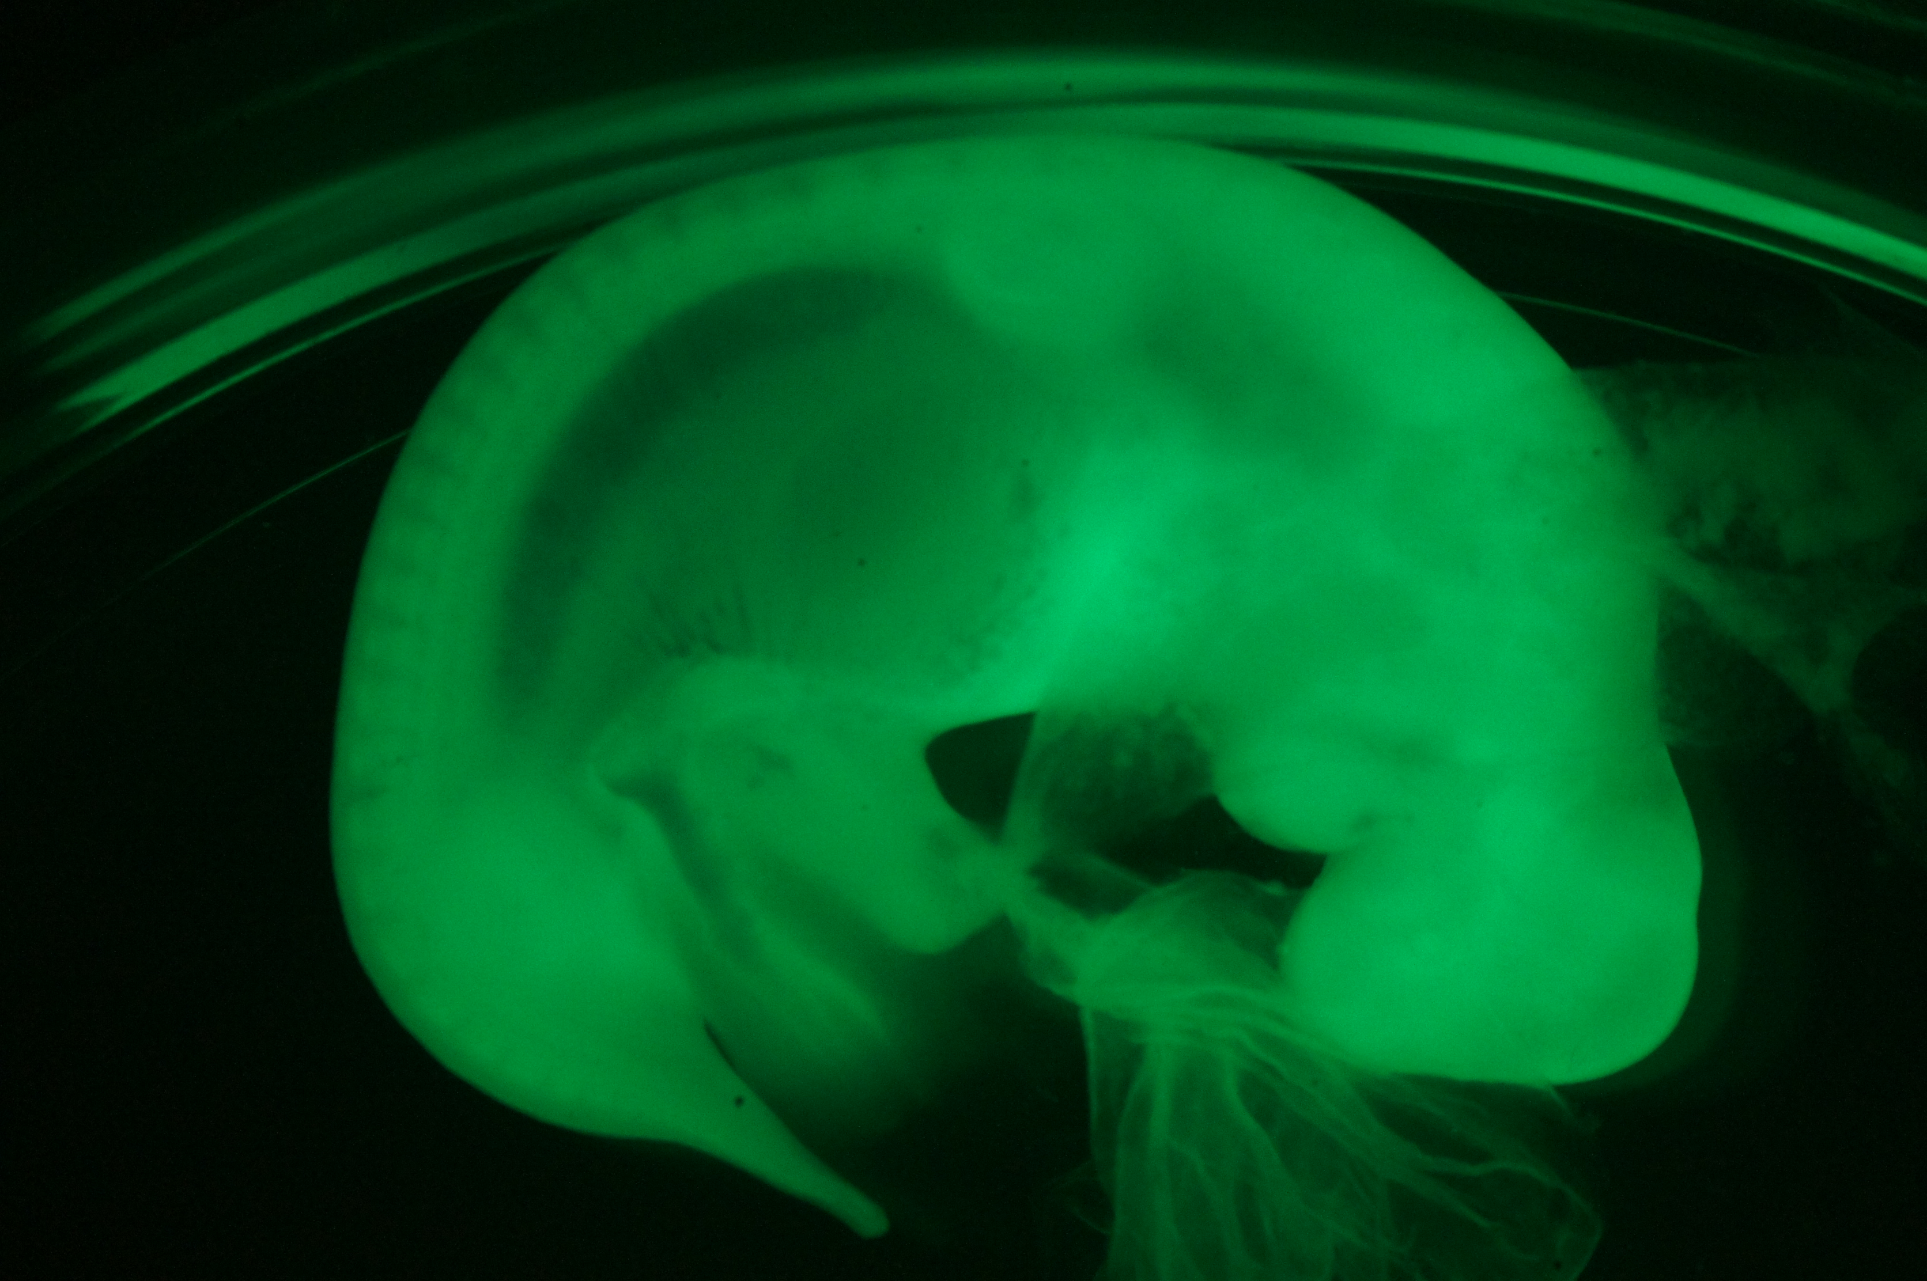
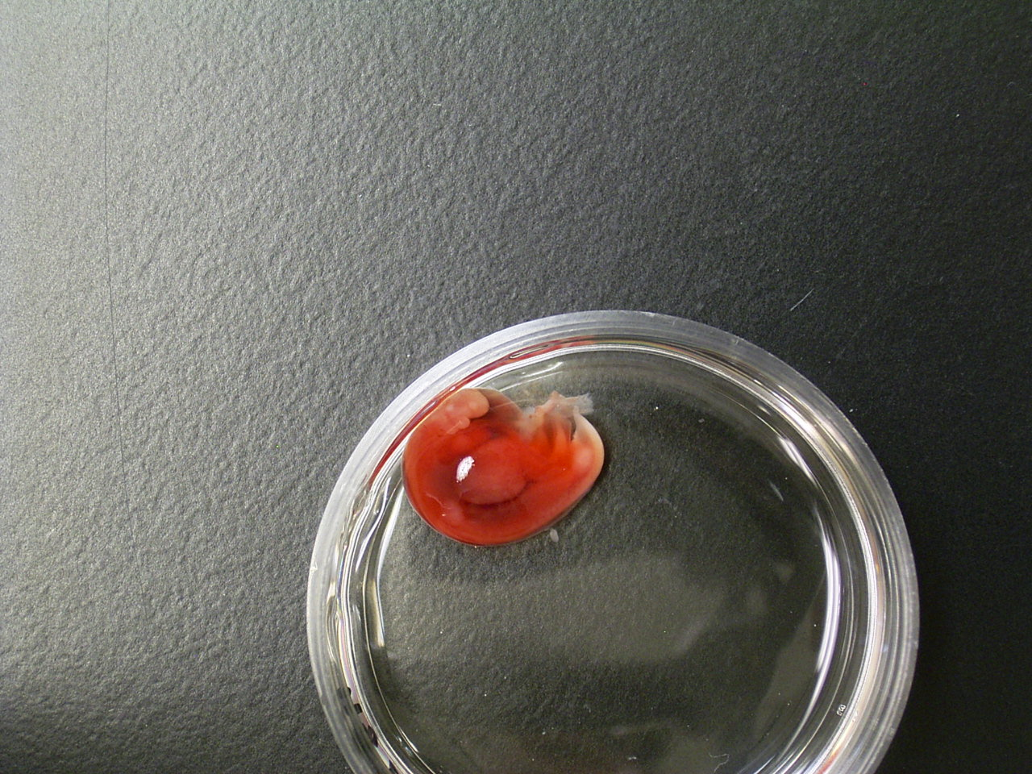
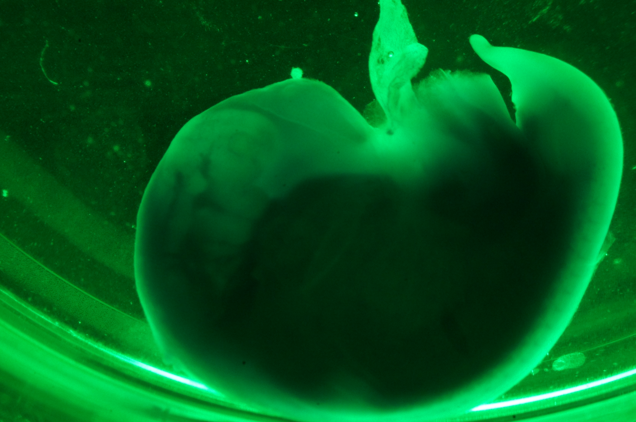
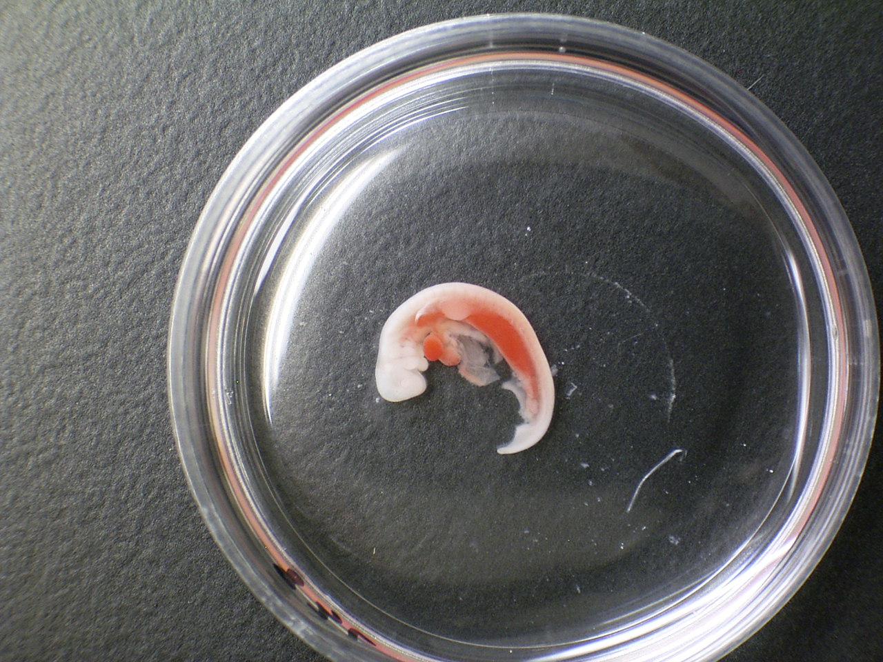
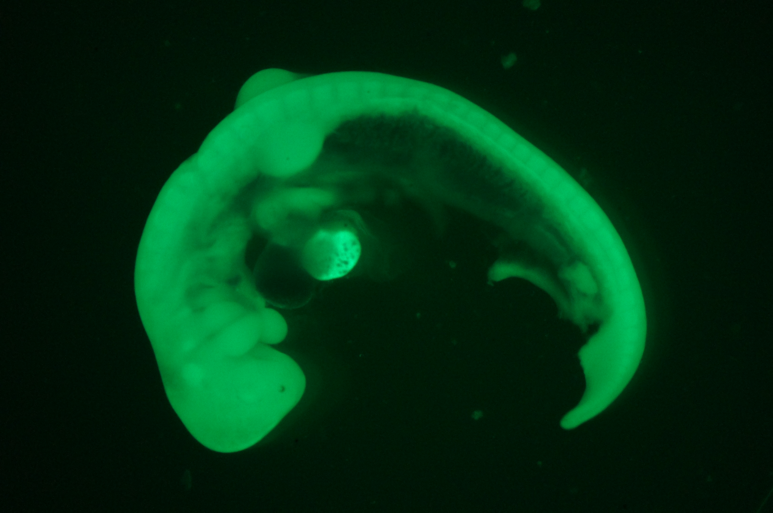
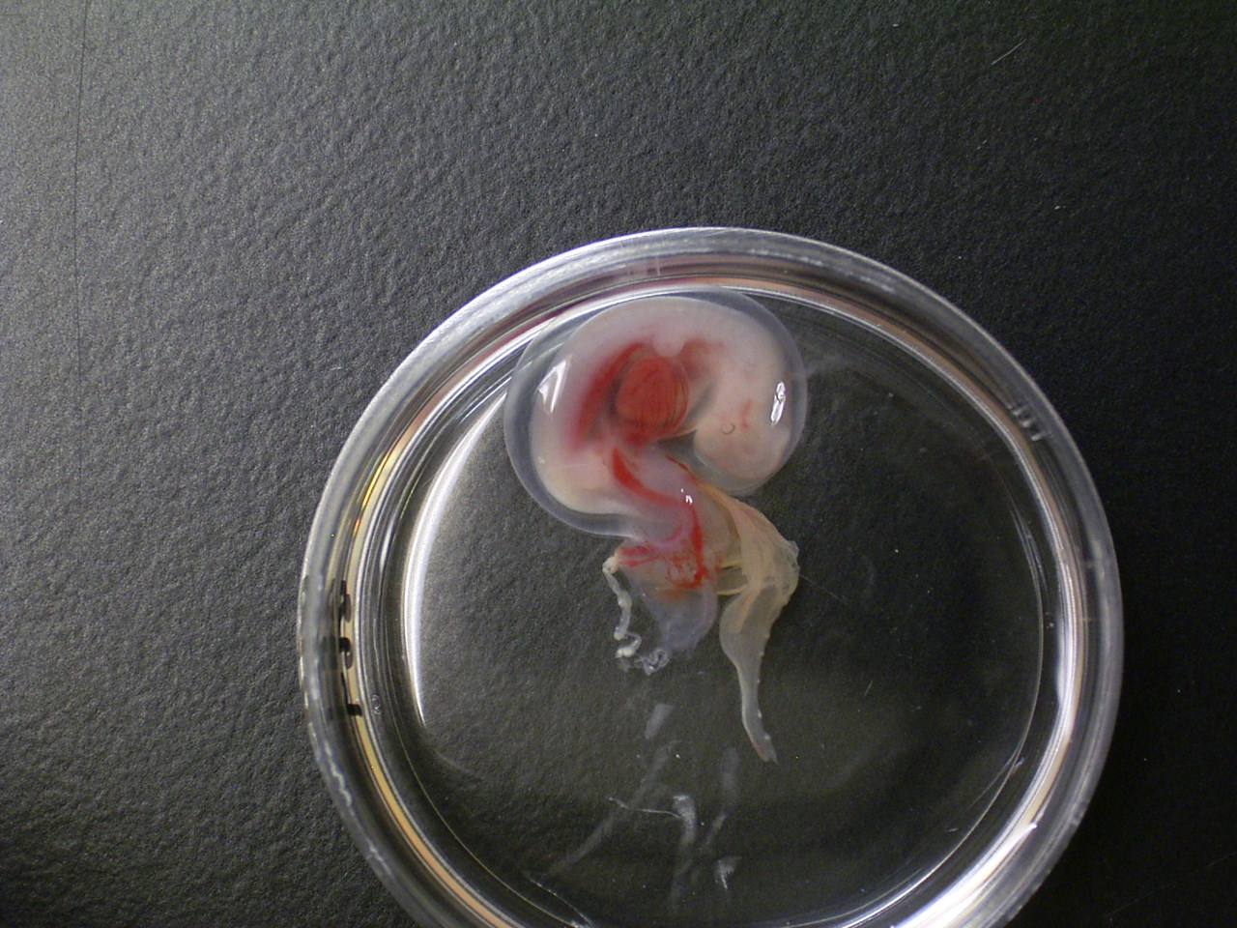
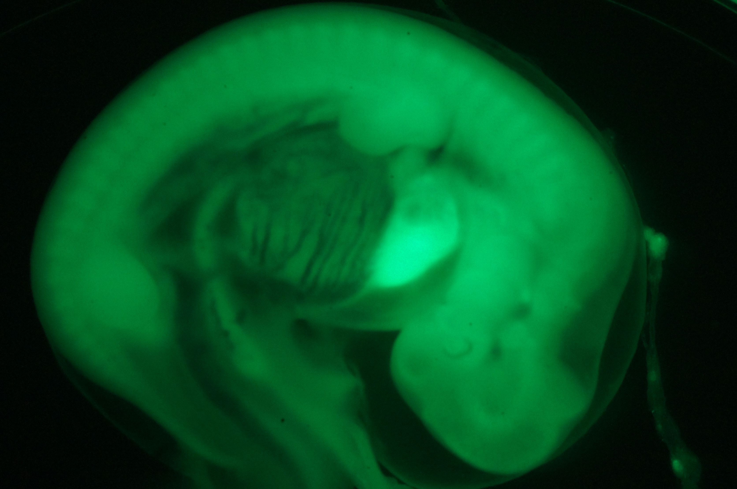
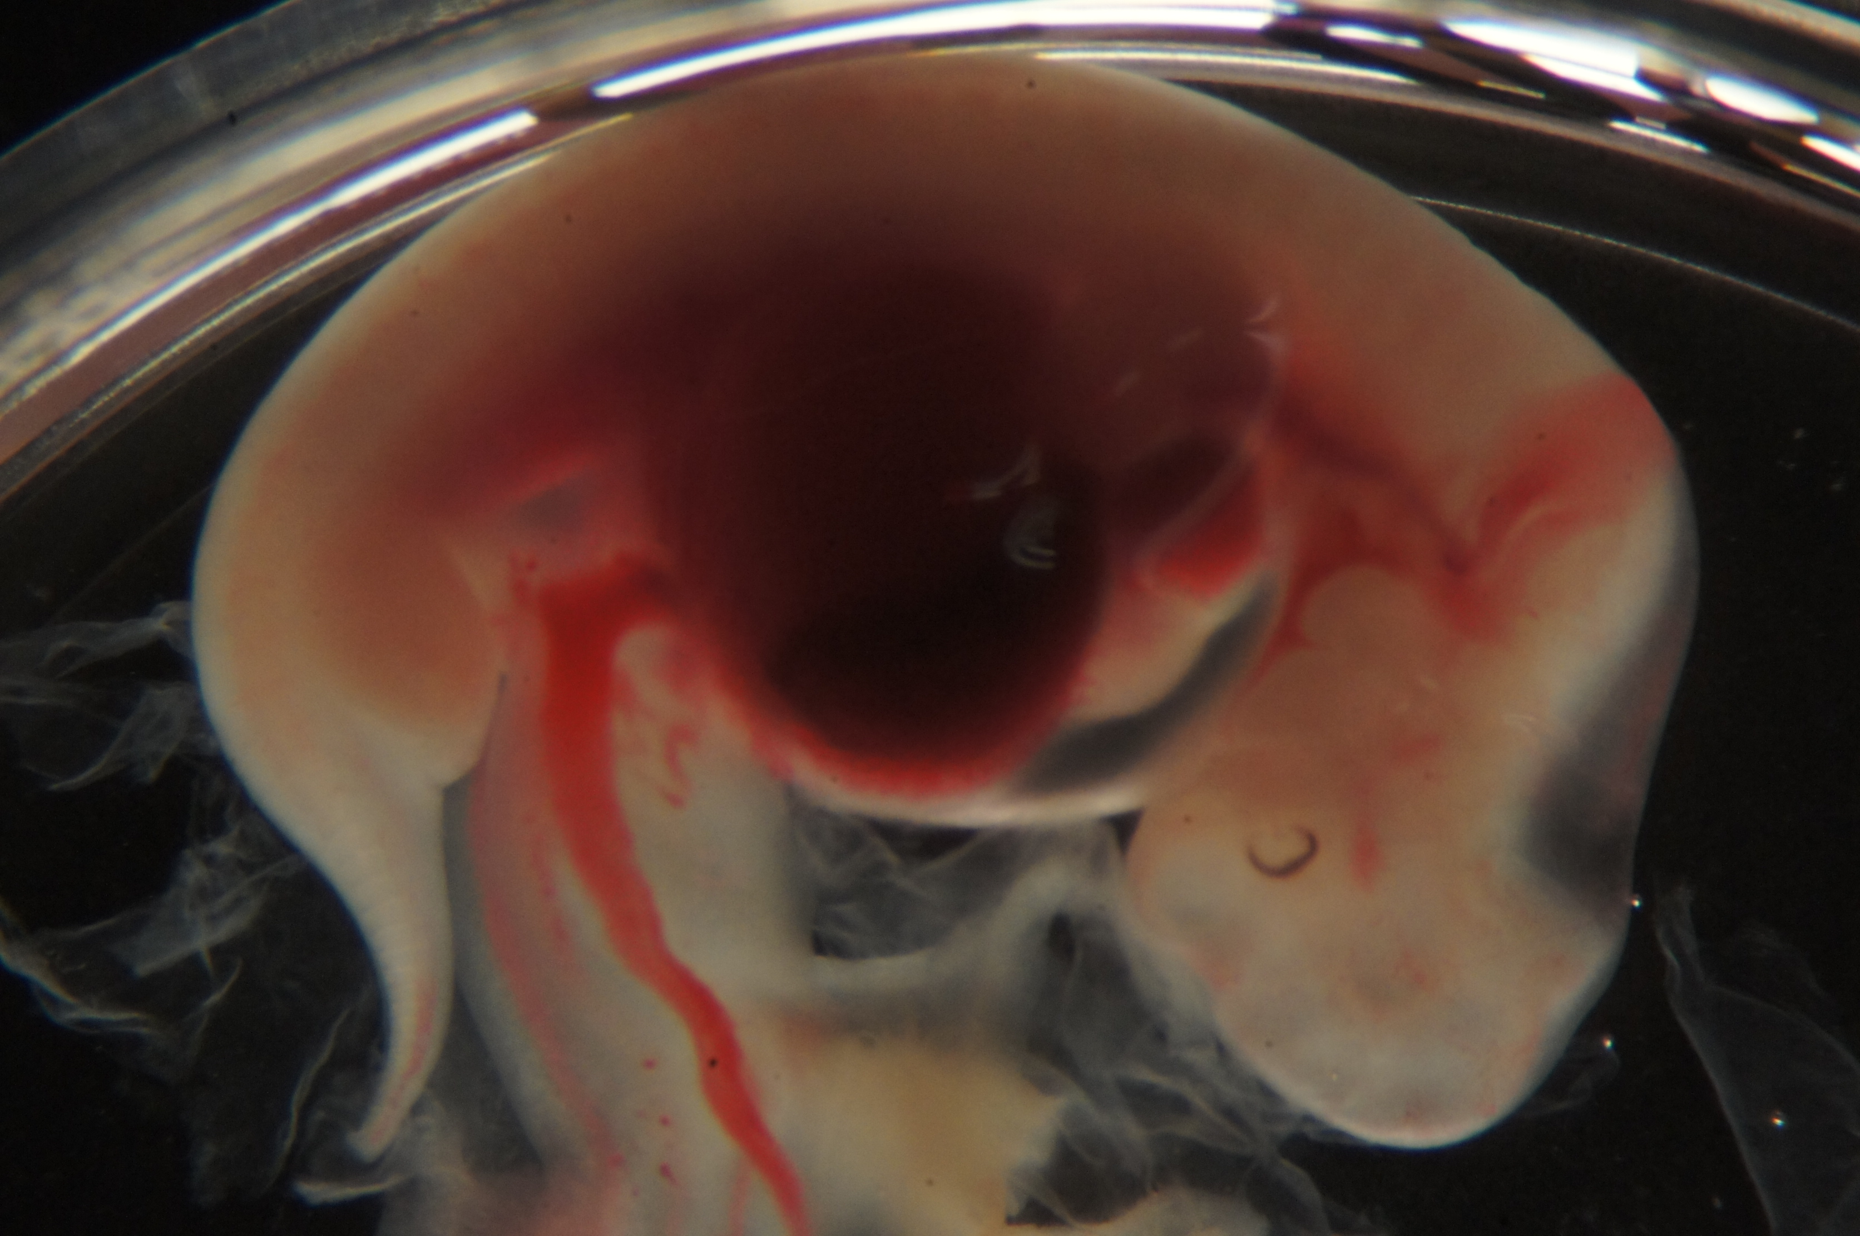
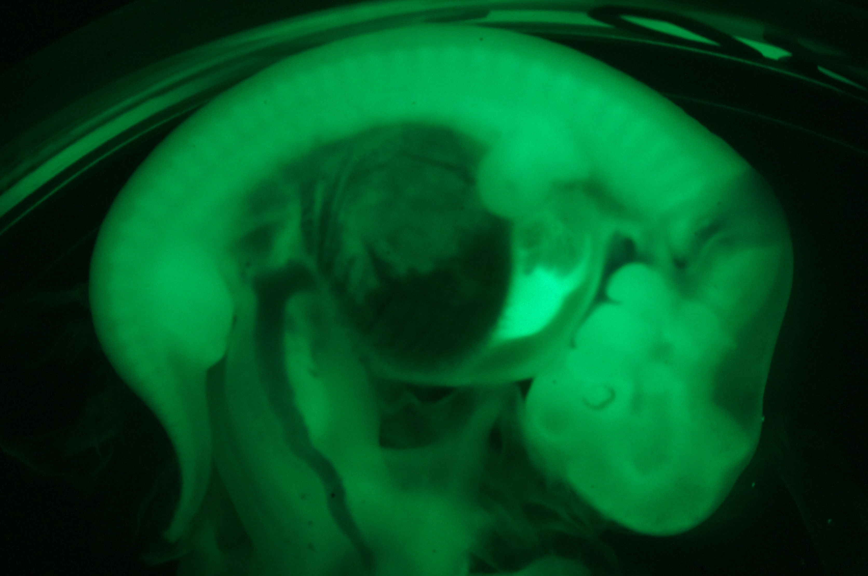
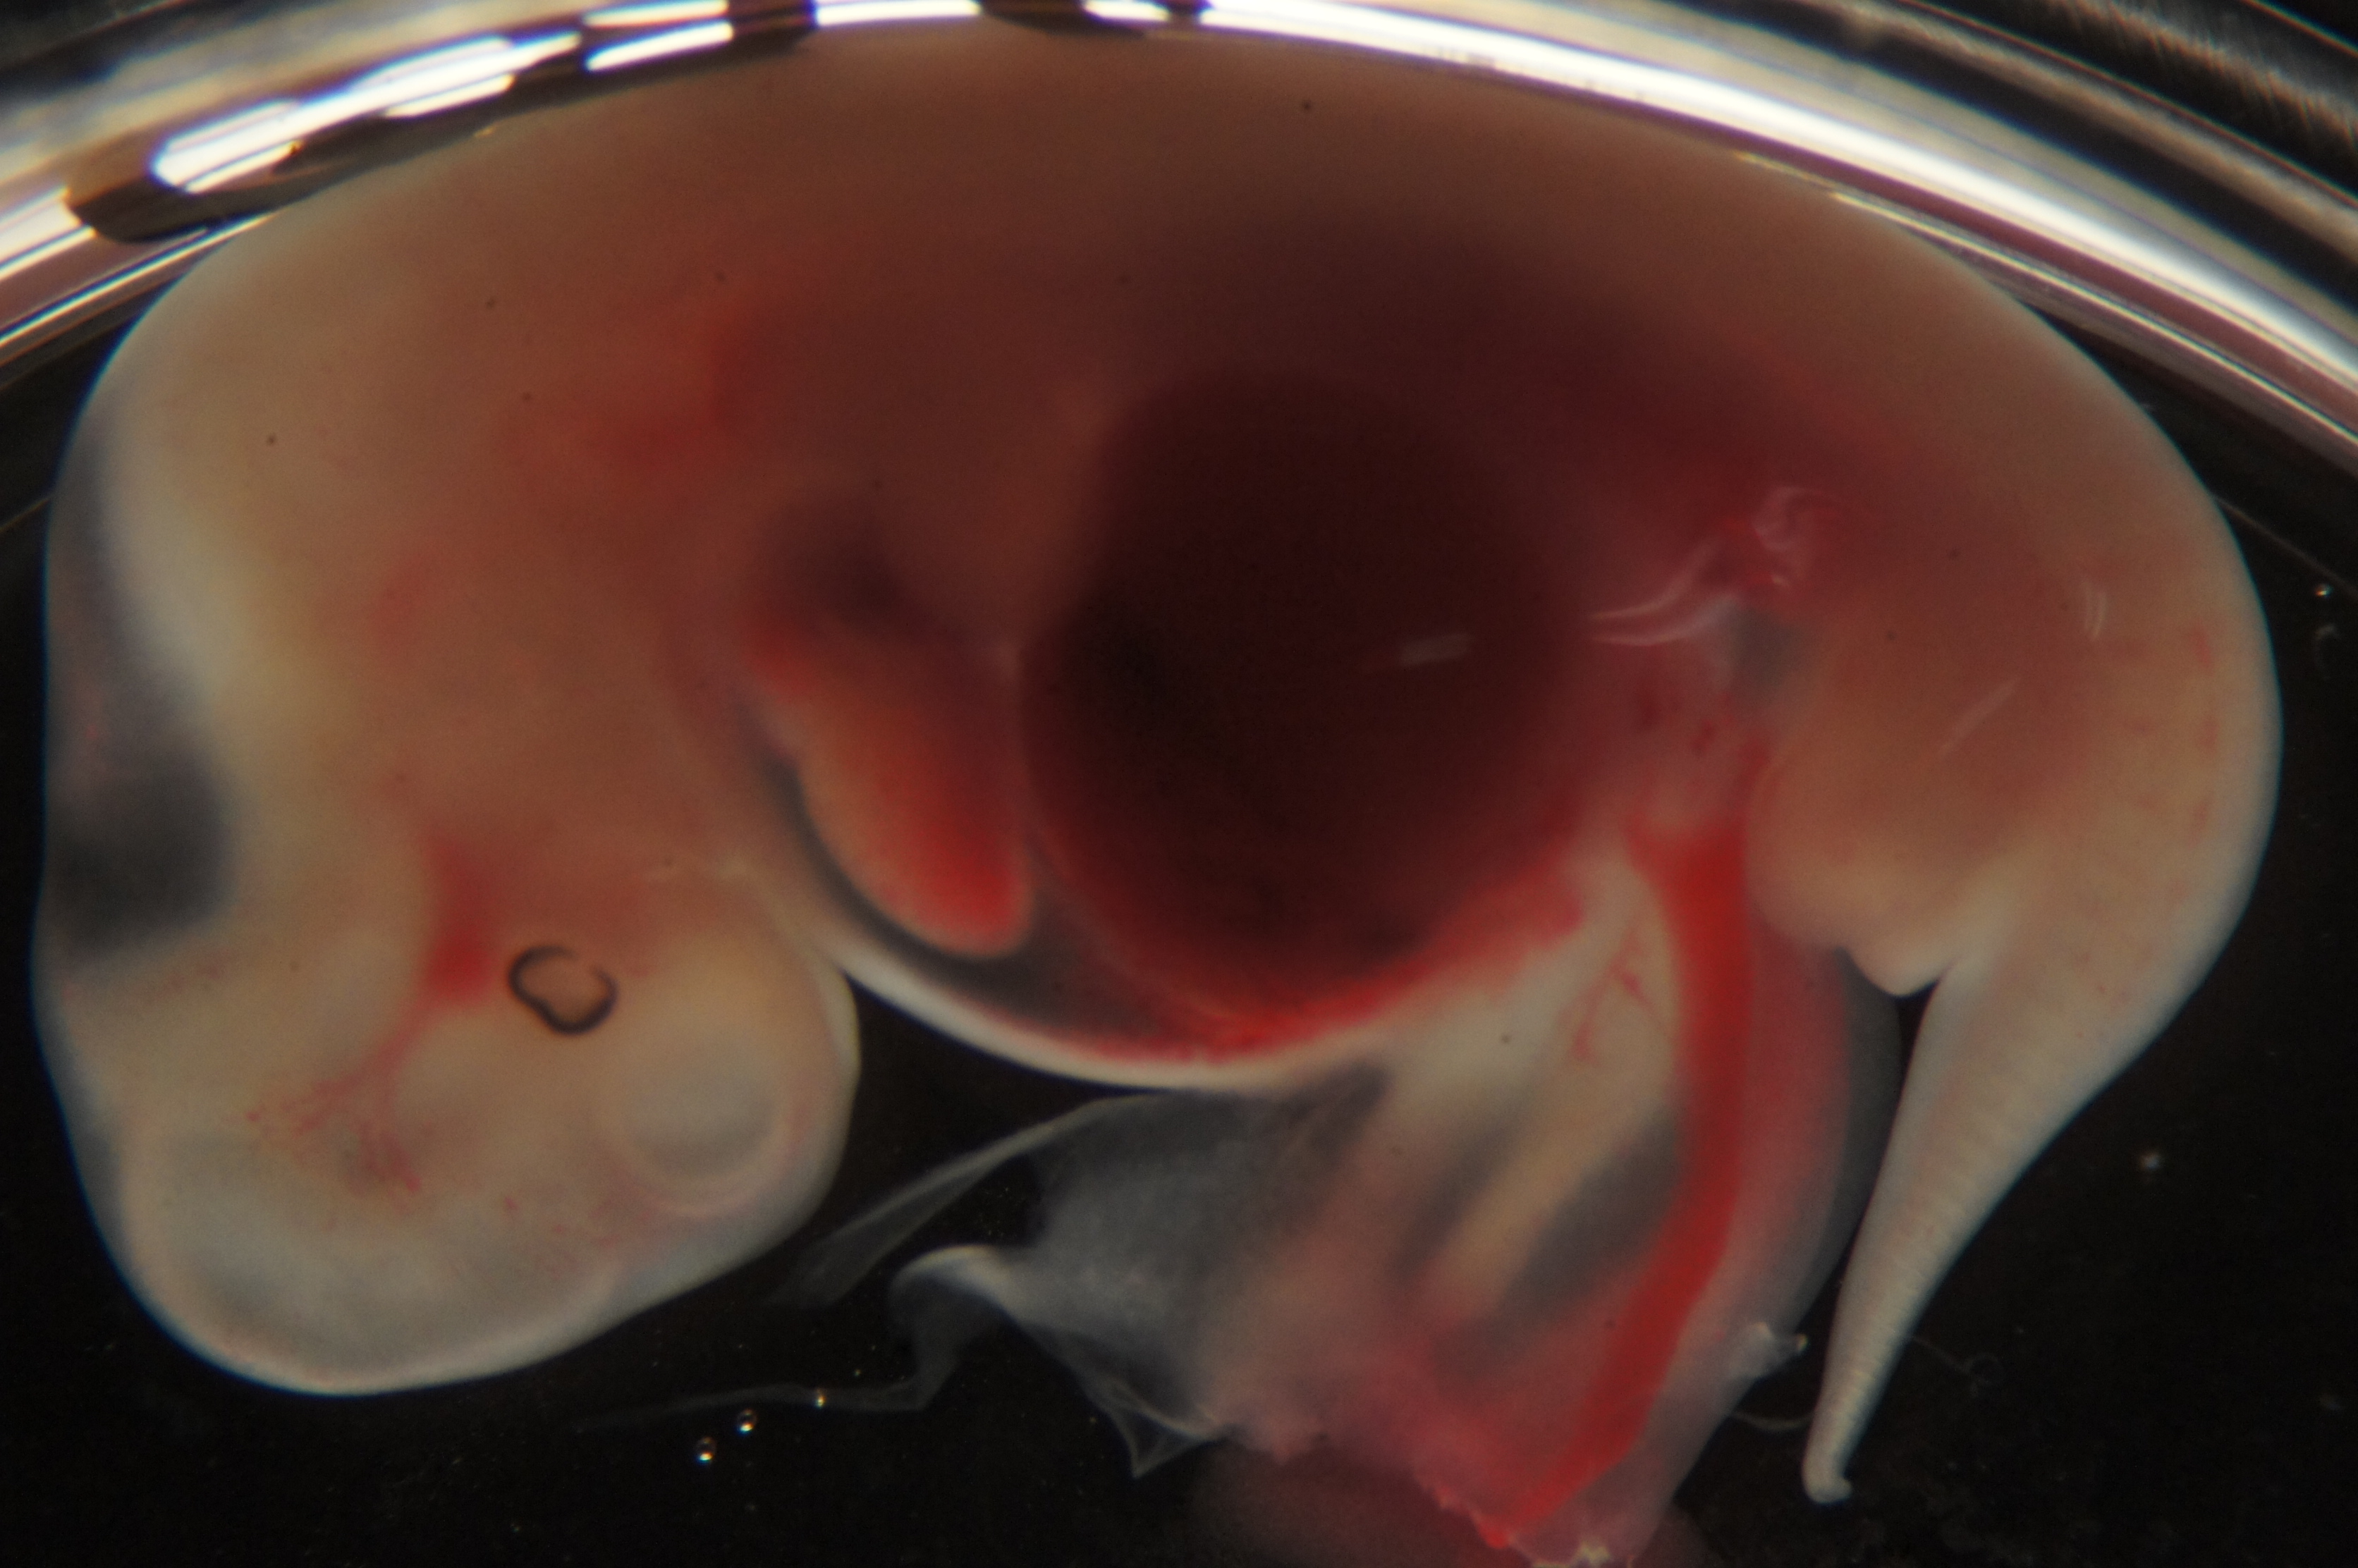
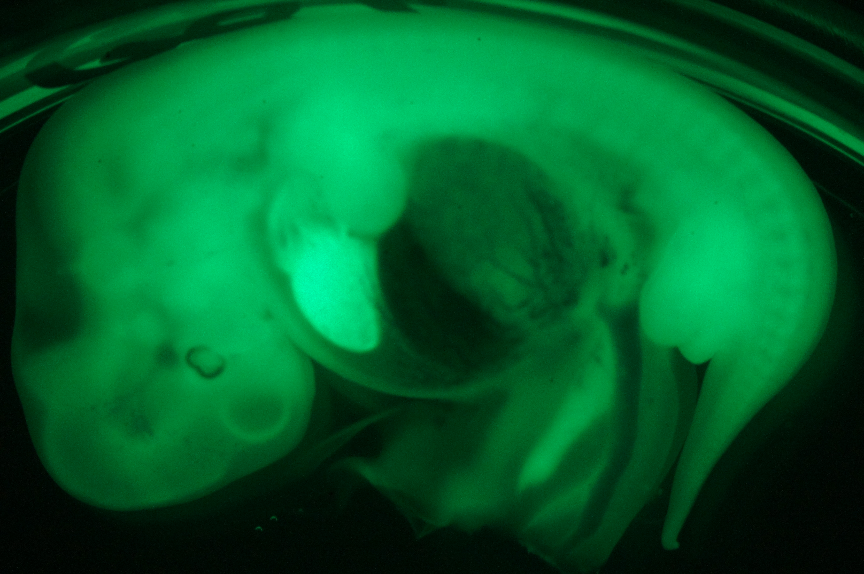
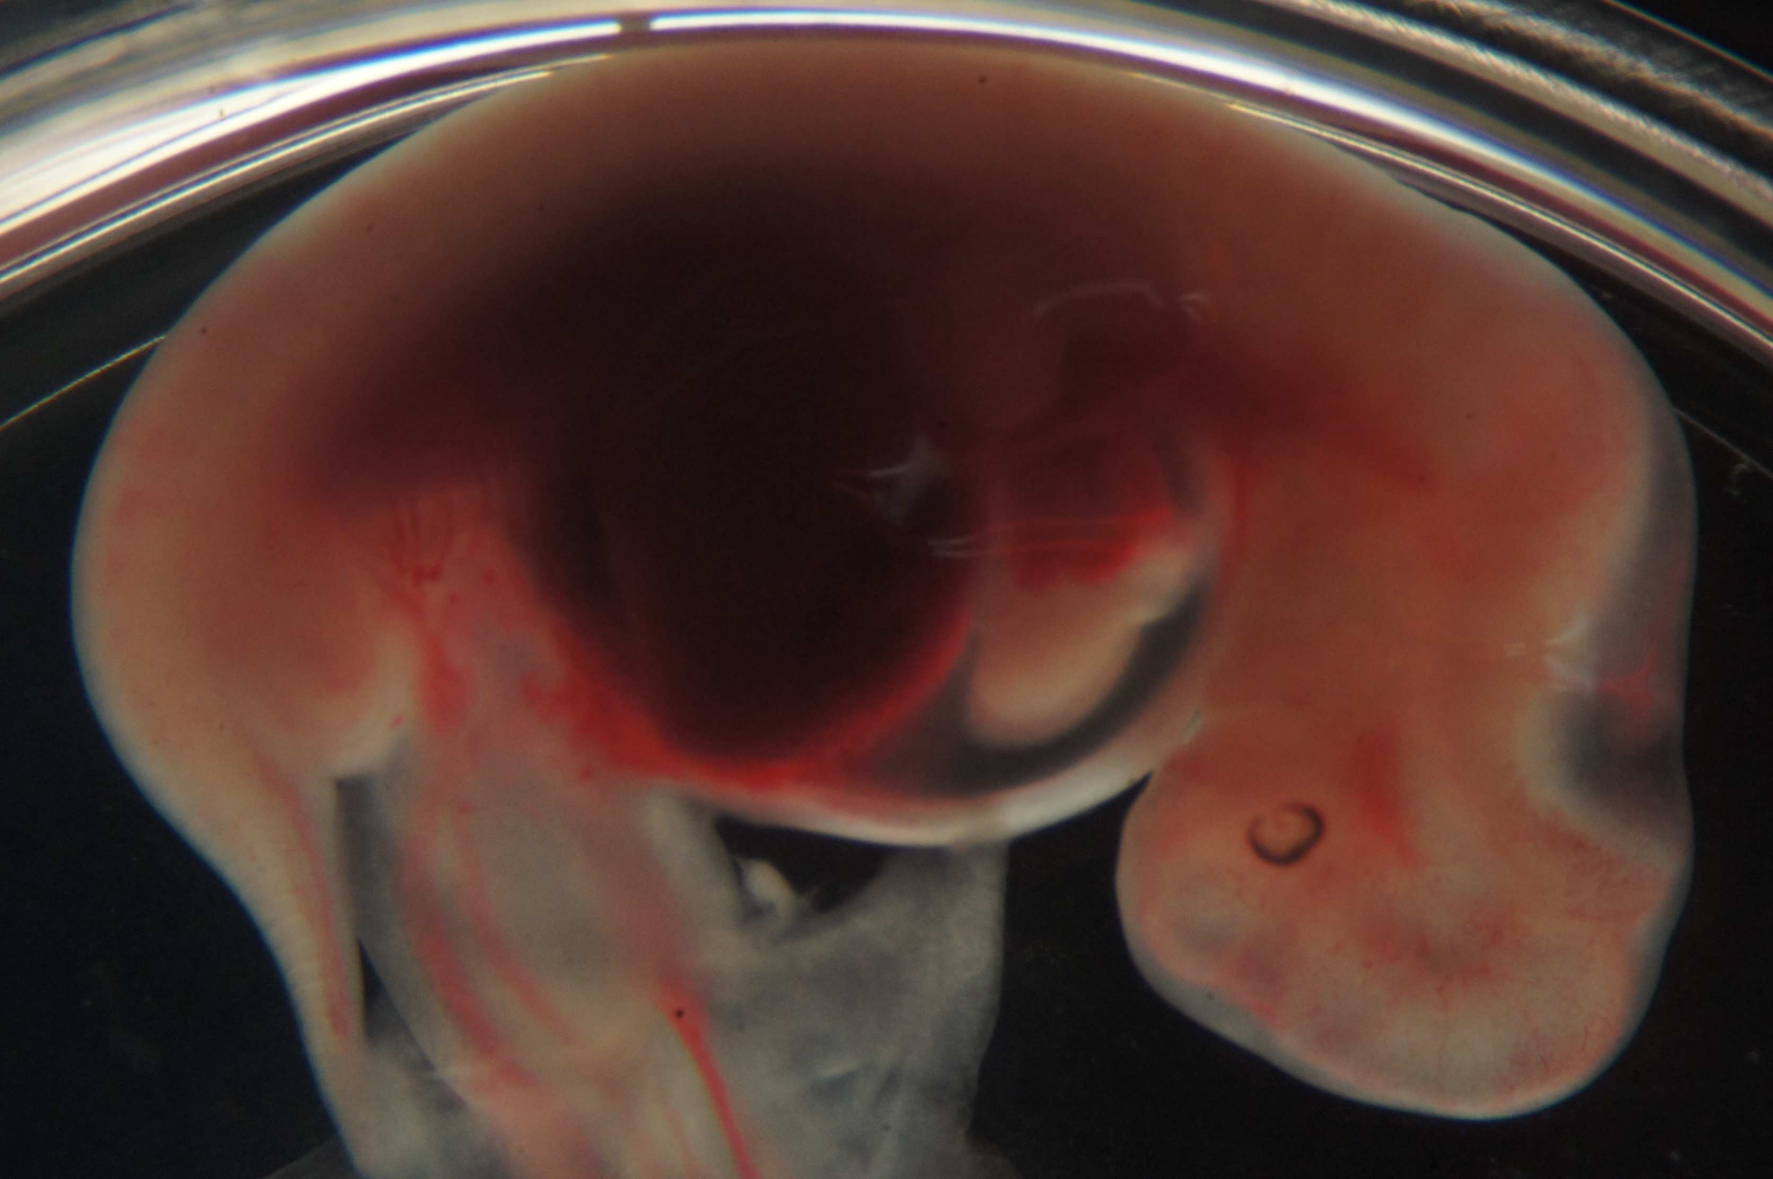
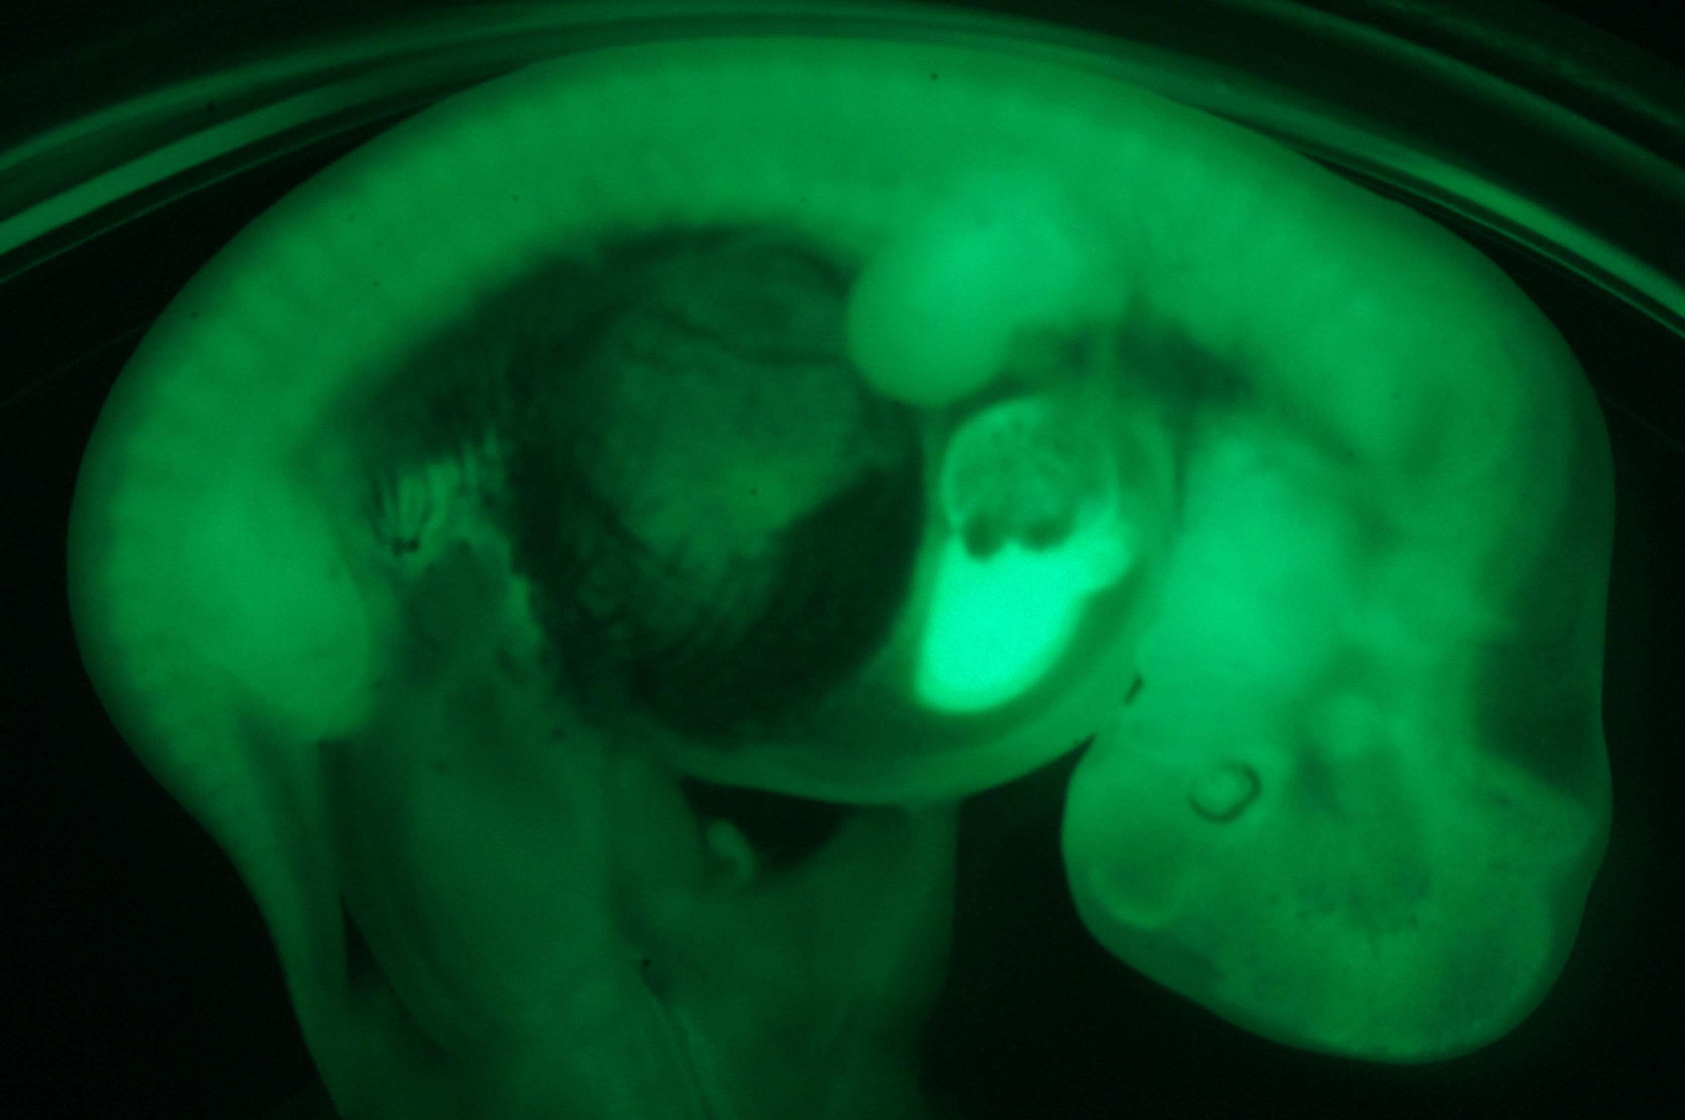
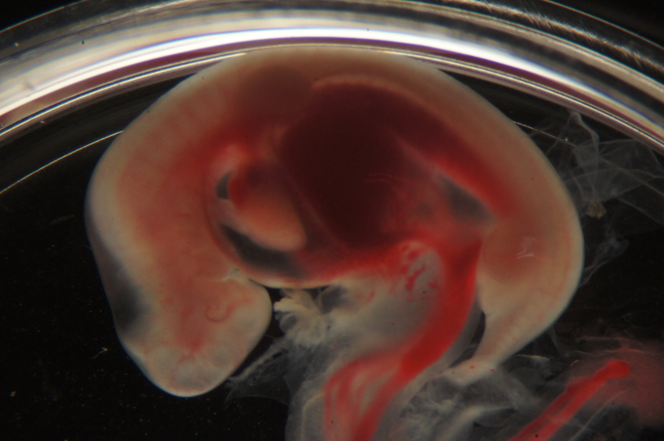
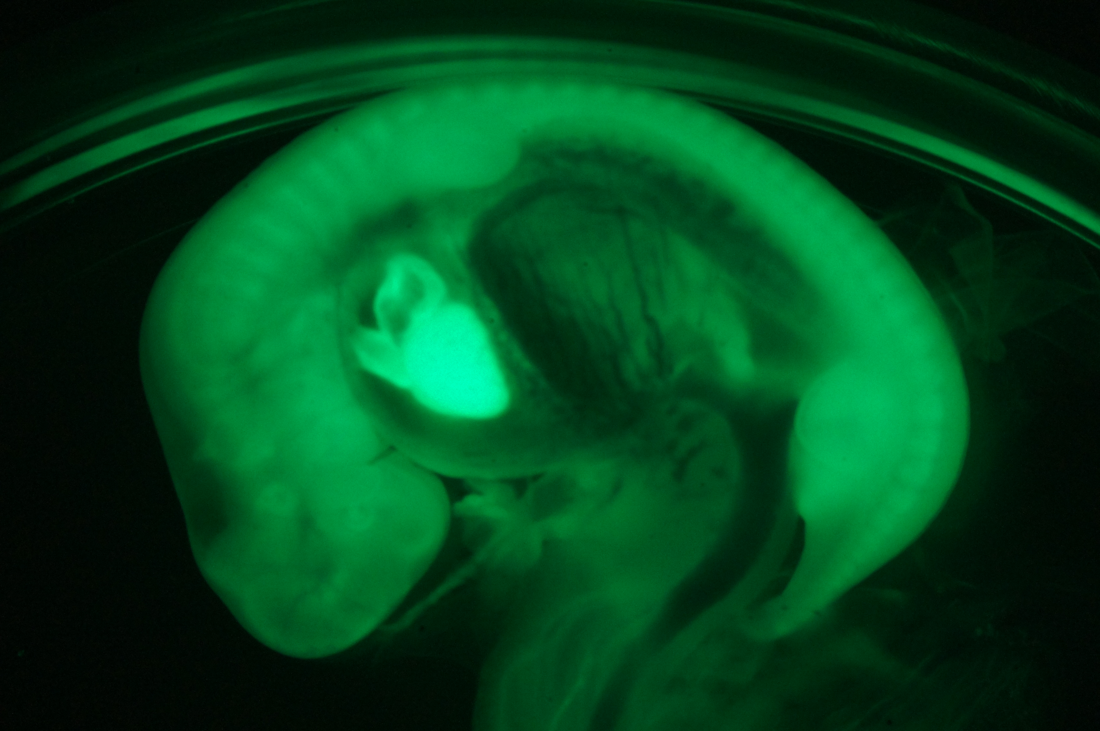
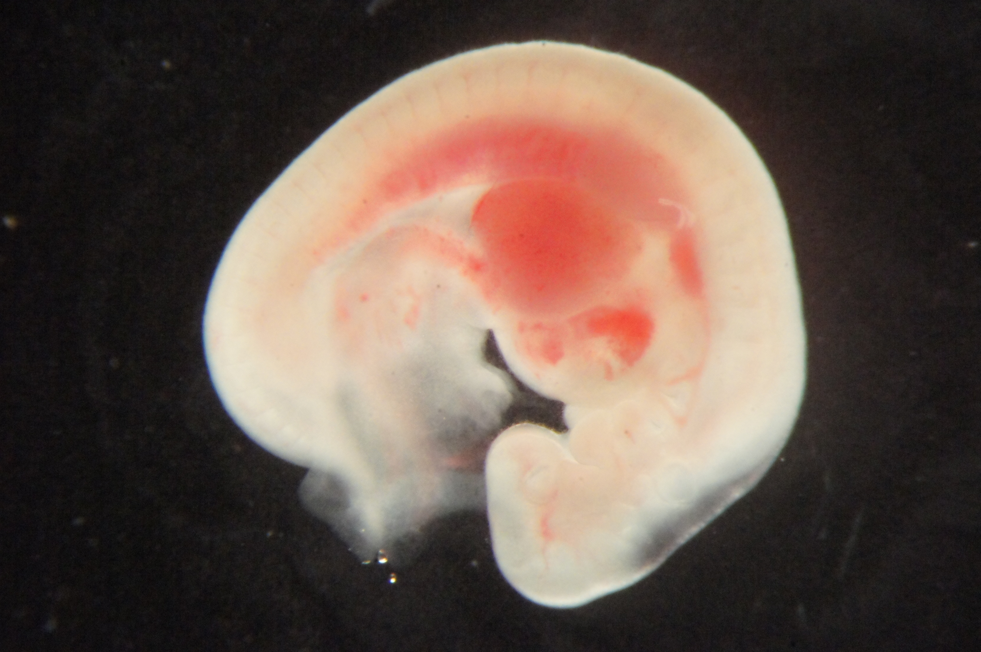
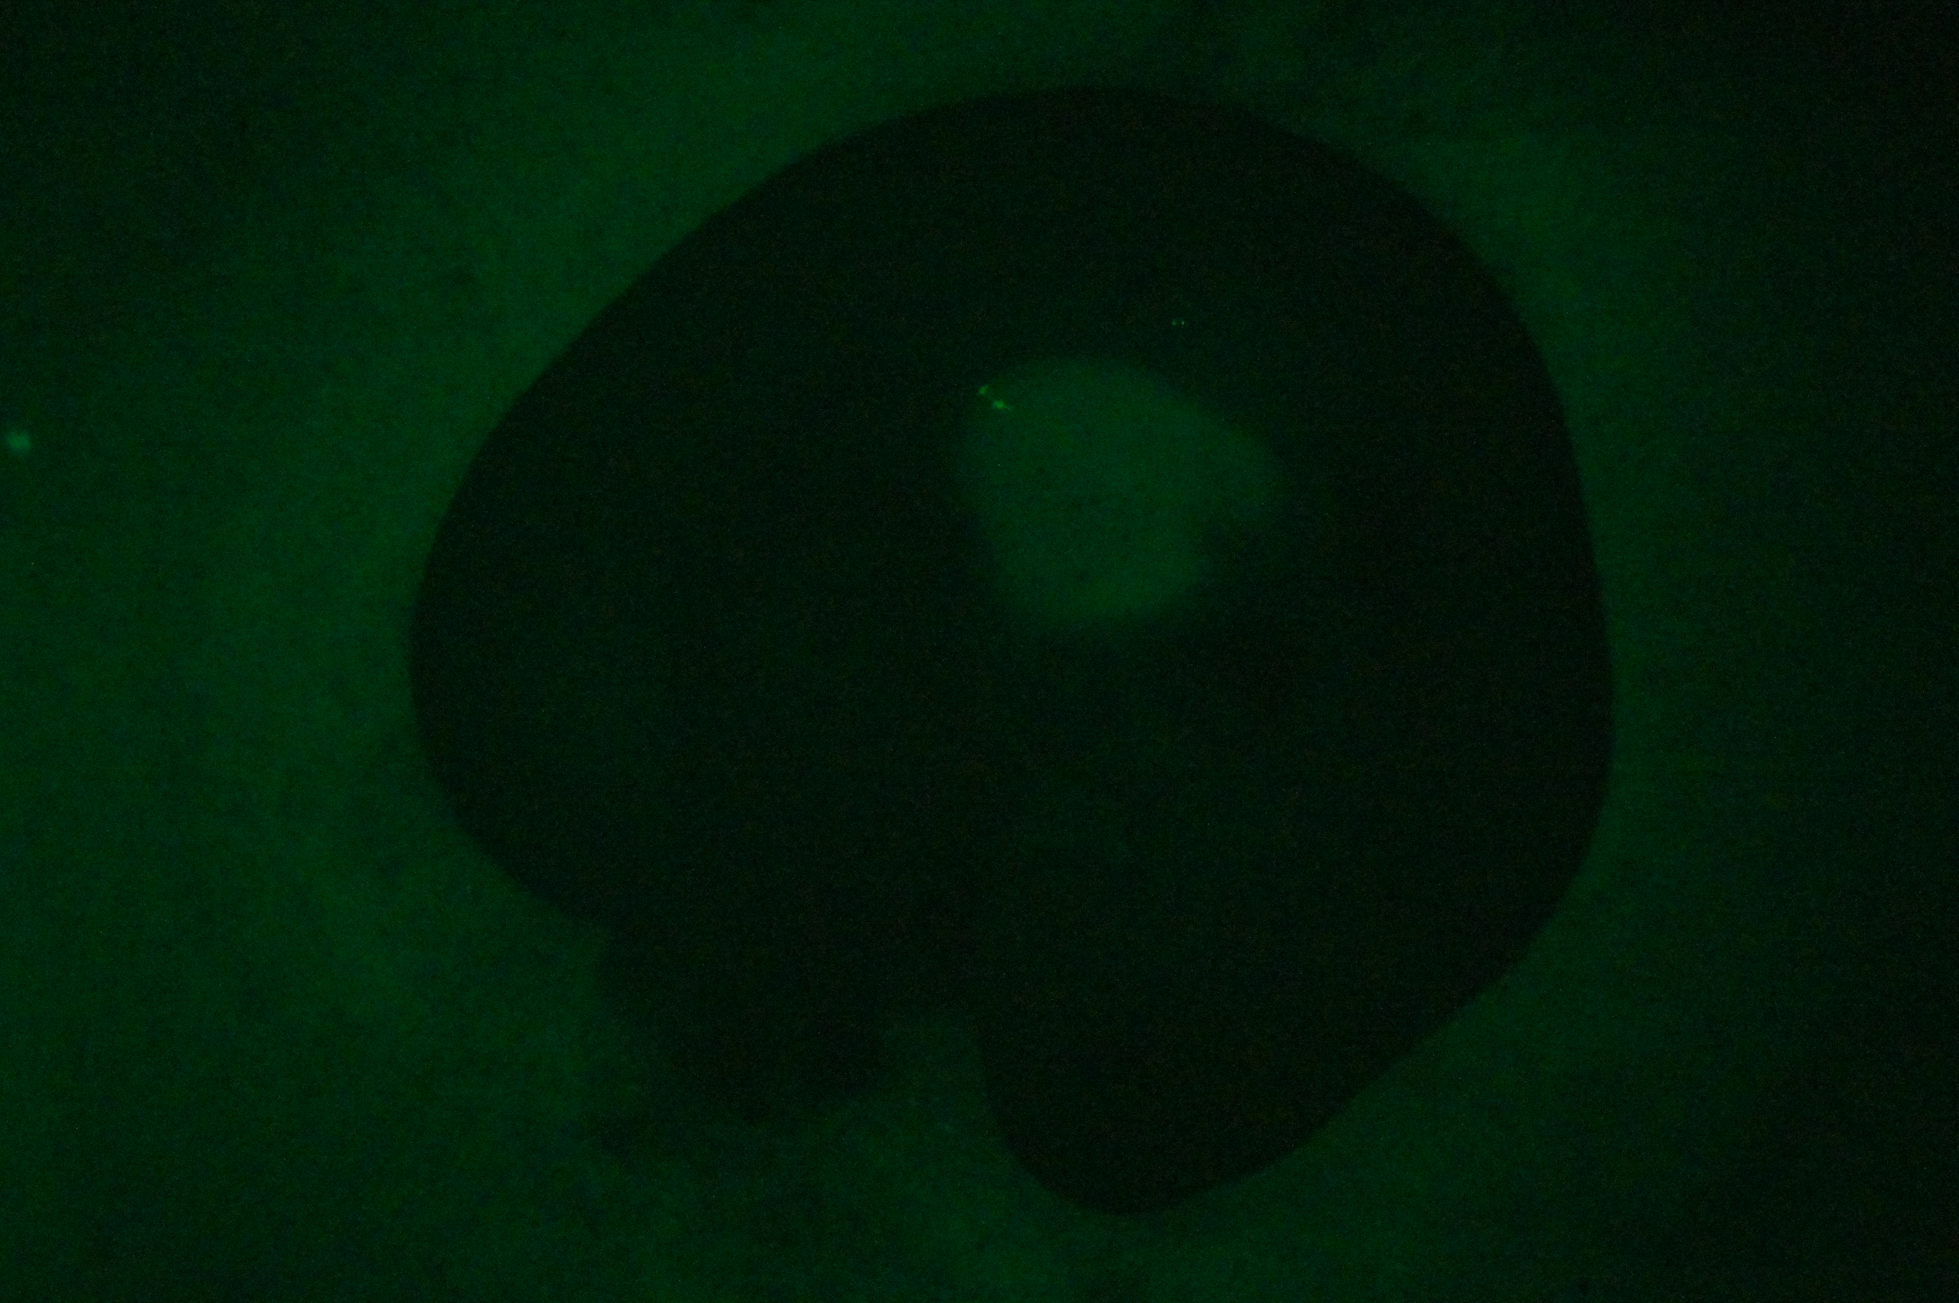
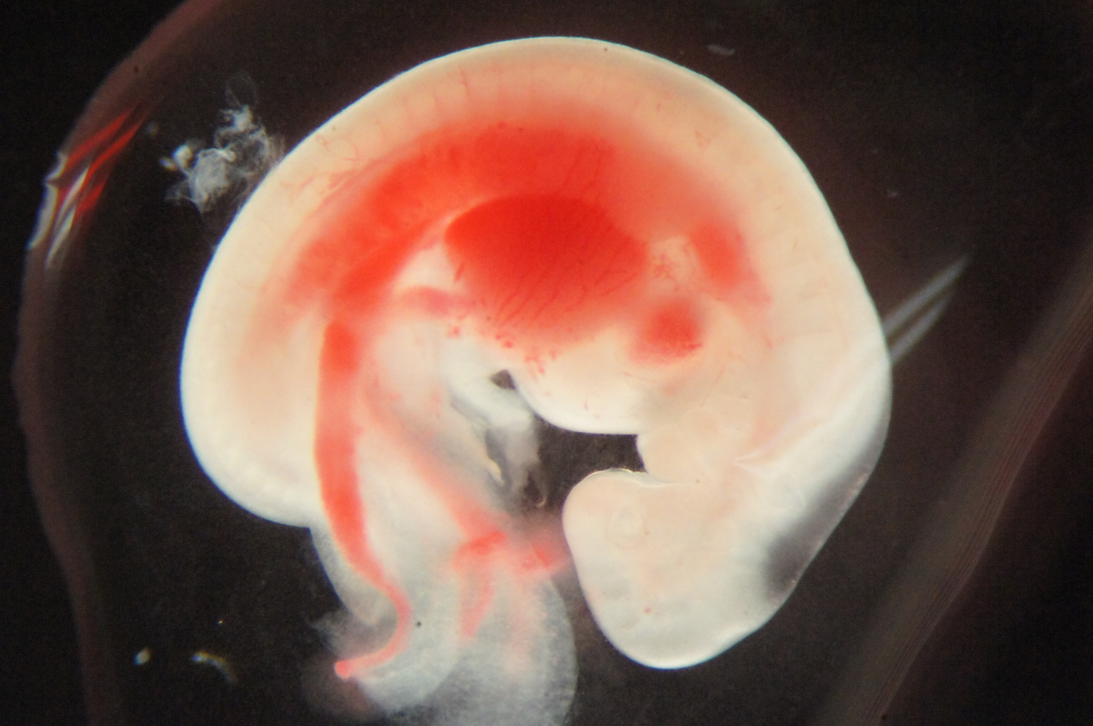
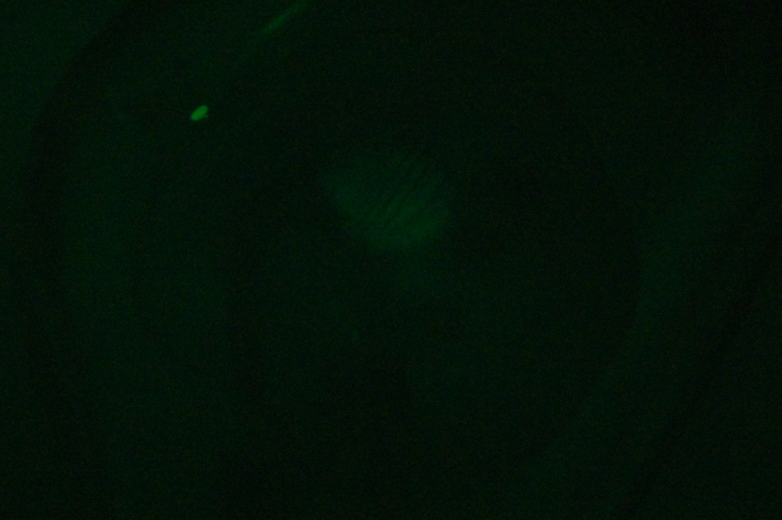
d34
#782-1
#782-2
#832
#869
1st round
cloned fetus
(Day 34)
#780-1
#780-2
#829
#931
1st round
cloned fetus
(Day 36)
#675
#687
2nd round
cloned fetus
(Day 34)
Fig. S2 Bright-field and fluorescent images of cloned fetuses. Left and right images of each panel show bright-field and fluorescent images, respectively. Bar = 5 mm.

Slide 4
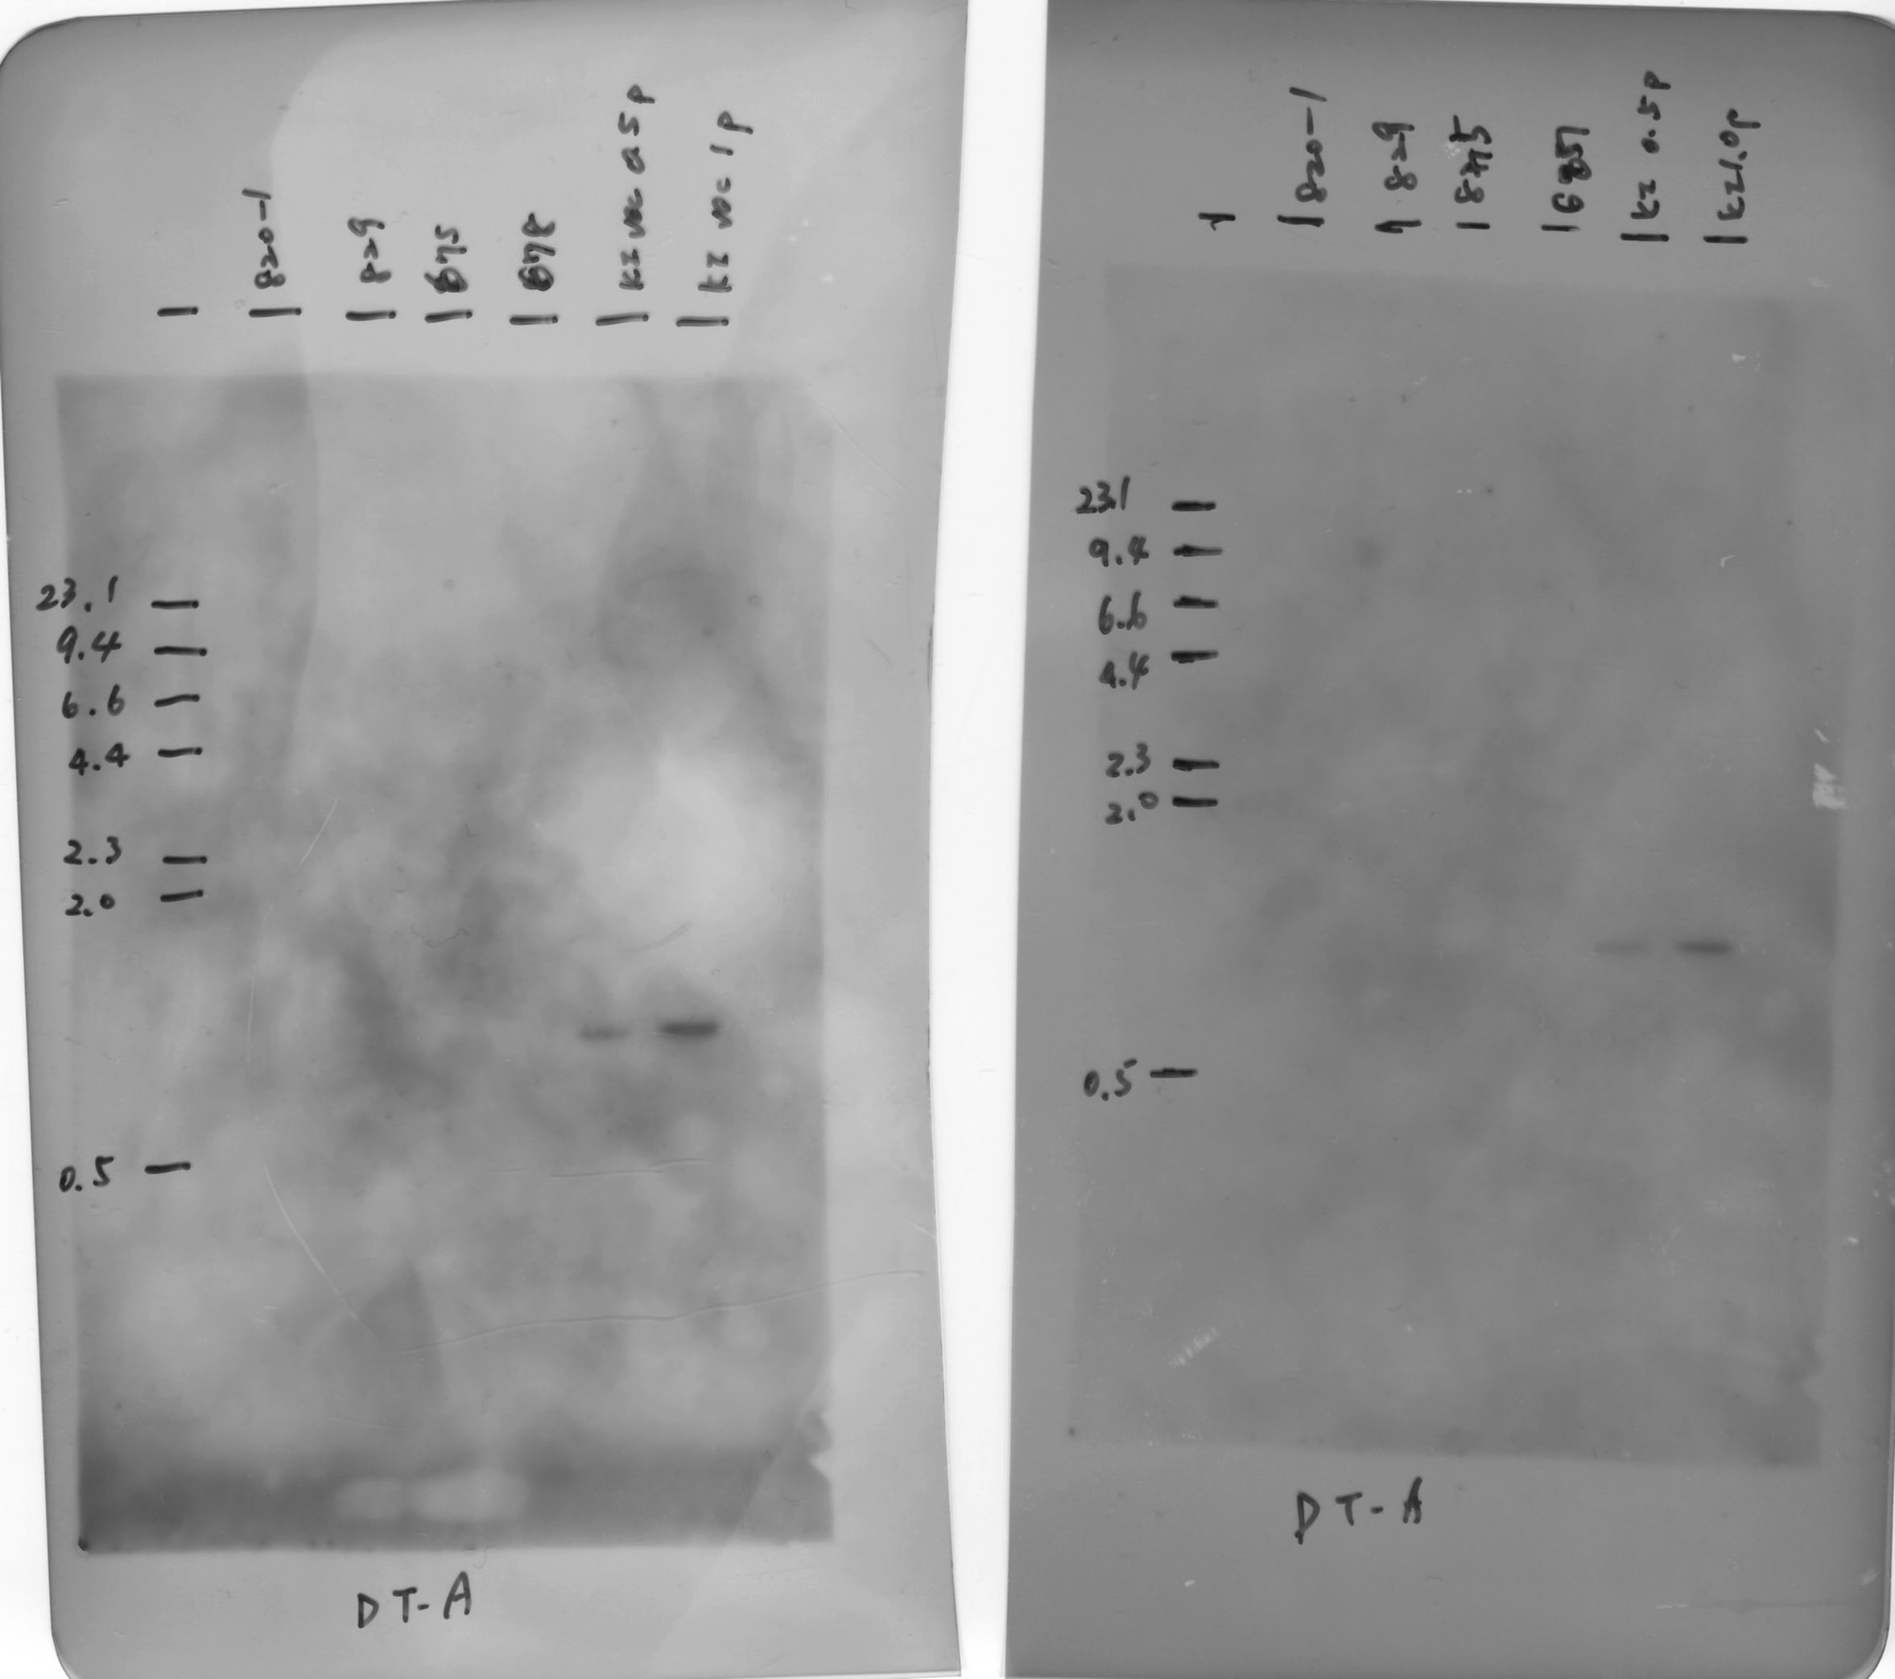
clones
donor DNA
(copies)
1st
2nd
kb
#820-1
#829
#675
#687
0.5
1.0
23.1
9.4
6.6
4.4
2.3
2.0
1.4
0.5
DT-A probe
Fig. S3 Southern blot analysis of the DT-A fragment. Lanes 5 and 6 contain donor DNA fragment that corresponds to 0.5 and 1.0 copies, respectively. There were no signals from the DT-A cassette in the genomic DNA of the cloned fetuses from the first and second rounds of SCNT.

Slide 5
Supplemental Table 1. Sequence of primers for PCR analysis and DIG-probe synthesis
Application |  |  | Primer | Sequence (5’-3’) | Product size (bp)
Junction analysis |  | 5’ 1st | IARS-F1 | GGCAAAAGTGAATTGTACAC | 1249
 |  |  | IARS-R1 | TAAACCTCGATATACAGACC
 |  | 5’ 2nd | IARS-F2 | GGGTGAACTTTATGGTATGTG | 1208
 |  |  | IARS-R2 | CAGACCGATAAAACACATGC
 |  | 3’ 1st | IARS-F3 | CTTACCGCATTGACAAGCAC | 1338
 |  |  | IARS-R3 | TACCACTGGCAGGAACAGCA
 |  | 3’ 2nd | IARS-F4 | GATGTCCTAAATGCACAGCG | 1258
 |  |  | IARS-R4 | GTGGTAAGATCATGAAGACG
Substitution analysis |  | 1st | IARS-F1 | GGCAAAAGTGAATTGTACAC | 1352
 |  |  | IARS-R5 | TTAACATCCCTGCCCTATGAC
 |  | 2nd | IARS-F2 | GGGTGAACTTTATGGTATGTG | 1316
 |  |  | IARS-R6 | CTGCCCTATGACATAAATGC
T7E1 assay |  |  | IARS-F6 | CCAAATGGTCATAATTAGCC | 579
 |  |  | IARS-R6 | CTGCCCTATGACATAAATGC
RT-PCR |  |  | IARS-F5 | GGTTTCTTTCAGAGCTACGC | 1237
 |  |  | IARS-R7 | AGCTATGGGTGAAGGTGCTG
DIG-probe synthesis | 5’ |  | IARS-5’probe-F1 | TCCACATAAAAGCTGCCCTG | 386
 |  |  | IARS-5’probe-R1 | CAACCACCACCACTCTCTAA
 | 3’ |  | IARS-3’probe-F1 | TACCAATCACCCACTTCCCA | 389
 |  |  | IARS-3’probe-R1 | CCAACGAGACATATCAGCAC
 | DT-A |  | DT-A-probe-F1 | ACCGACAATAAATACGACGC | 376
 |  |  | DT-A-probe-R1 | ACTCATACATCGCATCTTGG

Slide 6
Supplemental Table 2. Off-target analysis for pX330_IARS in #820-1 and #687 BFF cells
Site no. | Chr. | Strand | Start | End | Sequence (20 mer + PAM) | Mutation
ON | 8 | + | 384712 | 384733 | CCCAGCCAAATCTTCTGTCAAGG | #820-1 | #687
1 | 5 | + | 47574906 | 47574920 | AATAAACTAATCTTCTGTCAGGG | - | -
2 | 5 | + | 56783398 | 56783412 | GGTCTCTGAATCTTCTGTCAAGG | - | -
3 | 6 | + | 36794578 | 36794592 | ATTTTCTCAATCTTCTGTCATGG | - | -
4 | 9 | + | 67729166 | 67729180 | TTCTTAAAAATCTTCTGTCAAGG | ND
5 | 10 | + | 83076004 | 83076018 | AGGGTATCAATCTTCTGTCAAGG | - | -
6 | 12 | + | 2865133 | 2865147 | CTCCTGCTAATCTTCTGTCACGG | ND
7 | 12 | + | 35430319 | 35430333 | GCAGGTTCAATCTTCTGTCAGGG | - | -
8 | 13 | + | 43385426 | 43385440 | AAACCTTCAATCTTCTGTCAGGG | - | -
9 | 14 | + | 16283999 | 16284013 | TAAAAGCCAATCTTCTGTCAGGG | - | -
10 | 27 | + | 44364947 | 44364961 | TTGGTATAAATCTTCTGTCATGG | - | -
11 | 29 | + | 16222008 | 16222022 | TATTTAAAAATCTTCTGTCAAGG | - | -
12 | 2 | - | 110902813 | 110902827 | TTGCCTTTAATCTTCTGTCAAGG | - | -
13 | 6 | - | 102084448 | 102084462 | GATACAGAAATCTTCTGTCATGG | - | -
14 | 9 | - | 4318230 | 4318244 | TCCATAATAATCTTCTGTCATGG | ND
15 | 11 | - | 66970294 | 66970308 | AACTCCAGAATCTTCTGTCATGG | - | -
16 | 18 | - | 39530634 | 39530648 | AGACTGGTAATCTTCTGTCAAGG | - | -
17 | 18 | - | 62767357 | 62767371 | CAGGTGTGAATCTTCTGTCAGGG | - | -
18 | 22 | - | 30989628 | 30989642 | ATTGGCCTAATCTTCTGTCAAGG | - | -
19 | X | - | 22325451 | 22325465 | GAAAGCCTAATCTTCTGTCAGGG | - | -
20 | X | - | 48902801 | 48902815 | AAATTCCTAATCTTCTGTCAAGG | - | -
Matched nucleotides with the on-target sequence and are highlighted with red. PAM sequences are highlighted with green. ND: not determined.

Slide 7
Supplemental Table 3. Sequences of primers for off-target analysis
Site no. | Forward Primer (5’-3’) | Reverse Primer (5’-3’) | Product size (bp)
1 | GCCCATAAATCAACACAGCG | CCCCTTATTAAAGAAAGTGC | 250
2 | TCCTCGTGGACCACACATTC | GAAATTAACACAGTTGGGTG | 197
3 | TCATGGGCATTCTAATTGTC | CAAGCTCATTTAAGTCTTAGC | 211
4 | PCR failed
5 | TTGGATCCCTTCTCTACCAC | CTGCTAAGGGAAGAAAGGAC | 322
6 | PCR failed
7 | AAGTATGAGAGCGTCACCAG | CACAGTATCTTATCTGCTCC | 394
8 | ACTTTCACTTAATCCTCATC | GAGGTACCAAGCTTTTCTCA | 209
9 | GACCCAAGGATCGAACTGGT | GGAGTTTCCTACCAGCAGCC | 213
10 | TTCTGACATCCTGTAGTAGC | GATGGAGAAATCACACAGAG | 261
11 | TGCATTCCGTCTCACCTTTG | TTCAAAGACTTTGGATGTCTG | 310
12 | GGGGATGGATAAGAAAAGGG | GGGCATAAGGTCTGTGTTTAG | 264
13 | GATTCTAGTGAGCTGTCAGAG | CAGGTAAGTGAAGGAACAAAAC | 318
14 | PCR failed
15 | GCTGCTGTCTTTCAACCAAG | CAACCTCCCAAAACTTCCAG | 342
16 | GTTAACCACTCTTCTGCTAC | ACACCTGTGCATTTCAAACC | 314
17 | CCACAAACCAAGAGCACTGG | AGGTCTGCCCCAGCTCTGAC | 278
18 | CTCCACCCCATAAATTCCAC | CTCAAGCAGTTATCTATCCAC | 332
19 | AGTTGCCTGGCTGTGGCAGA | AGGAGAAAATAGGGCCTCTT | 185
20 | CCCCAAGAAAACCTAATCCT | GAAATGAGTGGCAAGAGAGC | 290

Slide 8
The original gel of Fig. 1d

Slide 9
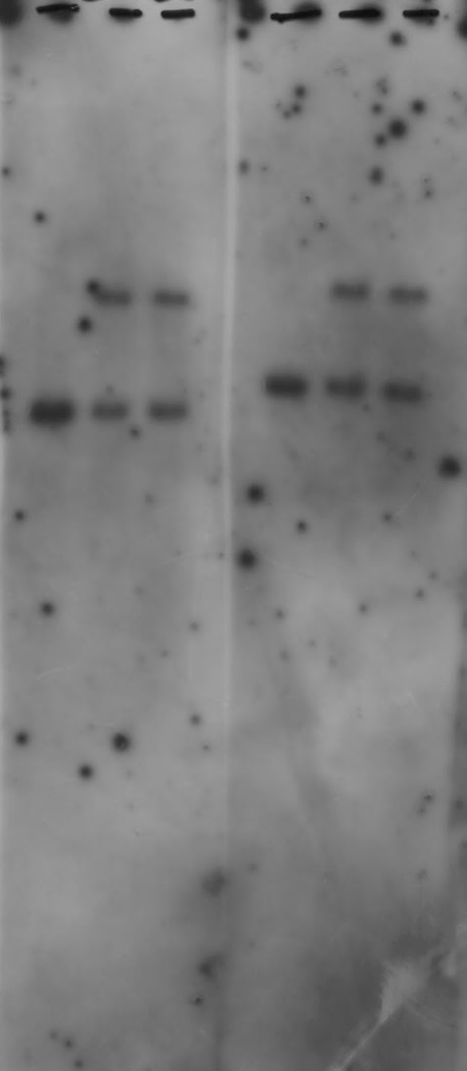
The original blot of Fig. 2c

Slide 10
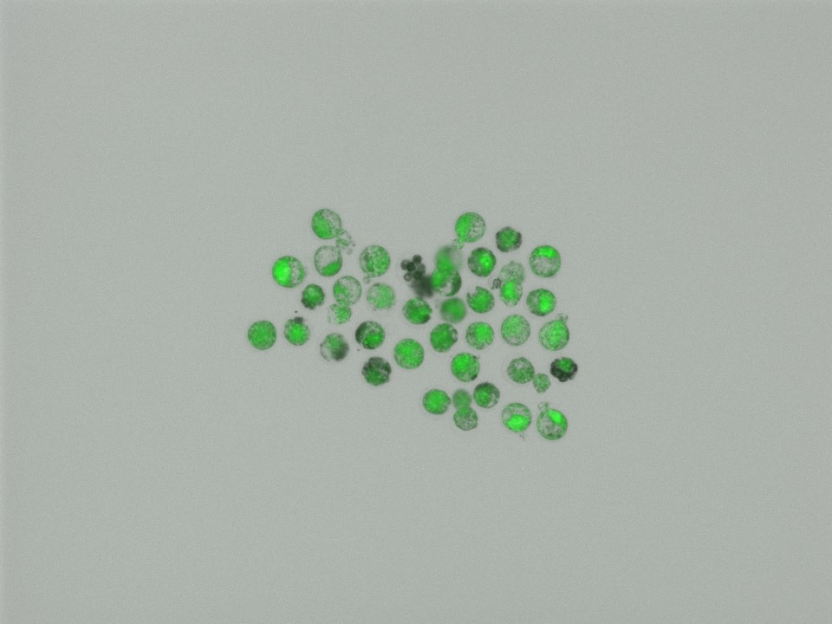
The original photo of Fig. 2d

Slide 11
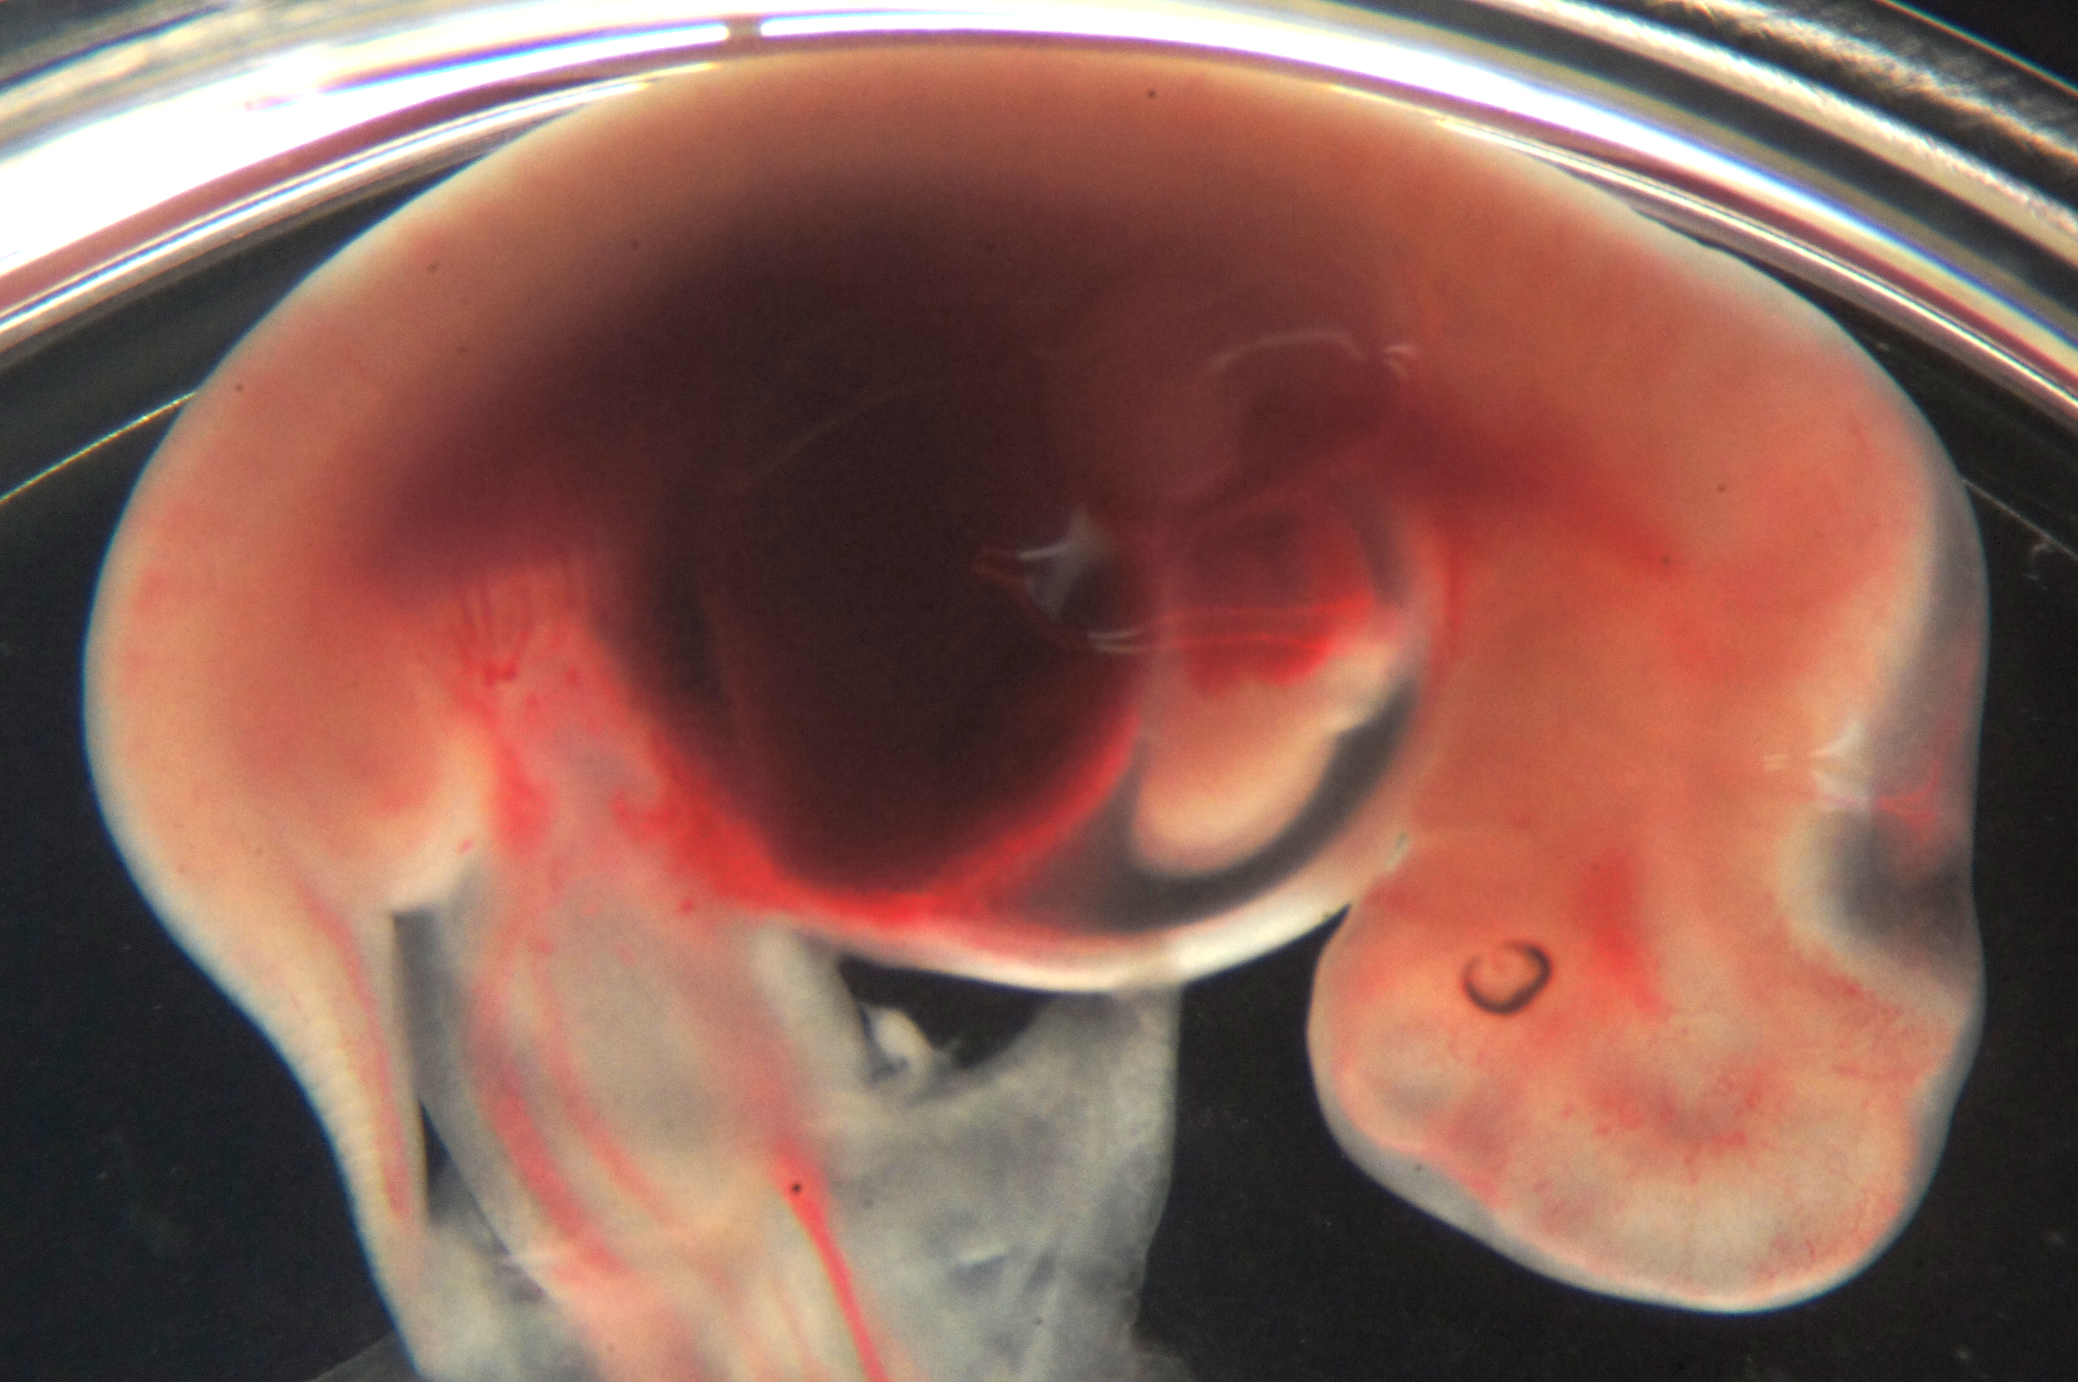
The original photos of Fig. 2e

Slide 12
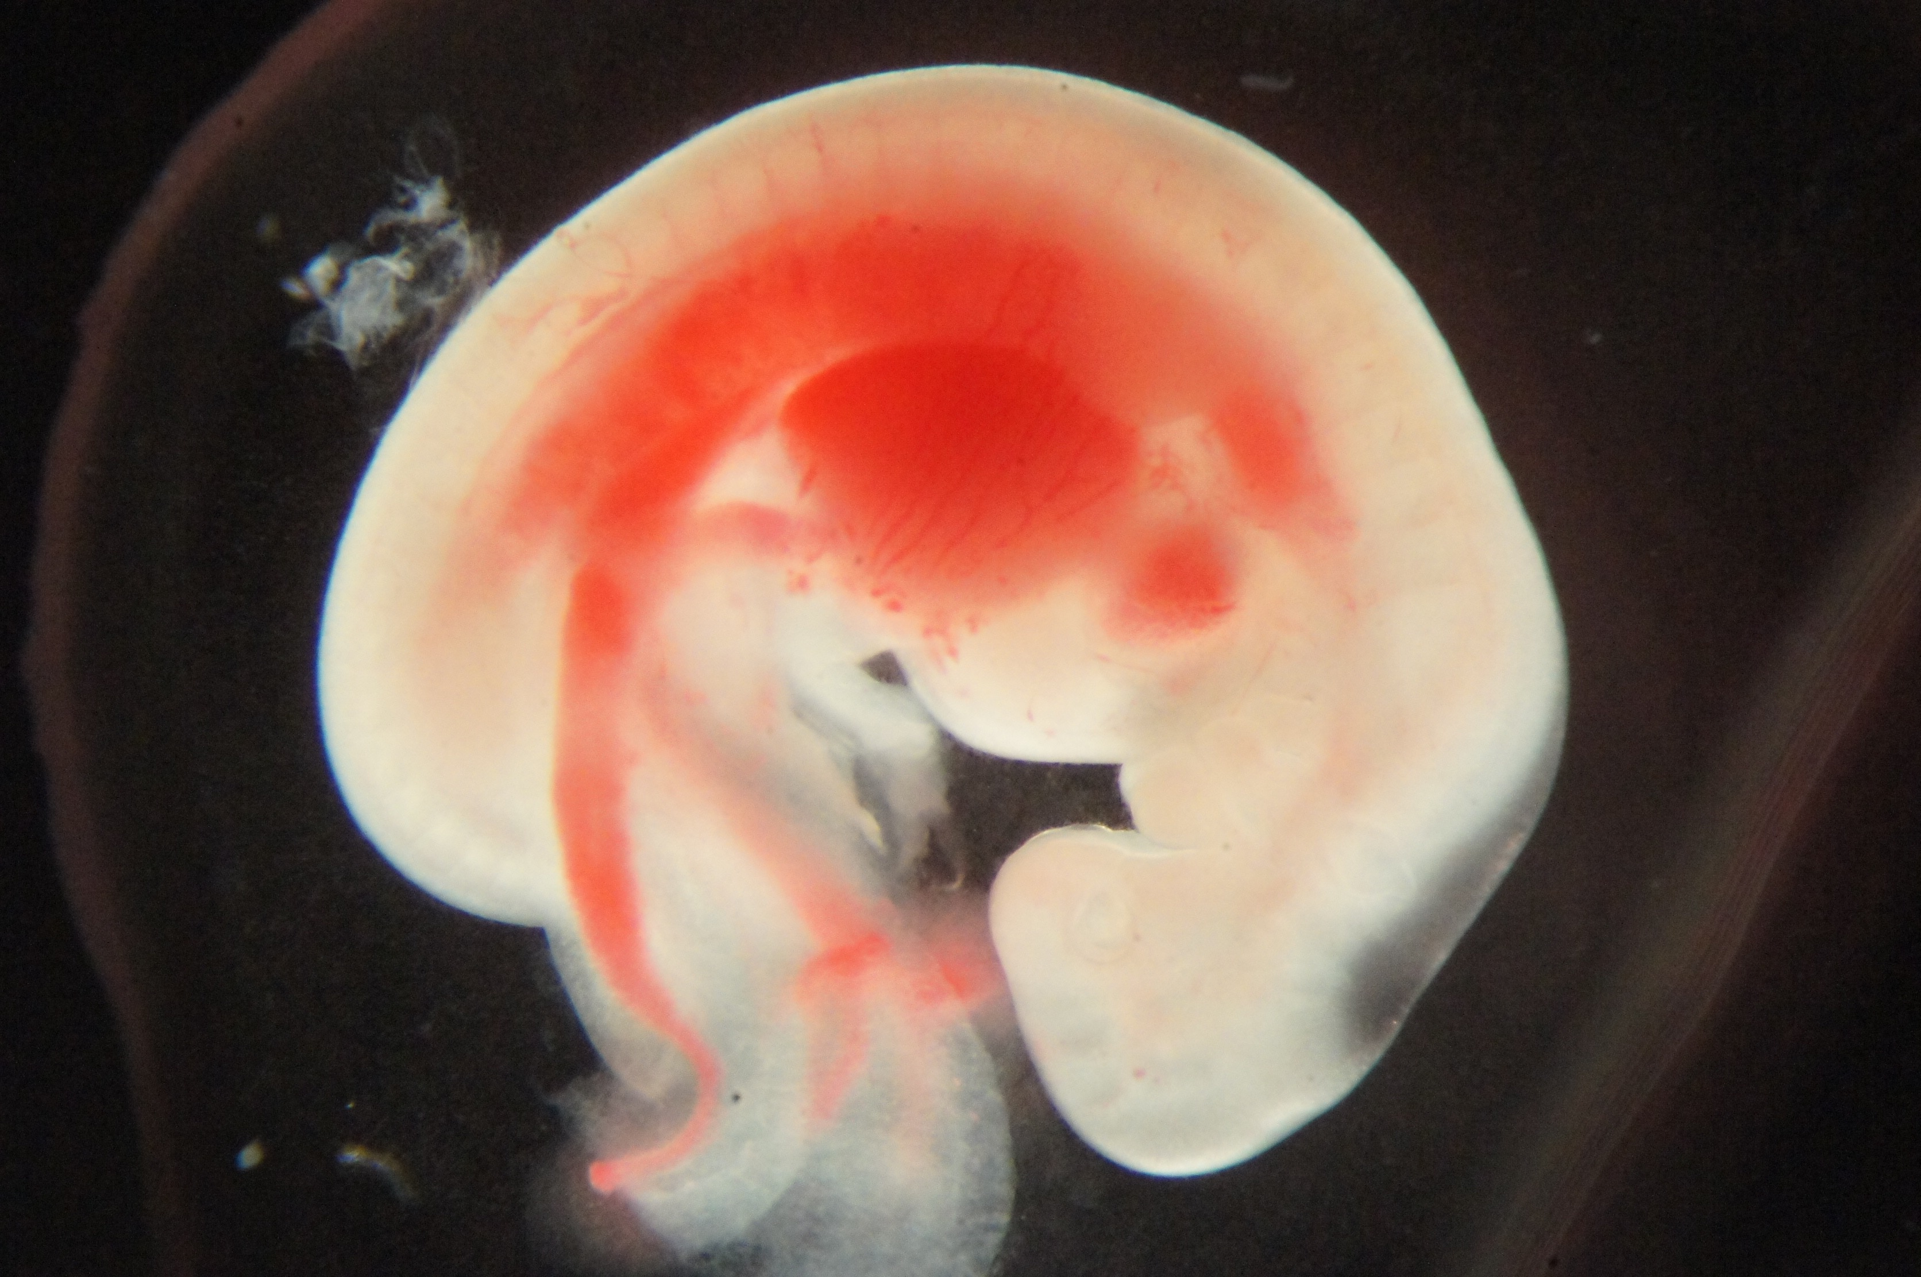
The original photos of Fig. 3b

Slide 13
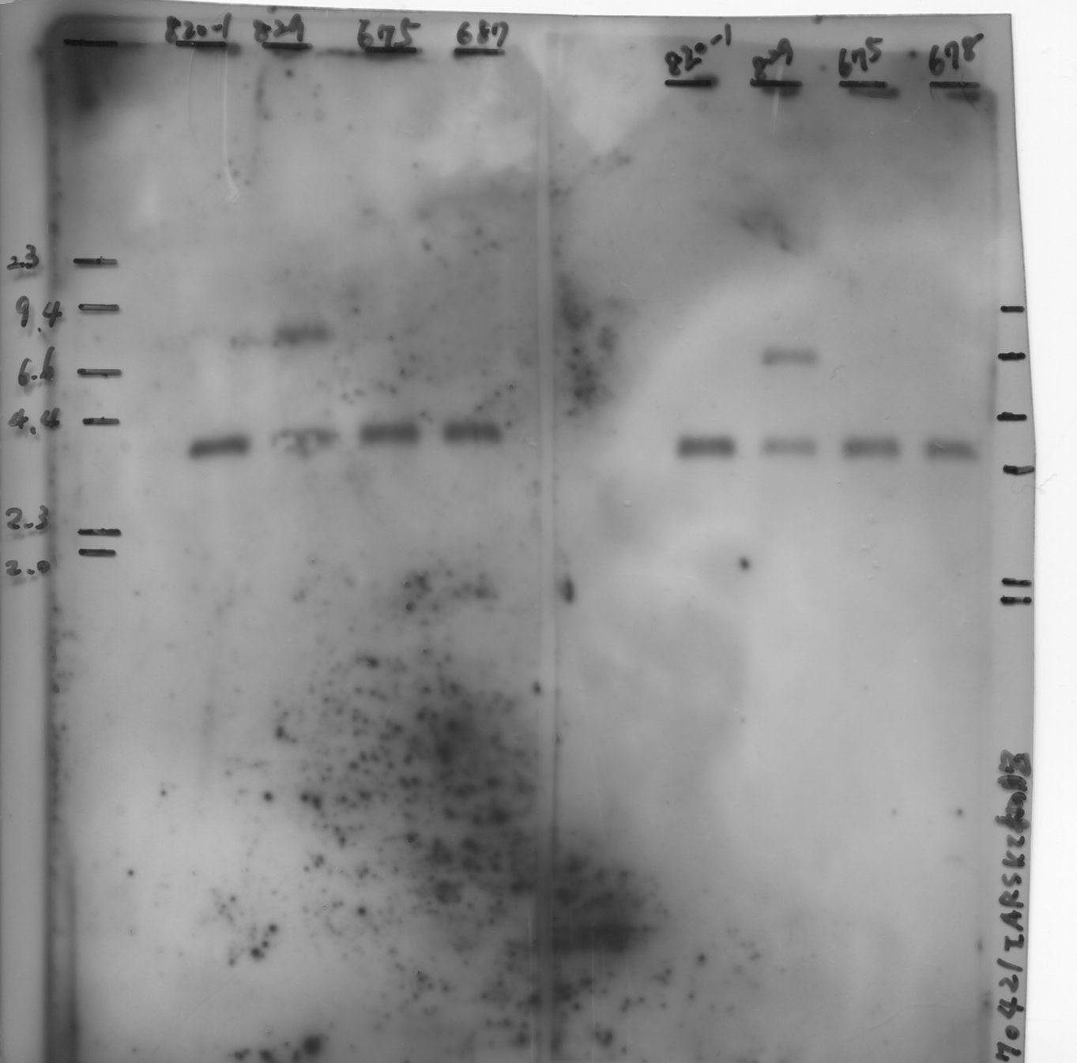
The original blot of Fig. 3c

Slide 14
The original gels of Fig. S1

Slide 15
#782-1
#782-2
#832
#869
#780-1
#780-2
#829
#931
#675
#687
The original photos of Fig. S2

Slide 16
The original blots of Fig. S3

