Slide 1
Platelets isolated from an Alzheimer mouse damage healthy cortical vessels and cause inflammation in an organotypic ex vivo brain slice model
Kathrin M. Kniewallner , Bettina M. Foidl
and Christian Humpel

Slide 2
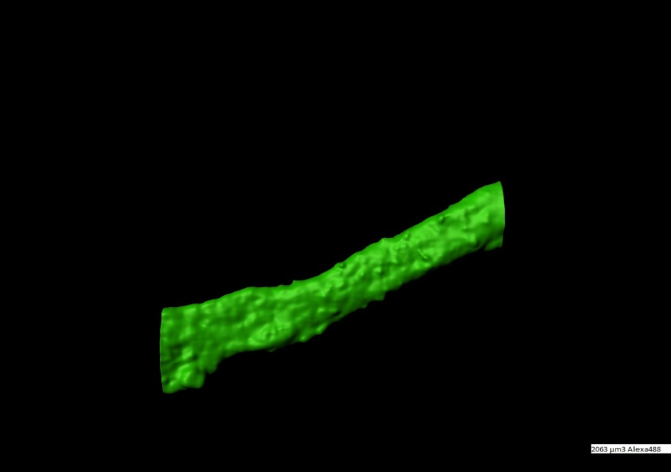
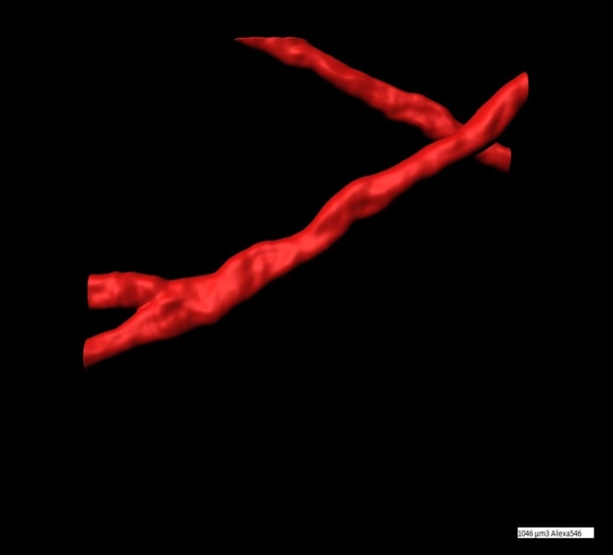
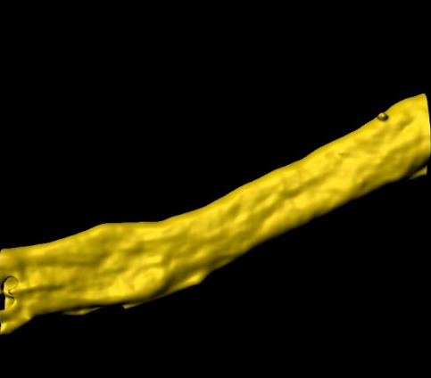
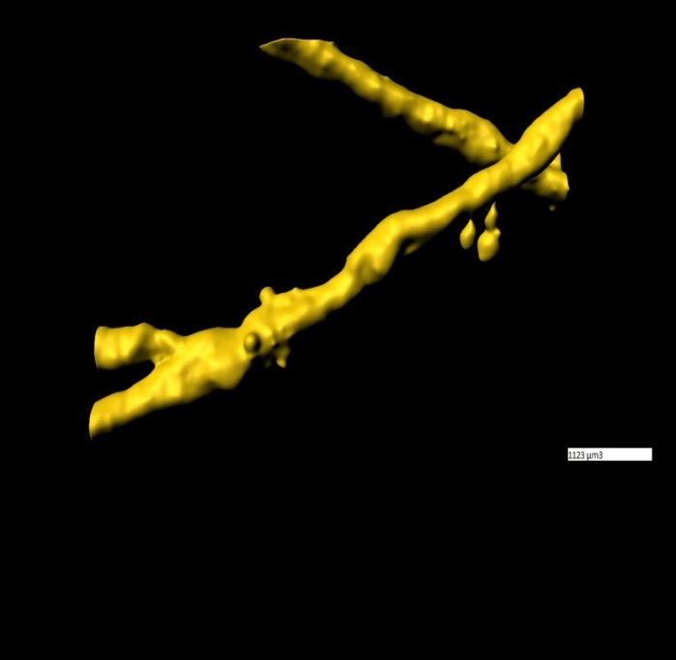
Supplementary Figure 1: Comparison collagen IV with Lectin-649
(a)
(b)
CollagenIV-A488
CollagenIV-A546
2063 µm³
1046 µm³
(c)
(d)
Lectin-649
Lectin-649
2048 µm³
1123 µm³
Co-localization = 96±4 % (n=10)
Brain vessels were stained with collagen-IV with Alexa-488 (green, a) or Alexa-546 (red, b) and with lectin-649 (yellow, c&d). Co-staining shows nearly full co-localization. Scale bar in a = 10 µm (a-d).

