Slide 1
Supplementary Figure 1.
A.
B.
LSK-
LSK
MPP
CD38
HPC
c-kit
CD123
CMP
GMP
Lineage
CD135
Lineage
HSPC
HSC
LT
ST
MEP
Lin-
CD34
CD34
CD45RA
FSC
Sca-1
CD34
GMP
CD16/32
CMP
MEP
CD34

Slide 2
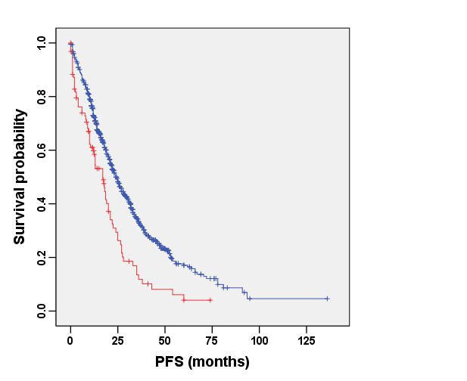
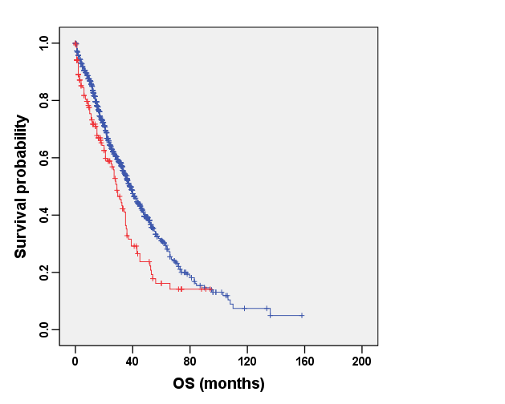
Supplementary Figure 2.
Events/N
HGB>60 567/909
HGB≤60 72/95
Death/N
HGB>60 568/1191
HGB≤60 95/172
Median survival time 24
Median survival time 38
p< 0.0001
p< 0.0001
Median survival time 17
Median survival time 29

Slide 3
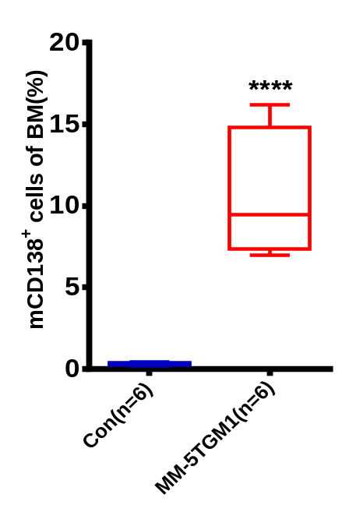
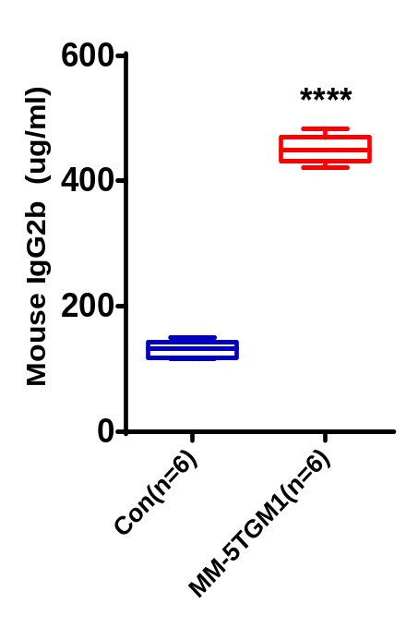
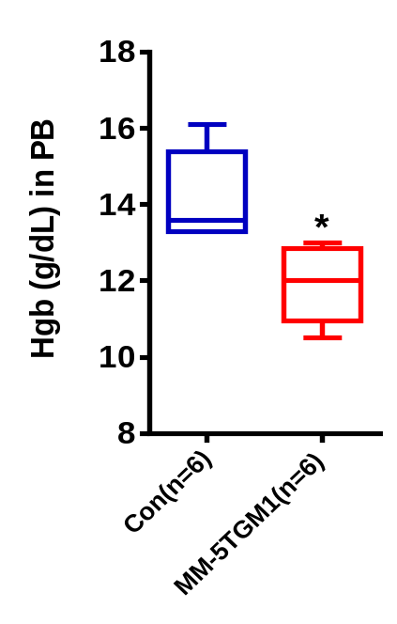
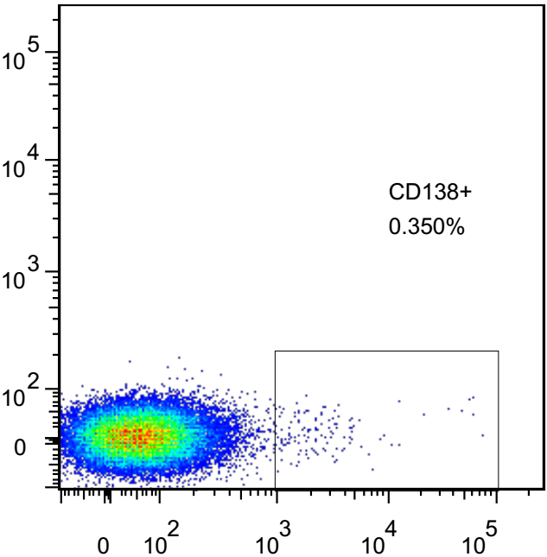
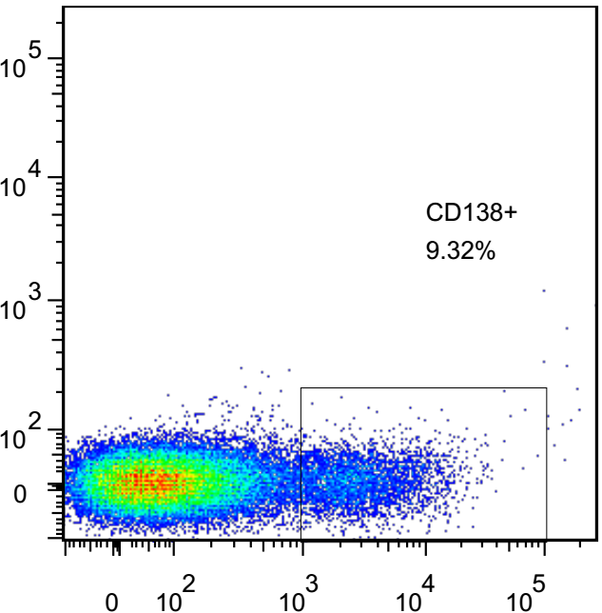
Supplementary Figure 3.
A.
B.
C.
Con
MM-5TGM1
APC
mCD138

Slide 4
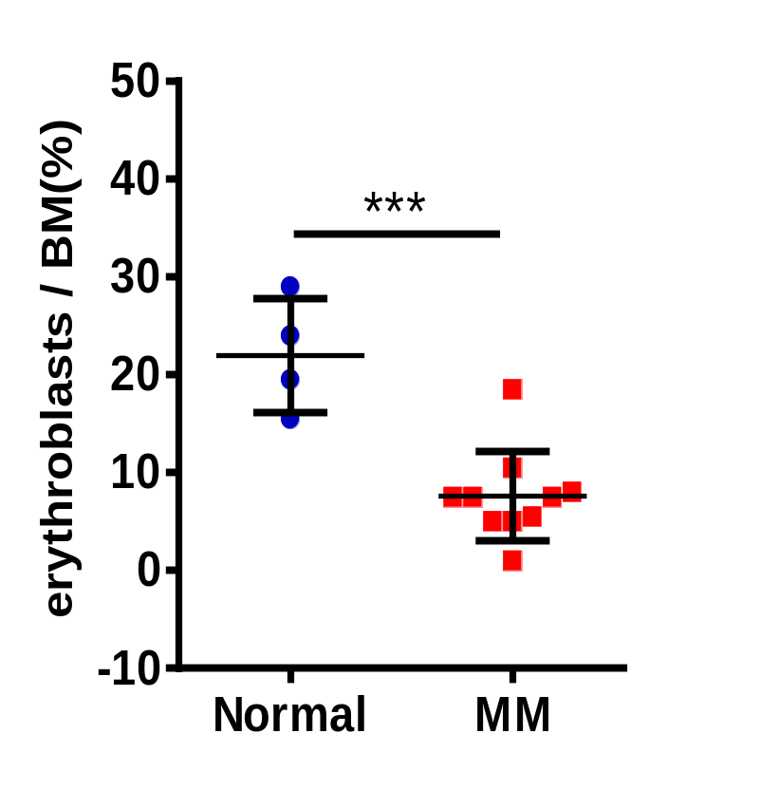
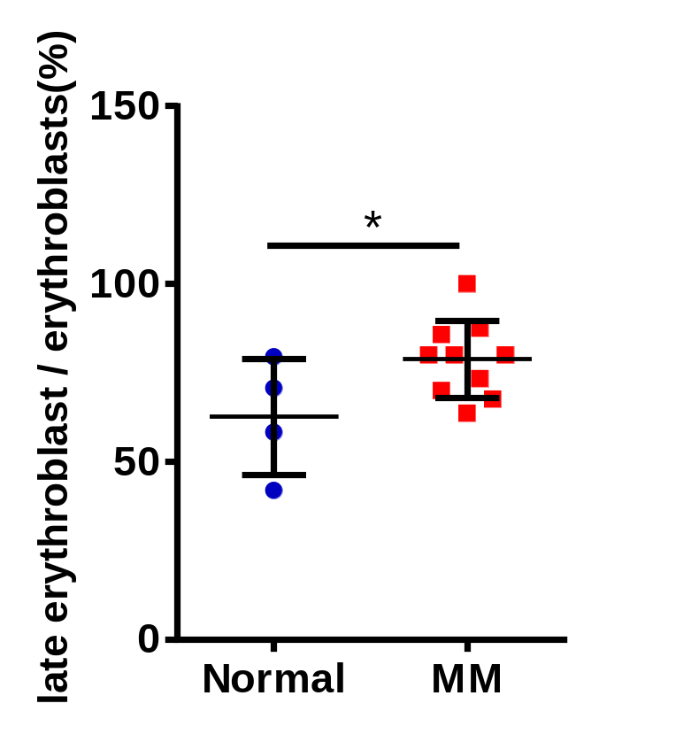
Supplementary Figure 4.
A.
B.

Slide 5
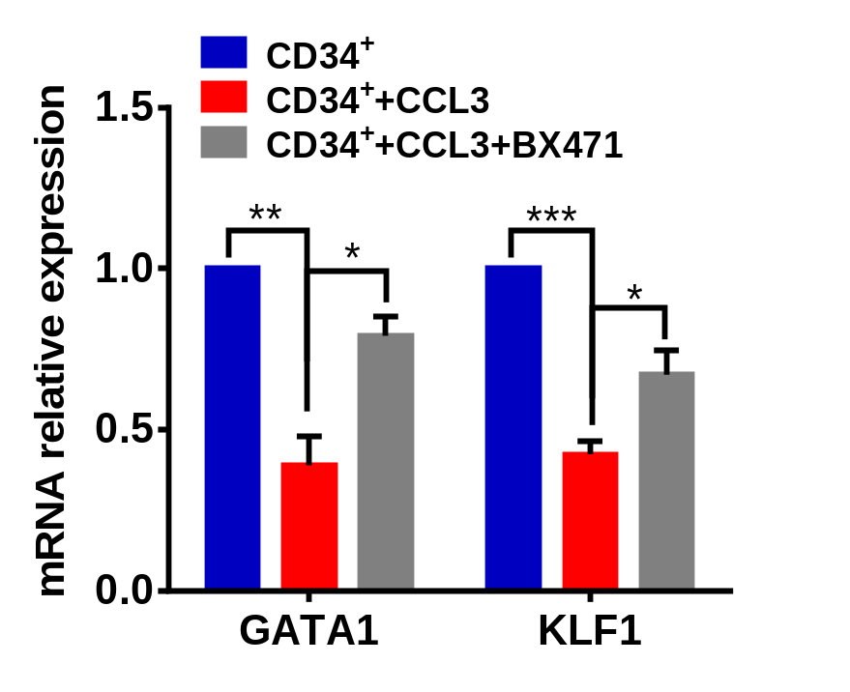
Supplementary Figure 5.
A.
B.
CCL3/ BX471
Ctrl
CCL3
Phos p38
1.0 1.0 1.3
p38
1.0 1.0 1.0
GAPDH
(P38)
GATA1
1.0 1.0 0.7
GAPDH
(GATA1)

Slide 6
Supplementary Figure 6.
Myeloma Bone Marrow
Myeloma cell
CCL3
CCL3
CCL3
CCL3
CCL3
CCL3
CCL3
CCL3
CCL3
CCL3
GMP
Monocytes
CCL3
HSC
CMP
CCL3
MEP
Erythroblasts
The schematic model of our hypothesis for HSPCs in response to elevated CCL3 in MM bone marrow.

