Slide 1
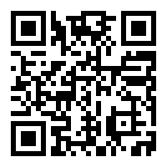











Development of a prediction score for COVID-19 associated mortality in AKI patients
SCAN to use the calculator
or use
https://covidmodels.shinyapps.io/covid_aki_app/
Latin America COVID-AKI Register
870 AKI patients with confirmed COVID-19
57 cities in 12 countries from Latin America
62.5% progressed to death
Outcome: Death in-hospital
AKI-COV score: COVID-19 risk stratification among AKI patients
Predictors Available
Score-Based Prediction
Demographic:
Age; male sex
Mild
(conventional ward)
The model may assist in identifying hospitalized AKI COVID-19 patients that may require more intensive monitoring
Comorbidities:
Hypertesion; Dehydratation
Condition at Admission:
Mild; Moderate; Severe
Moderate
(need Oxigen)
Severe
(need ICU)
MODEL
score
Probability
Death
S
Evaluated to
Laboratory Exams:
AST; WBC; creatinine
> 0.5
Intensive monitor
AKI Etiology:
COVID; Sepsis; Other
< 0.5
Closer Observation
Condition:
Mechanical Ventilation; Renal Replacement; vasopressors
Kidney Replacement
Mechanical
Ventilation
Vasopressor
Model accuracy in a validation cohort: AUC ROC 0.821 [0.75-0.88]

