Slide 1
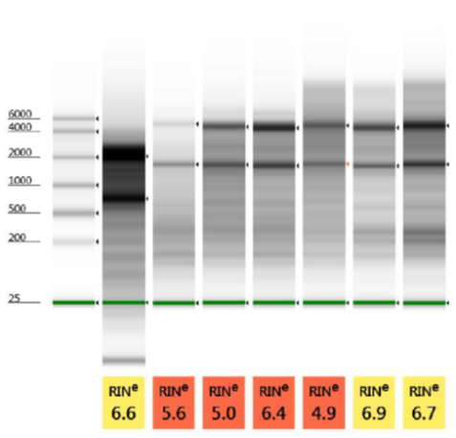
0 H + RNA Later
Ladder
0 H
1 H
2 H
4 H
8 H
12 H
24 H

Slide 2
0 H
0 H + RNA Later
1 H
2 H

Slide 3
4 H
8 H
12 H
24 H

