Slide 1
Differential methylation of G-protein coupled receptor signaling genes in gastrointestinal neuroendocrine tumors
Seyoun Byun^{1,2}, Kajsa E. Affolter^{1,3}, Angela K. Snow¹, Karen Curtin^{1,4}, Austin R. Cannon⁵, Lisa A. Cannon-Albright^{1,4}, Ramya Thota⁶, Deborah W. Neklason^{1,4, *}
¹Huntsman Cancer Institute, University of Utah, USA, ²Department of Biomedical Informatics, University of Utah School of Medicine, USA, ³Department of Pathology, University of Utah, USA, ⁴Division of Epidemiology, Department of Internal Medicine, University of Utah, USA, ⁵ Division of General Surgery, Department of Surgery, University of Utah School of Medicine, USA. ⁶Medical Oncology, Intermountain Healthcare, USA
Supplementary figures 1-5

Slide 2
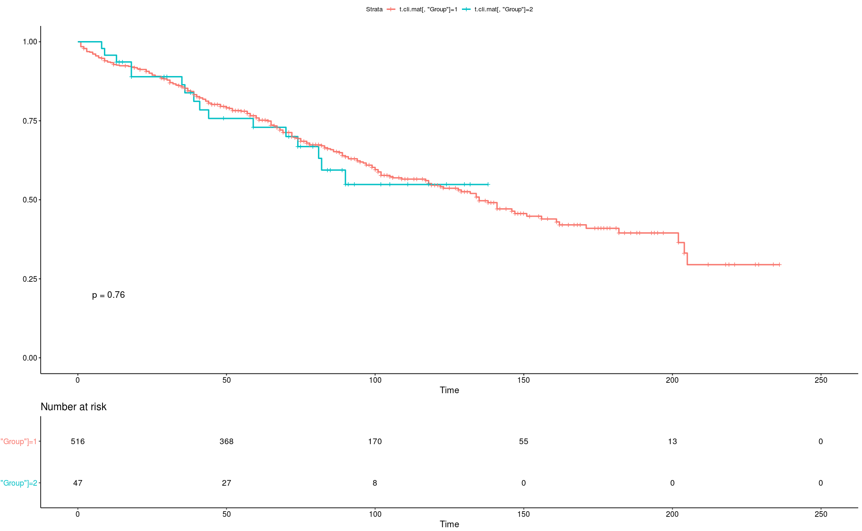
Group 1
Group 2
Group 1
Group 2
Figure S1. The survival analysis result of the selected 47 cases tested (Group 2, blue line) and the 516 cases not tested (Group 1, red line). There is no significant difference in survival rates (p=0.76). X-axis and Y-axis refers time (months) and expected overall survival rate, respectively.

Slide 3
Enriched functional pathways
-log10 (FDR)
Enriched GO terms
-log10 (FDR)
Figure S2. Pathways (upper) and GO terms (bottom) significantly enriched in 901 differentially methylated gene. The enriched GO terms were considered with adjust FDR < 0.05 (red line). X-axis and Y-axis refers -log10(FDR) and GO terms, respectively.

Slide 4
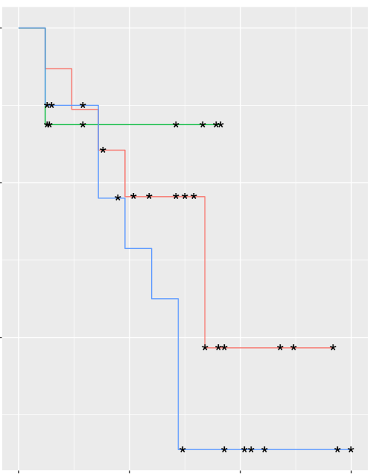
Overall Survival
100 %
80 %
18 LOH
MultiCNV
Survival
NoCNV
60 %
P=0.409
0 50 100 150
Time (Months)
Figure S3. Survival analysis for the CNV subgroups 18LOH, MultiCNV, and NoCNV. There is no significant difference in survival rates among the three subgroups. X-axis and Y-axis refers time (months) and survival rate, respectively.

Slide 5
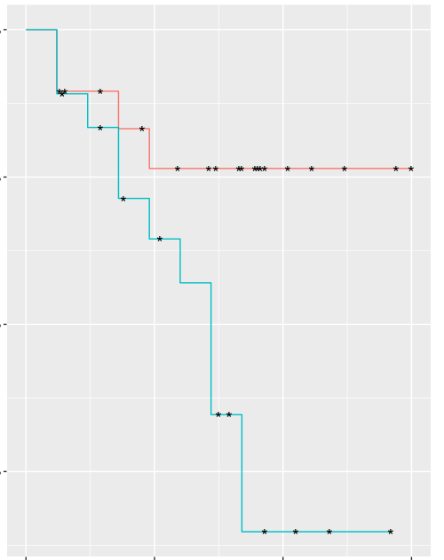
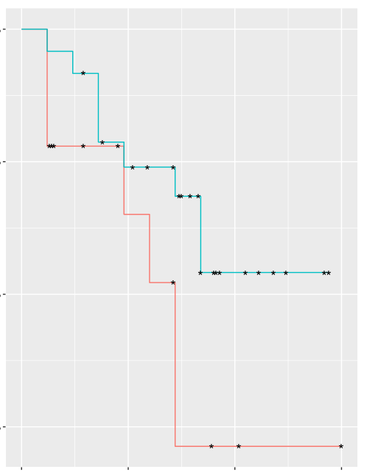
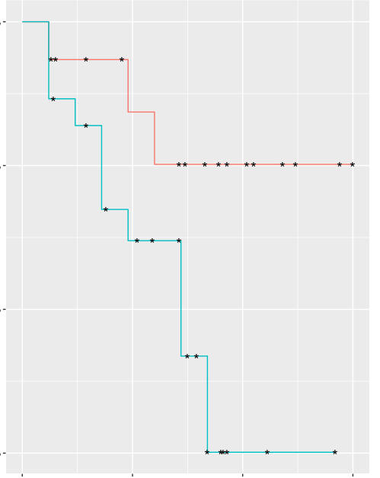
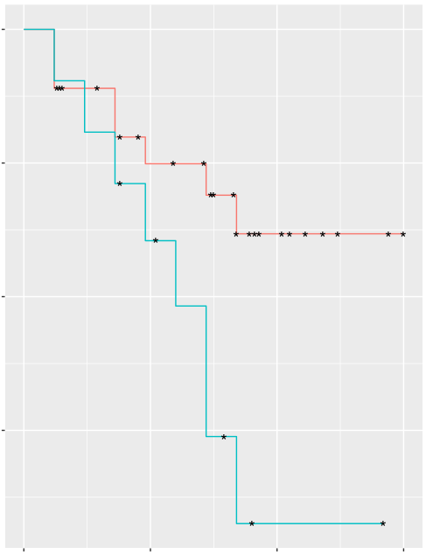
100%
OR2S2
100%
SMILR
80 %
80 %
Survival
Survival
60 %
60 %
40 %
40 %
P=0.0213
P=0.0253
0
50
100
150
0
50
100
150
Time (Months)
Time (Months)
100%
RNU6-653P
100%
AC010543.1
80 %
80 %
Survival
Survival
60 %
60 %
40 %
40 %
P=0.0472
P=0.0347
High Methylation
Low Methylation
0
50
100
150
0
50
100
150
Time (Months)
Time (Months)
Figure S4. Survival analysis comparing high methylation and low methylation of the total genes based on promoter methylated. X-axis and Y-axis refers time (months) and survival rate, respectively.

Slide 6
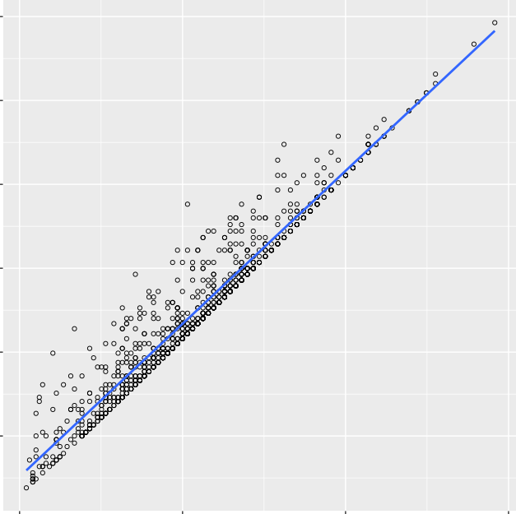
7
6
901 genes –log10(p-value) (n=44 samples)
5
4
3
2
2 4 6 8
901 genes –log10(p-value) (n=47 samples)
Figure S5. Scatter plot to compare p-value of differential methylation 901 genes of 18LOH vs. NoCNV between 47 samples including 3 appendiceal NETs and 44 SINET samples. X-axis and Y-axis refer –log10 (p-value).

