Slide 1
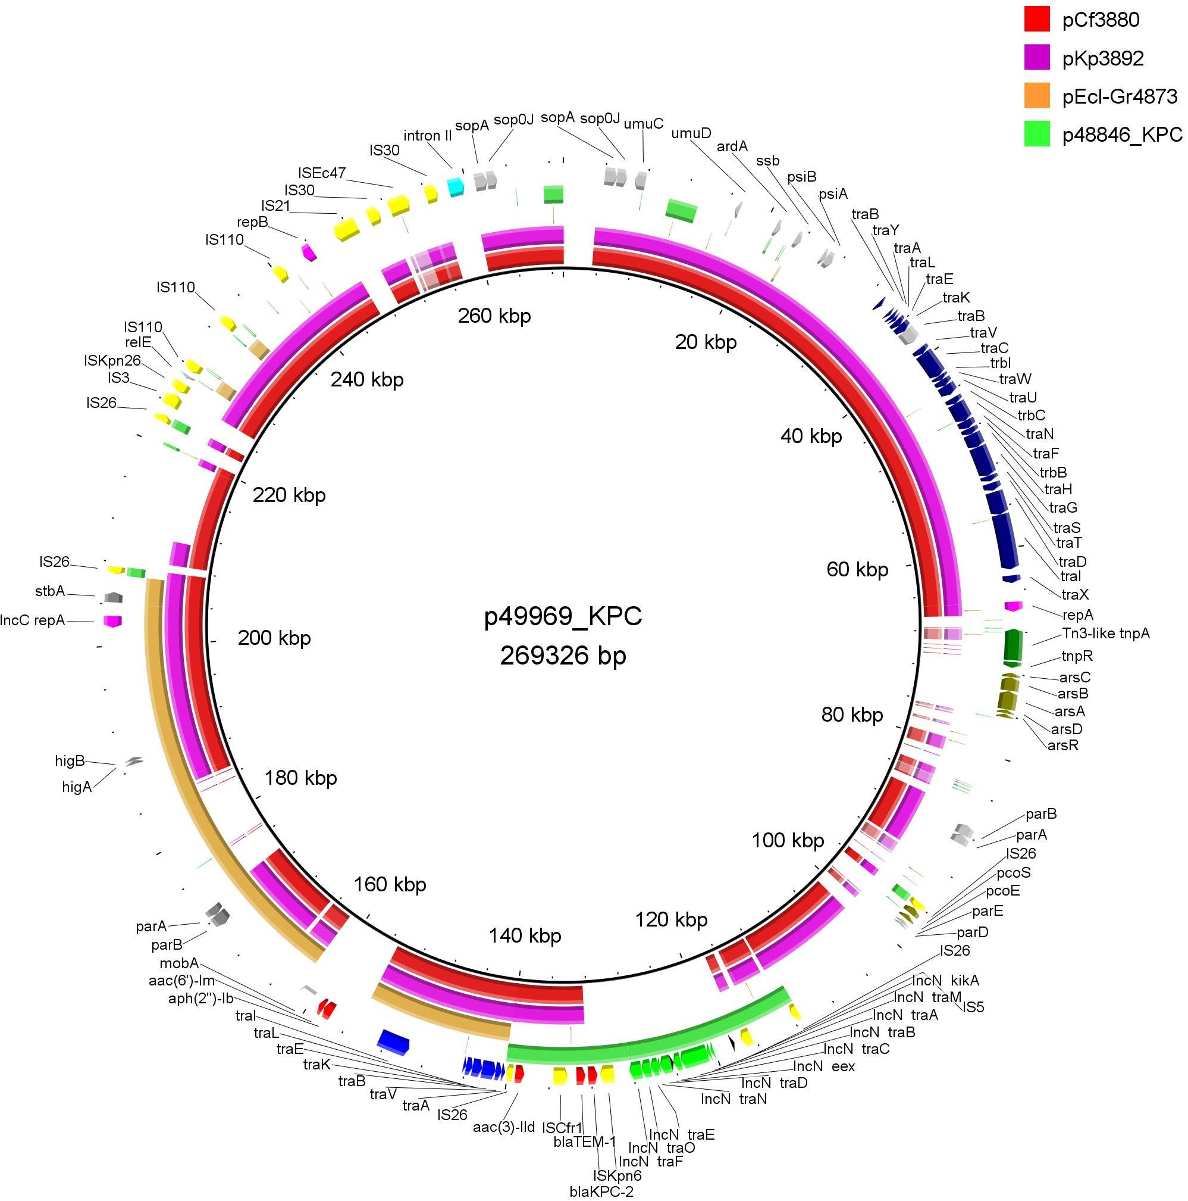
Figure S5. Circular map of IncFII/FIB/C₂ hybrid plasmid p48846_KPC, encoding KPC-2 carbapenemase, characterized from C. freundi strain Cfr-49969 isolates that was recovered from a Czech hospital.

