Slide 1
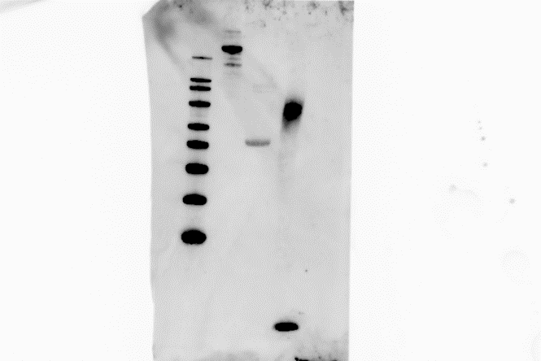
Figure 1C
Vehicle serum
Vaccine serum
1 2 3 4
1 2 3 4
1: Marker, 2: KLH, 3: Recombinant human CTGF, 4: BSA-CTGF (150-156)

