Slide 1
Figure legend
Figure S1 O. elatus plants grown in (a) wild growth conditions and (b) artificially cultivated conditions in the experimental site of Changbai Mountain.
Figure S2 Species accumulation curves of soil bactiria (a) and fungi (b) in O. elatus rhizosphere of artificial cultivation type (CT) and wild growth conditions (WT).
Figure S3 The correlation between SOM and alpha diversity of the soil bacterial (a, b, c, d), and fungi (e, f, g, h) in O. elatus rhizosphere soils under cultivated conditions (CT) and wild growth conditions (WT).
Figure S4 The correlation between soil pH and alpha diversity of the soil bacterial (a, b, c, d ), and fungi (e, f, g, h) in O. elatus rhizosphere soils under cultivated conditions (CT) and wild growth conditions (WT).

Slide 2
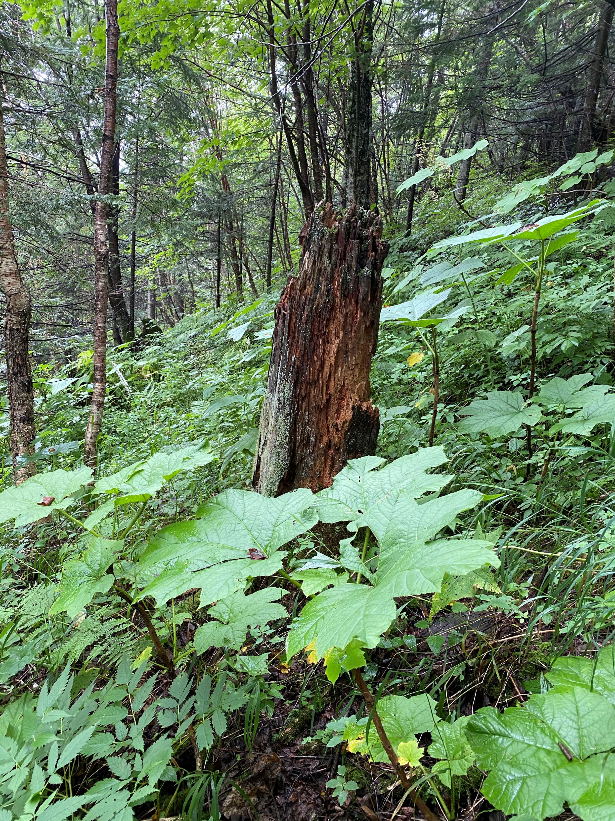
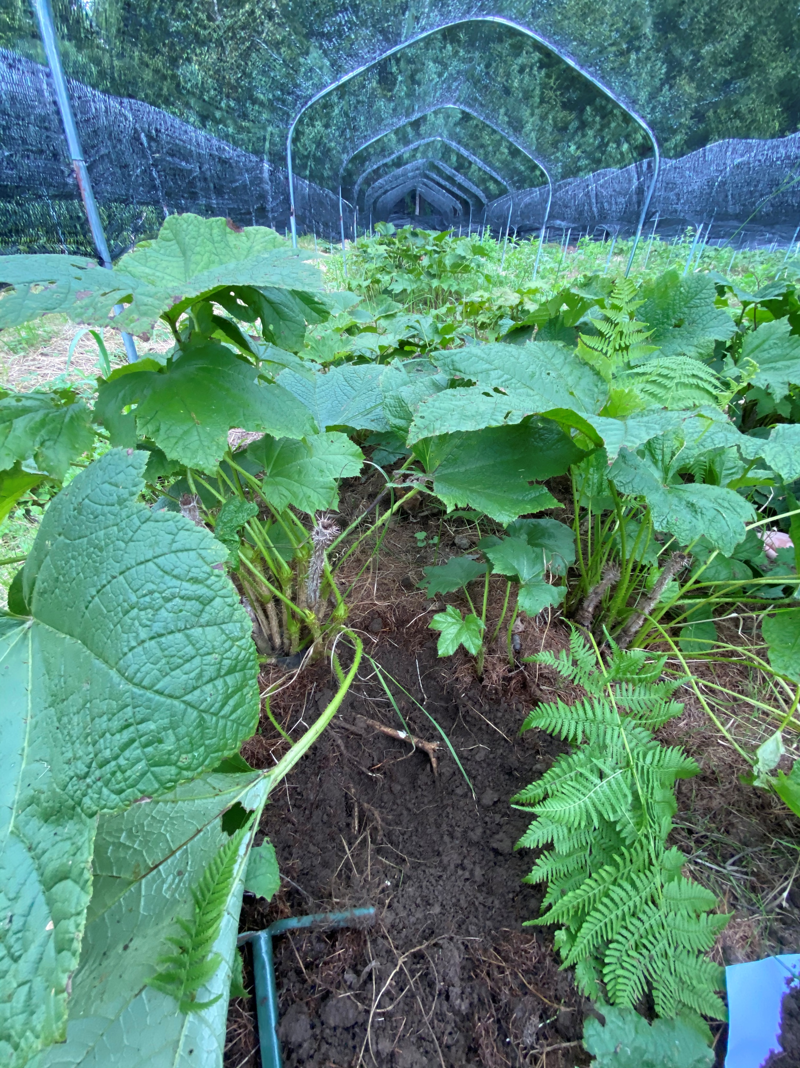
(a)
(b)
Oplopanax elatus Nakai plant
Oplopanax elatus Nakai plant
Oplopanax elatus Nakai plant of wild type
Oplopanax elatus Nakai plant of artificial type
Figure S1 O. elatus plants grown in (a) wild growth conditions and (b) artificially cultivated conditions in the experimental site of Changbai Mountain.

Slide 3
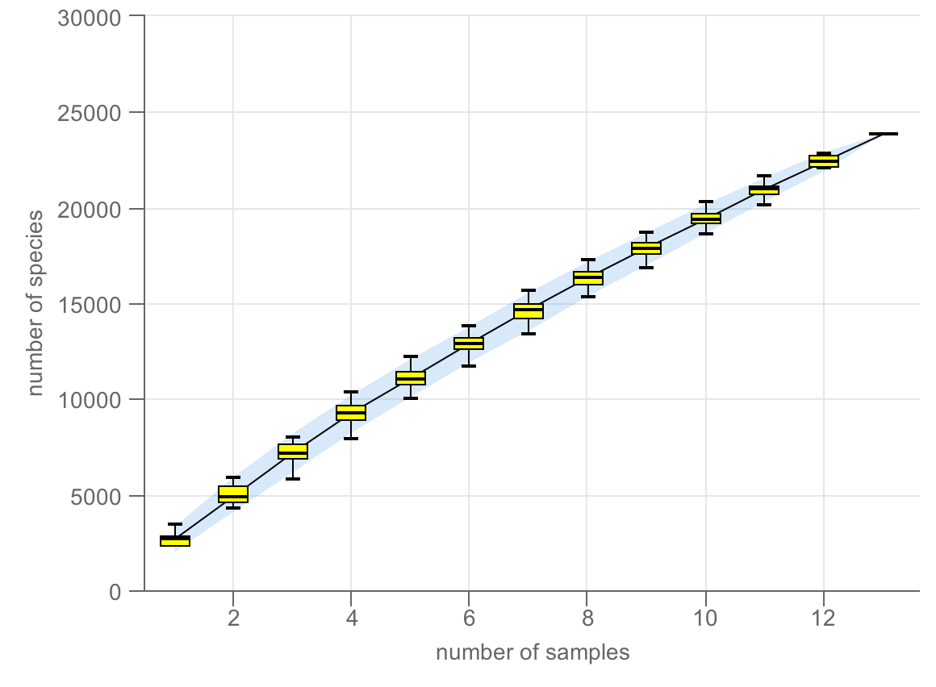
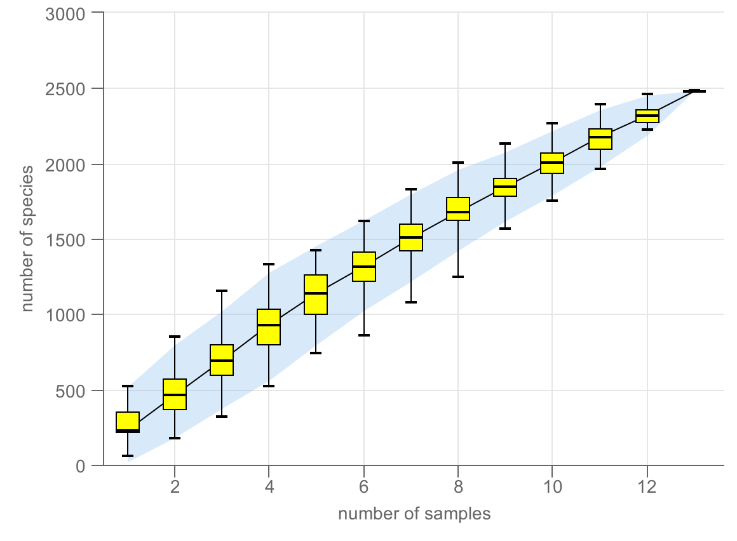
(a)
(b)
Figure S2 Species accumulation curves of soil bactiria (a) and fungi (b) in O. elatus rhizosphere of artificial cultivation type (CT) and wild growth conditions (WT).

Slide 4
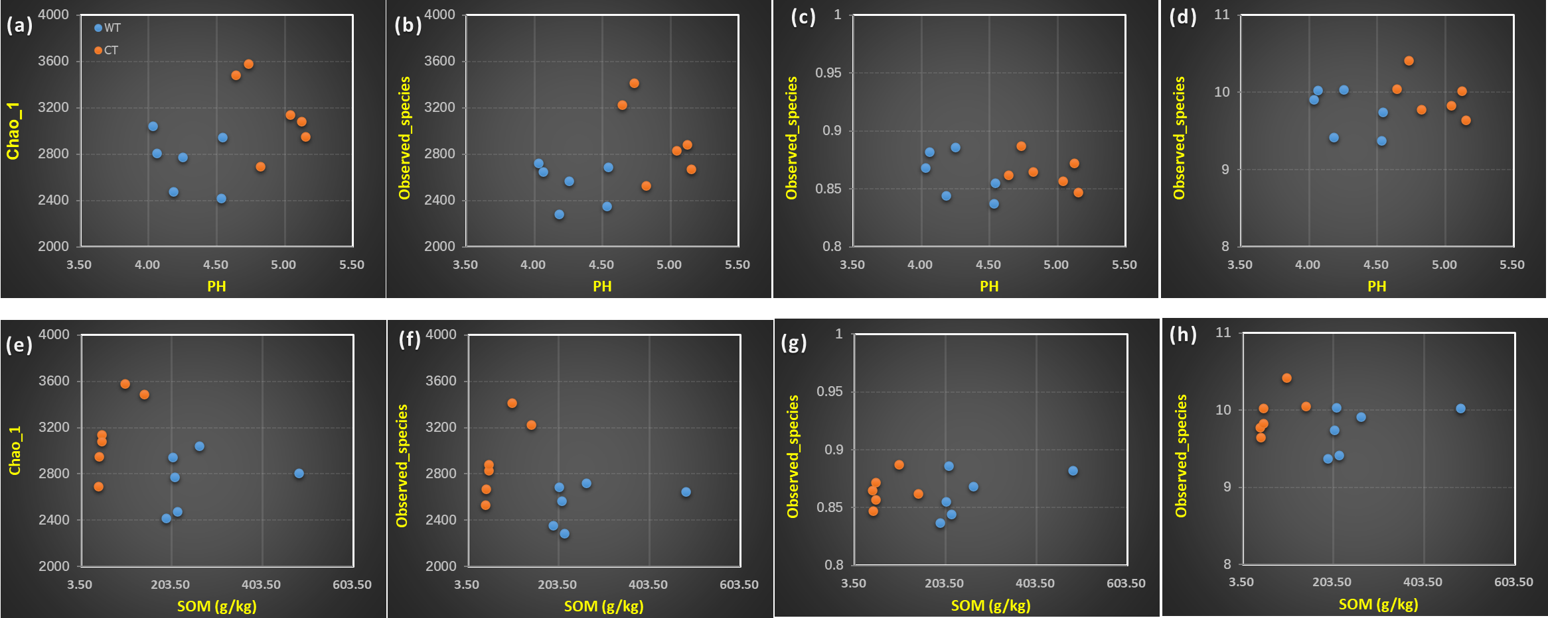
Figure S3 The correlation between SOM and alpha diversity of the soil bacterial (a, b, c, d ), and fungi (e, f, g, h) in O. elatus rhizosphere soils under cultivated conditions (CT) and wild growth conditions (WT).

Slide 5
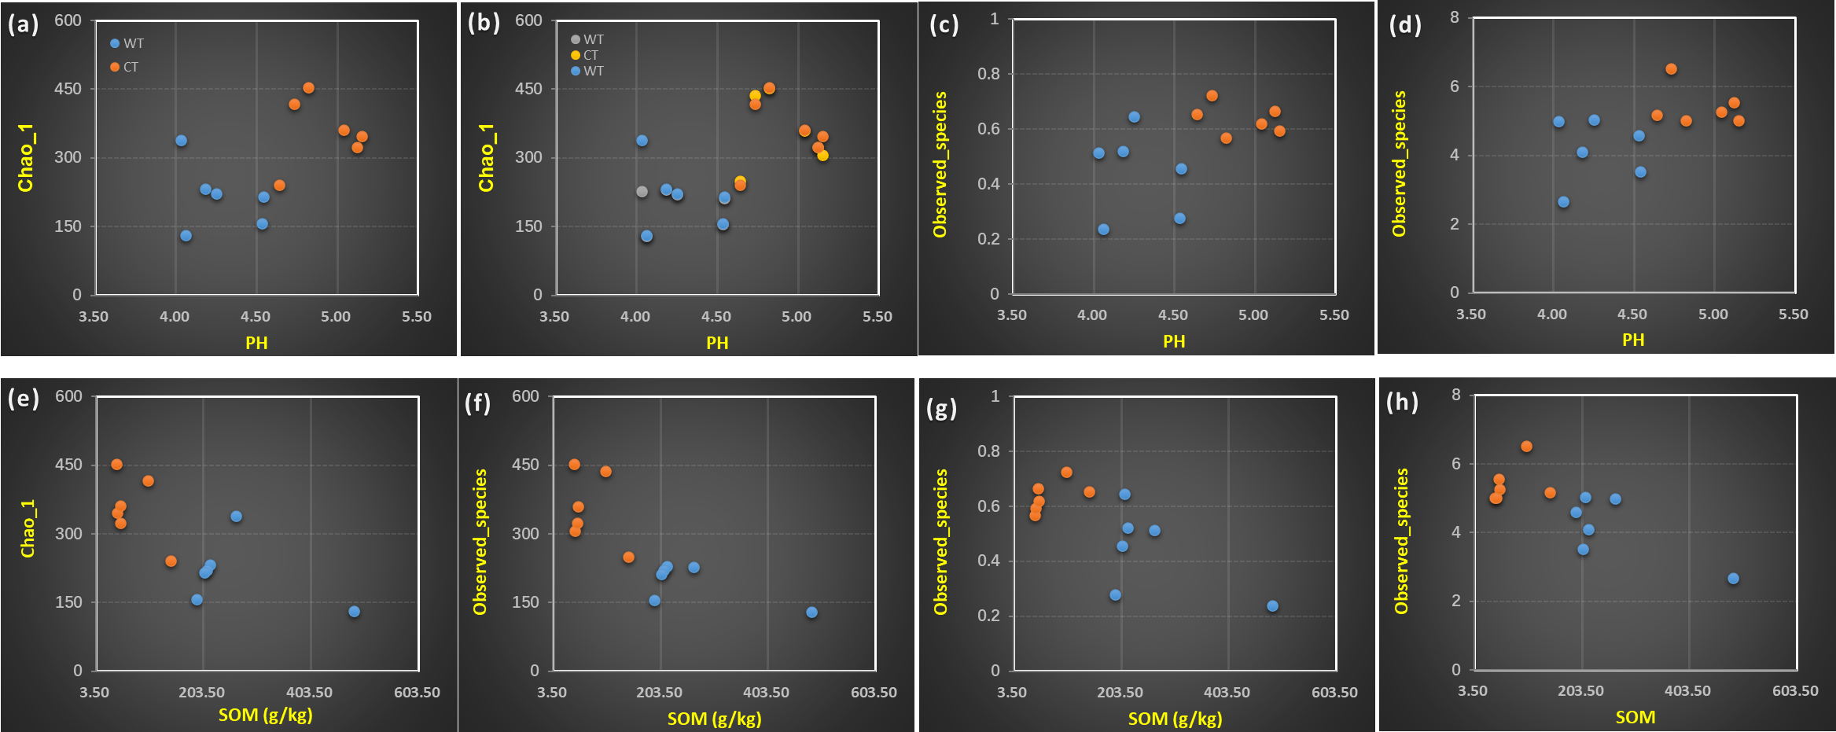
Figure S4 The correlation between soil pH and alpha diversity of the soil bacterial (a, b, c, d ), and fungi (e, f, g, h) in O. elatus rhizosphere soils under cultivated conditions (CT) and wild growth conditions (WT).

