Slide 1
Supplemented figures

Slide 2
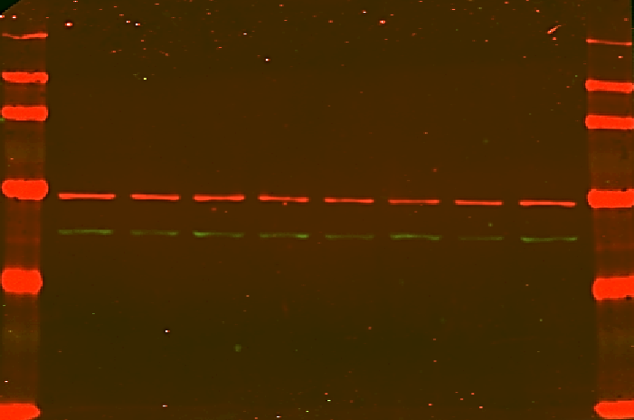
S. Fig 1
A B
24h 24h 24h 48h 48h 48h
c exo exo c exo exo
GRN GRN
24h 24h 24h 48h 48h 48h
c exo exo c exo exo
GRN GRN
Tubulin
Vimentin
tubulin
αSMA
Notes:
A. The blot used for the aSMA (lanes 2-7). Please note that the molecular weight of the reference gene tubulin is higher than that of the tested protein aSMA and therefore the blot was cropped and re arranged. B. The blot used for tubulin (first 6 lanes). All calculations of the relative levels of aSMA using tubulin as references were conducted on results from the same experiments. C. The original blot used to form Fig 4B.

Slide 3
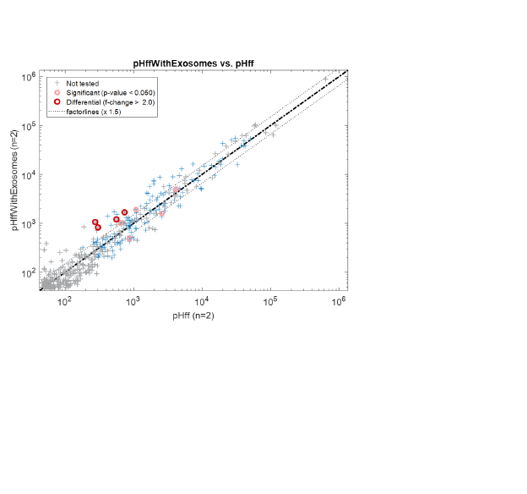
S. Fig 2A

Slide 4
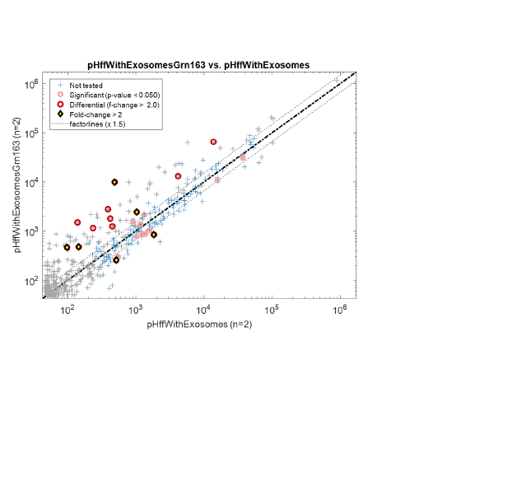
S. Fig 2B

Slide 5
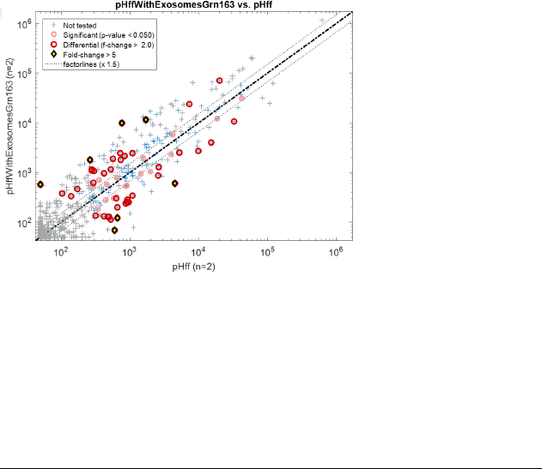
S. Fig 2C

Slide 6
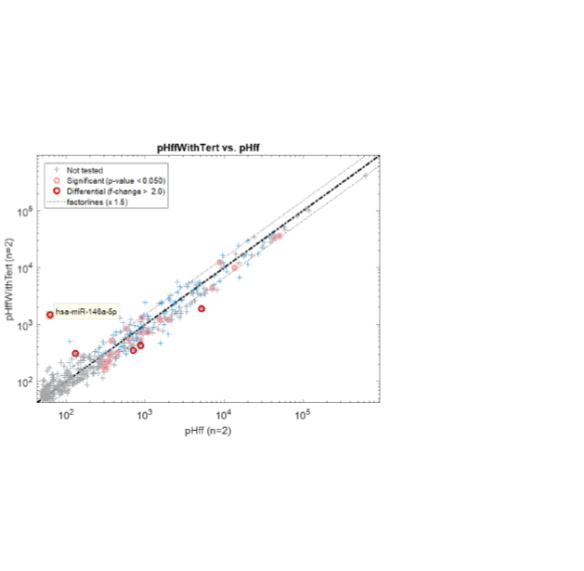
S. Fig 2D

Slide 7
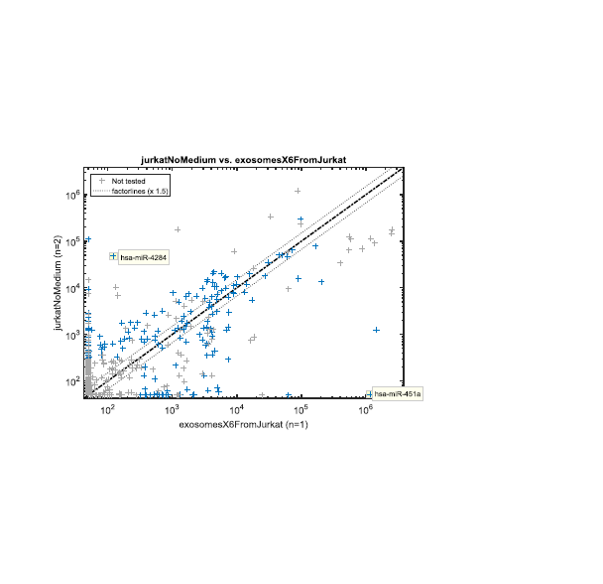
S. Fig 2E

