Slide 1
Supplementary Figure 1. Overall survival hazard rate funnel plot

Slide 2
Supplementary Figure 2. Forest plots for the treatment effects estimated by odds ratio of the 1-year event-free survival.

Slide 3
Supplementary Figure 3. Forest plots for the treatment effects estimated by odds ratio of the pathological response rate.

Slide 4
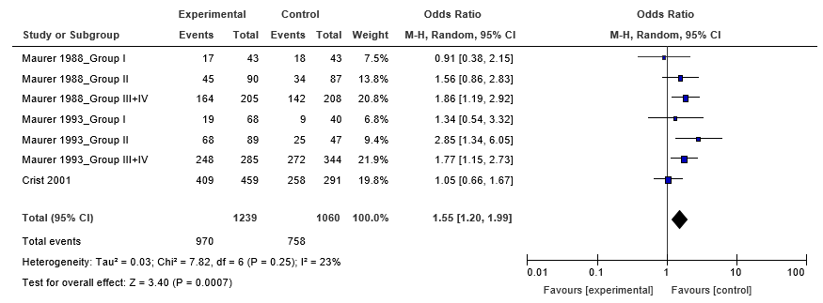
Supplementary Figure 4. Forest plots for the treatment effects estimated by odds ratio of the overall severe adverse event.

Slide 5
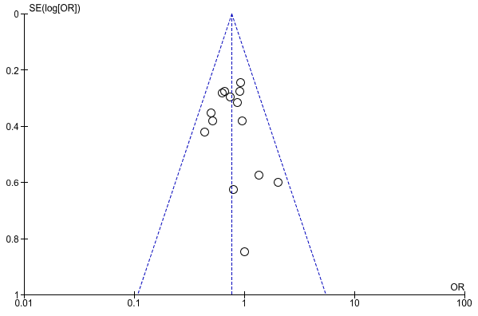
Supplementary Figure 5. 1-year event-free survival funnel plot

Slide 6
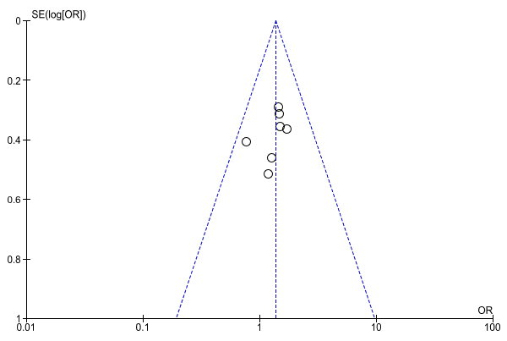
Supplementary Figure 6. Pathological response rate funnel plot

Slide 7
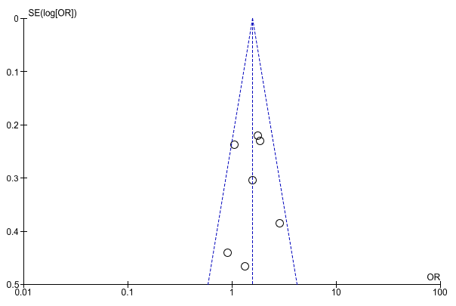
Supplementary Figure 7. Overall severe adverse event funnel plot

Slide 8
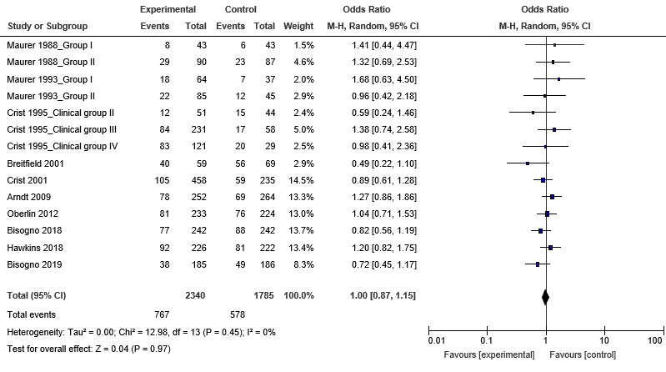
Supplementary Figure 8. Forest plots for the treatment effects estimated by odds ratio of the 3-year event-free survival.

Slide 9
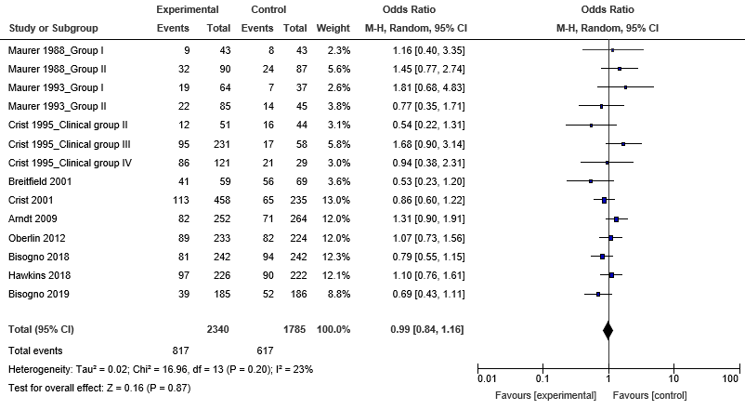
Supplementary Figure 9. Forest plots for the treatment effects estimated by odds ratio of the 5-year event-free survival.

Slide 10
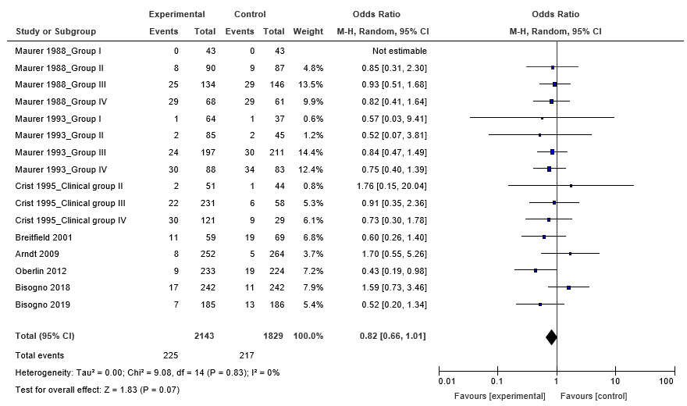
Supplementary Figure 10. Forest plots for the treatment effects estimated by odds ratios of the 1-year overall survival.

Slide 11
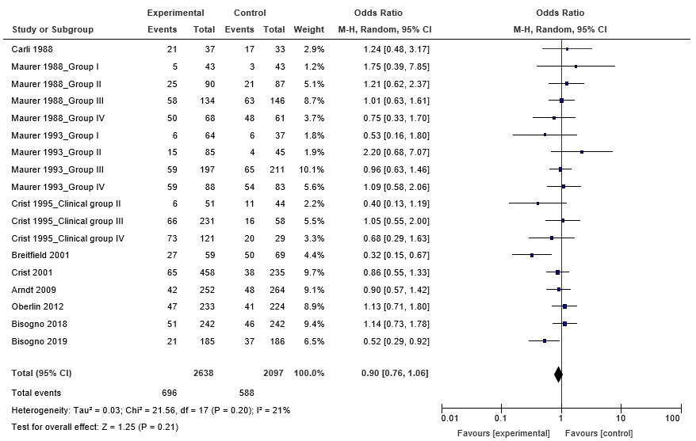
Supplementary Figure 11. Forest plots for the treatment effects estimated by odds ratio of the 3-year overall survival.

Slide 12
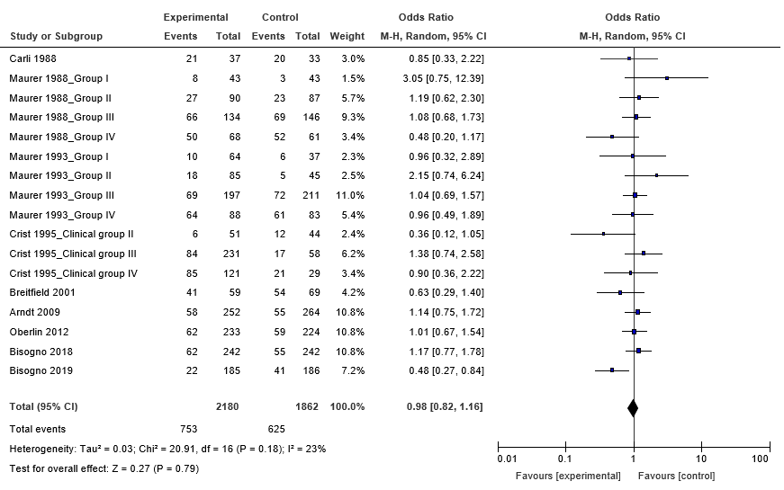
Supplementary Figure 12. Forest plots for the treatment effects estimated by odds ratio of the 5-year overall survival.

Slide 13
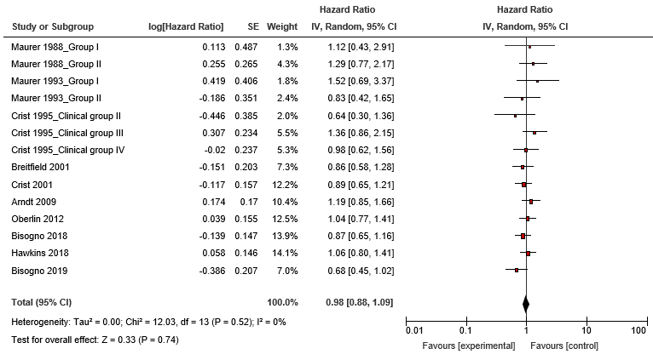
Supplementary Figure 13. Forest plots for the treatment effects estimated by hazards ratio of the event-free survival.

