Slide 1
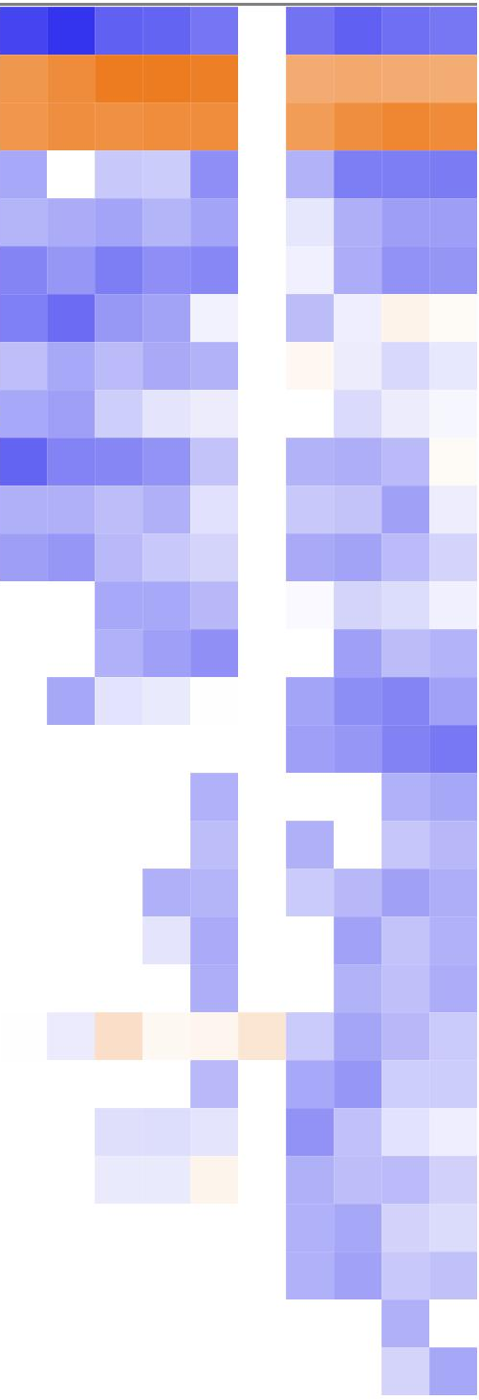
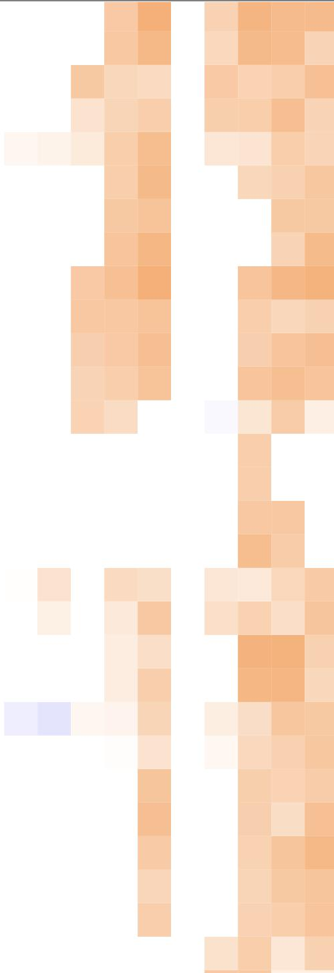
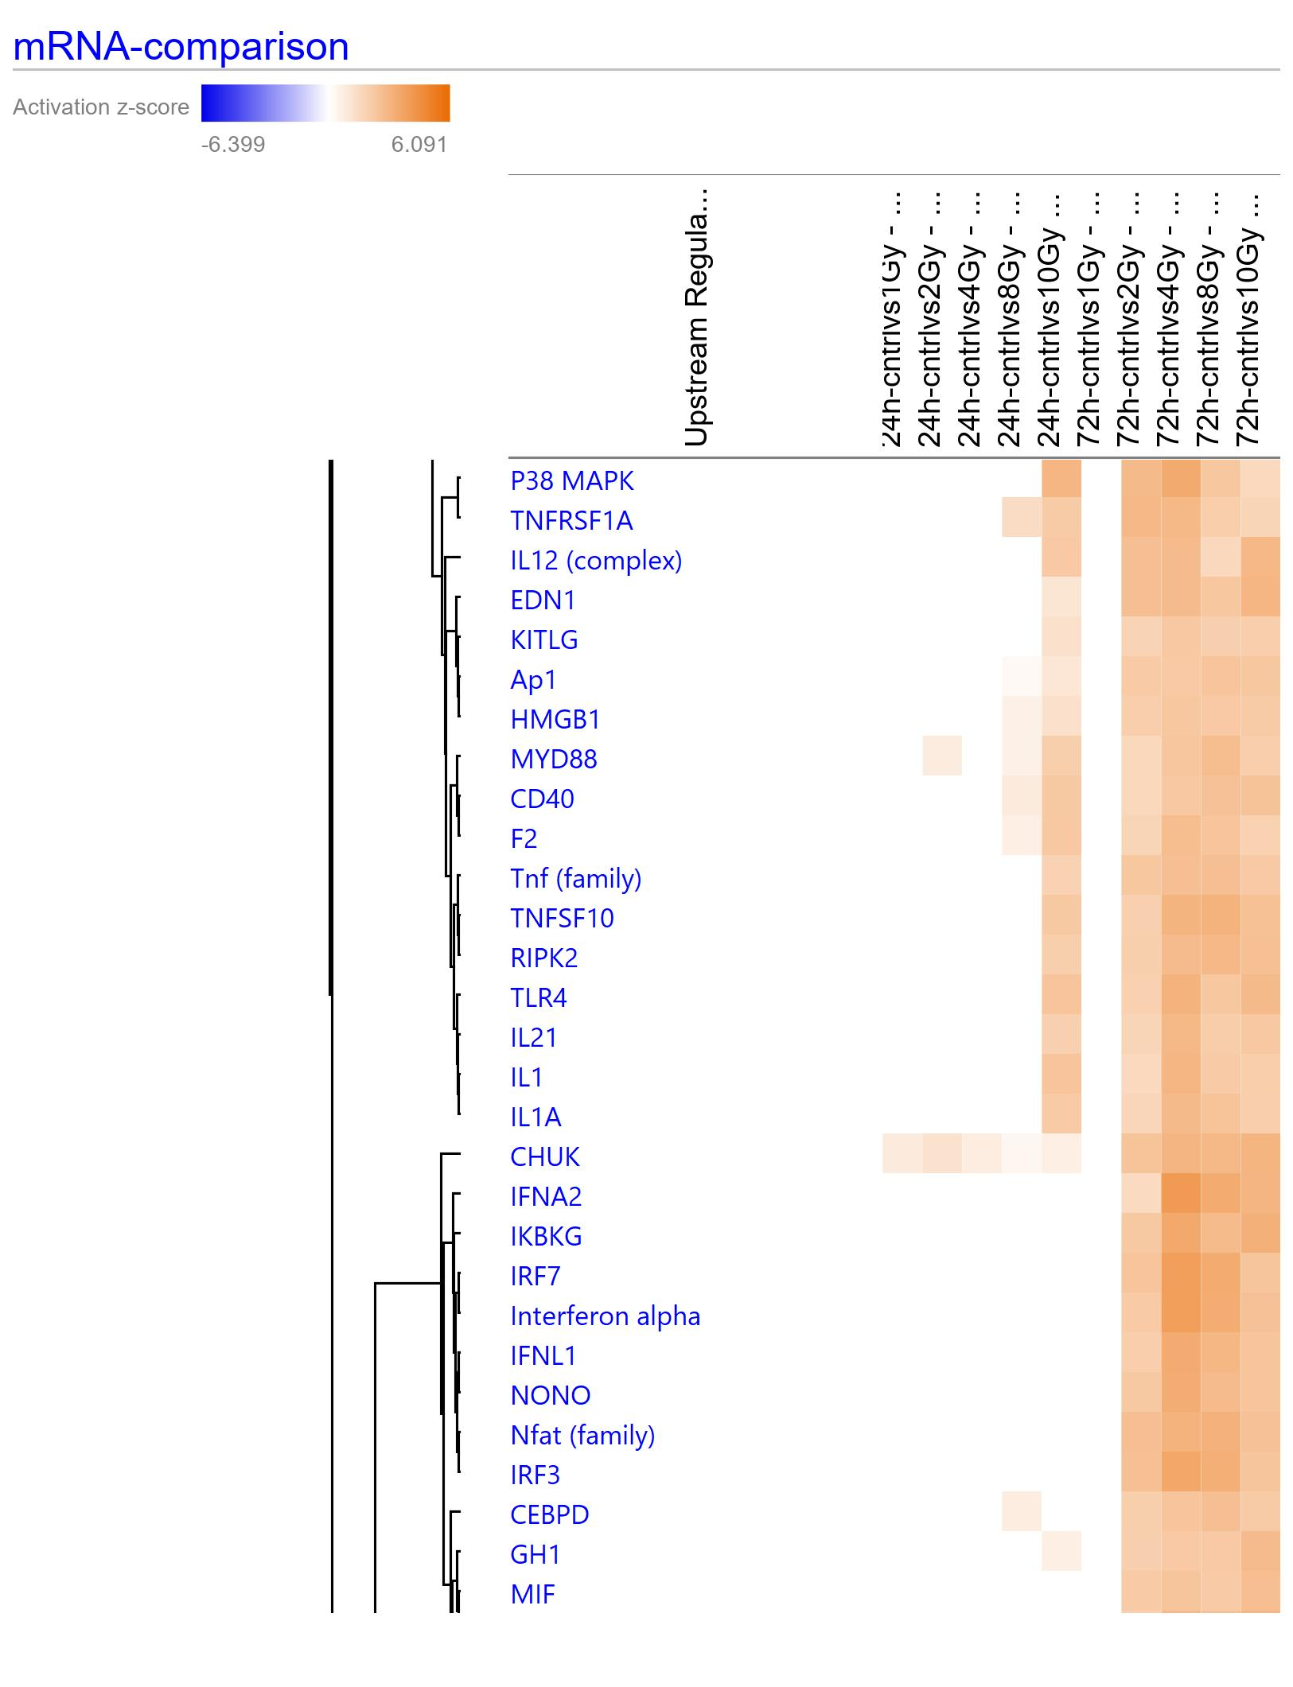
Supplementary Figure 10: Upstream regulators (drugs and chemicals) identified in IPA to effect significantly different gene expression profiles across different doses. A), and B) represent two different views from the complete list.
1 Gy
2 Gy
4 Gy
8 Gy
10 Gy
1 Gy
2 Gy
4 Gy
8 Gy
10 Gy
1 Gy
2 Gy
4 Gy
8 Gy
10 Gy
1 Gy
2 Gy
4 Gy
8 Gy
10 Gy
Upstream regulators- drugs and chemicals
p ≤ 0.01; |z| ≥ 2
24 h
72 h
24 h
72 h
aflatoxin B1
calcitriol
l-asparaginase
pirinixic acid
cephaloridine
estrogen
8-bromo-cAMP
dihydrotestosterone
1,4-bis[2-(3,5-dichloropyridyloxy)]benzene
beta-estradiol
10E,12Z-octadecadienoic acid
diethylstilbestrol
GW9662
elaidic acid
Z-LLL-CHO
pyrrolidine dithiocarbamate
sucrose
2-amino-5-phosphonovaleric acid
mibolerone
Ro31-8220
U0126
dexamethasone
SB203580
N-acetyl-L-cysteine
lactacystin
tyrphostin AG490
Sb202190
chelerythrine
iron
E. coli B5 lipopolysaccharide
tetradecanoylphorbol acetate
paclitaxel
AICAR
cisplatin
prexasertib
CX-5461
methyl methanesulfonate
5-fluorouracil
trovafloxacin
methylnitronitrosoguanidine
5-azacytidine
genistein
shikonin
lipoarabinomannan
aldesleukin
imiquimod
cycloheximide
Salmonella enterica serotype abortus equi lipopolysaccharide
bromodeoxyuridine
stallimycin
medroxyprogesterone acetate
salmonella minnesota R595 lipopolysaccharides
homocysteine
leukotriene D4
lenalidomide
niacinamide
lysophosphatidic acid
peptidoglycan
Activation score
-6.399 6.091

