Slide 1
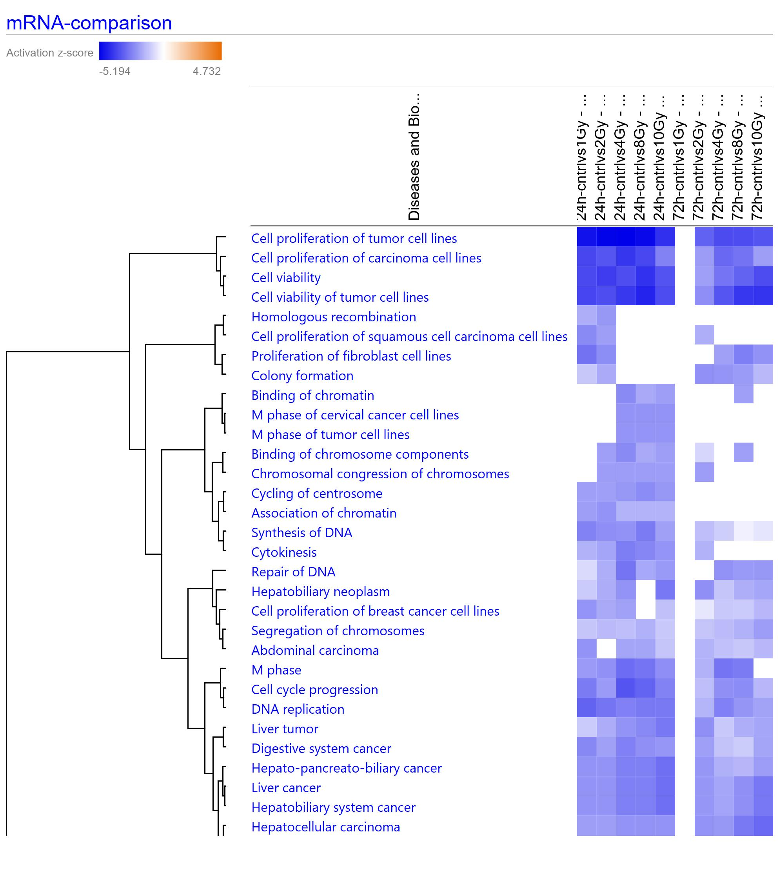
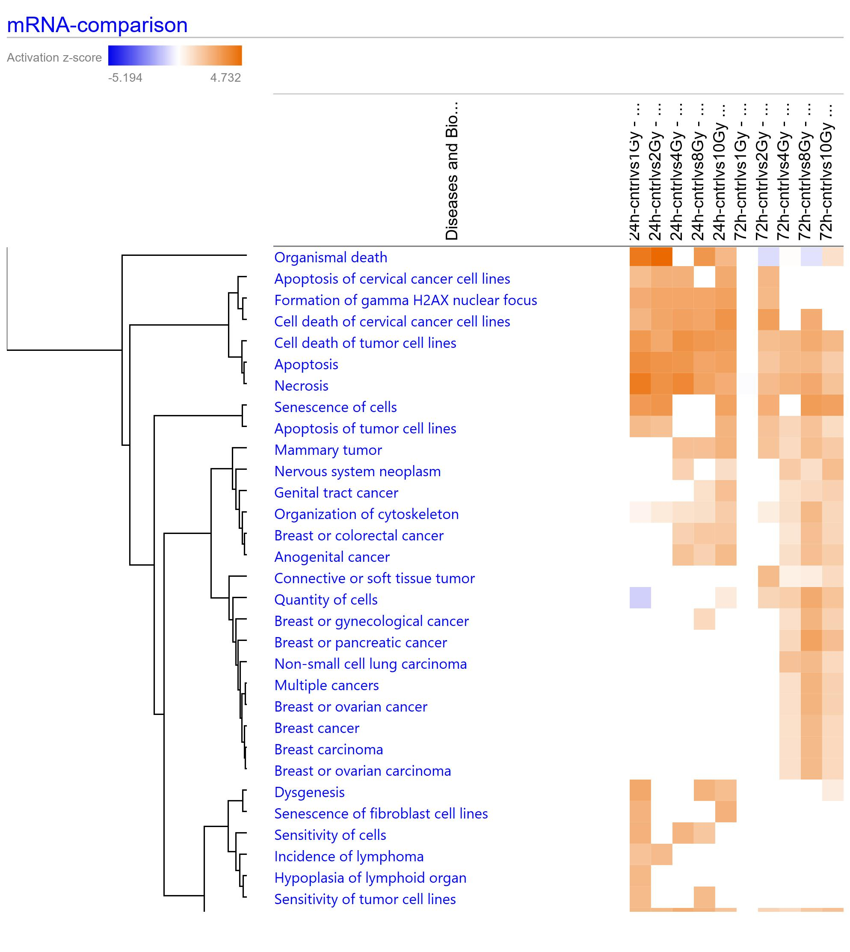
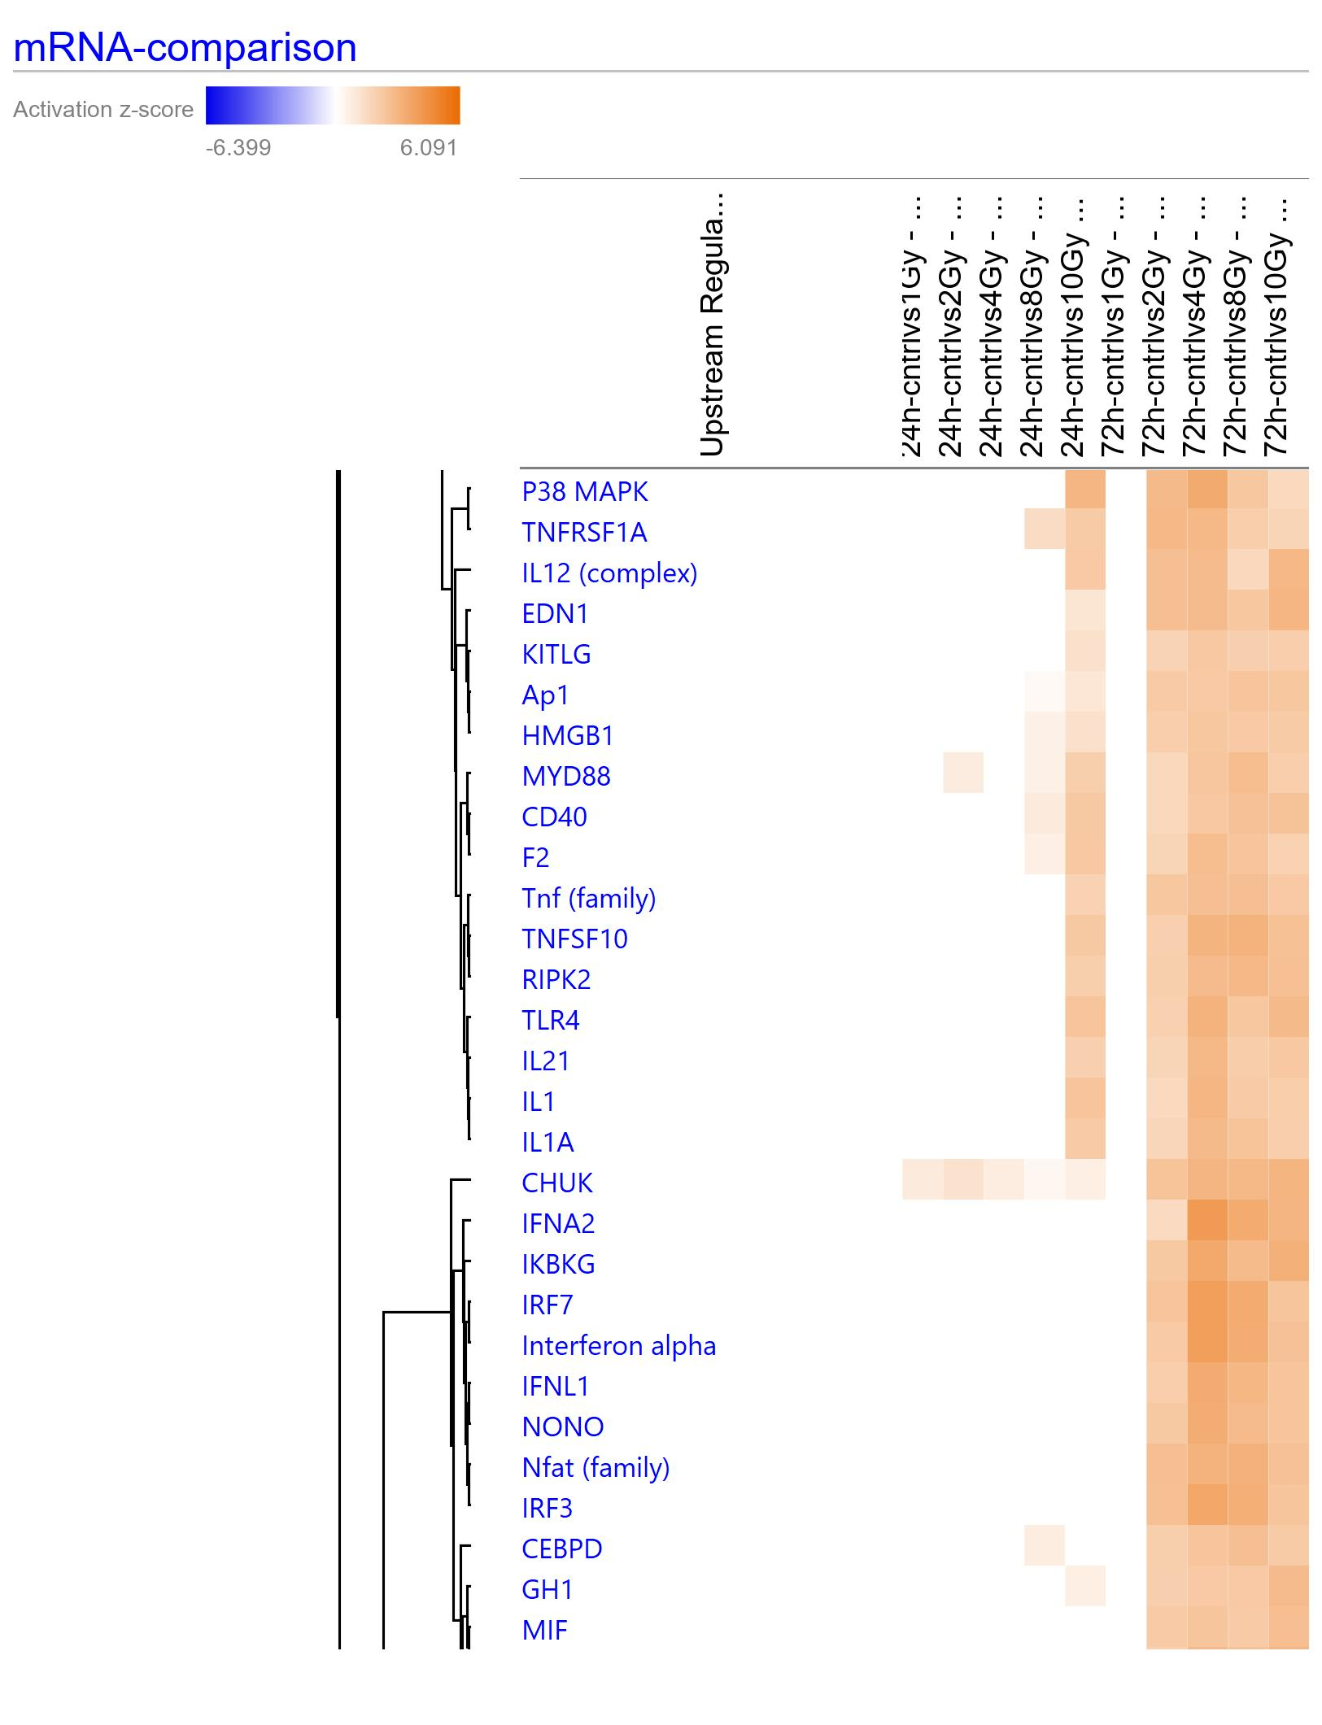
Supplementary Figure 11: Disease and Biofunction terms identified in IPA to effect significantly different gene expression profiles across different doses. A), and B) represent two different views from the complete list. A) shows repressed biofunctions while B) shows activation processes and biofunctions.
1 Gy
2 Gy
4 Gy
8 Gy
10 Gy
1 Gy
2 Gy
4 Gy
8 Gy
10 Gy
1 Gy
2 Gy
4 Gy
8 Gy
10 Gy
1 Gy
2 Gy
4 Gy
8 Gy
10 Gy
Diseases and Biofunctions
p ≤ 0.01; |z| ≥ 2
A
24 h
72 h
B
24 h
72 h
Cell proliferation of tumor cell lines
Cell proliferation of carcinoma cell lines
Cell viability
Cell viability of tumor cell lines
Homologous recombination
Cell proliferation of squamous cell carcinoma cell lines
Proliferation of fibroblast cell lines
Colony formation
Binding of chromatin
M phase of cervical cancer cell lines
M phase of tumor cell lines
Binding of chromosome components
Chromosomal congression of chromosomes
Cycling of centrosome
Association of chromatin
Synthesis of DNA
Cytokinesis
Repair of DNA
Hepatobiliary neoplasm
Cell proliferation of breast cancer cell lines
Segregation of chromosomes
Abdominal carcinoma
M phase
Cell cycle progression
DNA replication
Liver tumor
Digestive system cancer
Hepato-pancreato-biliary cancer
Liver cancer
Hepatobiliary system cancer
Hepatocellular carcinoma
Organismal death
Apoptosis of cervical cancer cell lines
Formation of gamma H2AX nuclear focus
Cell death of cervical cancer cell lines
Cell death of tumor cell lines
Apoptosis
Necrosis
Senescence of cells
Apoptosis of tumor cell lines
Mammary tumor
Nervous system neoplasm
Genital tract cancer
Organization of cytoskeleton
Breast or colorectal cancer
Anogenital cancer
Connective or soft tissue tumor
Quantity of cells
Breast or gynecological cancer
Breast or pancreatic cancer
Non-small cell lung carcinoma
Multiple cancers
Breast or ovarian cancer
Breast cancer
Breast carcinoma
Breast or ovarian carcinoma
Dysgenesis
Senescence of fibroblast cell lines
Sensitivity of cells
Incidence of lymphoma
Hypoplasia of lymphoid organ
Sensitivity of tumor cell lines
Activation score
-5.194 4.732

