Slide 1
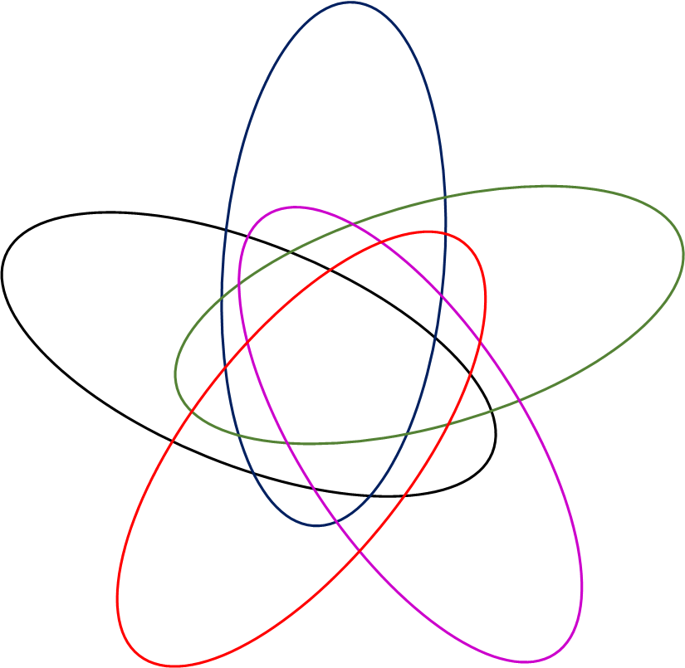
A mRNA_24 h
C miRNA_24 h
E lncRNA_24 h
2 Gy
2 Gy
2 Gy
8
2
0
1 Gy
4 Gy
4 Gy
4 Gy
1 Gy
1 Gy
1
1
0
0
0
0
0
0
1
0
0
0
0
0
1
1
1
35
5
29
0
0
4
3
0
2
3
5
6
0
1
0
2
0
1
54
0
6
1
2
93
9
5
0
2
2
0
6
2
0
1
2
3
1
0
0
0
3
1
0
0
1
0
0
2
8 Gy
1
0
0
0
0
8 Gy
1
0
0
1
0
8 Gy
10 Gy
1
51
10 Gy
0
10 Gy
0
0
46
6
7
96
23
3
13
12
B mRNA_72 h
D miRNA_72 h
F lncRNA_72 h
2 Gy
2 Gy
2 Gy
8
8
3
1 Gy
4 Gy
4 Gy
4 Gy
1 Gy
1 Gy
2
5
5
2
2
0
2
0
7
0
30
0
4
4
0
0
2
0
1
162
42
0
42
11
21
0
9
6
8
1
2
1
0
0
0
9
260
0
56
0
17
0
1
21
0
10
1
7
0
0
0
0
0
0
1
0
0
0
1
0
0
0
0
0
0
8 Gy
0
0
0
0
0
8 Gy
0
0
0
0
0
8 Gy
10 Gy
2
4
10 Gy
1
1
10 Gy
0
176
49
2
111
14
194
55
36
45
23
Notes:
Supplementary Figure 3: Venn diagrams displaying the overlapping and intersecting differentially expressed mRNAs, miRNAs and lncRNAs at the 24 h and 72 h time-points. Venn diagrams were generated on interactiVenn.net

