Slide 1
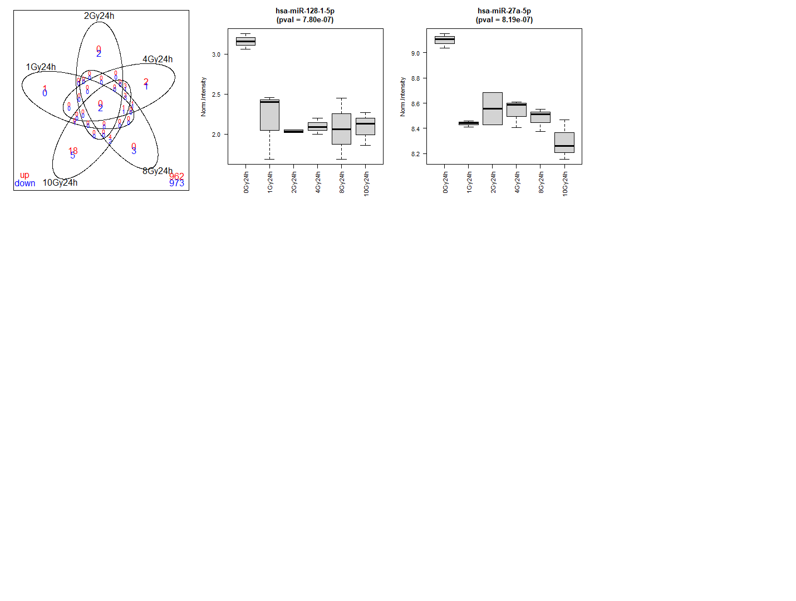
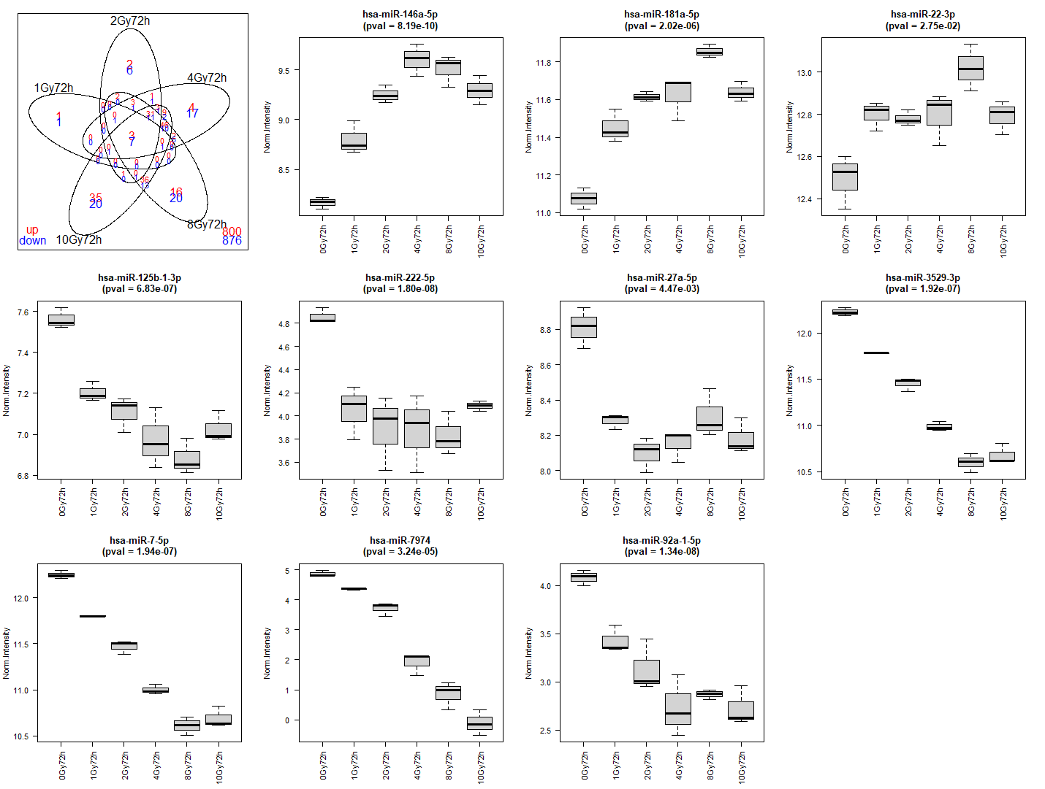
A
miRNA 24h
B
hsa-miR-146a-5p
pval = 8.19E-10
hsa-miR-181a-5p
pval = 2.02E-06
hsa-miR-22-3p
pval = 2.75E-02
hsa-miR-128-1-5p; pval = 7.80E-07
9.5
11.8
13.0
3.0
11.6
12.8
2.5
9.0
11.4
8.5
11.2
12.6
2.0
12.4
11.0
10 Gy
0 Gy
10 Gy
10 Gy
0 Gy
1 Gy
2 Gy
4 Gy
8 Gy
1 Gy
2 Gy
4 Gy
8 Gy
0 Gy
0 Gy
10 Gy
1 Gy
2 Gy
4 Gy
8 Gy
1 Gy
2 Gy
4 Gy
8 Gy
hsa-miR-27a-5p; pval = 8.19E-07
hsa-miR-125b-1-3p
pval = 6.83E-07
hsa-miR-222-5p
pval = 1.80E-08
hsa-miR-27a-5p
pval = 4.47E-03
9.0
7.6
4.8
4.6
8.8
8.8
7.4
8.6
4.4
8.6
7.2
4.2
8.4
8.4
4.0
7.0
3.8
8.2
8.2
6.8
3.6
8.0
0 Gy
10 Gy
10 Gy
10 Gy
1 Gy
2 Gy
4 Gy
8 Gy
0 Gy
10 Gy
1 Gy
2 Gy
4 Gy
8 Gy
0 Gy
1 Gy
2 Gy
4 Gy
8 Gy
0 Gy
1 Gy
2 Gy
4 Gy
8 Gy
hsa-miR-3529-3p
pval = 1.92E-07
hsa-miR-7-5p
pval = 1.94E-07
hsa-miR-7974-5p
pval = 3.24E-05
hsa-miR-92a-1-5p
pval = 1.34E-08
5
4.0
12.0
12.0
4
11.5
11.5
3
3.5
2
11.0
11.0
1
3.0
10.5
10.5
0
2.5
0 Gy
10 Gy
10 Gy
10 Gy
1 Gy
2 Gy
4 Gy
8 Gy
10 Gy
0 Gy
0 Gy
1 Gy
2 Gy
4 Gy
8 Gy
1 Gy
2 Gy
4 Gy
8 Gy
0 Gy
1 Gy
2 Gy
4 Gy
8 Gy
Notes:
Supplementary Figure 6: 0 Gy miRNA markers for A) 24 h and B) 72 h. 0 Gy-24 h miRNA markers were selected from the intersection of all doses in supplementary figure 2C while 0 Gy- 72 h markers were selected from the intersection of all doses in supplementary figure 2D

