Slide 1
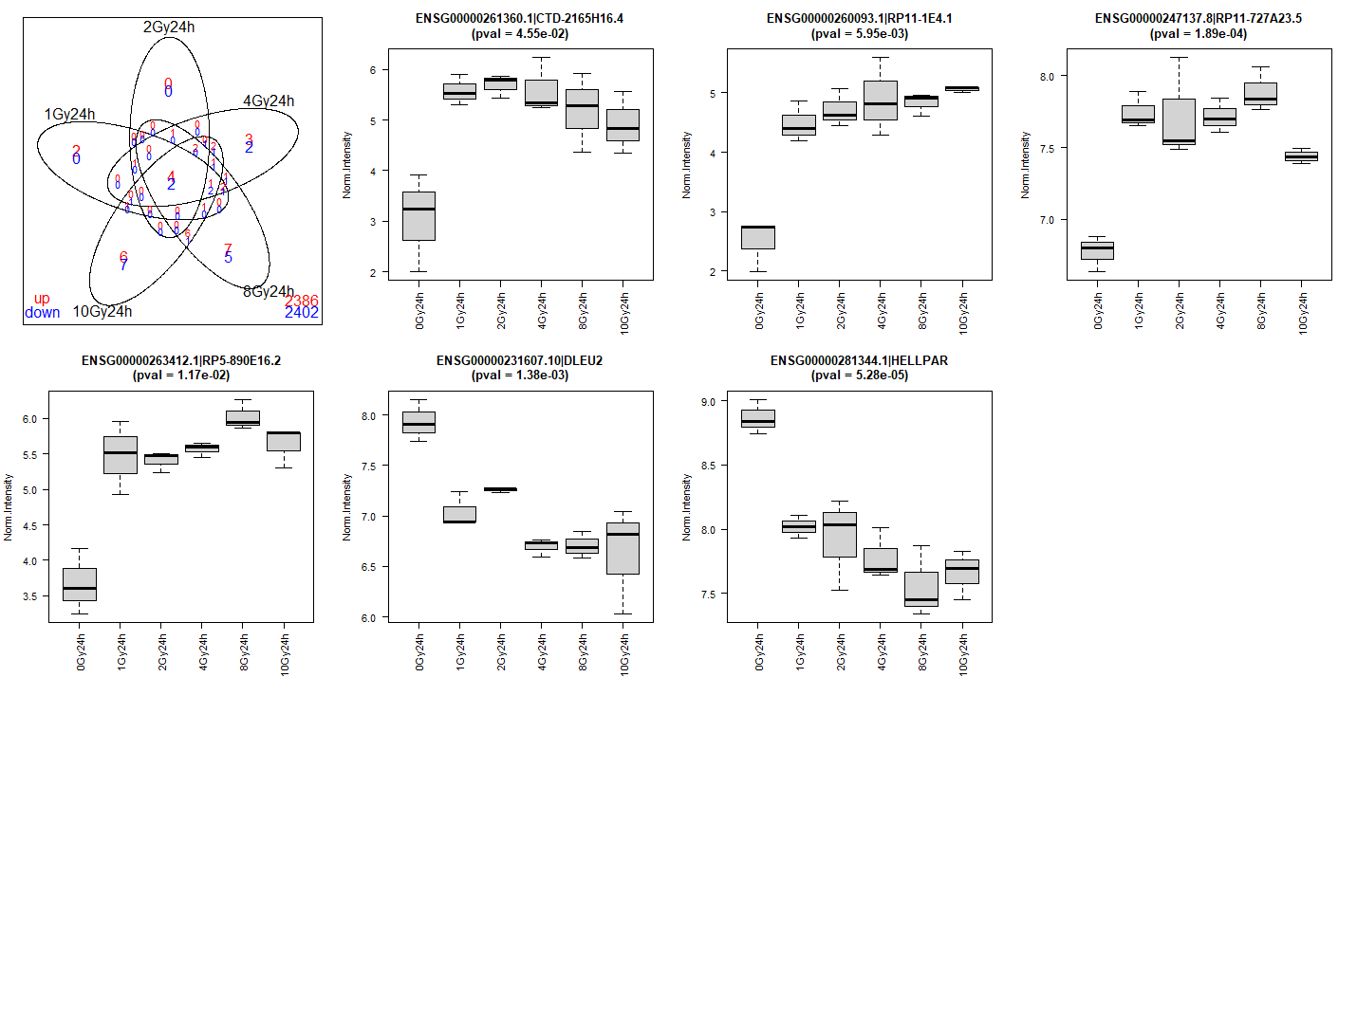
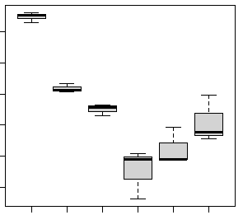
Supplementary Figure 8: 0 Gy lncRNA markers for 72 h. 0 Gy-72 h lncRNA markers were selected from the intersection of all doses in supplementary figure 2F.
CTD-2165H16-4
pval = 4.55E-02
RP11-E4.1
pval = 5.95E-03
RP11-727A23.5
pval = 1.89E-04
6
5
8.0
5
4
7.5
4
3
3
7.0
2
2
10 Gy
0 Gy
10 Gy
10 Gy
1 Gy
2 Gy
4 Gy
8 Gy
0 Gy
0 Gy
1 Gy
2 Gy
4 Gy
8 Gy
1 Gy
2 Gy
4 Gy
8 Gy
RP5-890E16.2
pval = 1.17E-02
DLEU2
pval = 1.38E-03
HELLPAR
pval = 5.28E-05
RP5-1086D14.6
pval = 1.81E-09
5.5
8.0
9.0
11.0
5.0
7.5
8.5
10.5
4.5
10.0
4.0
7.0
8.0
9.5
3.5
6.5
9.0
3.0
7.5
8.5
6.0
10 Gy
0 Gy
10 Gy
0 Gy
1 Gy
2 Gy
4 Gy
8 Gy
10 Gy
0 Gy
10 Gy
1 Gy
2 Gy
4 Gy
8 Gy
0 Gy
1 Gy
2 Gy
4 Gy
8 Gy
1 Gy
2 Gy
4 Gy
8 Gy

