Slide 1
Supplementary files
Title
TDAG51 deficiency attenuates dextran sulfate sodium-induced colitis in mice
Authors
Hyoeun Jeon#, Dulshara Sachini Amarasekara#, Nari Lee, Hye-Won Park, Jiyeon Yu and Jaerang Rho*

Slide 2
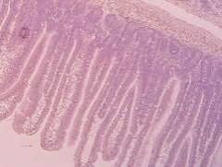
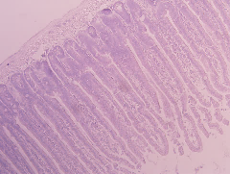
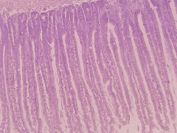
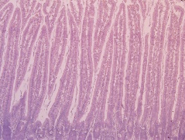
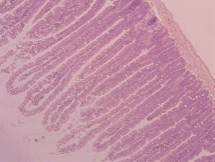
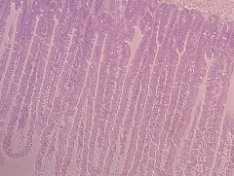
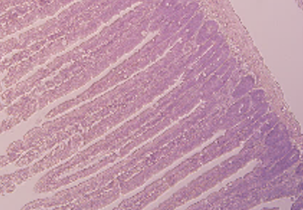
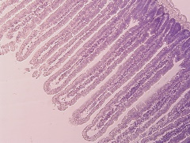
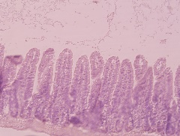
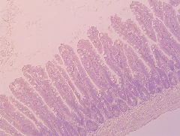
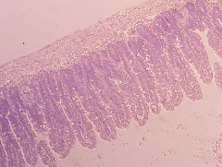
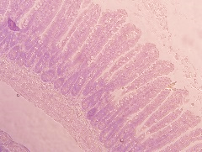
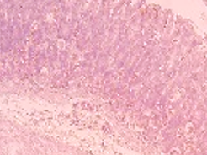
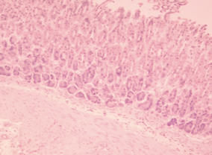
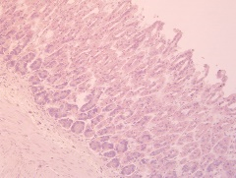
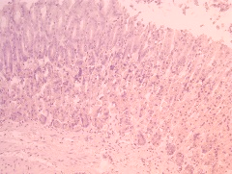
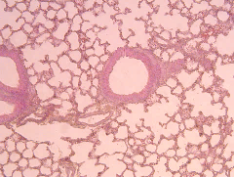
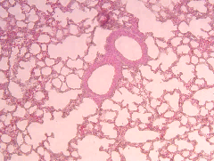
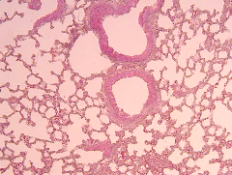
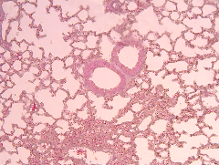
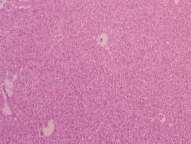
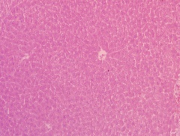
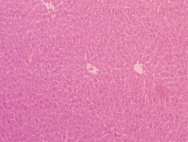
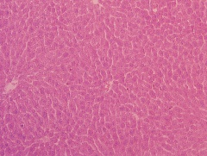
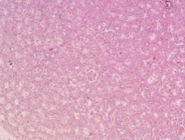
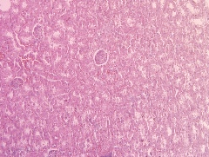
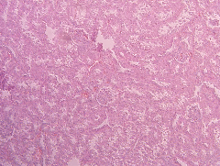
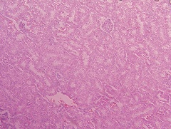
Supplementary Figure S1
DSS
-
TDAG51^{+/+}
+
-
TDAG51^{-/-}
+
Duodenum
Duodenum
Jejunum
Jejunum
Ileum
Ileum
Stomach
Stomach
Lung
Lung
Liver
Liver
Kidney
Kidney
Supplementary Figure S1. Histopathology analysis in DSS-treated TDAG51^{+/+} and TDAG51^{-/-} mice. C57BL/6J male mice were administered 2.5% DSS in drinking water for 7 days followed by water for 5 days. The mice were sacrificed on day 5. Organ sections were stained with H&E (original magnification, 200×). Scale bars, 100 μm.

Slide 3























Supplementary Figure S2
A
CT26 cell line
B
TDAG51
LPS
(100 ng/ml)
min
h
(Time)
1
262
0
5
15
30
1
2
4
8
12
24
48
QQ
PH
TDAG51
PHL
PHL
PQ
CT26^{TDAG51+/+} clone
⁵⁷QGTAEPSQPSGPTV⁷⁰
β-Actin
CT26^{TDAG51-/-} clone
⁵⁷QGTAEPSH*
C
D
LPS
(100 ng/ml)
CT26^{TDAG51+/+}
CT26^{TDAG51-/-}
CT26^{TDAG51+/+}
LPS
(100 ng/ml)
CT26^{TDAG51+/+}
CT26^{TDAG51-/-}
CT26^{TDAG51+/+}
CT26^{TDAG51-/-}
0
(h)
CT26^{TDAG51-/-}
1
2
4
0
1
2
0
4
5
15
30
0
5
15
30
p-IκBα
(min)
n.s.
p-IκBα
n.s.
IκBα
p-IκBα/IκBα
IκBα
p-IκBα/IκBα
p-p65
n.s.
(min)
p-p65
n.s.
(h)
p65
p-p65/p65
p65
p-p65/p65
p-p38
p-p38/p38
n.s.
(min)
p-p38
p-p38/p38
n.s.
(h)
p38
(min)
p38
(h)
p-ERK
p-ERK/ERK
n.s.
p-ERK
p-ERK/ERK
n.s.
ERK
(min)
ERK
(h)
p-JNK
p-JNK/JNK
n.s.
p-JNK
p-JNK/JNK
n.s.
JNK
(min)
JNK
(h)
TDAG51
TDAG51/β-Actin
***
***
***
TDAG51
TDAG51/β-Actin
***
***
***
β-Actin
***
β-Actin
***
E
(min)
(h)
F
CT26^{TDAG51+/+}
CT26^{TDAG51-/-}
CT26^{TDAG51+/+}
CT26^{TDAG51-/-}
LPS
(100 ng/ml)
Cytoplasm
Nucleus
Cytoplasm
Nucleus
LPS
(100 ng/ml)
Cytoplasm
Nucleus
Cytoplasm
Nucleus
0
5
15
30
0
5
15
30
0
5
15
30
0
5
15
30
0
1
2
4
0
1
2
4
0
1
2
4
0
1
2
(min)
4
p-p65
p-p65
(h)
p65
p65
p-c-Jun
p-c-Jun
c-Jun
c-Jun
c-Fos
c-Fos
TDAG51
TDAG51
α-Tubulin
α-Tubulin
B23
B23
p-p65/B23
(Nucleus)
n.s.
n.s.
c-Fos/B23
(Nucleus)
n.s.
n.s.
p-c-Jun/B23
(Nucleus)
n.s.
c-Fos/B23
(Nucleus)
n.s.
p-c-Jun/B23
(Nucleus)
p-p65/B23
(Nucleus)
(min)
(min)
(min)
(h)
(h)
(h)

Slide 4
Supplementary Figure S2. LPS-induced signaling is not affected by TDAG51 expression. A. TDAG51 induction by LPS stimulation in CT26 cells. CT26 cells, a murine colorectal carcinoma cell line, were stimulated with LPS (100 ng/ml) for the indicated times. TDAG51 expression was analyzed via anti-TDAG51 immunoblotting. β-Actin was used as a control. B. Schematic diagram of CRISPR-Cas9-mediated generation of TDAG51-deficient CT26 cells. The targeted guide RNA region (5’-gcc gaa ccg tcc caa cct ag-3’) is indicated by the red arrow. The frame shifted sequences and premature stop sequence are denoted by red. CT26^{TDAG51+/+} clone, wild type. CT26^{TDAG51-/-} clone, TDAG51-deficient clone. C. LPS-induced immediate signaling is not affected by TDAG51 expression. Signaling activations were detected by specific antibodies recognizing phosphorylated and total IκBα, p65, p38, ERK and JNK (left panel). β-Actin was used as the loading control. The relative level of the phosphorylated form was analyzed after normalization to the total protein input (right panel). D. LPS-induced late signaling is not affected by TDAG51 expression. E. LPS-induced immediate nuclear translocation of the NF-κB and AP-1 transcription factors was not affected by TDAG51 expression. The protein levels in the nucleus and cytoplasm were visualized by immunoblotting with antibodies recognizing phosphorylated or total p65, c-Jun and c-Fos (top panels). The nuclear and cytoplasmic fractions were analyzed by immunoblotting with antibodies specific for α-Tubulin (cytoplasmic marker) and B23 (nuclear marker). The relative nuclear translocation of the phosphorylated form was analyzed (bottom panel). F. LPS-induced late nuclear translocation of the NF-κB and AP-1 transcription factors was not affected by TDAG51 expression. ***P < 0.001. n.s., not significant.

Slide 5
Uncropped gel image for anti-TDAG51 western blot in Figure 1.
A
75
63
TDAG51
(short exposure)
48
35
25
(kDa)
75
63
TDAG51
(long exposure)
48
35
(kDa)
75
63
β-Actin
48
35
(kDa)
B
63
TDAG51
48
35
(kDa)
63
β-Actin
48
35
(kDa)

Slide 6
Uncropped gel image for western blot analysis in Figure 4.
A
iNOS
140
100
(kDa)
100
Cox-2
75
60
(kDa)
TDAG51
48
35
(kDa)
β-Actin
48
35
(kDa)

Slide 7
Uncropped gel image for western blot analysis in Figure 6.
A
B
100
75
75
GST-PPARγ
63
63
48
Myc-TDAG51
48
(kDa)
35
25
75
(kDa)
63
Myc-TDAG51
48
35
25
(kDa)
63
β-Actin
48
75
35
63
(kDa)
β-Actin
48
35
(kDa)
NF-κB-Luc
NF-κB-Luc
C
100
GST-PPARγ
100
GST-PPARγ
75
75
63
63
(kDa)
(kDa)
75
63
75
Myc-TDAG51
48
Myc-TDAG51
63
35
48
(kDa)
35
(kDa)
63
63
β-Actin
48
β-Actin
48
35
35
(kDa)
(kDa)
IL-6-Luc
IL-1β-Luc
TNF-α-Luc

Slide 8
Uncropped gel image for western blot analysis in Figure S2.
A
75
63
TDAG51
48
35
25
(kDa)
63
β-Actin
48
35
(kDa)

Slide 9
Uncropped gel image for western blot analysis in Figure S2.
C
63
63
p-IκBα
48
48
35
IκBα
35
(kDa)
(kDa)
75
75
p-p65
63
p65
63
48
48
(kDa)
(kDa)
75
75
63
63
p-p38
48
p38
48
35
35
25
25
(kDa)
(kDa)
75
75
63
63
ERK
48
p-ERK
48
35
35
25
25
(kDa)
(kDa)
p-JNK
63
JNK
63
48
48
35
35
(kDa)
(kDa)
75
63
TDAG51
48
35
25
(kDa)
75
63
β-Actin
48
35
(kDa)

Slide 10
Uncropped gel image for western blot analysis in Figure S2.
D
75
75
63
63
48
IκBα
48
p-IκBα
35
35
(kDa)
(kDa)
100
100
75
p65
75
p-p65
63
63
(kDa)
(kDa)
75
75
63
63
p-p38
48
p38
48
35
35
(kDa)
(kDa)
75
75
63
63
p-ERK
48
ERK
48
35
35
(kDa)
(kDa)
75
75
63
63
p-JNK
48
JNK
48
35
35
25
(kDa)
(kDa)
25
75
63
TDAG51
48
35
(kDa)
75
63
β-Actin
48
35
(kDa)

Slide 11
Uncropped gel image for western blot analysis in Figure S2.
E
p-p65
75
75
63
63
48
48
p65
CT26^{TDAG51+/+}
(kDa)
(kDa)
75
CT26^{TDAG51+/+}
CT26^{TDAG51-/-}
p-p65
63
48
CT26^{TDAG51-/-}
(kDa)
75
63
p-c-Jun
48
35
CT26^{TDAG51+/+}
CT26^{TDAG51-/-}
(kDa)
75
63
c-Jun
48
35
CT26^{TDAG51+/+}
CT26^{TDAG51-/-}
(kDa)
75
63
c-Fos
48
35
CT26^{TDAG51+/+}
(kDa)
63
c-Fos
48
35
CT26^{TDAG51-/-}
(kDa)
TDAG51
63
48
35
CT26^{TDAG51+/+}
CT26^{TDAG51-/-}
(kDa)
75
α-Tubulin
63
48
35
CT26^{TDAG51+/+}
CT26^{TDAG51-/-}
(kDa)
75
63
48
B23
35
25
CT26^{TDAG51+/+}
CT26^{TDAG51-/-}
(kDa)

Slide 12
Uncropped gel image for western blot analysis in Figure S2.
F
p-p65
75
75
p65
63
63
48
CT26^{TDAG51+/+}
48
(kDa)
(kDa)
CT26^{TDAG51+/+}
CT26^{TDAG51-/-}
75
p-p65
63
48
CT26^{TDAG51-/-}
(kDa)
75
75
63
c-Jun
48
p-c-Jun
63
35
48
CT26^{TDAG51+/+}
(kDa)
CT26^{TDAG51+/+}
35
75
(kDa)
63
c-Jun
48
75
35
63
CT26^{TDAG51-/-}
(kDa)
p-c-Jun
48
35
CT26^{TDAG51-/-}
(kDa)
75
63
c-Fos
48
35
CT26^{TDAG51+/+}
CT26^{TDAG51-/-}
(kDa)
75
75
63
63
TDAG51
48
48
35
35
CT26^{TDAG51+/+}
(kDa)
(kDa)
CT26^{TDAG51-/-}
75
α-Tubulin
63
48
CT26^{TDAG51+/+}
CT26^{TDAG51-/-}
35
(kDa)
75
63
B23
48
35
CT26^{TDAG51+/+}
CT26^{TDAG51-/-}
(kDa)

