Slide 1
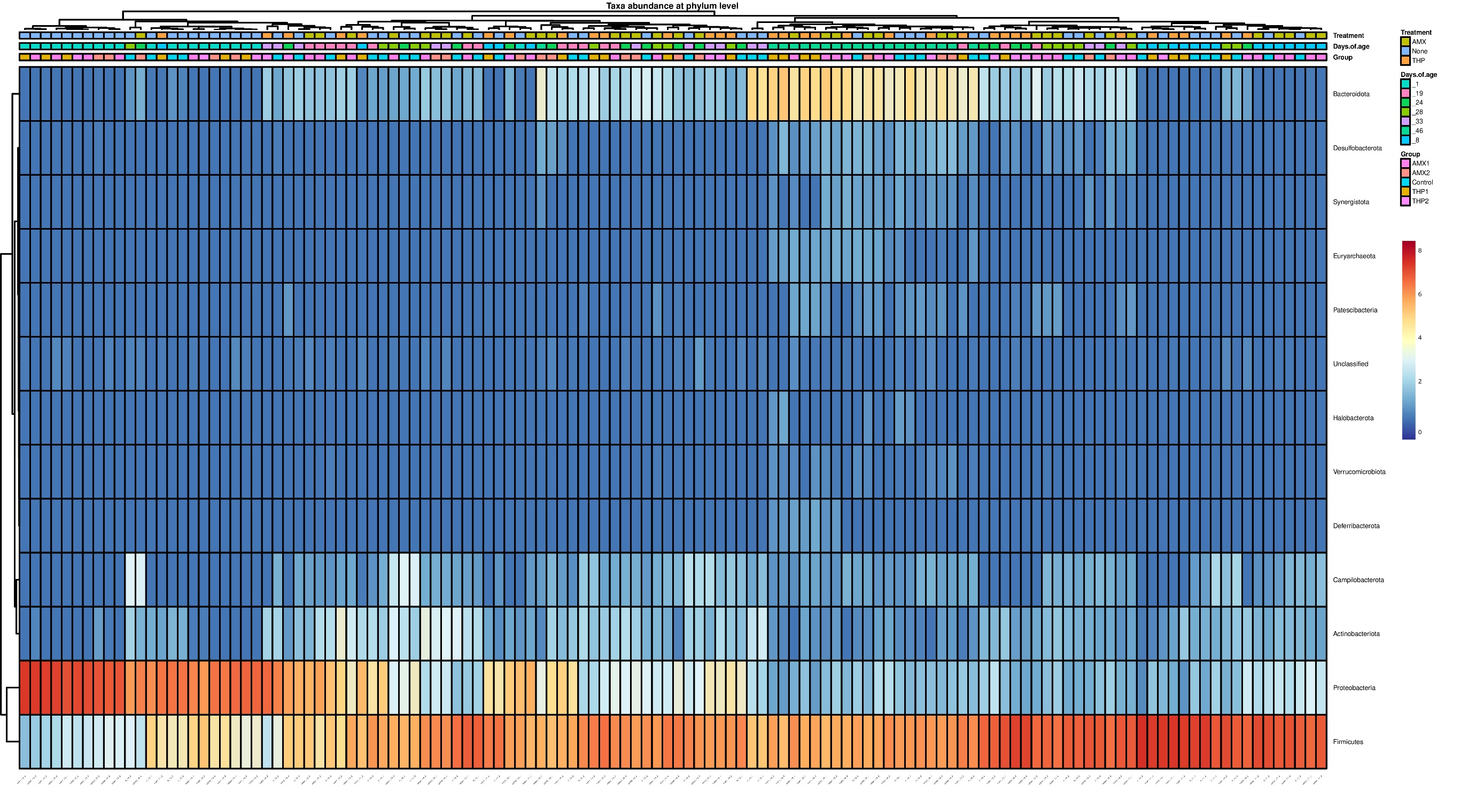
Supplementary Fig. S1: heatmap at phylum level. The heatmap was generated in R (version 4.2.1) (https://www.r-project.org/) using package pheatmap (version 1.0.12).

