Slide 1
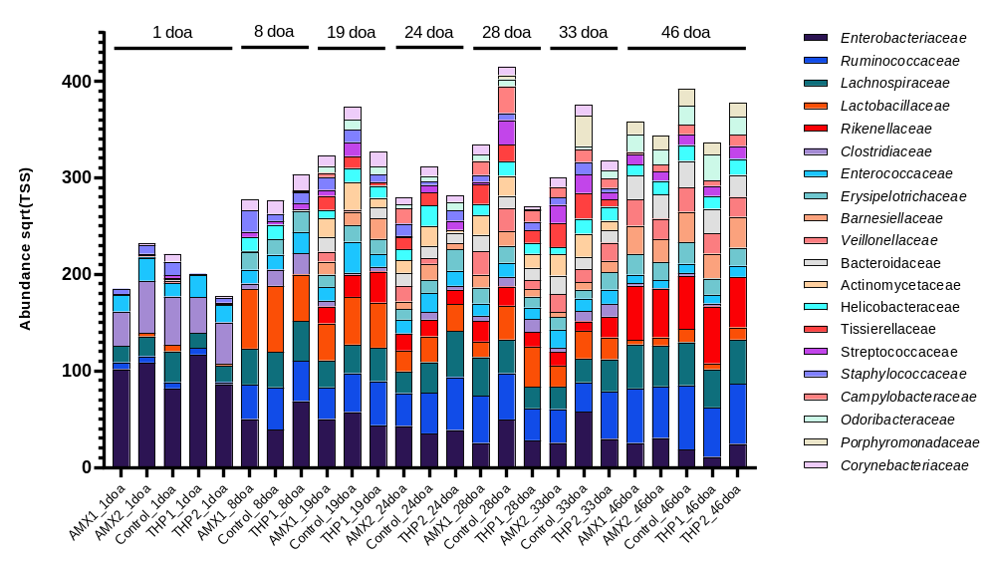
Supplementary Fig. S2: Relative abundance of the twenty most abundant families.

