Slide 1
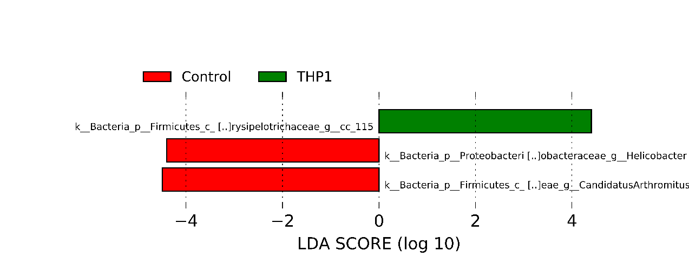
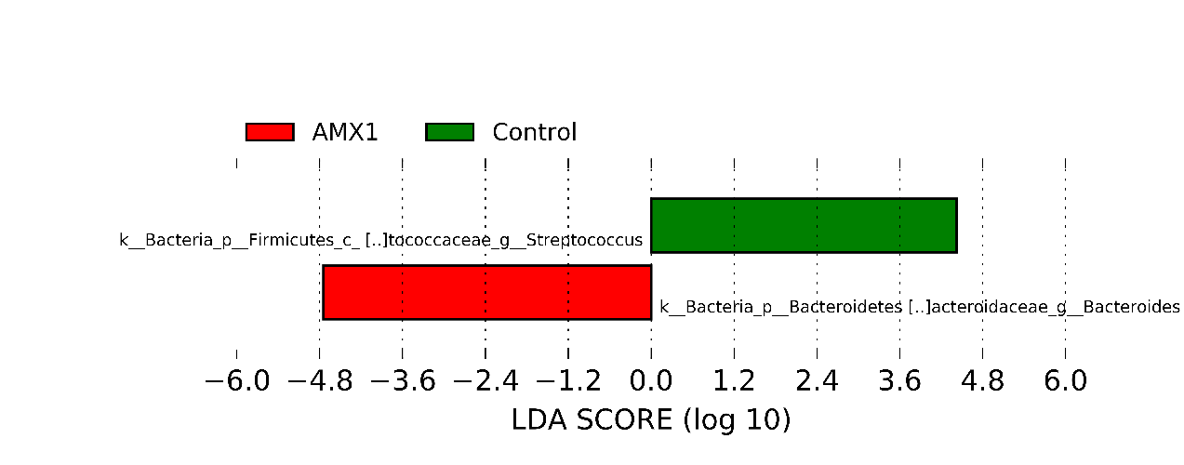
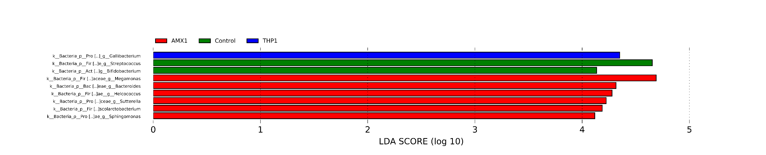
Supplementary Fig. S3: LDA scores of LEfSe comparison analysis between control and groups treated at 5 days of age for three consecutive days. A) 1 day post treatment (d.p.t), B) 12 d.p.t., and C) 21 d.p.t..
A
B
C

