Slide 1
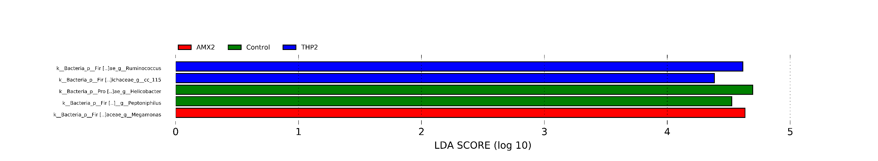
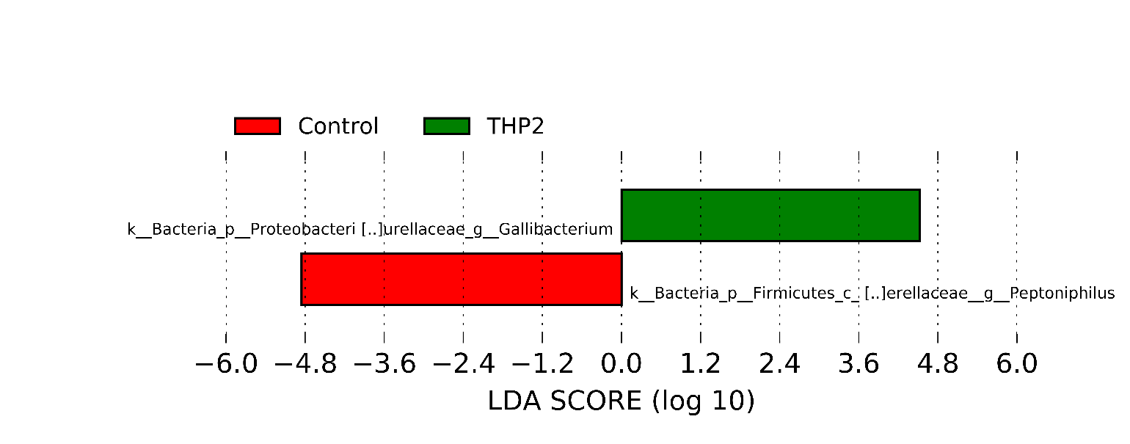
Supplementary Fig. S4: LDA scores of LEfSe comparison analysis between control and groups treated at 21 days of age for three consecutive days. A) 1 day post treatment (d.p.t) and B) 9 d.p.t..
A
B

