Slide 1
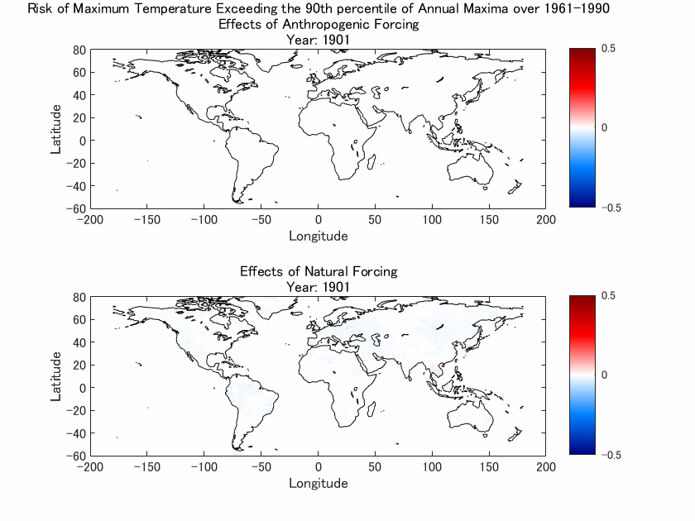
Figure S1. Animated figure of the contributions of anthropogenic and natural forcings to the risk of exceeding the 90th percentile of 1961-1990 annual temperature maxima. The upper panel shows the contribution of anthropogenic forcing to the change in probabilities of exceeding the 90th percentile of 1961-1990 annual temperature maxima. The lower panel shows the contribution of natural forcing to the change in probabilities of exceeding the 90th percentile of 1961-1990 annual temperature maxima. This figure was created using MATLAB R2020a (https://www.mathworks.com/).

Slide 2
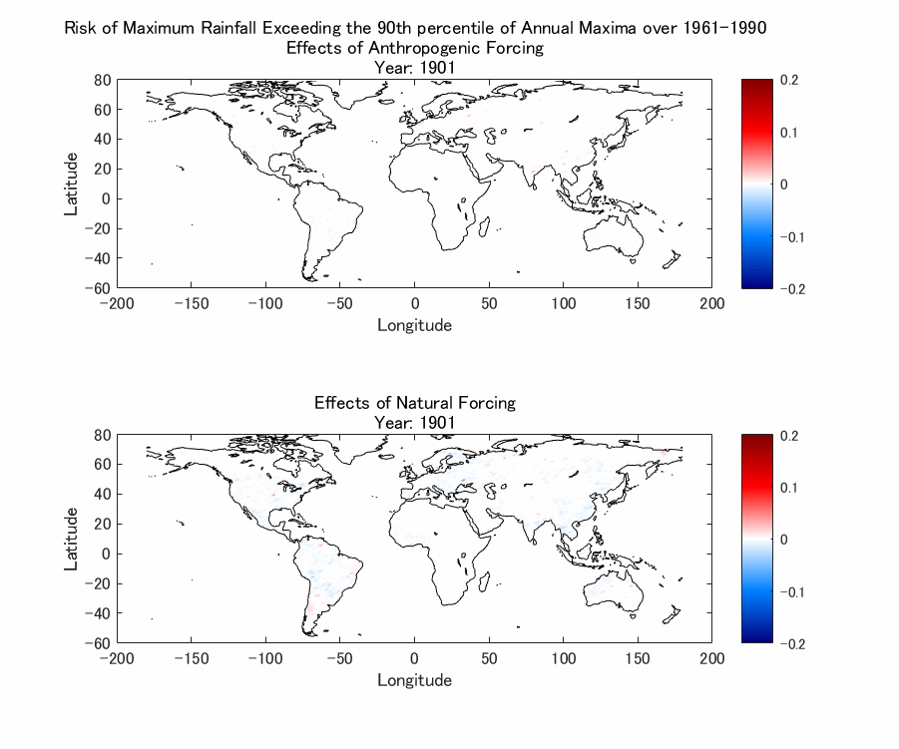
Figure S2. Animated figure of the contributions of anthropogenic and natural forcings to the risk of exceeding the 90th percentile of 1961-1990 annual rainfall maxima. The upper panel shows the contribution of anthropogenic forcing to the change in probabilities of exceeding the 90th percentile of 1961-1990 annual rainfall maxima. The lower panel shows the contribution of natural forcing to the change in probabilities of exceeding the 90th percentile of 1961-1990 annual rainfall maxima. This figure was created using MATLAB R2020a (https://www.mathworks.com/).

