Slide 1
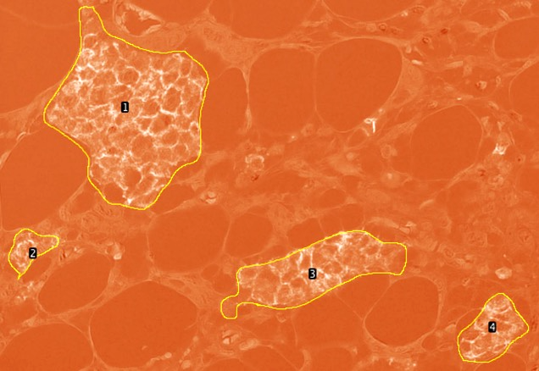
Supplemental figure 1
Fig. S1. Quantitative evaluation of E-cadherin. The figure shows the image processed with ImageJ; each cluster was numbered and the sum of their staining intensities is calculated. Those numbers were summed and divided by the area of the cluster.

