Slide 1
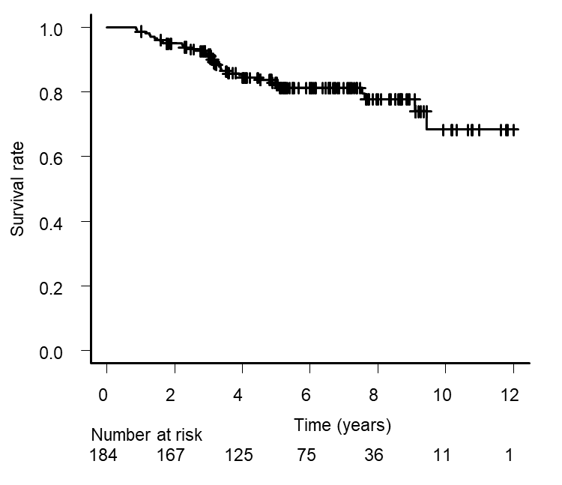
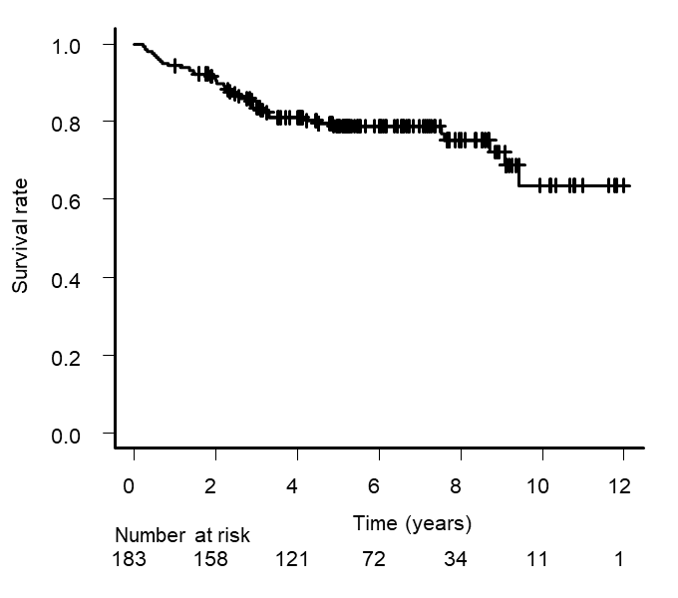
Supplementary Fig. 1
a
Overall survival
b
Relapse-free survival

Slide 2
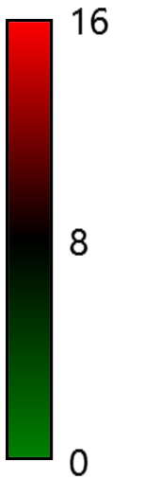
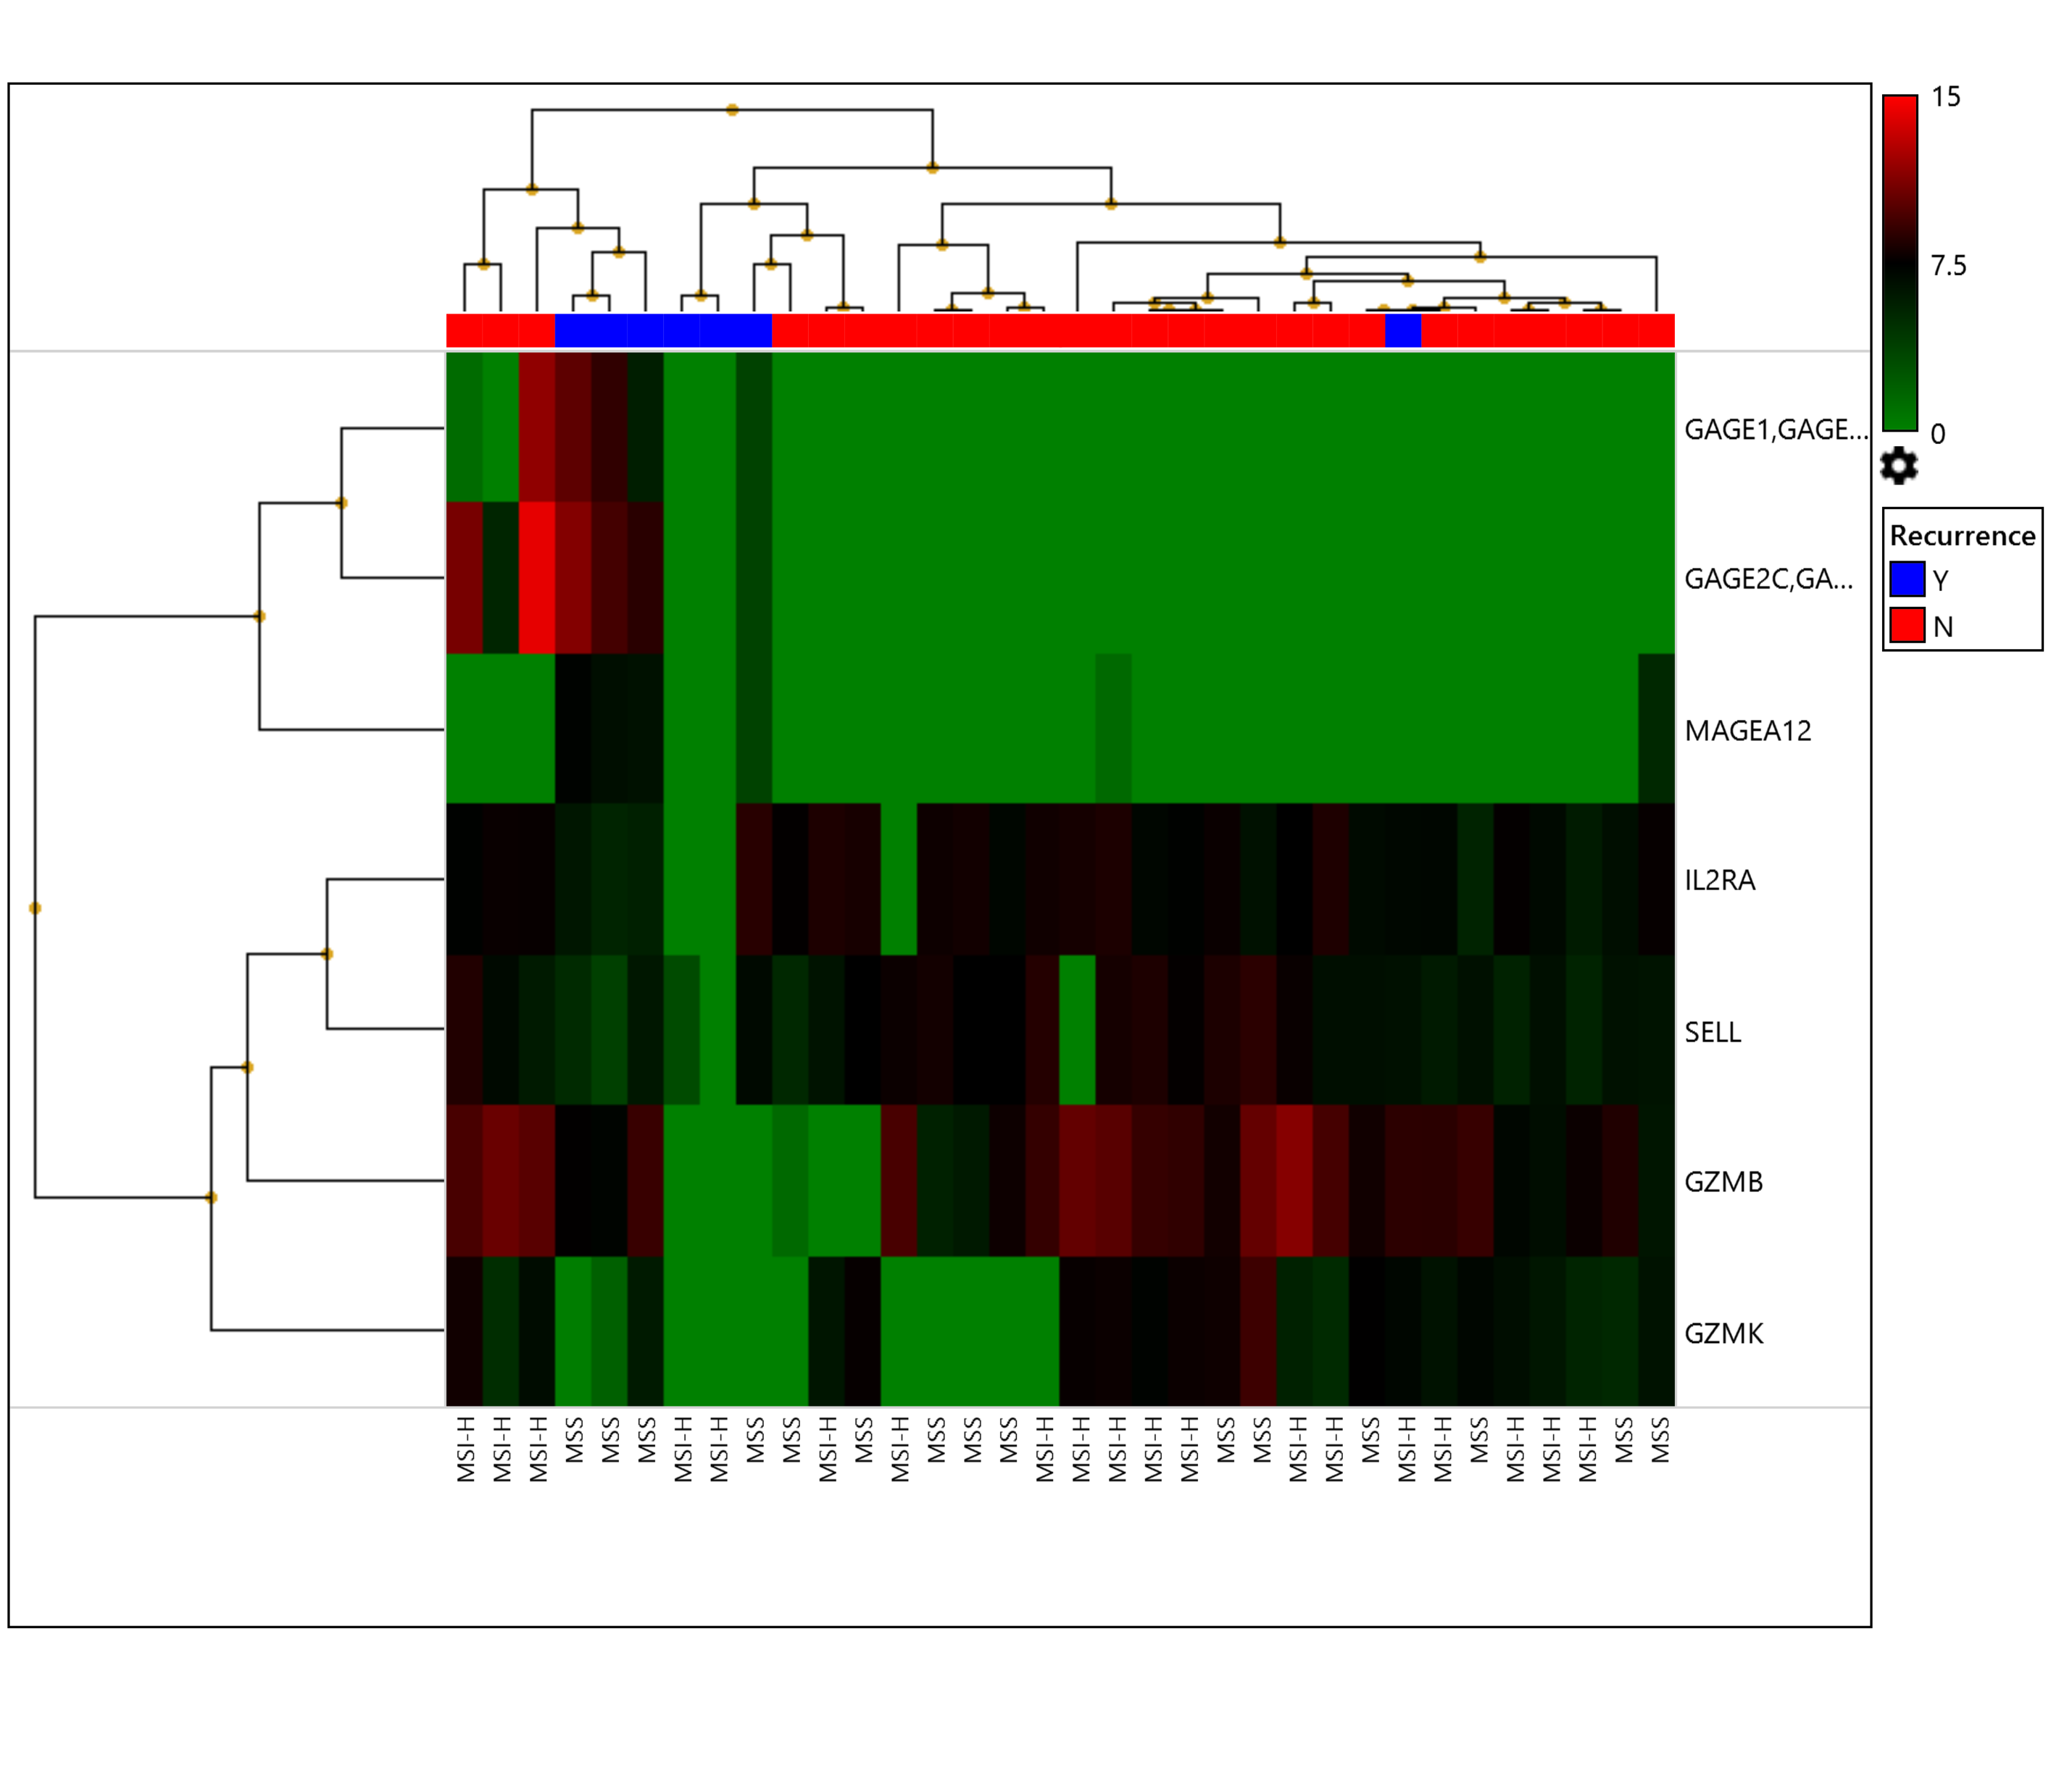
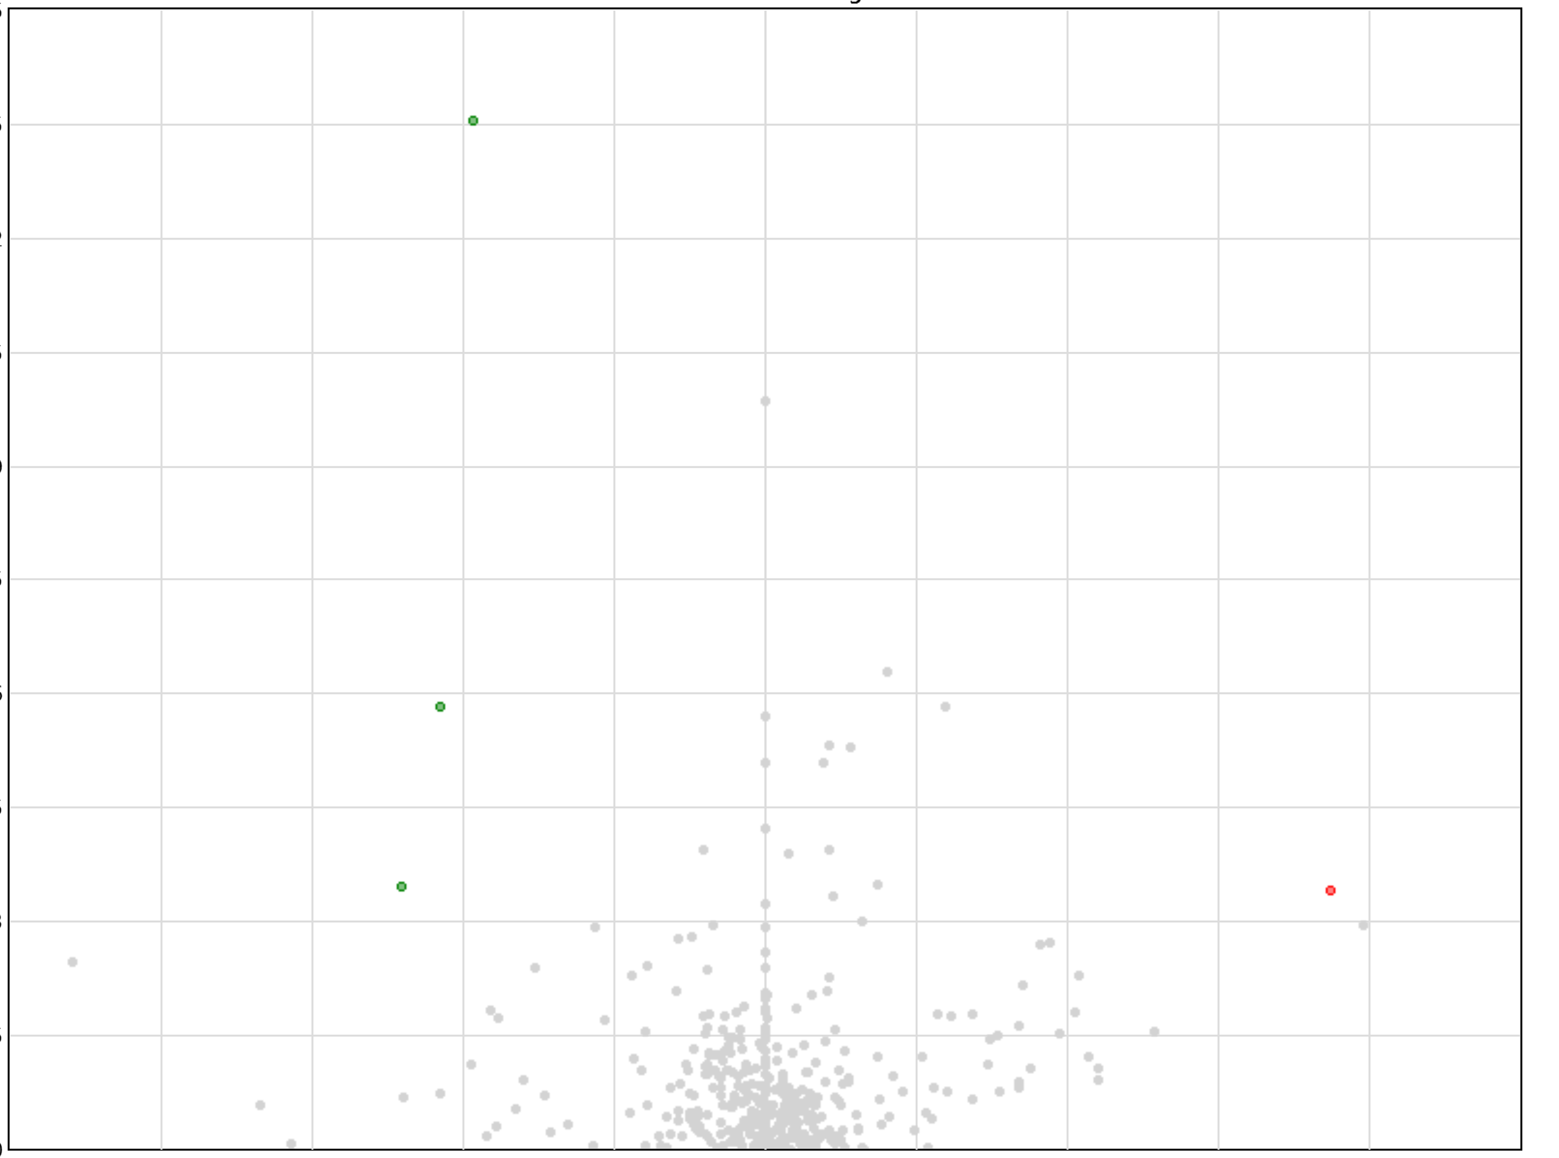
Supplementary Fig. 2
Recurrence
Yes
No
6.5
5.85
MAGEA12
5.2
4.55
3.9
GAGE1
-log₁₀[P value]
GAGE2C
GZMK
3.25
2.6
1.95
1.3
0.65
0
1
3.48
-512
-3.48
-147.03
-42.22
-12.13
12.13
42.22
147.03
512
Yes
Recurrence
No

