Slide 1
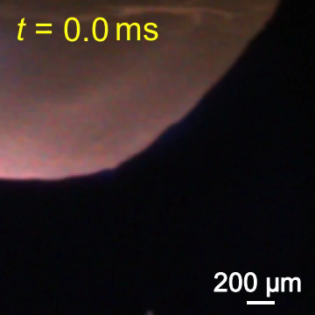
A video of the splash occurred from the tungsten-based anode surface
during arc discharge captured by a high-speed camera.

