Slide 1
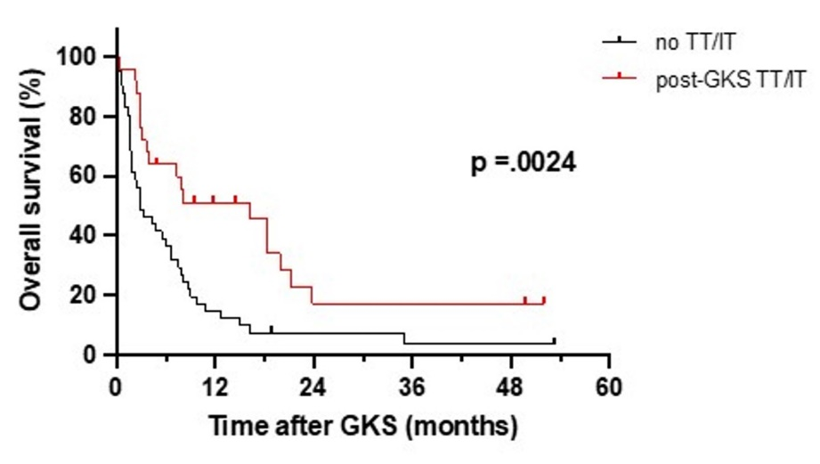
Supplement 2. Kaplan-Meier graph depicting the overall survival after Gamma Knife surgery (GKS) between the groups with and without concurrent targeted therapy or immunotherapy (TT/IT) following GKS

