Slide 1
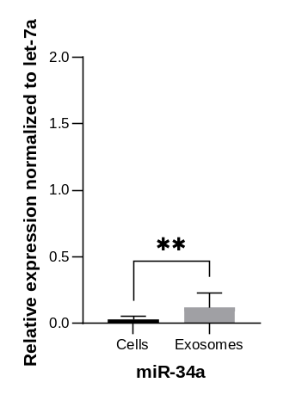
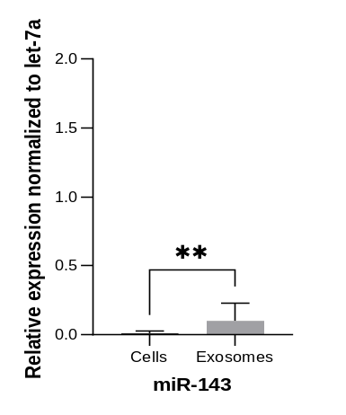
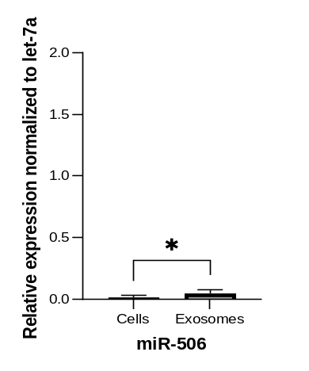
Supplementary Figure 1
P=0.0058
P=0.0070
P=0.0175
Fig, S1. Expression of anti-angiogenic miRNAs in ProtheraCytes® and secreted exosomes. Total RNA from ProtheraCytes (Cells) and their exosomes collected from AMI patients were subjected to real time PCR and normalized to small RNA (let-7a) (miR-34a and miR-143: Mann-Whitney test, miR-506: t-test, n=7).

