Slide 1
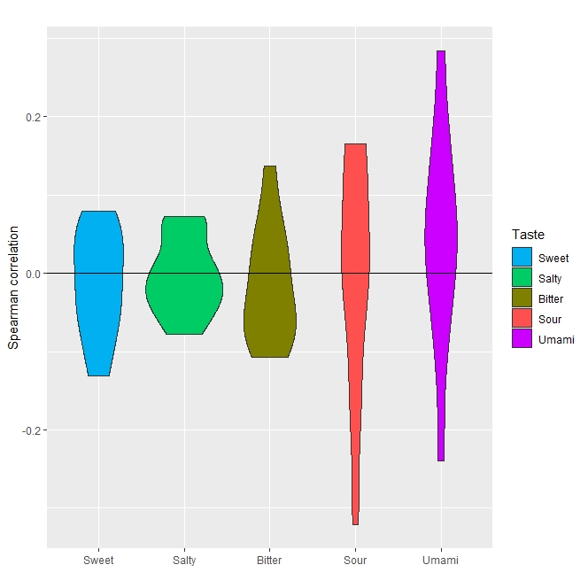
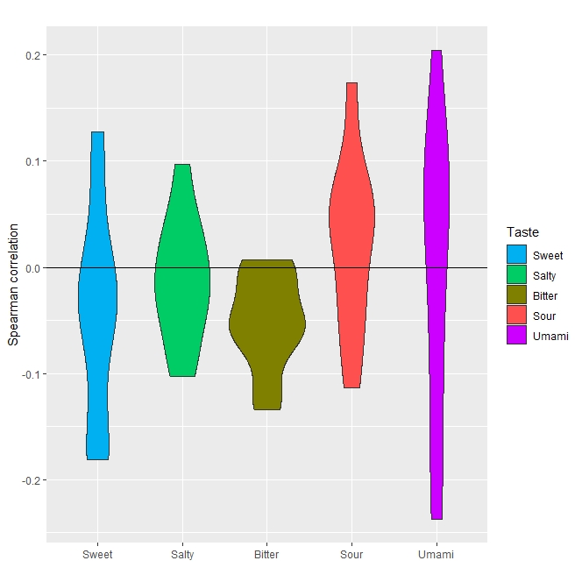
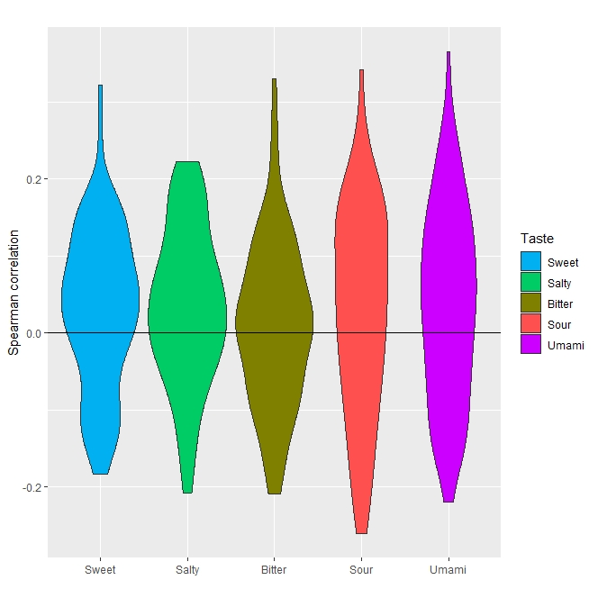
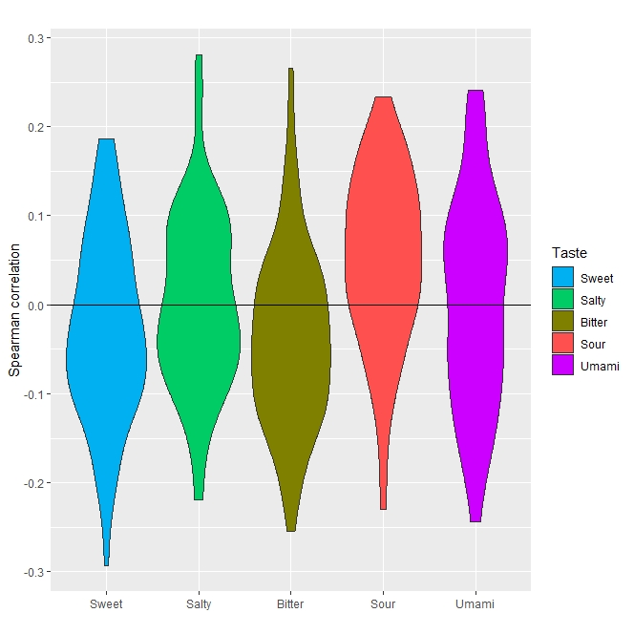
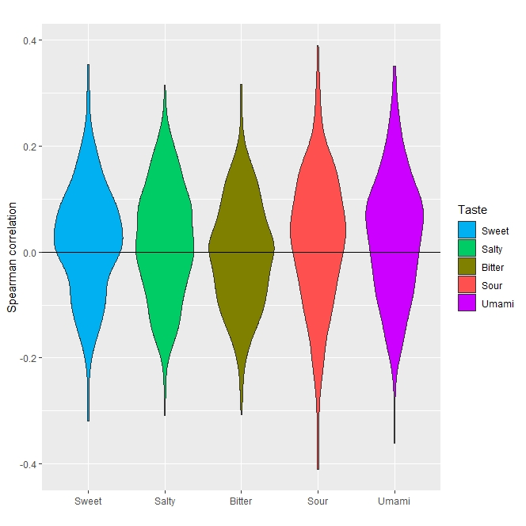
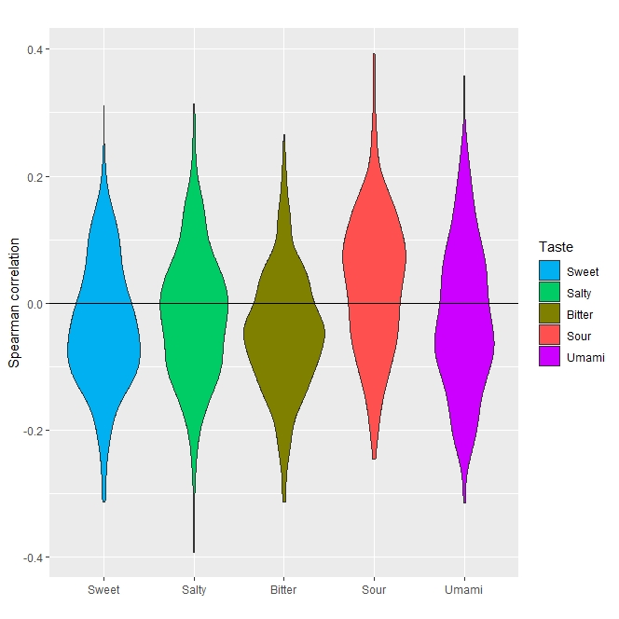
A) Saliva
B) Lingual film
Phylum
Genus
Species
Supplementary Figure 1: Violin plots showing distribution of Spearman correlations estimated between each species (resp. genus and phylum) expression and each taste sensitivity.

