Slide 1
HE
αGlcNAc (red)
TFF2 (brown)
αGlcNAc (red) + TFF2 (brown)

Slide 2
Figure S1.
Immunohistochemical expression of αGlcNAc and TFF2 in non-neoplastic Brunner’s gland (case 19). αGlcNAc and TFF2 are expressed weakly and diffusely in cytoplasm of the cells. Double immunohistochemical stain shows that each expression area is matched. Information about anti-αGlcNAc and anti-TFF2 antibodies were provided in the main text. Protocols of single and double immunohistochemistry were also provided in the main text. Scale bar: 100μm (inset 20μm)

Slide 3
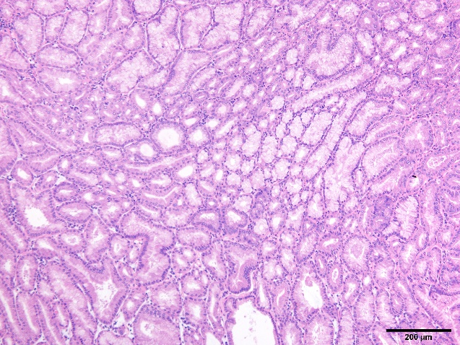
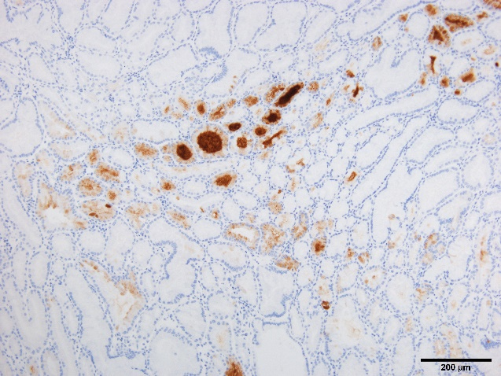
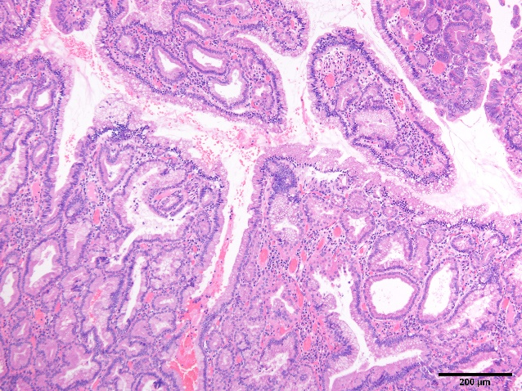
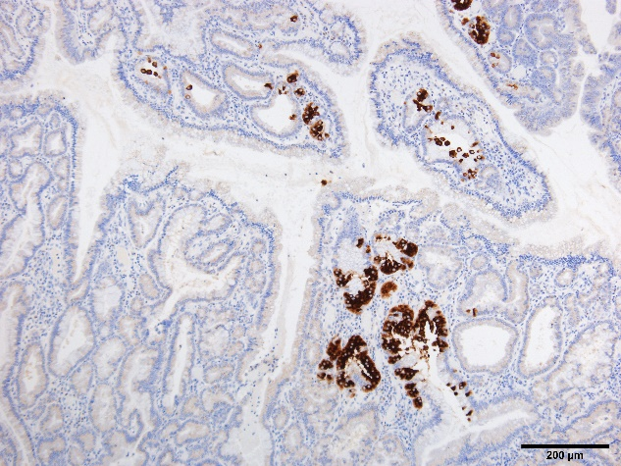
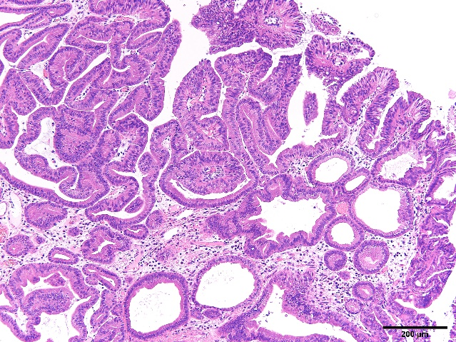
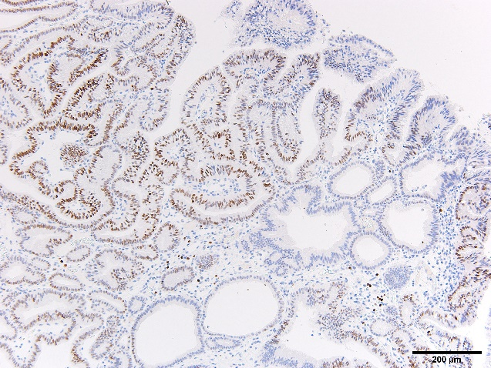
HE
pepsinogen -1
HE
H⁺/K⁺-ATPase
HE
MIST -1

Slide 4
Figure S2.
Immunohistochemical expression of pepsinogen-1, H⁺/K⁺-ATPase and MIST-1 in pyloric gland adenoma. Pepsinogen-1 and H⁺/K⁺-ATPase are partially expressed in cytosol of pyloric gland adenoma cells (case 21: pepsinogen-1, case 5: H⁺/K⁺-ATPase). MIST-1 is partially expressed in nuclear of pyloric gland adenoma cells (case 20). Scale bar: 200μm

