Slide 1
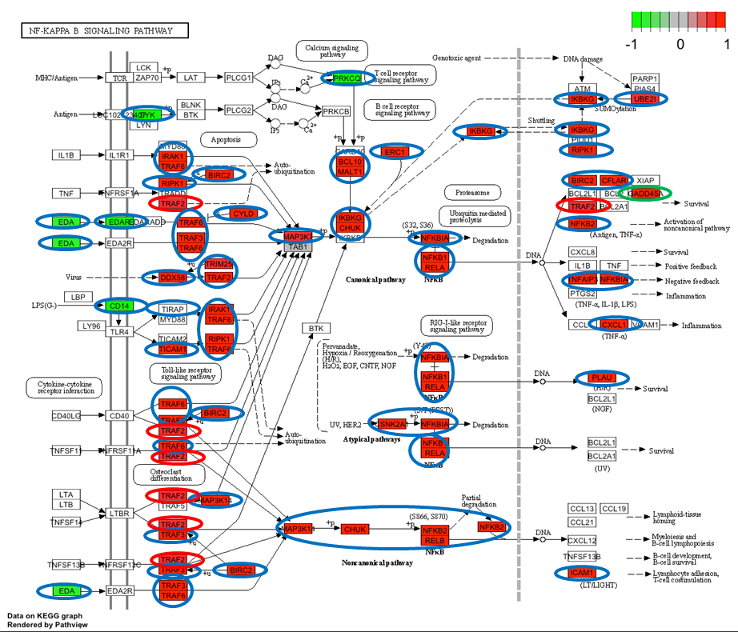
Supplementary figure 8: Nuclear factor kappa-light-chain-enhancer of activated B cells (NF-κB) KEGG pathway (Kanehisha and Goto, 2000) generated on Pathviews with the differentially expressed genes found in the present work for the different comparisons. A) BCoV infected cells at 72 hpi; B) C. parvum infected cells at 72 hpi; C) Co-exposed cells at 72 hpi. Outline in blue is used to indicate that the gene is upregulated in BCoV-infected cells; orange in C. parvum-infected cells; red in co-exposed cells and green in both single infections (BCoV and C. parvum) but not in co-exposed.
A
B
C

