Slide 1
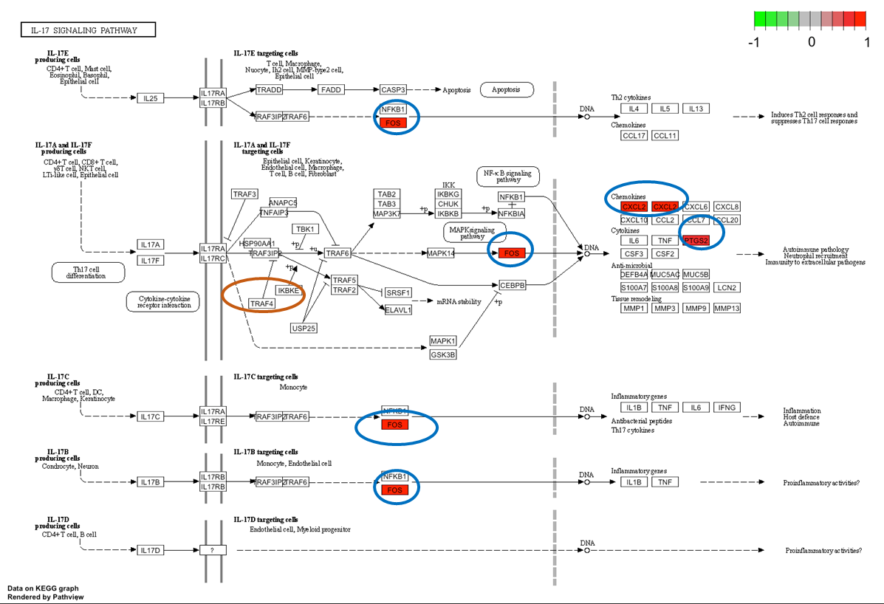
Supplementary figure 9: Interleukin 17 (IL17) KEGG pathway (Kanehisha and Goto, 2000) generated on Pathviews with the differentially expressed genes found in the present work for the different comparisons. A) BCoV infected cells at 24 hpi; B) C. parvum infected cells at 24 hpi; C) Co-exposed cells at 24 hpi. Outline in blue is used to indicate that the gene is upregulated in BCoV-infected cells; orange in C. parvum-infected cells; red in co-exposed cells and green in both single infections (BCoV and C. parvum) but not in co-exposed.
A
B
C

