Slide 1
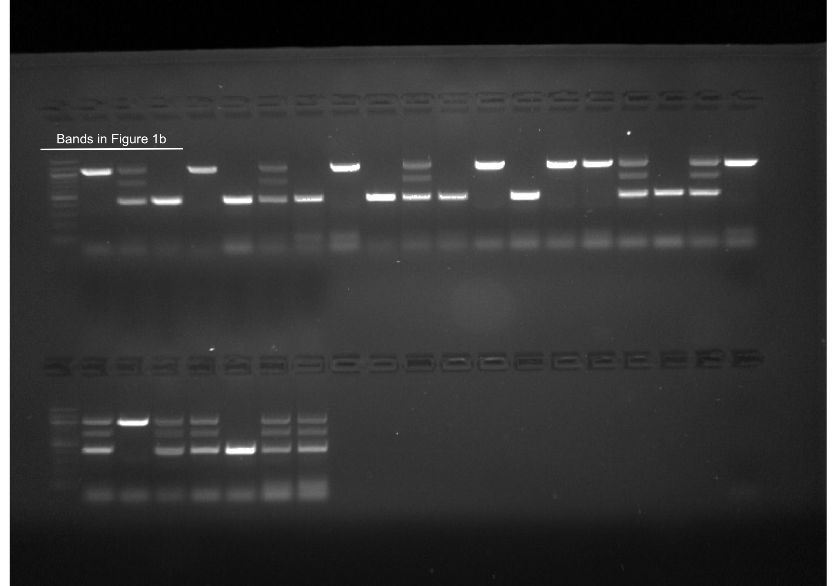
Supplemental Figure 7A. Uncropped gel in Fig. 1b
The other lanes in the gel indicate the PCR products from tail clips from different mice being genotyped.

Slide 2
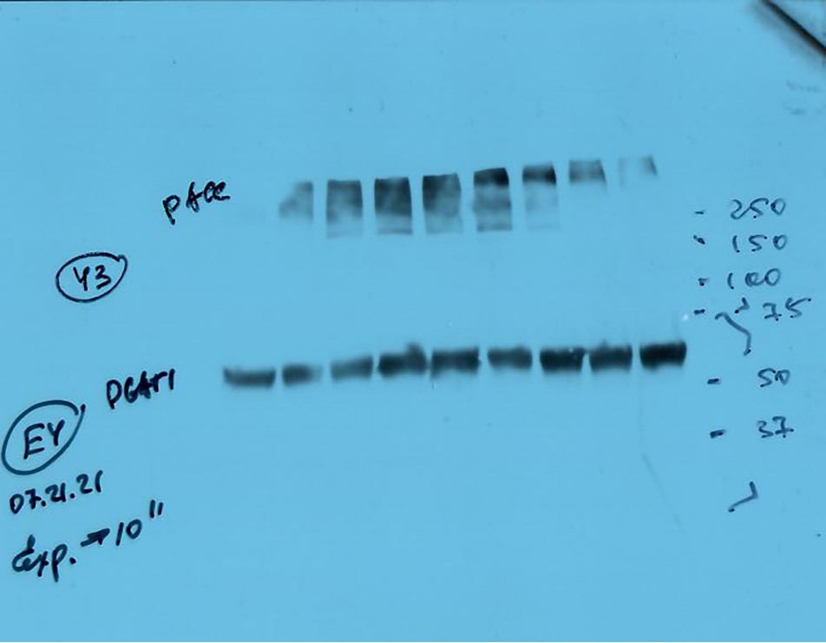
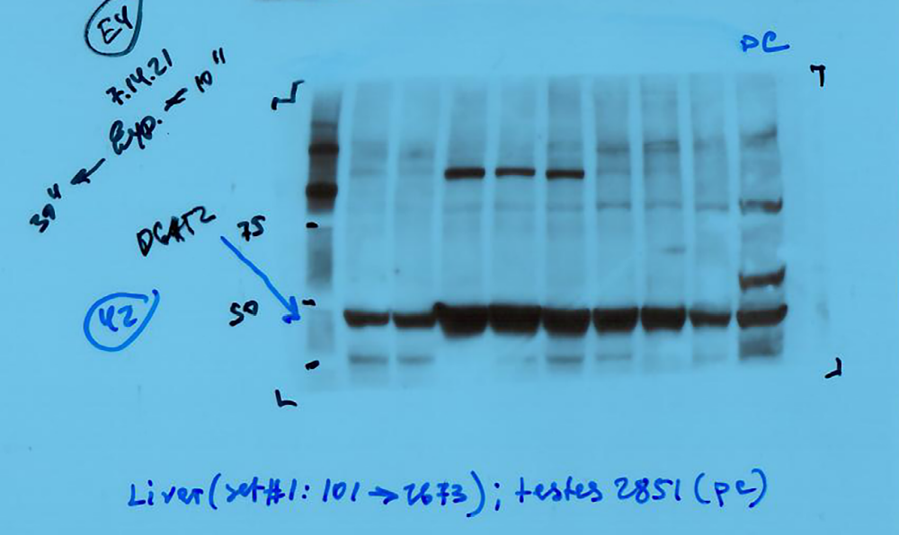
Supplemental Figure 7B. Original blots for Fig. 6a: DGAT1, DGAT2.
Red box indicates bands used for publication.
DGAT1 (50-57 kDa)
DGAT2 (45-50 kDa)
10A^{-/-} 10A^{+/+}
10A ^{+/+} 10A^{-/-}
positive control
positive control

Slide 3
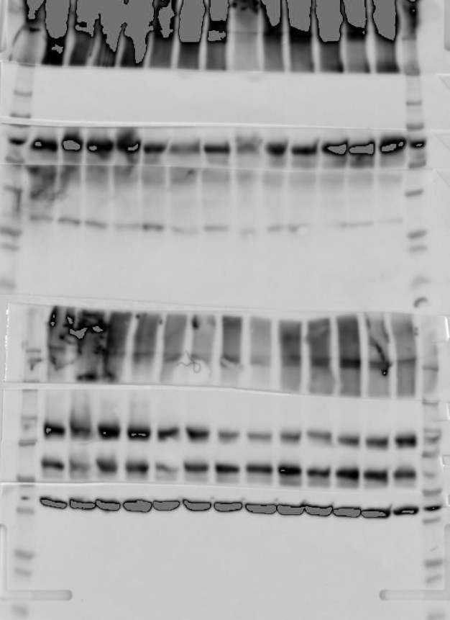
Supplemental Figure 7C. Original blots for Fig. 6a: ACC, p-AMPKα^{T172}, p-ACC^{S79}, AMPKα, β-actin.
Red box indicates bands used for publication. Left panel: exposure with markers, p-ACC^{S79}, AMPKα, β-actin exposures used for publication; right panel: ACC, p-AMPKα^{T172} exposures used for publication.
MW (kDa)
250
ACC
(280 kDa)
150
100
75
50
p-AMPKα^{T172}
(62 kDa)
37
25
20
15
250
p-ACC^{S79}
(280 kDa)
150
100
75
50
AMPKα (62 kDa)
37
β-actin (42 kDa)
25
20
15
10A ^{+/+} 10A^{-/-}
10A ^{+/+} 10A^{-/-}

Slide 4
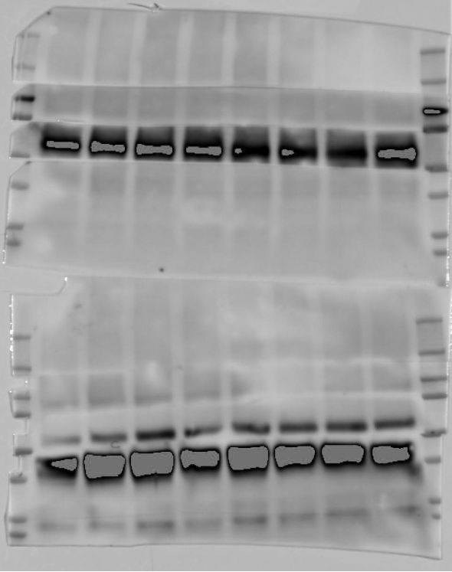
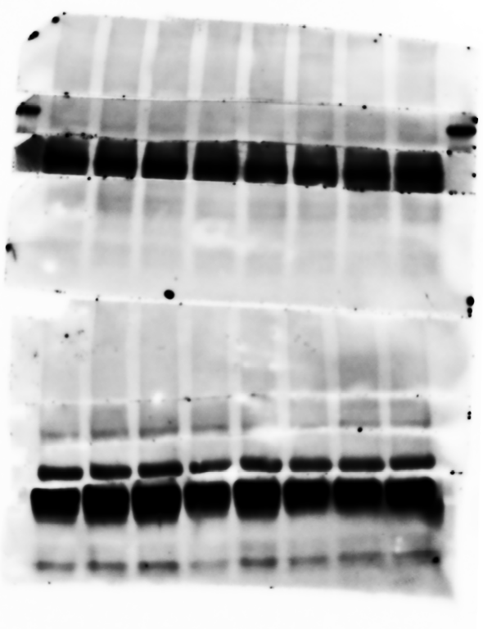
Supplemental Figure 7D. Original blots for Fig. 6b:p-IRβ^{Y1146}, p-IRβ^{Y1150/51}.
Red box indicates bands used for publication. Left panel: exposure with markers; right panel: exposures used for publication.
MW (kDa)
250
150
100
p-IRβ^{Y1150/51}
(95 kDa)
75
50
37
25
20
250
150
100
p-IRβ^{Y1146}
(95 kDa)
75
50
37
25
20
10A ^{+/+} 10A^{-/-}
10A ^{+/+} 10A^{-/-}

Slide 5
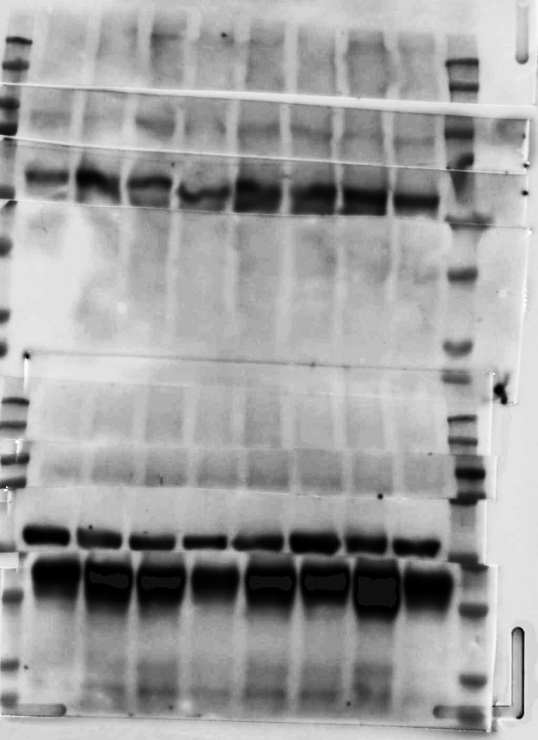
Supplemental Figure 7E. Original blots for Fig. 6b: p-GSK3β^{S9}, p-cPLA₂^{S505,} cPLA₂, IRβ.
Red box indicates bands used for publication. Left panel: exposure with markers, p-cPLA₂^{S505,} cPLA₂ exposures used for publication; right panel: p-GSK3β^{S9}, IRβ exposures used for publication.
MW (kDa)
10A ^{-/-} 10A^{+/+}
250
150
100
75
p-cPLA₂^{S505}
(95 kDa)
50
37
25
20
250
150
100
cPLA₂
(95 kDa)
75
IRβ (95 kDa)
50
37
p-GSK3β^{S9}
(49 kDa)
25
20
10A ^{+/+} 10A^{-/-}
10A ^{+/+} 10A^{-/-}

Slide 6
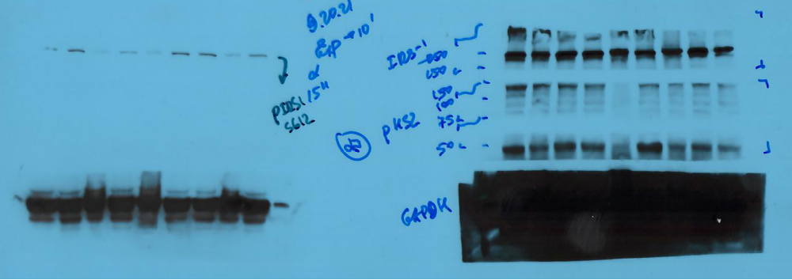
Supplemental Figure 7F. Original blots for Fig. 6b: p-IRS-1^{S612}, IRS-1.
Red box indicates bands used for publication.
p-IRS-1^{S612} (180 kDa)
IRS-1 (180 kDa)
10A^{-/-} 10A^{+/+}
10A ^{+/+} 10A^{-/-}

Slide 7
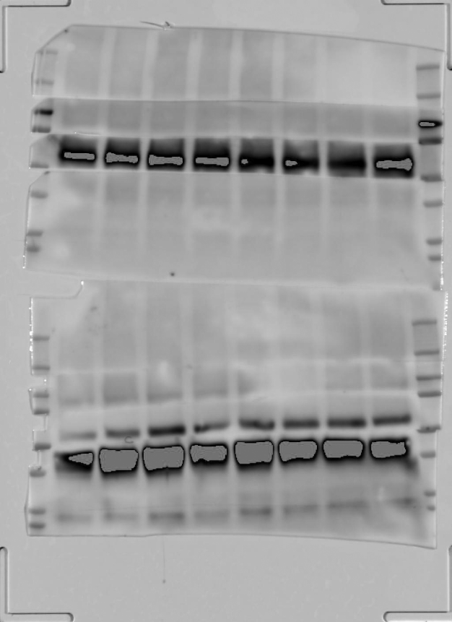
Supplemental Figure 7G. Original blots for Fig. 6b: p-Akt^{S473/T308}, Akt, GSK-3β.
Red box indicates bands used for publication. Left panel: exposure with markers, Akt exposure used for publication; right panel: p-Akt^{S473/T308}, GSK-3β exposures used for publication.
MW (kDa)
250
150
100
75
p-Akt^{S473/T308}
60 kDa
50
37
25
20
250
150
100
75
Akt (60 kDa)
50
GSK-3β (49 kDa)
37
25
20
10A ^{+/+} 10A^{-/-}
10A ^{+/+} 10A^{-/-}

Slide 8
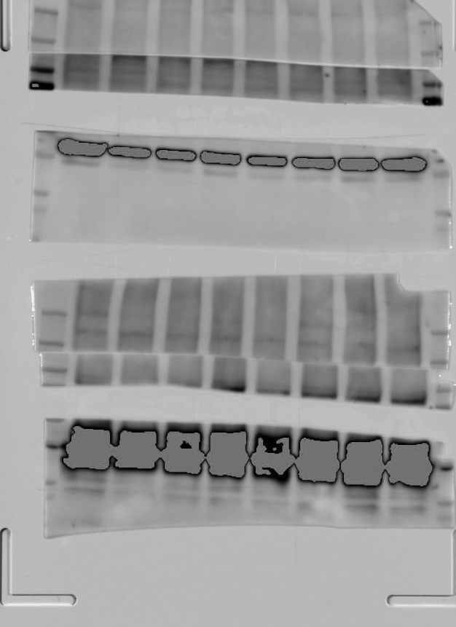
Supplemental Figure 7H. Original blots for Fig. 6b: β-actin.
Red box indicates bands used for publication. Left panel: exposure with markers; right panel: exposure used for publication.
MW (kDa)
250
150
100
75
50
37
25
20
250
150
100
75
50
37
β-actin (42 kDa)
25
20
10A ^{+/+} 10A^{-/-}
10A ^{+/+} 10A^{-/-}

