Slide 1
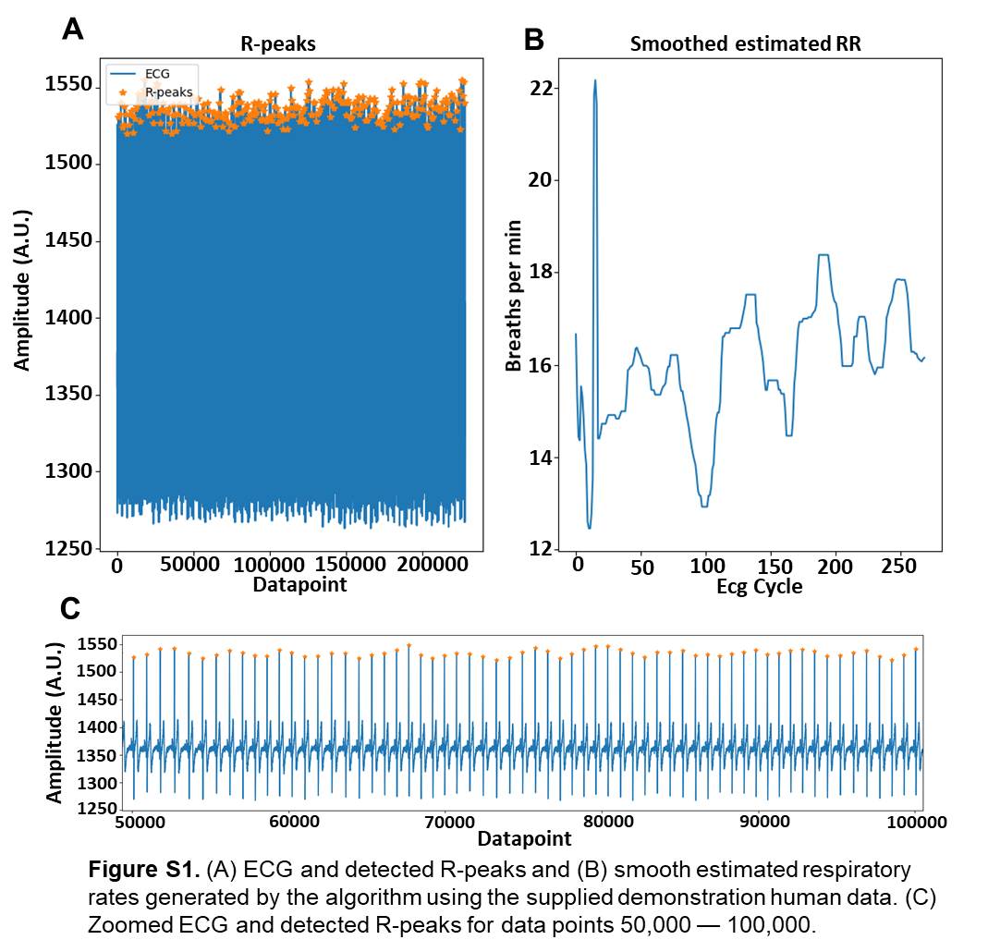
RR estimation
Supplementary Information
Roberts et al.

Slide 2
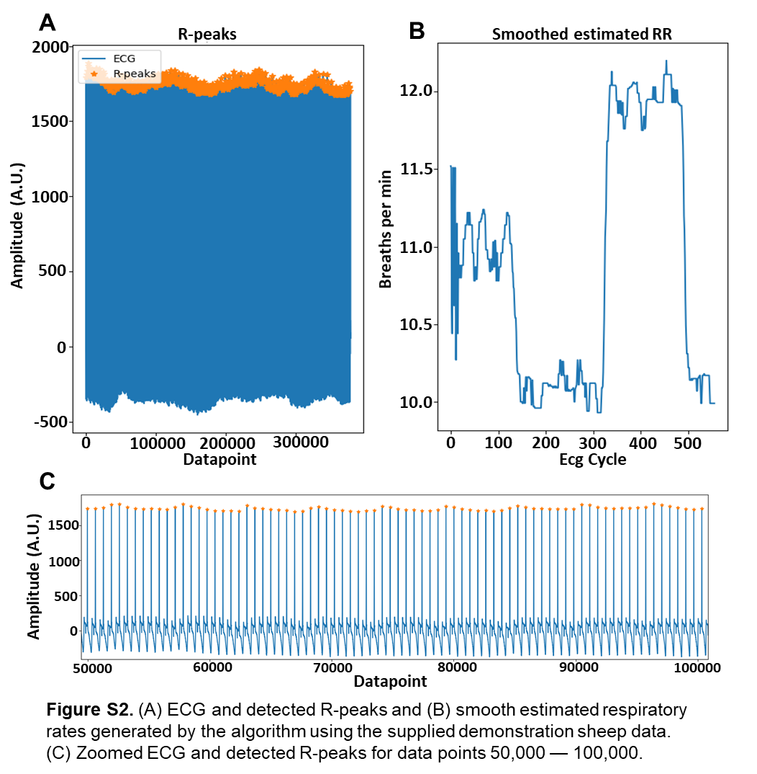
RR estimation
Supplementary Information
Roberts et al.

Slide 3
RR estimation
Supplementary Information
Roberts et al.
Human |  | Sheep
sample | estRR | sample | estRR
0 | 16.66 | 0 | 11.52
1 | 15.32 | 1 | 11.51
2 | 14.43 | 2 | 10.62
3 | 14.36 | 3 | 10.44
4 | 15.53 | 4 | 11.15
5 | 15.31 | 5 | 11.51
6 | 14.81 | 6 | 10.8
7 | 14.14 | 7 | 10.62
8 | 13.83 | 8 | 11.15
9 | 12.6 | 9 | 11.51
10 | 12.45 | 10 | 10.8
11 | 12.45 | 11 | 10.27
12 | 12.76 | 12 | 10.62
13 | 13.53 | 13 | 11.15
14 | 21.84 | 14 | 10.62
15 | 22.17 | 15 | 10.44
16 | 21.65 | 16 | 10.96
17 | 14.4 | 17 | 10.8
18 | 14.4 | 18 | 10.8
19 | 14.52 | 19 | 10.88
20 | 14.72 | 20 | 10.88
21 | 14.72 | 21 | 10.8
22 | 14.72 | 22 | 10.8
23 | 14.72 | 23 | 10.88
24 | 14.83 | 24 | 10.88
25 | 14.91 | 25 | 10.88
Table S1. The first 25 human (left) and sheep (right) smoothed respiratory rate (estRR) estimates generated by the Python script using the supplied demonstration data. These data are automatically saved as csv files when the script finishes execution. When user-supplied ECG data are analyzed, a similar data output is provided.

