Slide 1
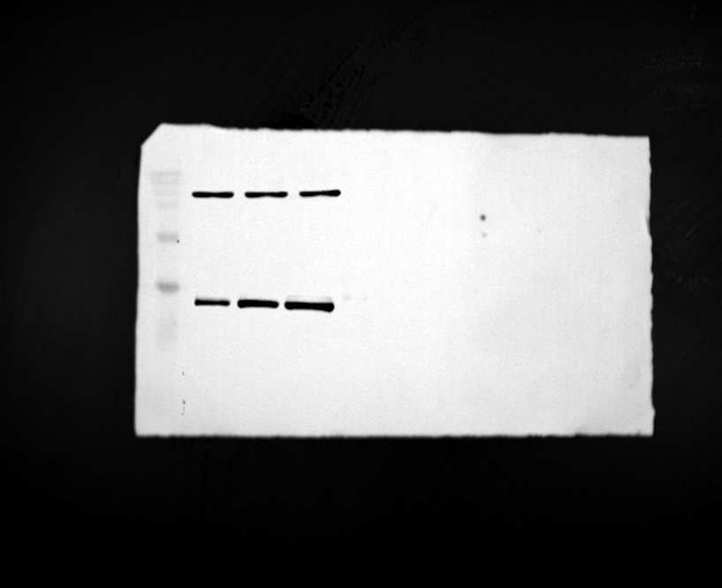
Marker
70kD
55kD
β-actin
45kD
35kD
25kD
Rep 1
15kD
B2M

Slide 2
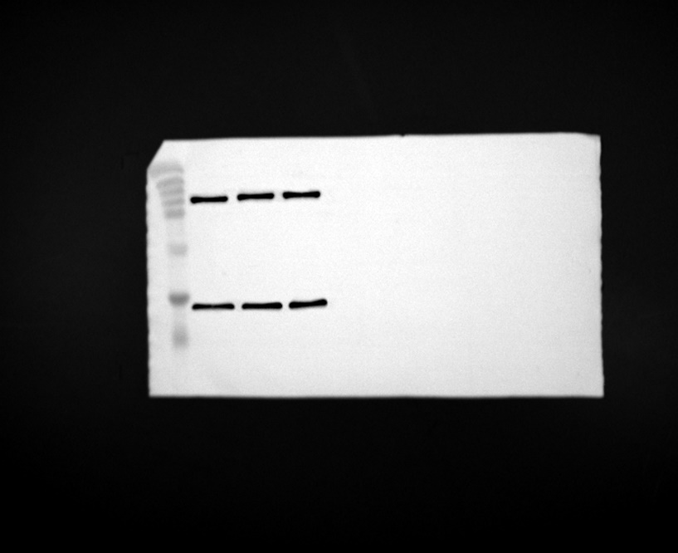
Marker
70kD
β-actin
55kD
45kD
35kD
Rep 2
25kD
15kD
B2M

Slide 3
Marker
70kD
β-actin
55kD
45kD
35kD
25kD
Rep 3
B2M
15kD

