Slide 1
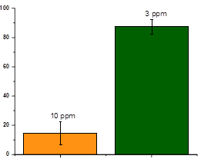
% Mortality
Resistant
Susceptible
Strains
Fig S1. Comparison of the toxicity of chlorantraniliprole in the resistant and susceptible strains of S. frugiperda.

Slide 2
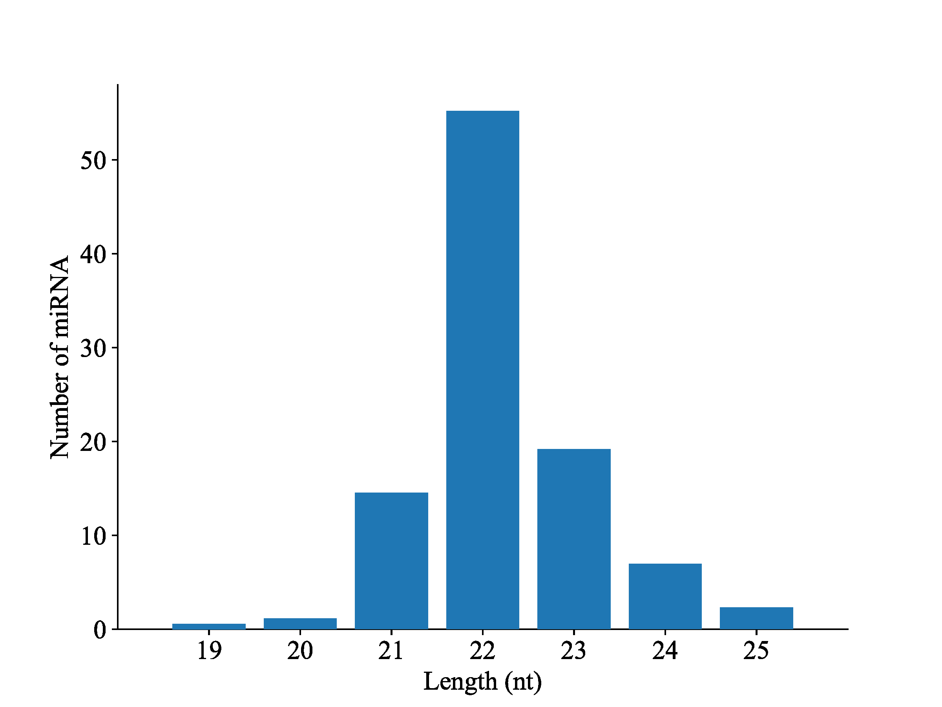
Fig S2. microRNA (miRNA) length distribution in S. frugiperda libraries.

Slide 3
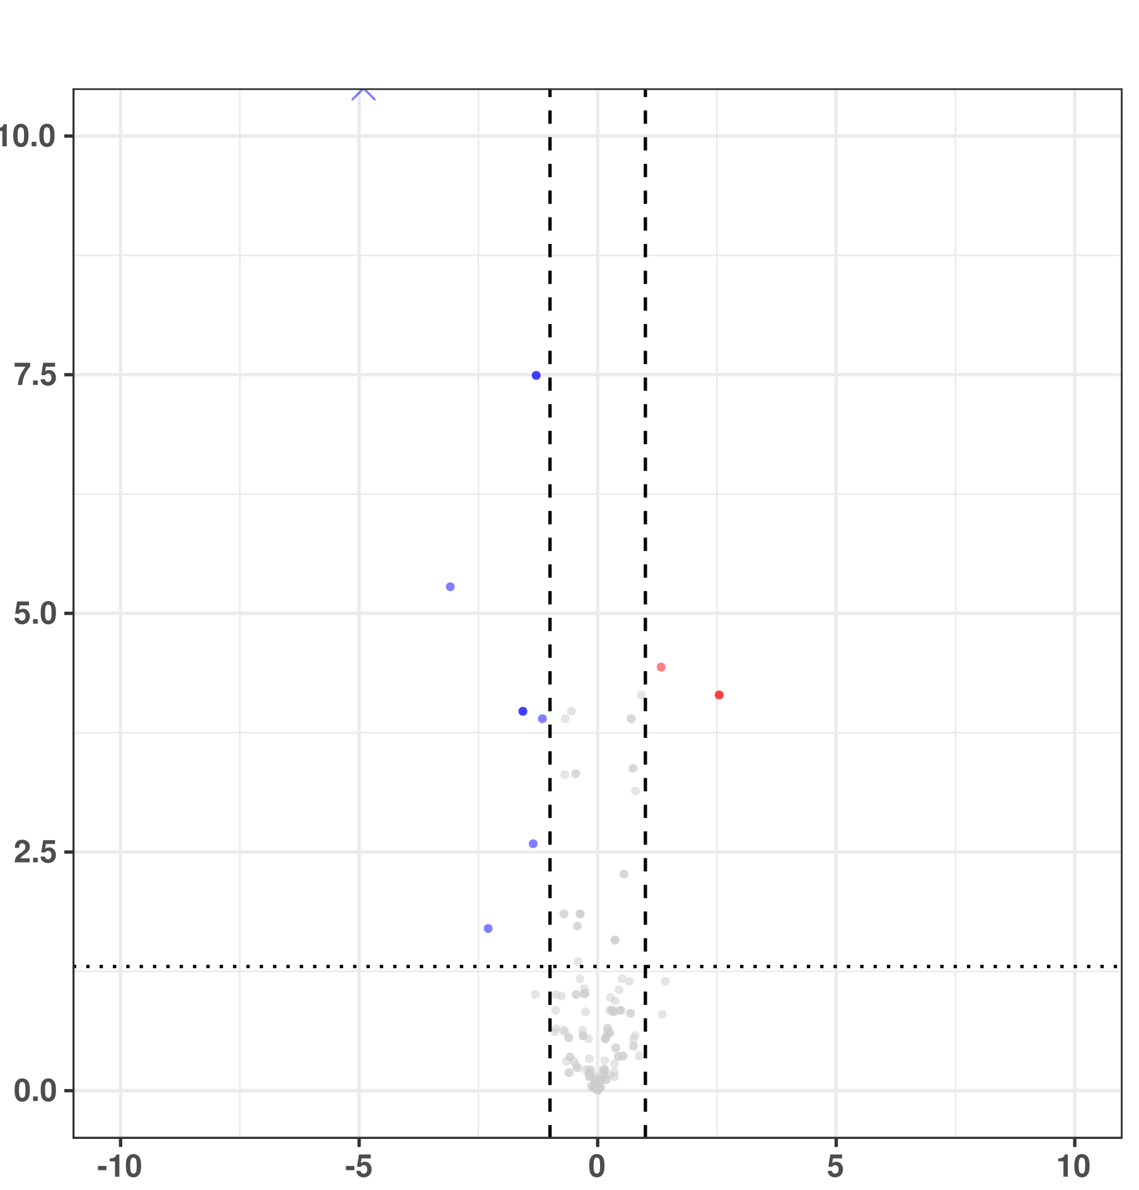
sfr-novel-miR-60 & 63
-log10 p value adjusted
sfr-novel-miR-10
sfr-novel-miR-9
sfr-miR-10460-5p
sfr-miR-10476-5p
sfr-novel-miR-11
sfr-novel-miR-60
Up-regulated
Down-regulated
Non-significant
NA
sfr-miR-10483-2-3p
sfr-novel-miR-53
log2 Fold change
Fig S3. The volcano plots showing the DE miRNAs in the comparisons of resistant versus susceptible strains of S. frugiperda. The significantly upregulated and downregulated miRNAs were shown in red and blue, respectively.

Slide 4
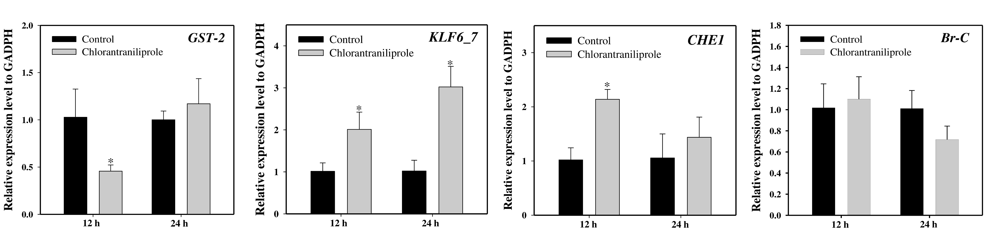
Fig S4. Relative expression of potential target genes of differentially expressed miRNAs after chlorantraniliprole treatment in the field populations of S. frugiperda. The expression levels were normalized by GADPH. Statistical significance was analysed using a paired t-test. The asterisks represent significant difference (P<0.05).

Slide 5
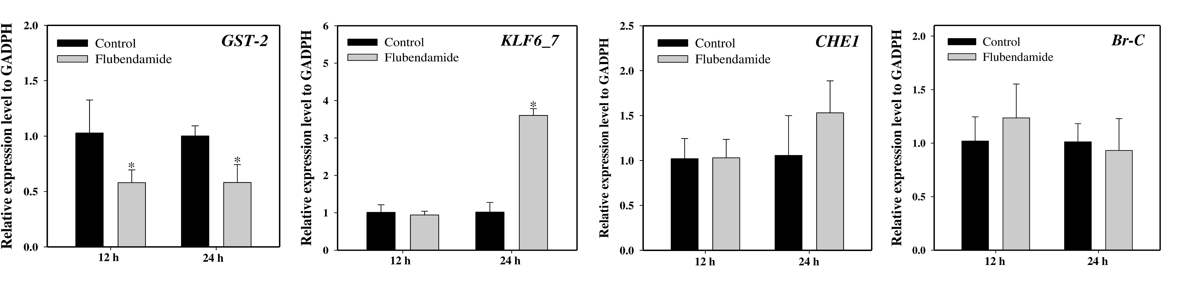
Fig S5. Relative expression of potential target genes of differentially expressed miRNAs after flubendamide treatment in the field populations of S. frugiperda. The expression levels were normalized by GADPH. Statistical significance was analysed using a paired t-test. The asterisks represent significant difference (P<0.05).

