Slide 1
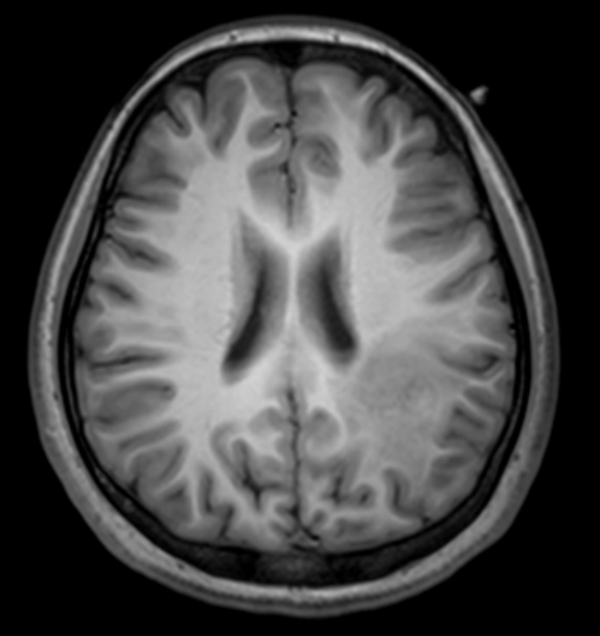
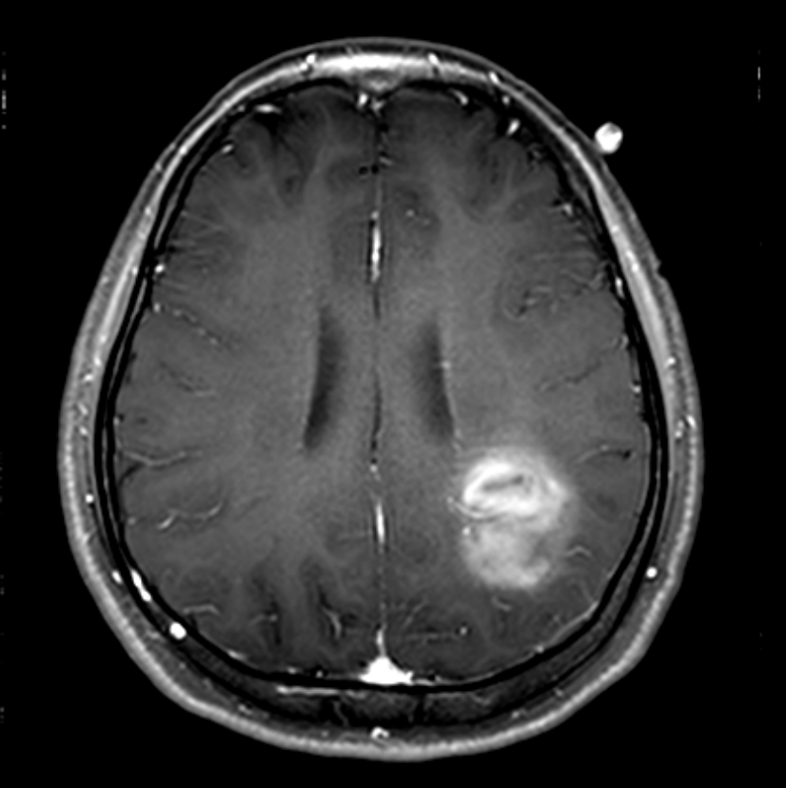
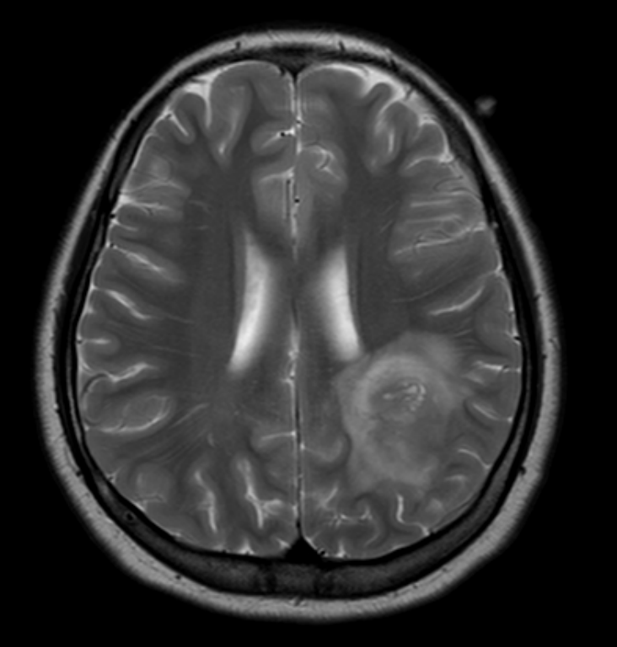
Infiltrative margin-1/22
T1
T1-enhanced
T2

Slide 2
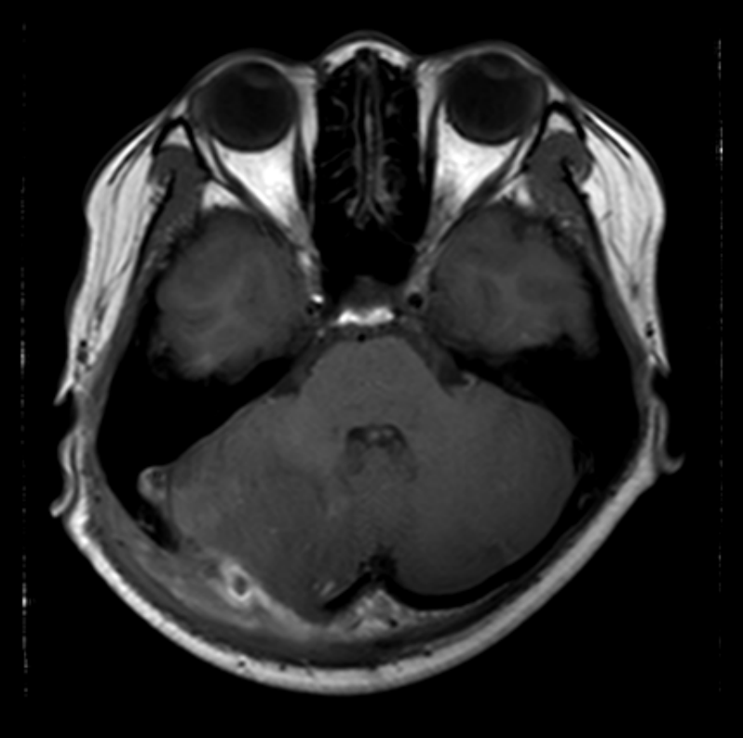
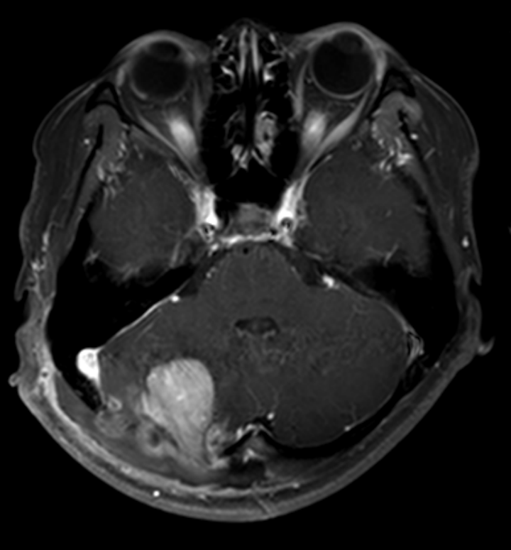
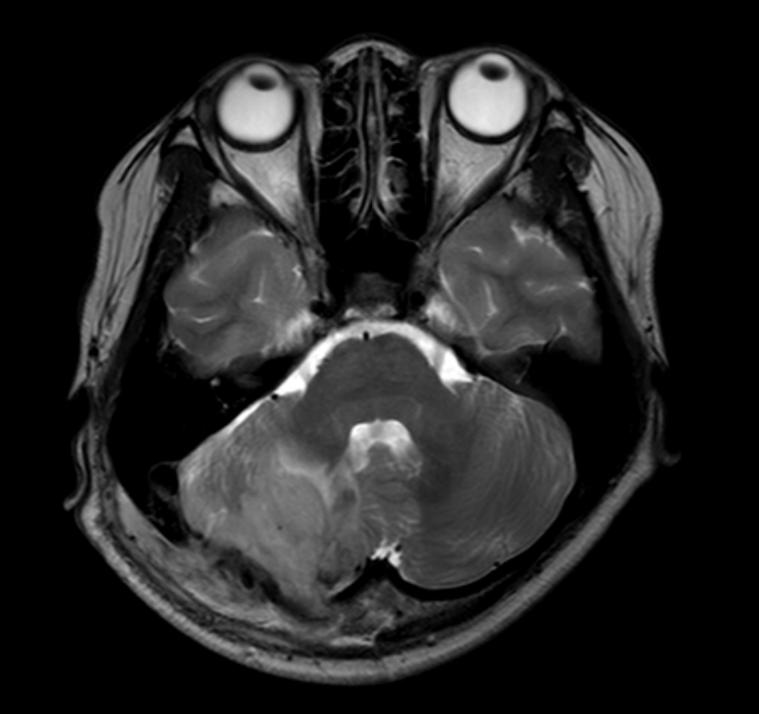
Infiltrative margin-2/22
T1
T1-enhanced
T2

Slide 3
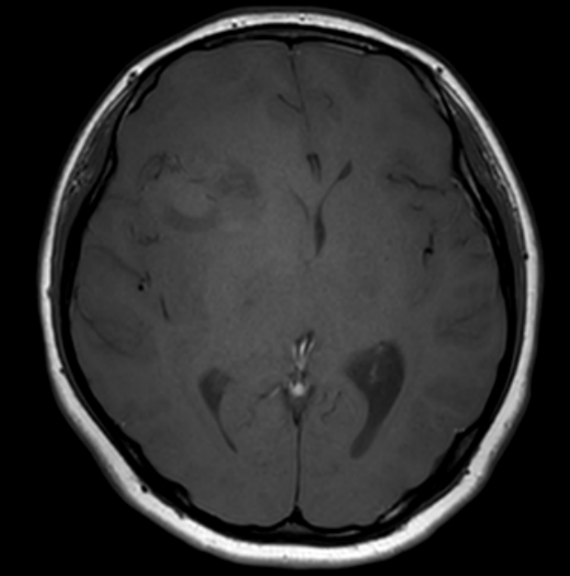
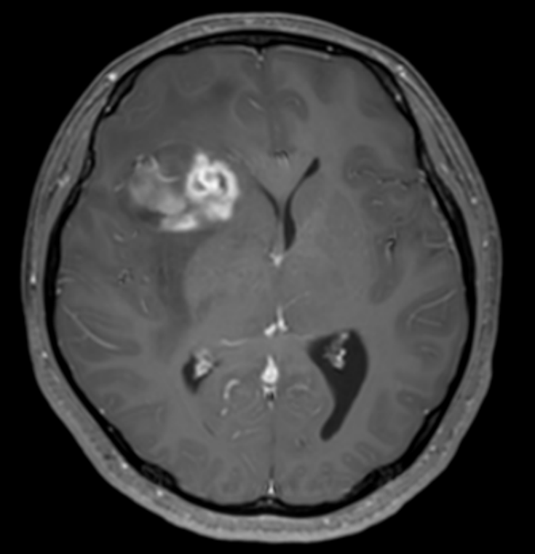
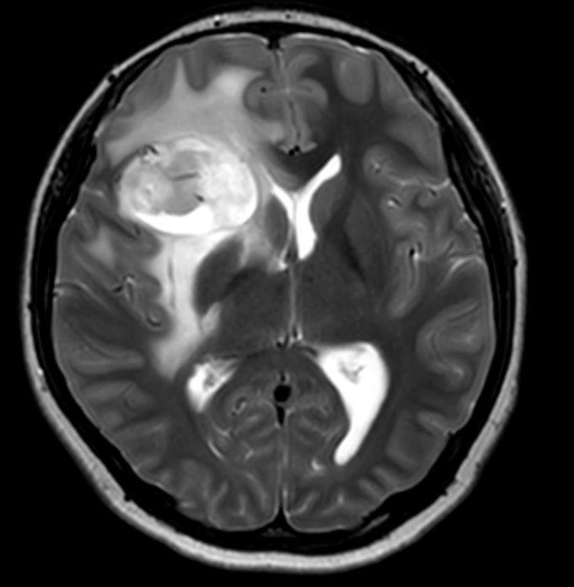
Infiltrative margin-3/22
T1
T1-enhanced
T2

Slide 4
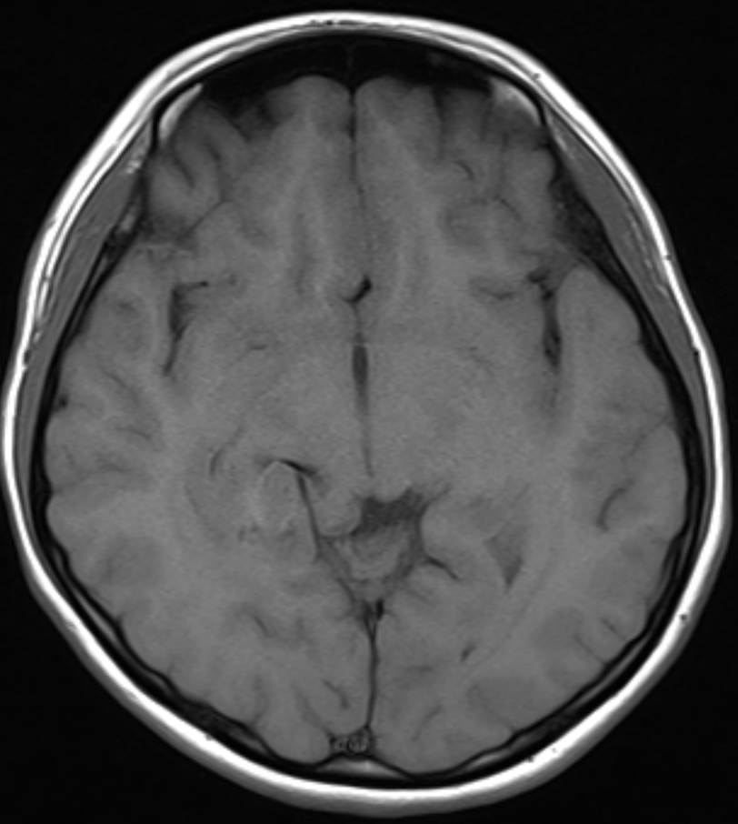
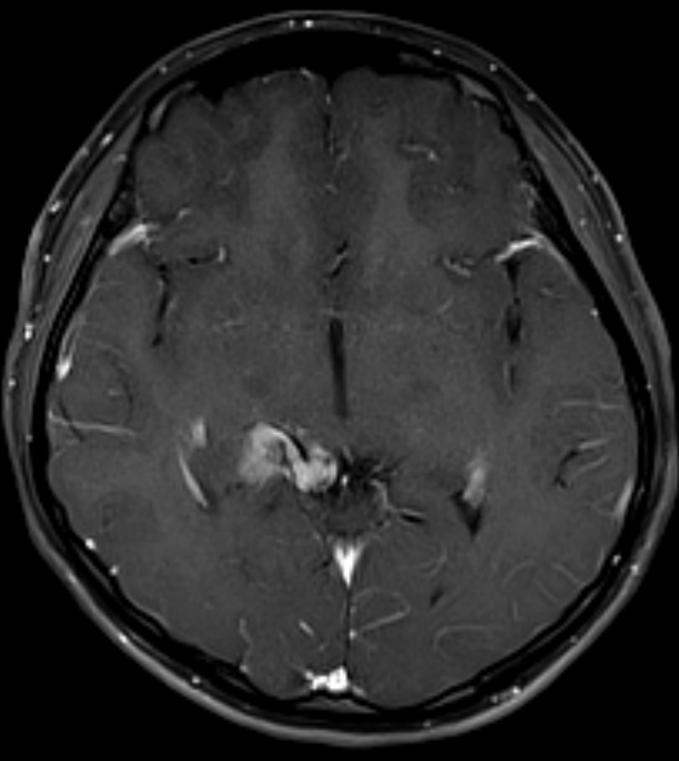
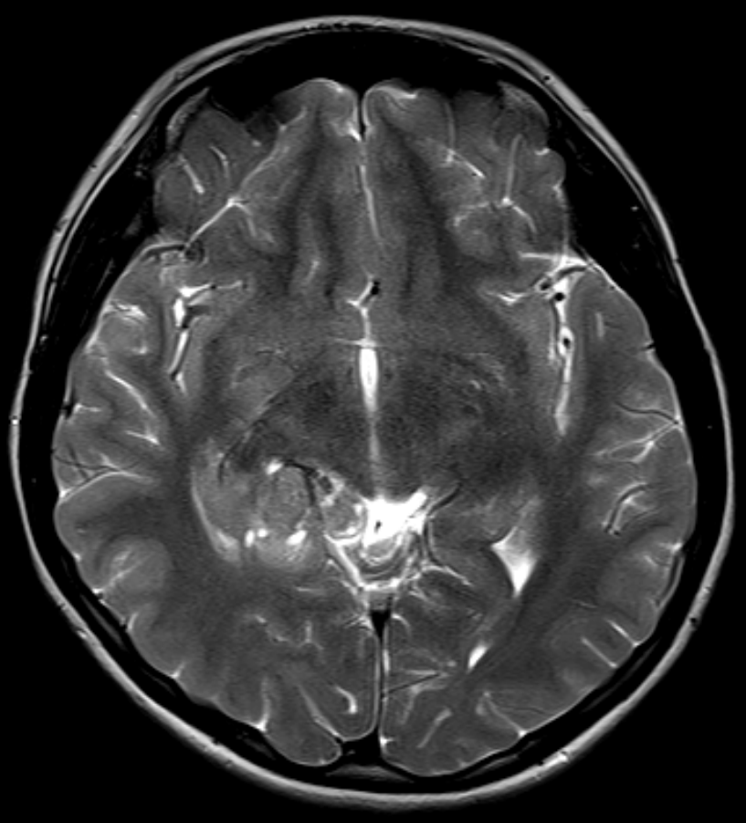
Infiltrative margin-4/22
T1
T1-enhanced
T2

Slide 5
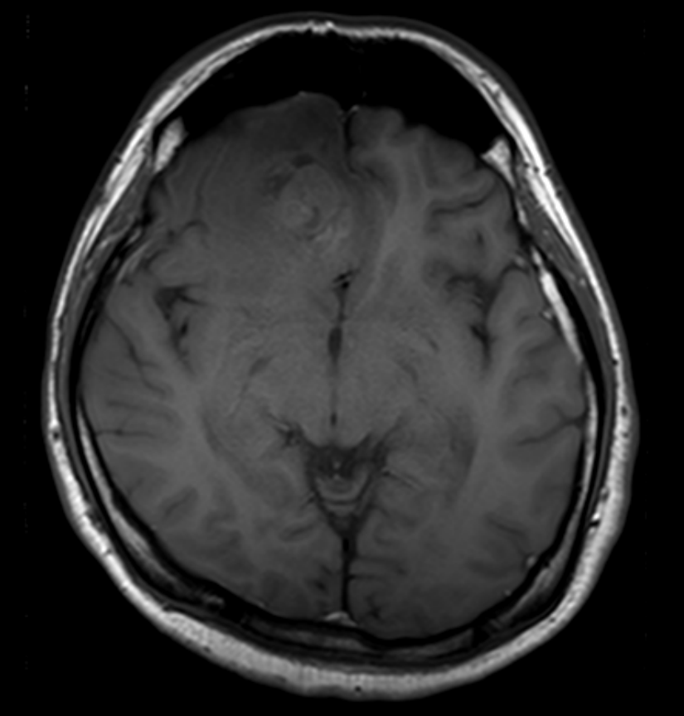
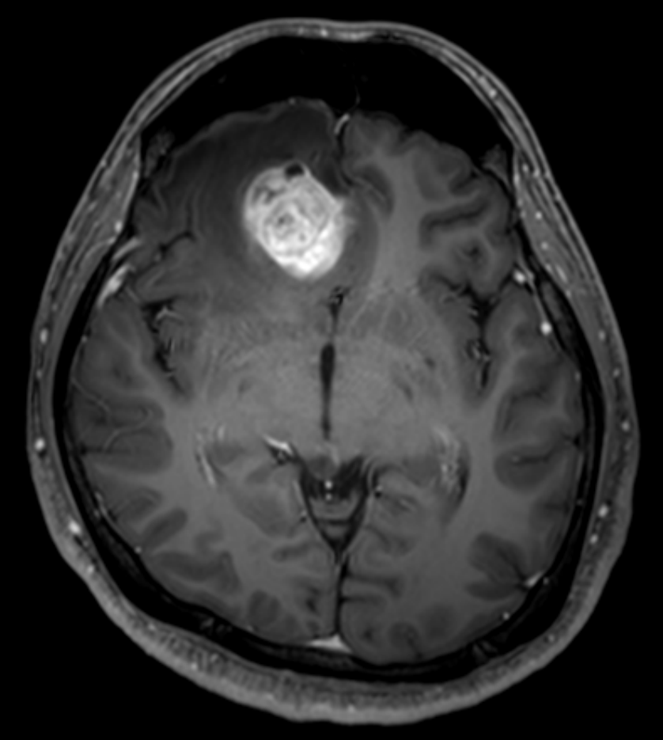
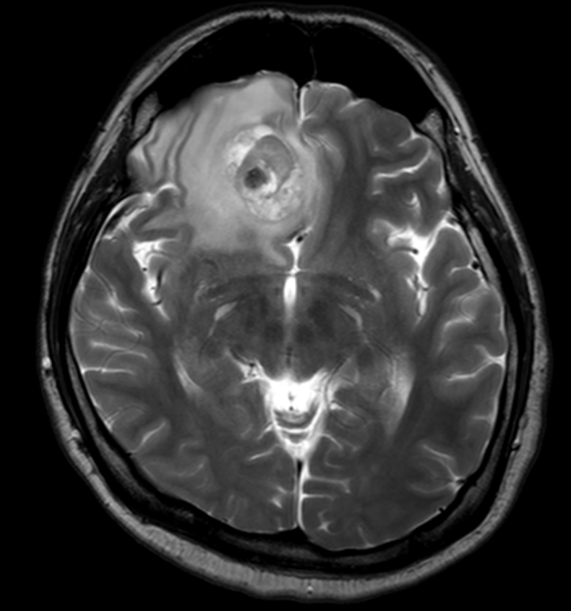
Infiltrative margin-5/22
T1
T1-enhanced
T2

Slide 6
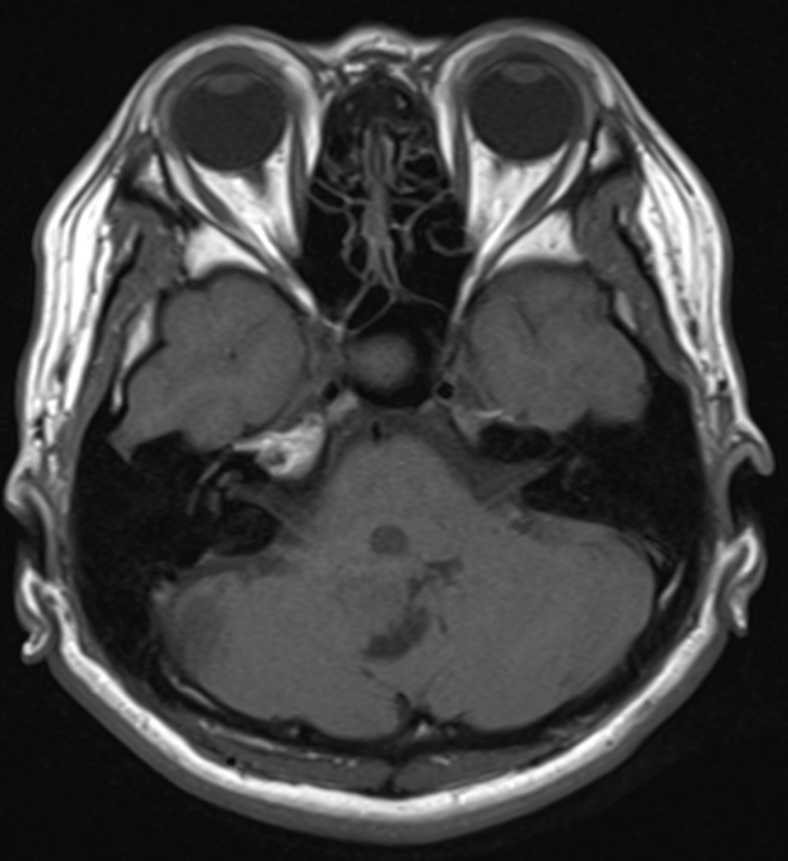
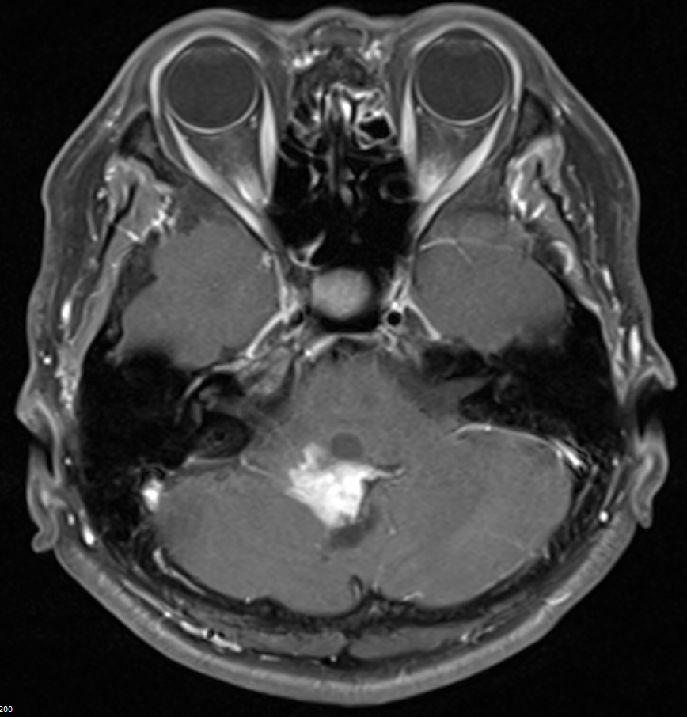
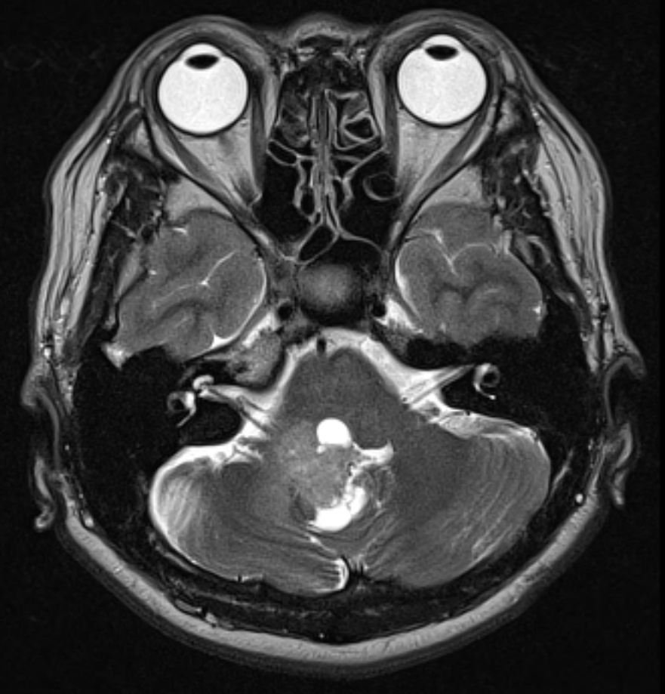
Infiltrative margin-6/22
T1
T1-enhanced
T2

Slide 7
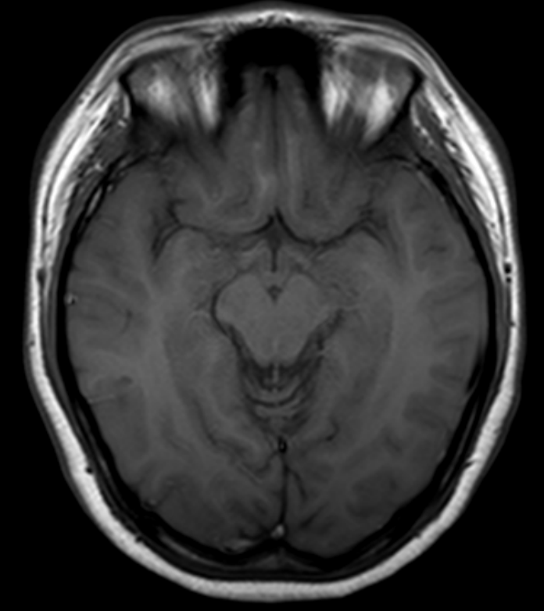
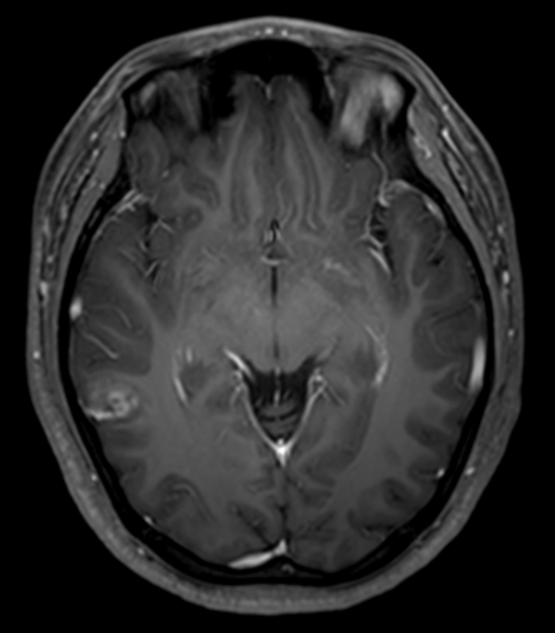
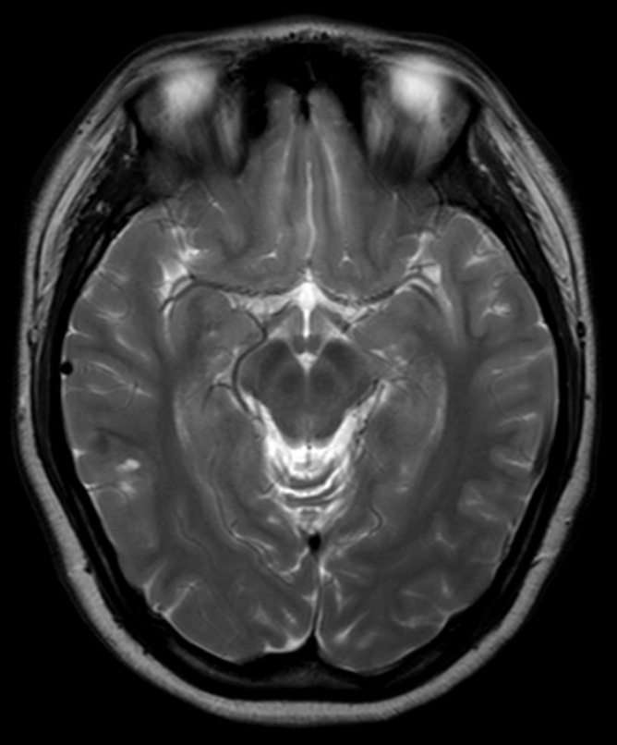
Infiltrative margin-7/22
T1
T1-enhanced
T2

Slide 8
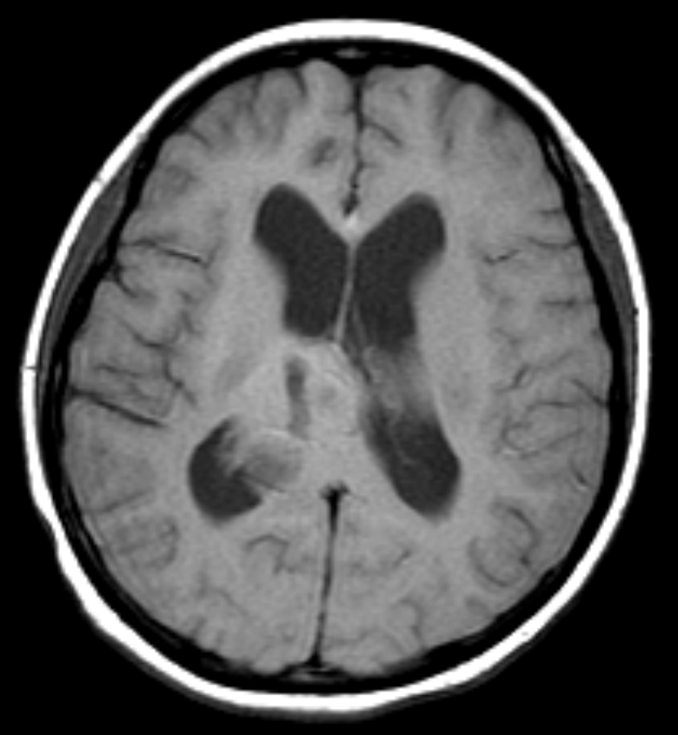
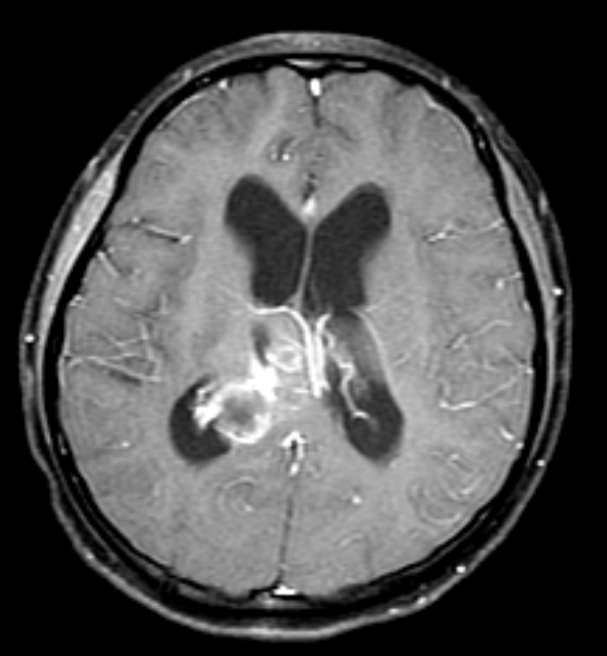
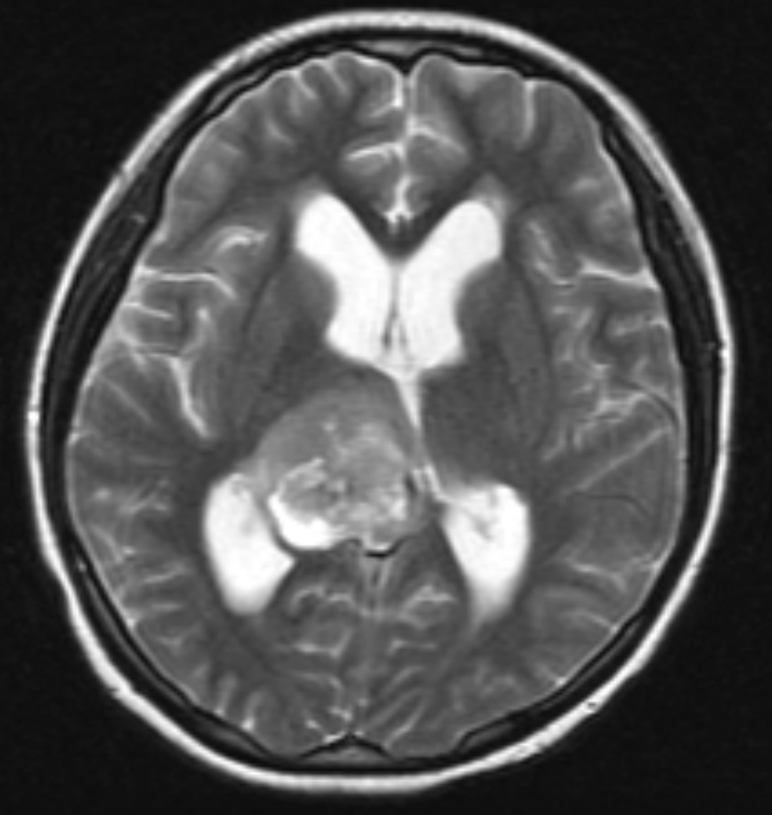
Infiltrative margin-8/22
T1
T1-enhanced
T2

Slide 9
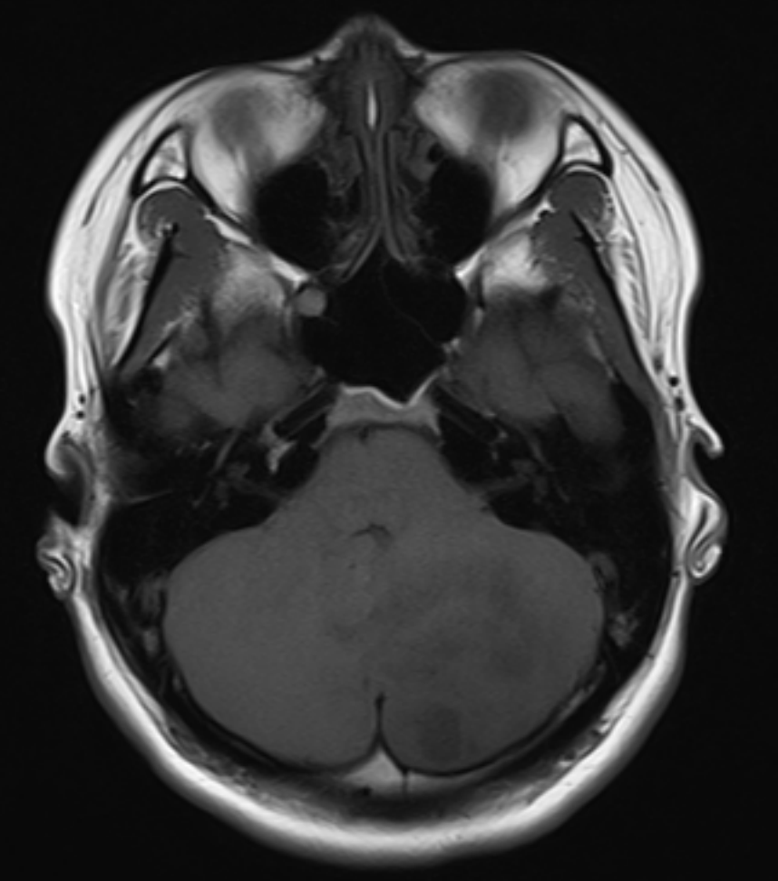
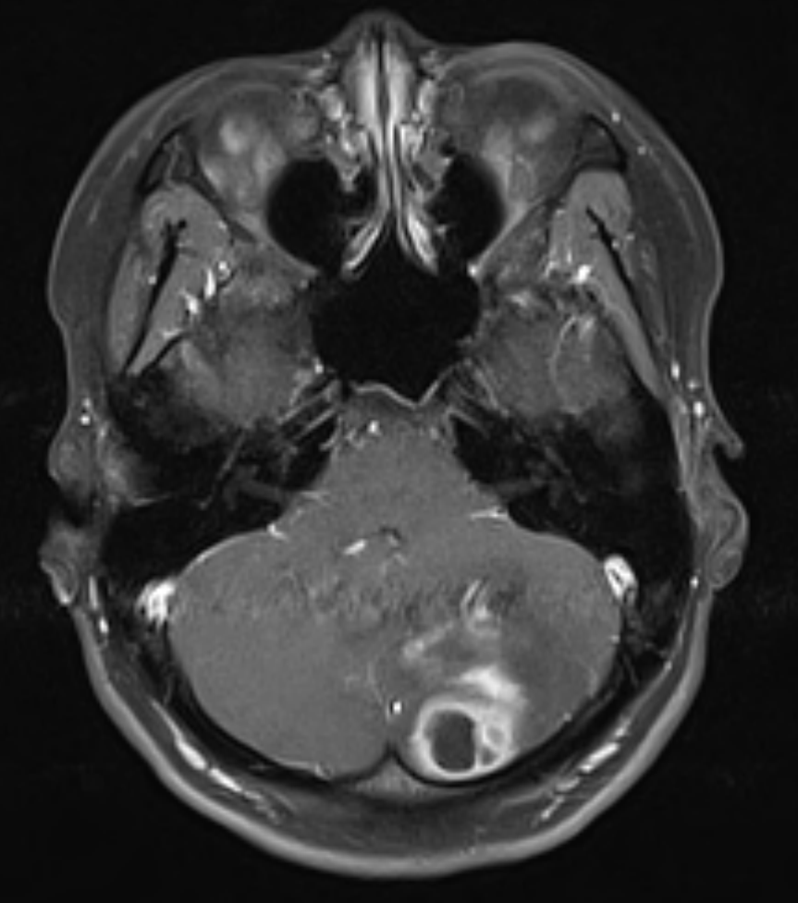
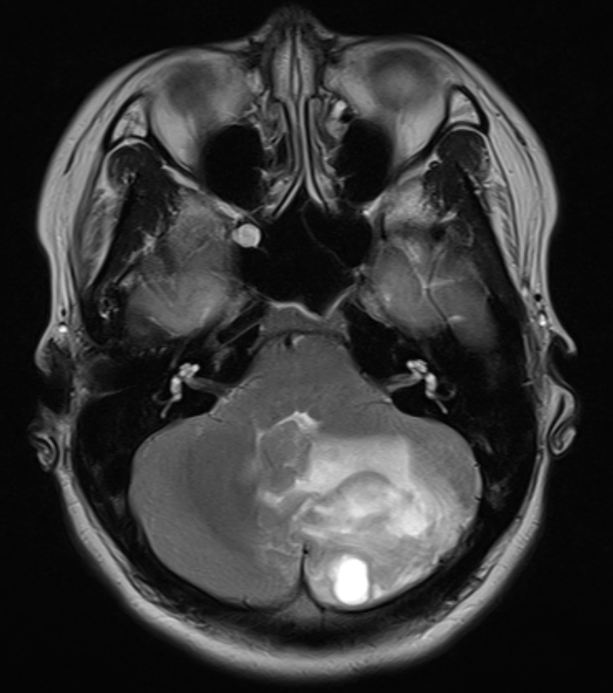
Infiltrative margin-9/22
T1
T1-enhanced
T2

Slide 10
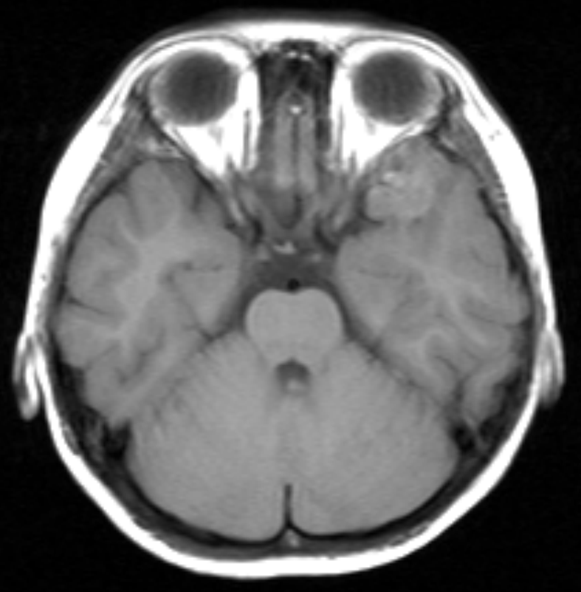
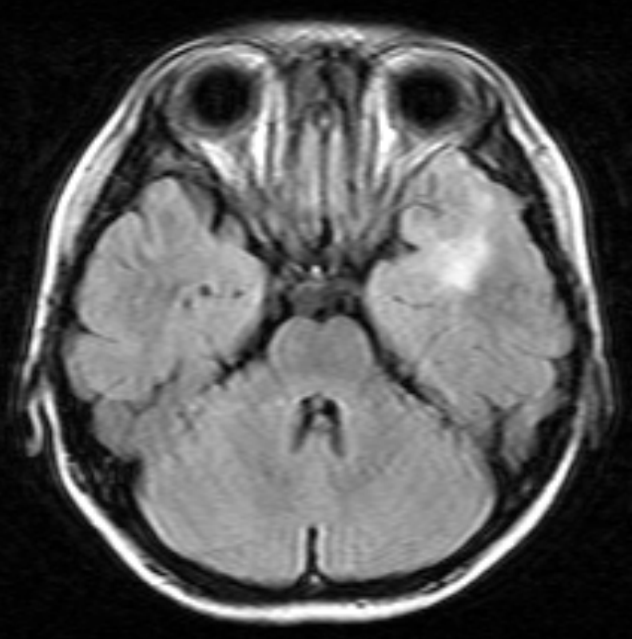
Infiltrative margin-10/22
T1
T2
* Lack of T1-enhanced image

Slide 11
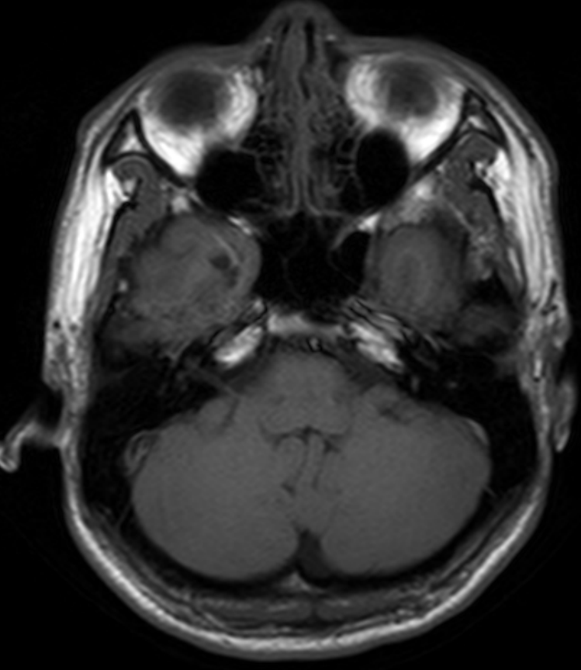
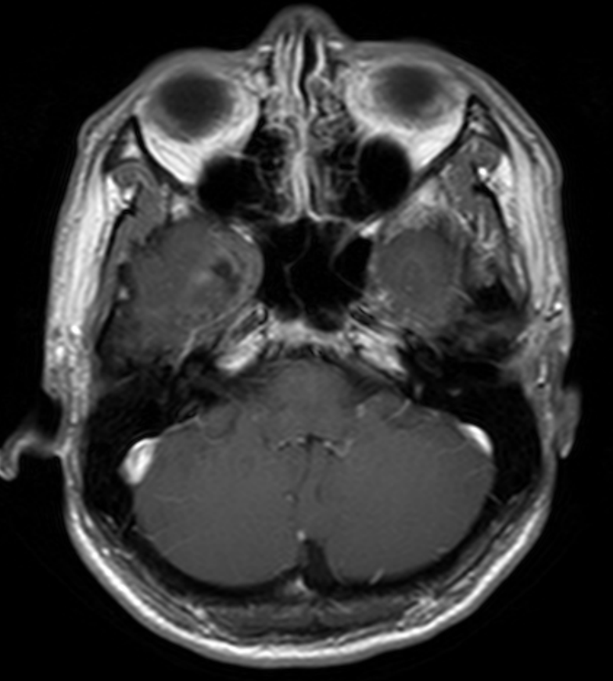
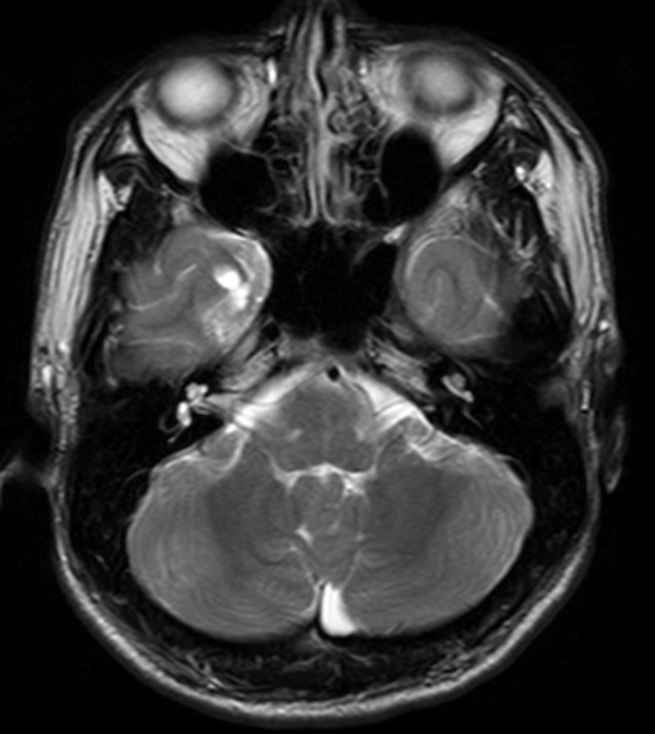
Infiltrative margin-11/22
T1
T1-enhanced
T2

Slide 12
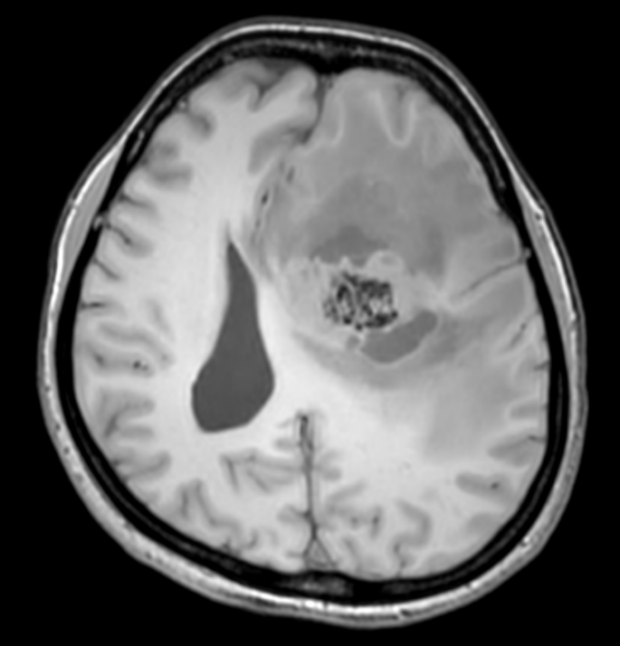
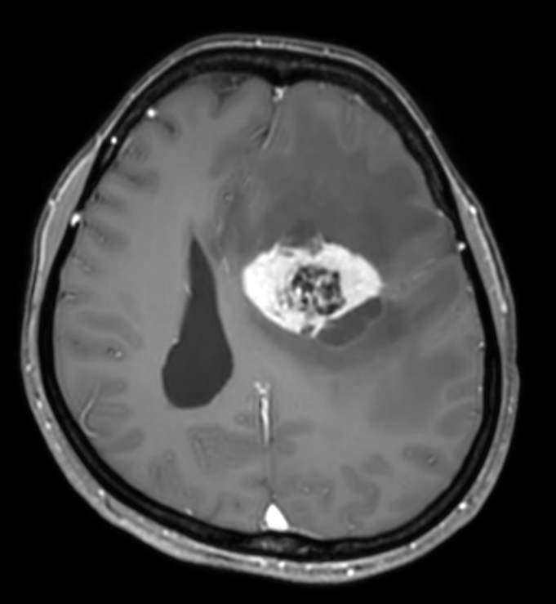
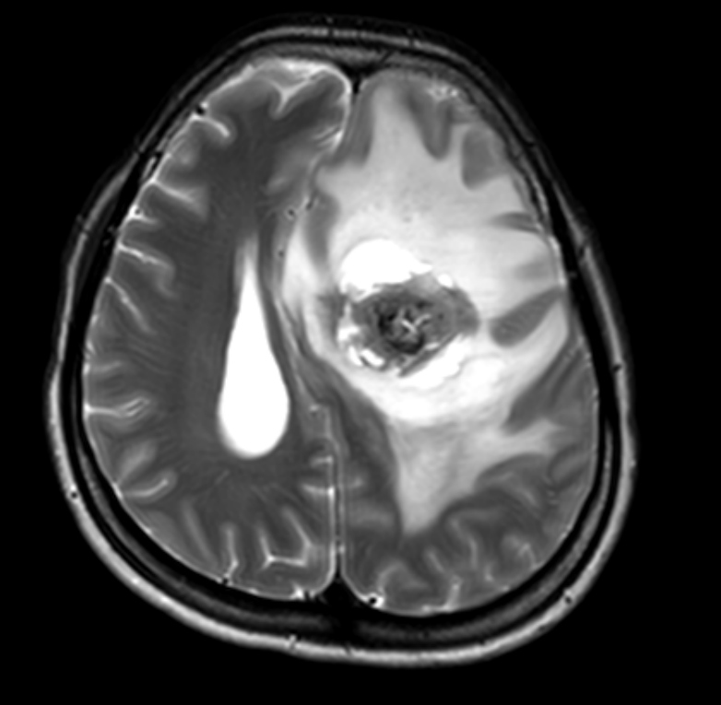
Infiltrative margin-12/22
T1
T1-enhanced
T2

Slide 13
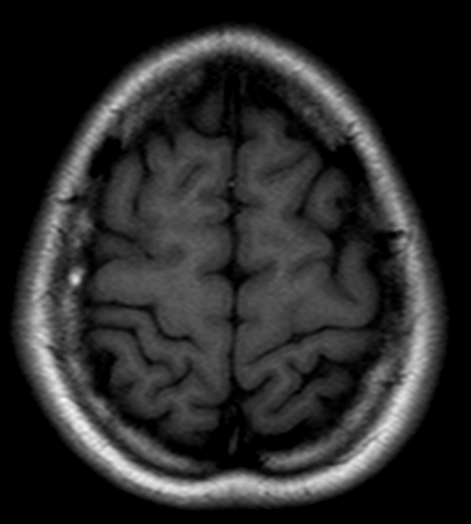
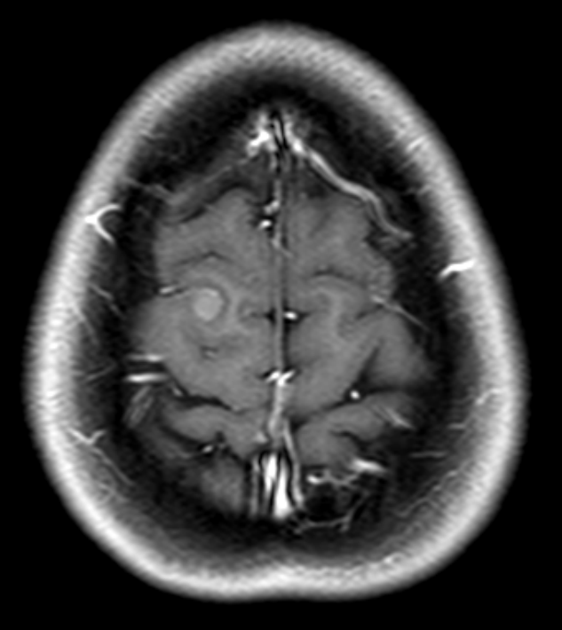
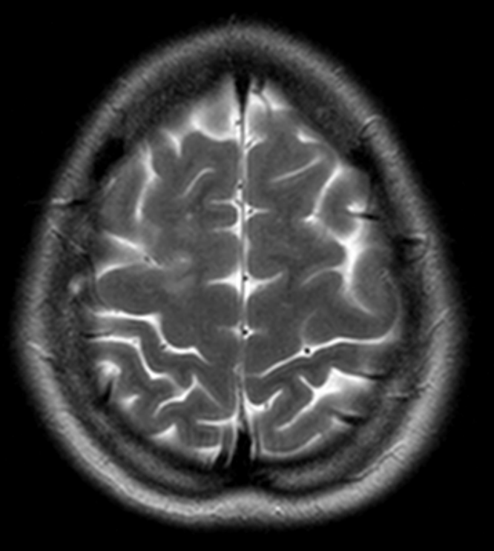
Infiltrative margin-13/22
20305646
T1
T1-enhanced
T2

Slide 14
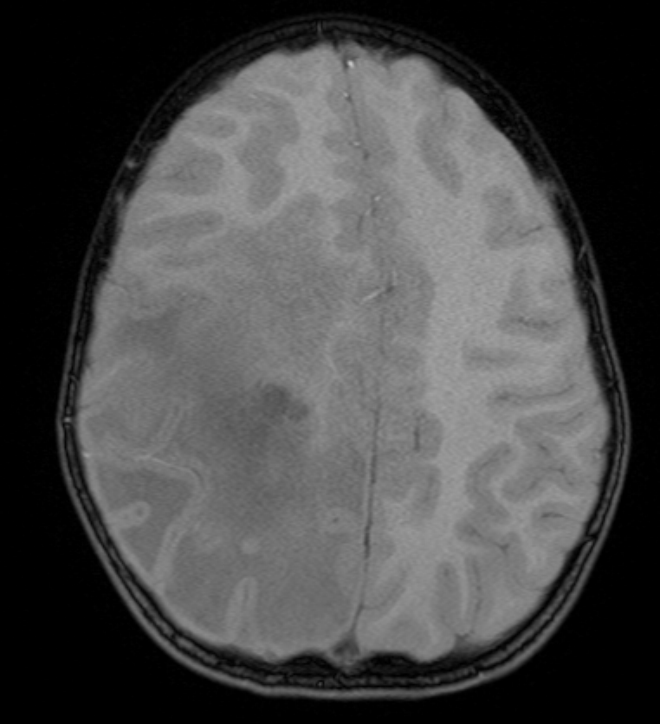
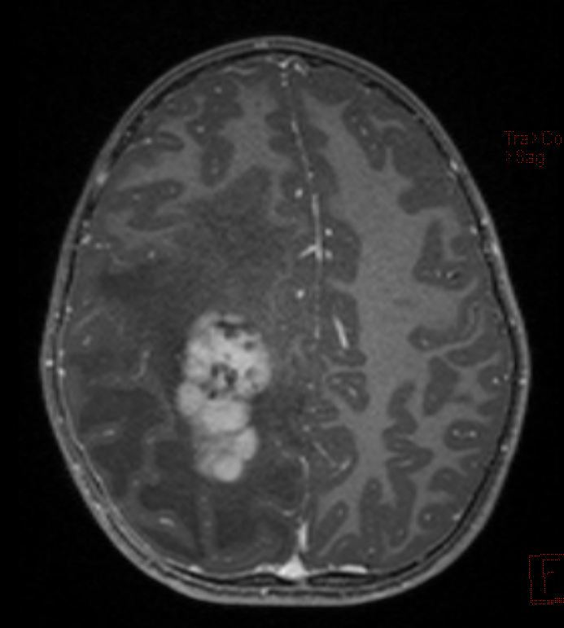
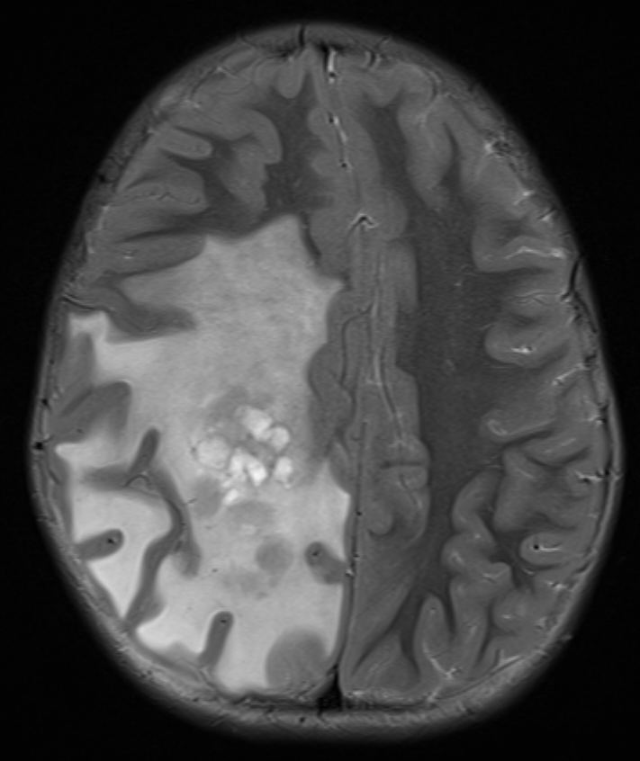
Infiltrative margin-14/22
T1
T1-enhanced
T2

Slide 15
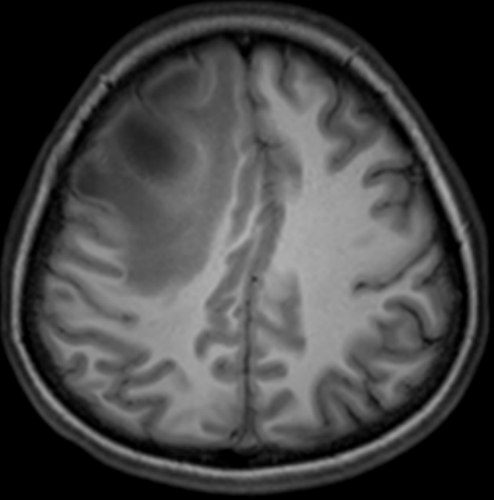
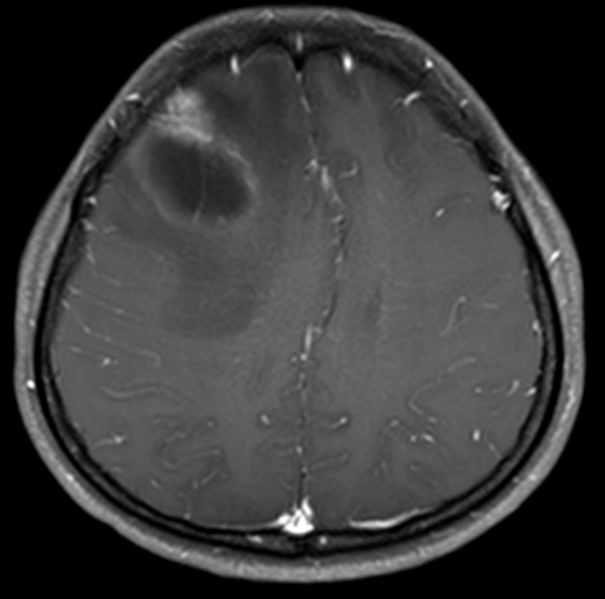
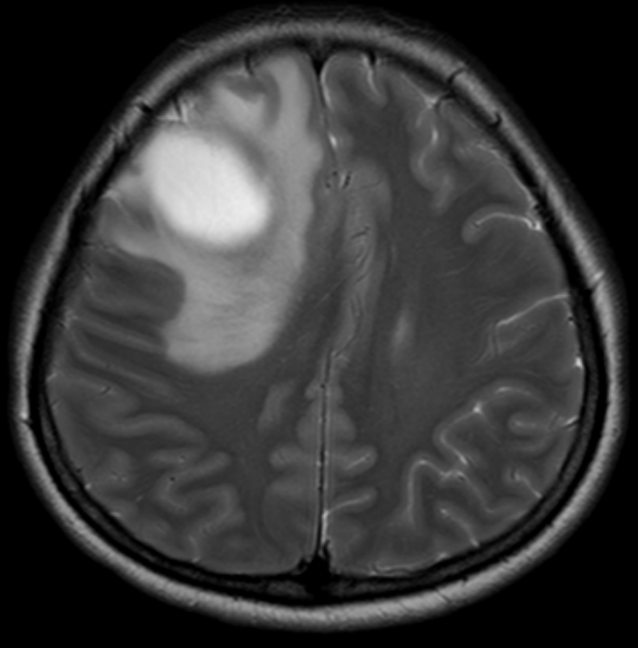
Infiltrative margin-15/22
T1
T1-enhanced
T2

Slide 16
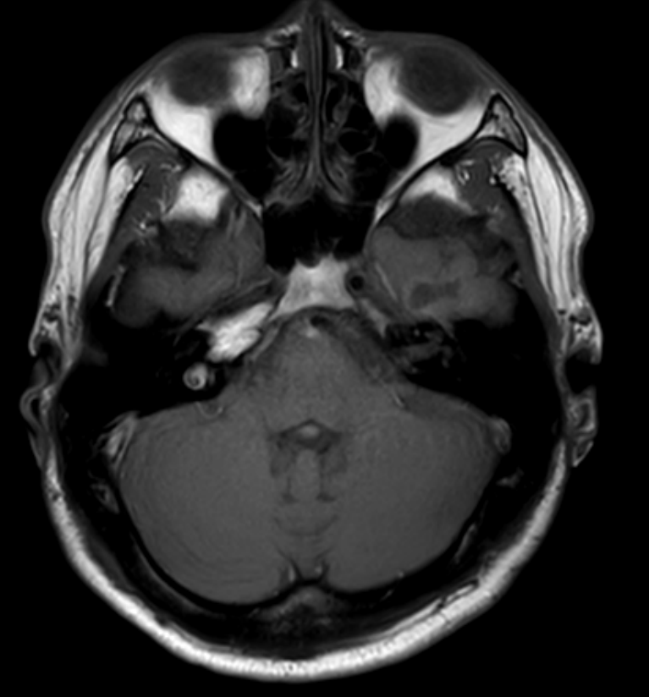
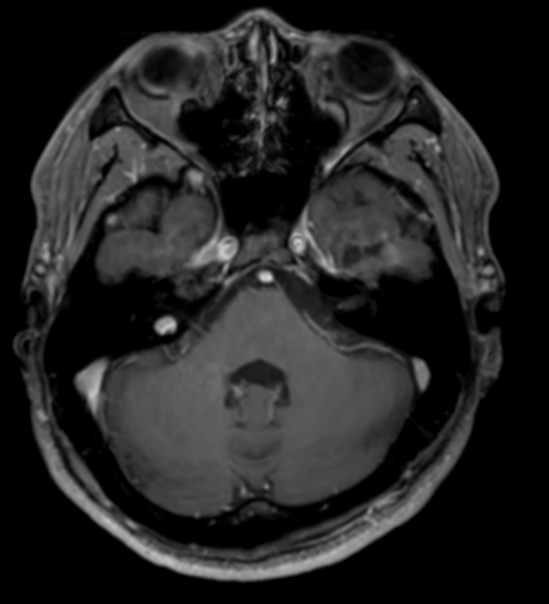
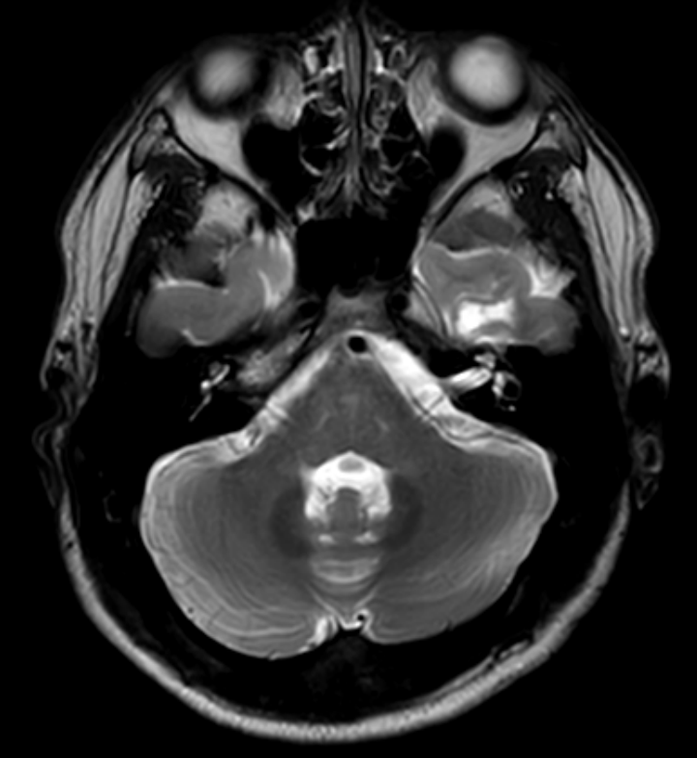
Infiltrative margin-16/22
T1
T1-enhanced
T2

Slide 17
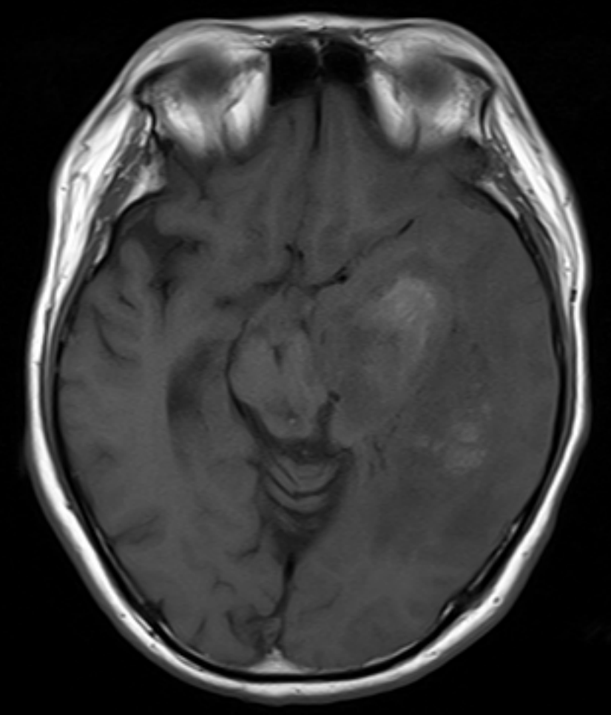
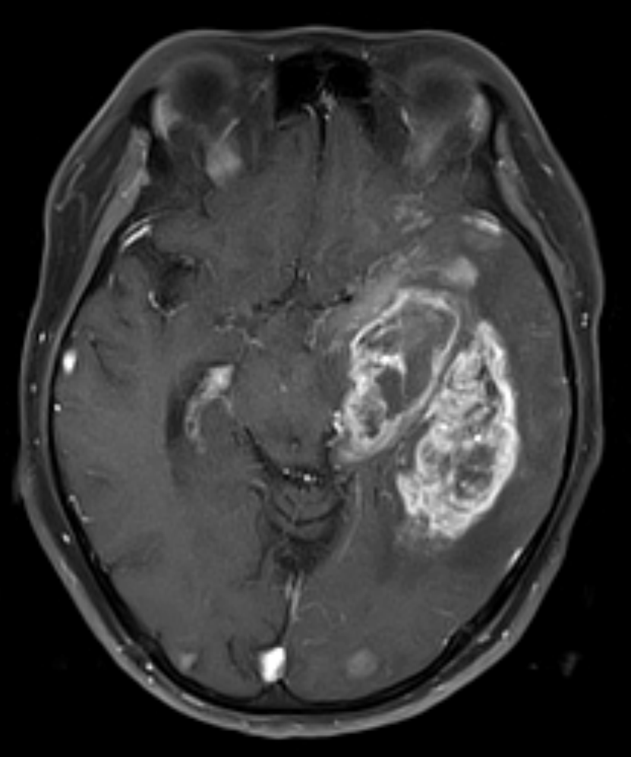
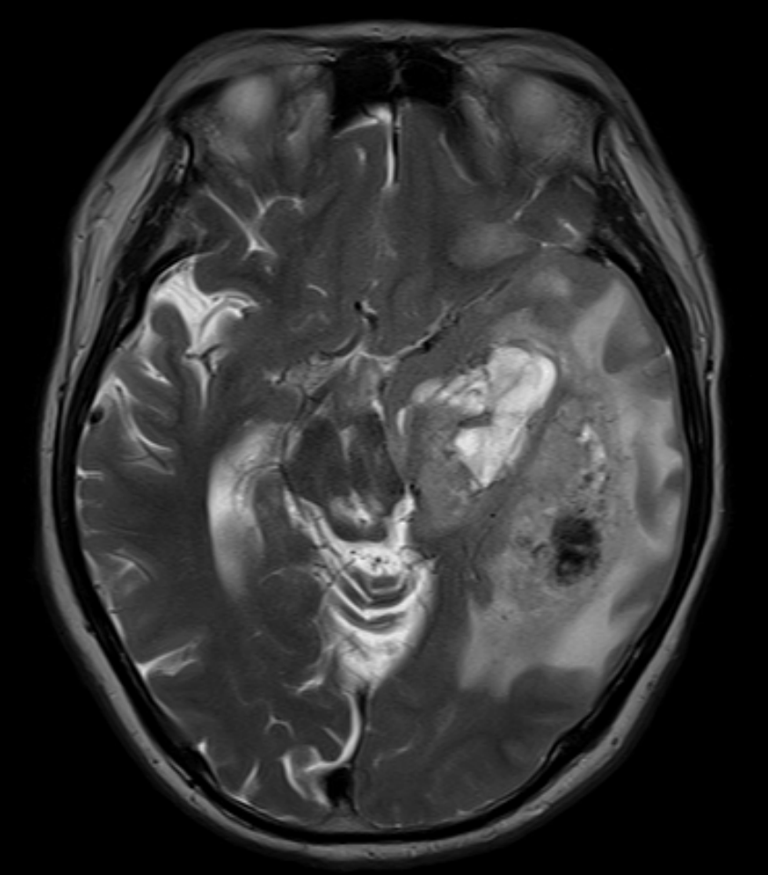
Infiltrative margin-17/22
T1
T1-enhanced
T2

Slide 18



Infiltrative margin-18/22
T1
T1-enhanced
T2

Slide 19



Infiltrative margin-19/22
T1
T1-enhanced
T2

Slide 20



Infiltrative margin-20/22
T1
T1-enhanced
T2

Slide 21



Infiltrative margin-21/22
T1
T1-enhanced
T2

Slide 22



Infiltrative margin-22/22
T1
T1-enhanced
T2

Slide 23



circumscribed margin-1/27
T1
T1-enhanced
T2

Slide 24



circumscribed margin-2/27
T1
T1-enhanced
T2

Slide 25



circumscribed margin-3/27
T1
T1-enhanced
T2

Slide 26



circumscribed margin-4/27
T1
T1-enhanced
T2

Slide 27



circumscribed margin-5/27
T1
T1-enhanced
T2

Slide 28



circumscribed margin-6/27
T1
T1-enhanced
T2

Slide 29



circumscribed margin-7/27
T1
T1-enhanced
T2

Slide 30



circumscribed margin-8/27
T1
T1-enhanced
T2

Slide 31



circumscribed margin-9/27
T1
T1-enhanced
T2

Slide 32



circumscribed margin-10/27
T1
T1-enhanced
T2

Slide 33



circumscribed margin-11/27
T1
T1-enhanced
T2

Slide 34



circumscribed margin-12/27
T1
T1-enhanced
T2

Slide 35



circumscribed margin-13/27
T1
T1-enhanced
T2

Slide 36



circumscribed margin-14/27
T1
T1-enhanced
T2

Slide 37



circumscribed margin-15/27
T1
T1-enhanced
T2

Slide 38



circumscribed margin-16/27
T1
T1-enhanced
T2

Slide 39


circumscribed margin-17/27
T1
T2
* Lack of T1-enhanced image

Slide 40



circumscribed margin-18/27
T1
T1-enhanced
T2

Slide 41



circumscribed margin-19/27
T1
T1-enhanced
T2

Slide 42



circumscribed margin-20/27
T1
T1-enhanced
T2

Slide 43



circumscribed margin-21/27
T1
T1-enhanced
T2

Slide 44



circumscribed margin-22/27
T1
T1-enhanced
T2

Slide 45


circumscribed margin-23/27
T1-enhanced
T2
* Lack of T1

Slide 46



circumscribed margin-24/27
T1
T1-enhanced
T2

Slide 47



circumscribed margin-25/27
T1
T1-enhanced
T2

Slide 48


circumscribed margin-26/27
T1-enhanced
T2
* Lack of T1 image

Slide 49



circumscribed margin-27/27
T1
T1-enhanced
T2

