Slide 1
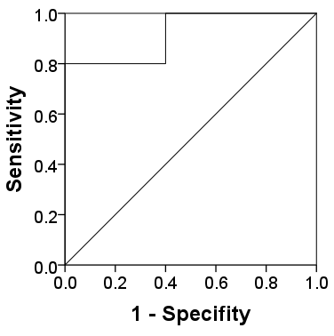
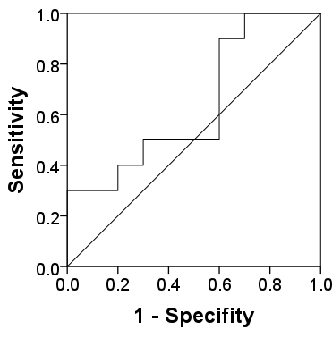

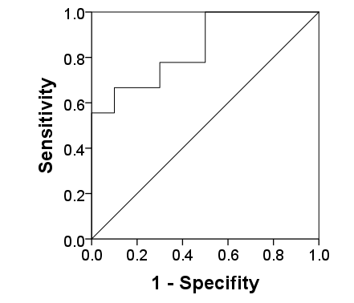
NEAT1
AUC = 0.920
P = 0.001
MIR100HG
AUC = 0.640
P = 0.290
HIF1A-AS3
AUC = 0.905 P = 0.007
MIR29B2CHG
AUC = 0.844
P = 0.011
Supplementary Figure 1: ROC curve analysis for comparison of the performance of NEAT1, MIR100HG, HIF1A-AS3, and MIR29B2CHG that were significantly differentially expressed between the study groups. The curve above the diagonal shows the true-positive against the false-negative rate as a trade-off between sensitivity and specificity.

