Slide 1
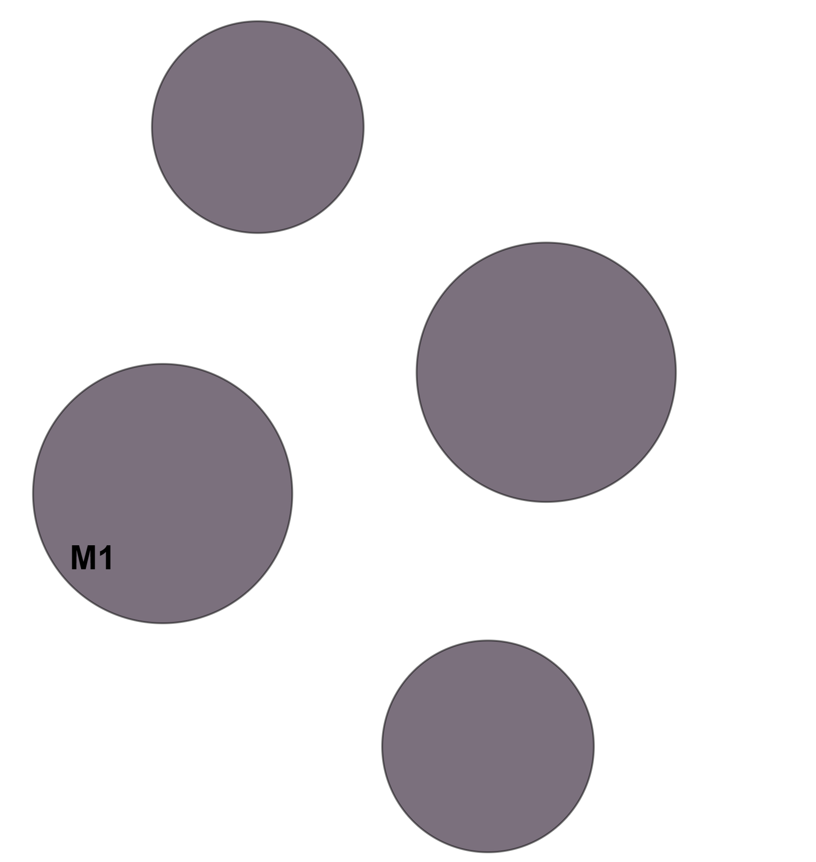
Supplementary Figure 2: Significative module obtained in the co-expression modules analysis in the blood-specific network through HumanBase.
VNN3
PYHIN1
FCRL3
SYMBOL | DESCRIPTION | SIGNIFICATIVE MODULE (q value = 0.0022)
CIITA | class II major histocompatibility complex transactivator | M1 (innate imune response)
FCRL3 | Fc receptor like 3 | M1 (innate imune response)
PYHIN1 | pyrin and HIN domain family member 1 | M1 (innate imune response)
VNN3 | vanin 3 | M1 (innate imune response)
CIITA

